Slide 1
A Lightweight Adaptive Cost-Aware Work-Stealing Scheduler with Hybrid Work-Stealing and Work-Sharing
A Project Component for Parallel and Distributed Computing (UCS645) | Thapar Institute of Engineering and Technology (Deemed to be University), Patiala — May 2026
Team Members
Sr.
Name
Roll No.
Project guide: Dr. Saif Nalband
Assistant Professor, DCSE
Department: Computer Science and Engineering
Thapar Institute of Engineering and Technology
Patiala – 147004
Submission: April 2026
1
Rohini Bansal
102317175
2
Shivam Kumar
102497026
3
Sudhanshu Raj
102483063
4
Ankit Kumar
102483012

Slide 2
Problem Statement & Motivation
Efficient task scheduling is a foundational requirement for achieving maximal parallelism and resource utilization in High Performance Computing (HPC). Yet classical approaches fall short in practice, each introducing distinct and costly trade-offs.
Static Scheduling: Load Imbalance
Work-Stealing: Overhead Bottleneck
The Missing Adaptive Layer
Neither purely static nor purely reactive dynamic schedulers are equipped to intelligently decide when to steal, what to steal, and from whom. There is a critical gap for an adaptive mechanism that combines proactive task sharing with reactive stealing — gated by task cost estimates and guided by thread locality — to minimize overhead while sustaining effective load balance across both regular and irregular workloads.
Traditional static allocation assigns tasks to processors at compile-time without accounting for runtime variability. When task durations differ — as they do in recursive and irregular workloads — some processors become idle while others remain overloaded, directly degrading throughput and wasting CPU cycles.
Dynamic work-stealing, introduced by Blumofe & Leiserson (1999), allows idle workers to acquire tasks from busy workers at runtime, improving load balance. However, in practice, indiscriminate stealing of microscopically small tasks introduces heavy synchronization overhead, lock contention, and context-switching costs that can negate the performance gains entirely.

Slide 3
Objectives
This project is structured around four primary technical objectives, each targeting a specific gap in the state of parallel task scheduling research and practice.
1
2
Design a Parallel Task Scheduler from Scratch
Implement Work-Stealing & Work-Sharing
Engineer a fully custom parallel scheduler in C++17 using native concurrency primitives (std::thread, std::mutex), without relying on any external scheduling library. This establishes fine-grained control over all scheduling decisions and thread management.
Develop both reactive work-stealing (idle workers pull tasks from busy workers) and proactive work-sharing (overloaded workers push tasks to underloaded workers) within a unified scheduling framework. Each worker maintains a local double-ended queue (deque) for task locality.
3
4
Evaluate Against OpenMP Baseline
Improve Efficiency via Cost & Locality Awareness
Rigorously benchmark custom scheduler performance across multiple workloads and thread counts against OpenMP — an industry-standard parallel computing framework — using execution time, speedup, and efficiency metrics recorded to CSV for Python-based visualization.
Integrate cost-aware gating (steal/share only if task's estimated computational cost exceeds a predefined threshold) and locality-aware victim selection (prioritize same-NUMA-group workers) to suppress unnecessary migration overhead and minimize cross-node latency.

Slide 4
Background & Related Work
Foundational Work
Identified Research Gaps
Blumofe & Leiserson (1999) formalized the work-stealing algorithm for multithreaded computations. Their model guarantees near-optimal execution time: if a computation has T₁ total work and T∞ critical-path length, the expected time on P processors is O(T₁/P + T∞). Workers maintain local deques; idle workers steal from the front of a randomly chosen victim's deque, while the owner pops from the back — minimizing contention.
Small-Task Migration Overhead
No Proactive Sharing
Blumofe's model is purely reactive — workers only acquire tasks when idle. There is no proactive mechanism for overloaded workers to push tasks, leaving heavy-imbalance scenarios underserved.
Classical work-stealing performs stealing regardless of task cost, causing excessive synchronization overhead for tiny recursive tasks (e.g., Fibonacci sub-problems with n < 10).
Quinn (2004) provides the foundational treatment of parallel programming with MPI and OpenMP, establishing static scheduling as the baseline from which dynamic strategies improve.
Agrawal et al. (2010) extended work-stealing to distributed environments, identifying adaptive policies as a necessary evolution to handle heterogeneous task sizes.
Lack of Hybrid Strategies
Existing approaches treat work-stealing and work-sharing as independent paradigms. No adaptive mechanism dynamically selects between them based on runtime system state metrics.

Slide 5
Proposed Approach — Adaptive Hybrid Scheduler
The proposed scheduler integrates cost-aware gating and locality-aware victim selection within a dual-policy adaptive framework, operating across five modes for comprehensive evaluation.
Five Operating Modes
Core Adaptive Mechanisms
01
Cost-Aware Gating
Locality-Aware Victim Selection
Sequential
A task is stolen or shared only if its estimated computational cost exceeds a predefined threshold τ. This prevents the scheduler from thrashing on microscopic tasks (e.g., Fibonacci(2)), suppressing synchronization overhead where migration costs exceed computation savings.
Single-threaded baseline; all tasks executed serially for reference timing.
Workers are grouped into simulated NUMA locality nodes using a locality identifier. Stealing and sharing operations prioritize same-group threads first, crossing group boundaries only when intra-group options are exhausted — minimizing cross-node memory access latency.
02
Static
Tasks pre-distributed across workers at initialization; no runtime adjustments.
03
Work-Stealing
Idle workers dynamically steal tasks from the front of heavily loaded workers' deques.
Work-First vs. Help-First Policy
04
The scheduler dynamically toggles between Work-First (local execution priority, low overhead) and Help-First (active task pushing during high imbalance) by comparing steal rate against task creation rate per millisecond in real time.
Adaptive Hybrid
Combines work-stealing and work-sharing; switches policy based on runtime imbalance metrics.
05
OpenMP Baseline
Industry-standard #pragma omp directives; serves as the competitive benchmark.

Slide 6
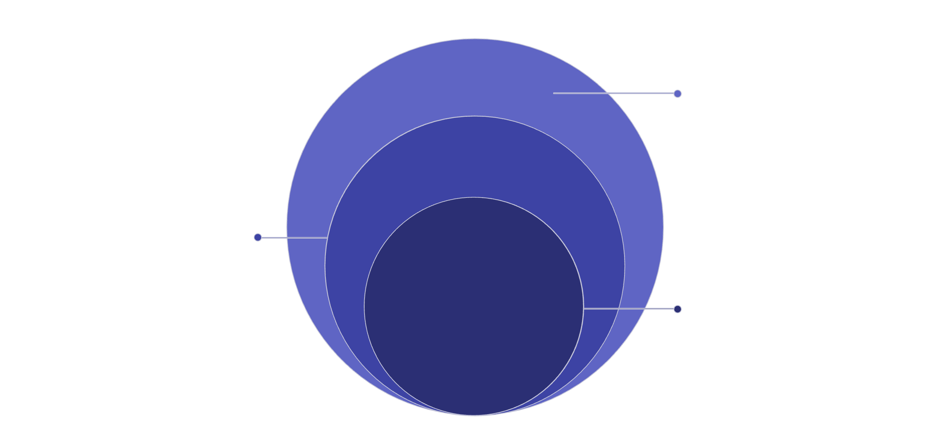
System Architecture
The scheduler is organized as a three-tier hierarchical system. Each tier has clearly defined responsibilities, and communication flows downward for task dispatch and upward for metrics and load-state feedback.
Tasks
Metadata: cost estimate, depth, unique ID
Workers
Threads with local deques, steal/share, locality groups
Scheduler
Controls distribution, balancing, and policy switching
Tier 1 — Scheduler
Tier 2 — Workers
Tier 3 — Tasks
Central coordinator for task submission and distribution
Monitors real-time metrics: queue sizes, steal rates, creation rates
Triggers policy switch between Work-First and Help-First modes
Ensures graceful shutdown and result aggregation
Each worker maps to one std::thread with a private deque
Push/pop from back (owner); steal from front (thief) — minimizes contention
Grouped into locality domains for NUMA-aware victim selection
Reports idle time, steal count, and task completion to Scheduler
Self-contained unit of computation wrapped in a callable object
Carries metadata: estimated cost, recursion depth, task ID
Cost field used by gating logic to approve or reject steal/share
Supports recursive sub-task spawning during execution

Slide 7
Algorithm Details
Dual Scheduling Strategy
Pseudocode — Adaptive Work Loop
Work-First Policy
Help-First Policy
function WorkerLoop(worker_id): while scheduler.is_running(): task = local_deque.pop_back() if task is None: // Attempt steal or receive share victim = select_victim(worker_id) candidate = victim.deque.steal_front() if candidate.cost > COST_THRESHOLD: task = candidate else: continue // skip: too cheap to steal execute(task) update_metrics(steals, shares, idle_time) function select_victim(worker_id): // Locality-aware: prefer same NUMA group for peer in same_locality_group(worker_id): if peer.deque.size() > IMBALANCE_THRESHOLD: return peer // Fallback to cross-group return max_loaded_worker() function adaptive_policy_switch(): if steal_rate > creation_rate: switch_to_help_first() // push proactively else: switch_to_work_first() // local priority
Worker executes tasks from its own local deque before attempting any steal or share. Minimizes inter-thread communication. Activated when steal rate ≤ creation rate — system is not under heavy imbalance. Reduces unnecessary synchronization in low-contention phases.
Overloaded workers proactively push tasks to underloaded peers rather than waiting for them to steal. Activated when steal rate > creation rate — indicating queue buildup and high imbalance. Bypasses standard queue bottlenecks; directly alleviates hotspot threads.
Cost-Aware Gating Logic
Before any steal or share operation is executed, the scheduler evaluates the target task's cost field against threshold τ. Only tasks satisfying task.cost > τ are eligible for migration. This single check prevents the system from drowning in synchronization overhead on tiny sub-problems.

Slide 8

Implementation Details
Technology Stack
Three Benchmark Workloads
C++17 from Scratch
Recursive Fibonacci — Irregular
Parallel Merge Sort — Balanced
The entire scheduler — including all thread management, deque operations, and synchronization — is implemented using native C++17 std::thread and std::mutex. No external scheduling library (TBB, Cilk, etc.) was used for the core logic, ensuring full control and transparency of scheduling decisions.
Highly dynamic, recursive task generation with exponentially variable sub-problem sizes. OpenMP uses #pragma omp task. Tests the scheduler's ability to handle extreme load imbalance and deep recursion trees. Represents the hardest case for static allocation.
Divide-and-conquer workload with predictable, roughly symmetric task distribution. OpenMP uses #pragma omp parallel for. Tests performance on structured, moderately balanced workloads where overhead sources differ from irregular cases.
Performance Pipeline
Performance metrics (execution time, speedup, efficiency, steal count, share count) are recorded at runtime and exported to a structured CSV file. Python matplotlib scripts dynamically parse this output to generate comparative graphs for all modes and thread counts.
Synchronization Model
Matrix Multiplication — Compute-Intensive
Each worker's deque is protected by a std::mutex. Lock acquisition is strictly scoped (RAII pattern) to minimize critical section duration. Cost-aware gating further reduces contention by rejecting cheap steal candidates before the lock is even fully exercised.
Perfectly regular, mathematically uniform nested loop computation. OpenMP uses #pragma omp parallel for collapse(2) with compile-time loop tiling. Represents the best case for static compiler-optimized parallelism — the most challenging scenario for a dynamic runtime scheduler.

Slide 9
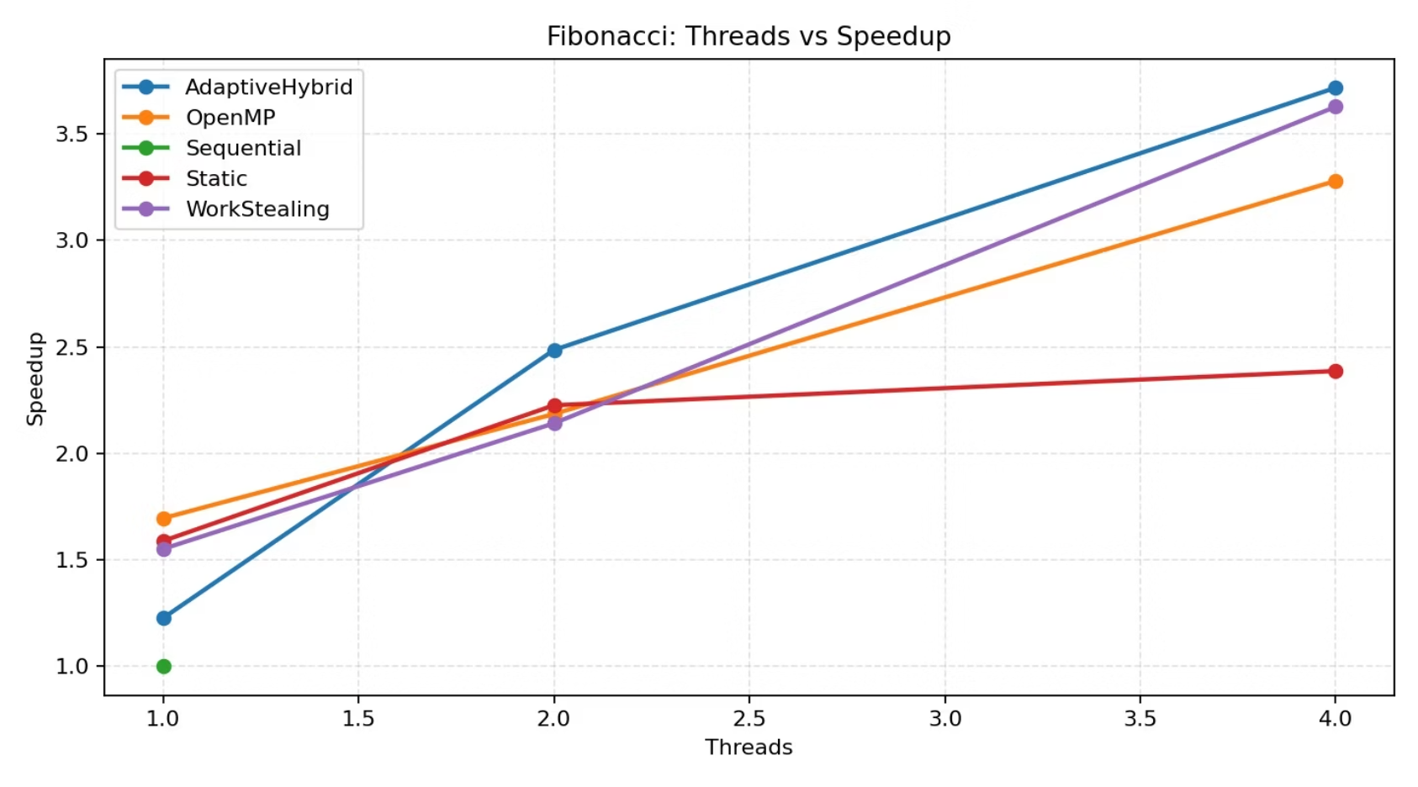

Results — Fibonacci (Irregular Workload)
KEY PERFORMANCE WIN
Execution Time vs. Thread Count
Speedup Comparison — All Modes
As thread count increases from 1 to 8, all dynamic modes show significant execution time reduction. The custom Adaptive Hybrid and Work-Stealing schedulers exhibit the steepest decline, particularly at high thread counts where OpenMP's lock contention on tiny recursive tasks begins to compound.
At maximum thread count, the custom Adaptive Hybrid and Work-Stealing schedulers outperform OpenMP by approximately 11.7% on the Fibonacci workload — a statistically significant margin that validates the architectural design.
Why Does Custom Beat OpenMP Here?
Fibonacci is a highly irregular workload: the recursive tree generates thousands of sub-problems of wildly varying cost. OpenMP's #pragma omp task relies on an internal runtime that experiences elevated lock contention and queue saturation at depth. Our Help-First policy actively pushes tasks directly to idle workers during heavy imbalance phases, bypassing the centralized bottleneck. Cost-aware gating further prevents the scheduler from thrashing on sub-problems below the cost threshold — a mechanism OpenMP does not natively provide at the application level.
The chart illustrates that both the Adaptive Hybrid and Work-Stealing modes achieve superior speedup on Fibonacci compared to OpenMP and Static modes. Sequential serves as the 1.0 baseline. Static scheduling plateaus early due to its inability to rebalance when task sub-trees prove asymmetric.

Slide 10
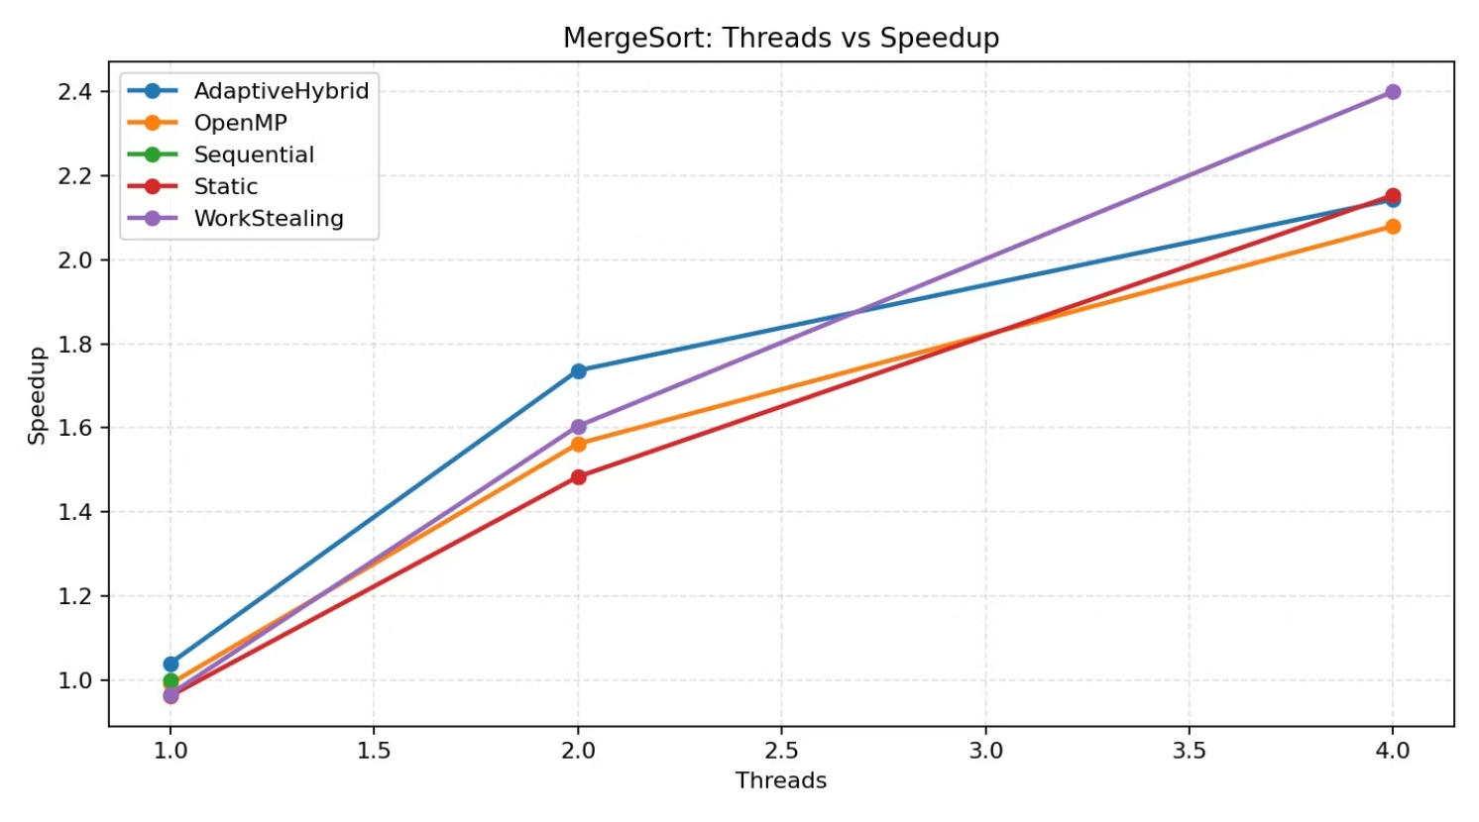
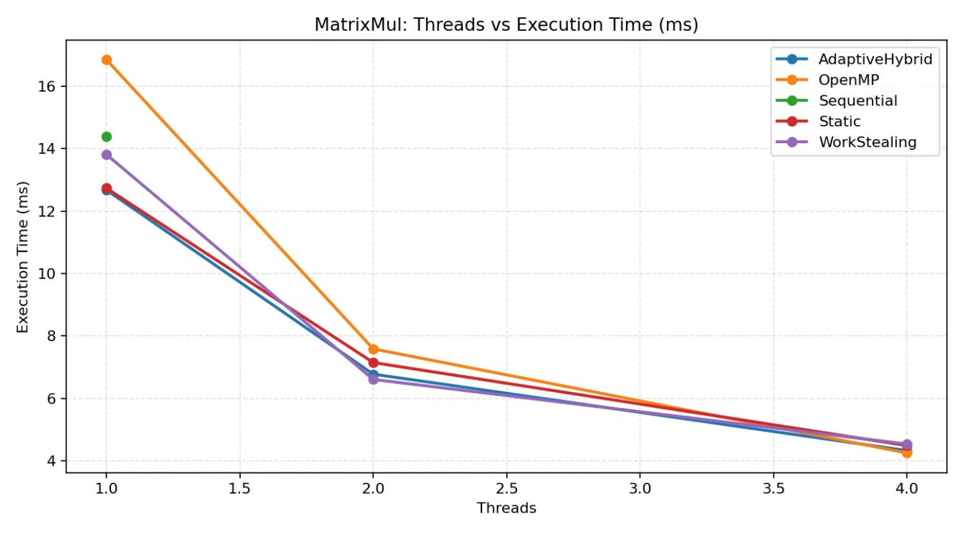


Results — Merge Sort & Matrix Multiplication
Merge Sort (Balanced Divide-and-Conquer)
Matrix Multiplication (Compute-Intensive)
For Parallel Merge Sort, the three dynamic modes — Work-Stealing, Adaptive Hybrid, and OpenMP — exhibit nearly identical speedup profiles across all thread counts. The structured divide-and-conquer partitioning of Merge Sort naturally suppresses major load imbalance from the outset, leaving little headroom for dynamic policies to differentiate themselves. Static scheduling performs adequately but trails slightly at higher thread counts where minor imbalances accumulate.
On Matrix Multiplication, OpenMP edges ahead of the custom Adaptive Hybrid by approximately 1.7% at maximum thread count. This outcome is expected and honest: OpenMP's #pragma omp parallel for collapse(2) flattens the two-dimensional iteration space at compile time, enabling loop tiling and memory access optimizations that a runtime-evaluated dynamic queue system cannot replicate. The microscopic advantage of compile-time knowledge in perfectly uniform loops is well-documented in the literature.
Merge Sort result validates that the custom scheduler introduces no harmful overhead on balanced workloads — it matches OpenMP performance without conceding ground.
This result demonstrates the scheduler's intellectual honesty — it does not claim universal superiority, but rather identifies the precise workload categories where each approach excels.

