Slide 1
LEADREVIVE / MANAGEMENT REVIEW
Make missed follow-up work visible
Revenue leakage & lead recovery intelligence | Business operations portfolio
Question
Which enquiries need attention, who owns the next action, and can a repeatable process surface missed work?
758
synthetic records
13 documented KPIs
SYNTHETIC | 9a80207b950500a9 | d0b3c24632 | External live delivery disabled
01
Notes:
Evidence: snapshot 9a80207b950500a9; data revision d0b3c24632131978efcdfa1d8cb57f1d46347e76d109e3a596ef0f8c8084c401; export generation f03b072d3f984a95a83a34ccb865a534. All data synthetic. Figures use verified KPI fields; image hashes recorded in metadata.json. Original Power BI window screenshots are cropped to the report canvas in slide viewports only; original pixels/files are retained. No recovered revenue or external delivery claim.

Slide 2
LEADREVIVE / MANAGEMENT REVIEW
A reliable record before a reminder
Canonical PostgreSQL; normalized intake; conservative conflict review
Capture → validate → assign → prioritize → remind → review → measure
Sales associate: own and reschedule work
Manager: assign overdue work and balance capacity
Analyst: reconcile cohorts, denominators and evidence
SYNTHETIC | 9a80207b950500a9 | d0b3c24632 | External live delivery disabled
02
Notes:
Evidence: snapshot 9a80207b950500a9; data revision d0b3c24632131978efcdfa1d8cb57f1d46347e76d109e3a596ef0f8c8084c401; export generation f03b072d3f984a95a83a34ccb865a534. All data synthetic. Figures use verified KPI fields; image hashes recorded in metadata.json. Original Power BI window screenshots are cropped to the report canvas in slide viewports only; original pixels/files are retained. No recovered revenue or external delivery claim.

Slide 3
LEADREVIVE / MANAGEMENT REVIEW
Where attention is needed
Frozen current-state cohort at 2026-10-24T15:44:29.684236Z; not historical reconstruction
Overdue / scheduled
Estimated exposure
First-response median
411 / 586
INR 104,279,000
59 hours
Exposure is an estimated open-opportunity sum. It is not lost or recovered revenue. Uncontacted leads are excluded from the response-time median.
SYNTHETIC | 9a80207b950500a9 | d0b3c24632 | External live delivery disabled
03
Notes:
Evidence: snapshot 9a80207b950500a9; data revision d0b3c24632131978efcdfa1d8cb57f1d46347e76d109e3a596ef0f8c8084c401; export generation f03b072d3f984a95a83a34ccb865a534. All data synthetic. Figures use verified KPI fields; image hashes recorded in metadata.json. Original Power BI window screenshots are cropped to the report canvas in slide viewports only; original pixels/files are retained. No recovered revenue or external delivery claim.

Slide 4
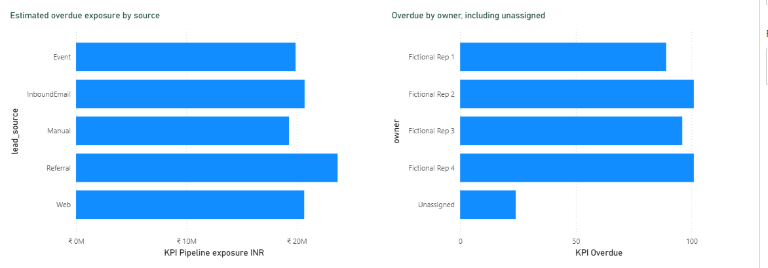
LEADREVIVE / MANAGEMENT REVIEW
Diagnose workload before changing source spend
SYNTHETIC portfolio case
Referral: 94 overdue
Review workload first
24 overdue unassigned
Assign the next owner
Exposure is estimated
Not recovered revenue
SYNTHETIC | 9a80207b950500a9 | d0b3c24632 | External live delivery disabled
04
Notes:
Evidence: snapshot 9a80207b950500a9; data revision d0b3c24632131978efcdfa1d8cb57f1d46347e76d109e3a596ef0f8c8084c401; export generation f03b072d3f984a95a83a34ccb865a534. All data synthetic. Figures use verified KPI fields; image hashes recorded in metadata.json. Original Power BI window screenshots are cropped to the report canvas in slide viewports only; original pixels/files are retained. No recovered revenue or external delivery claim.

Slide 5
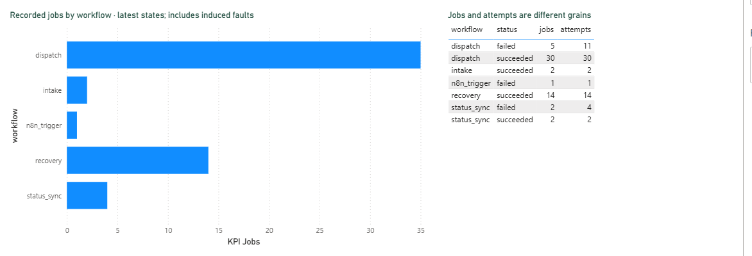
LEADREVIVE / MANAGEMENT REVIEW
Four working workflows, clear approval boundaries
Intake · recovery · outbox/approval · status sync
386 leads surfaced
Owner reminders reserved
6 sink-only approvals
Exact-content review
13 local sink acceptances
External sending blocked
SYNTHETIC | 9a80207b950500a9 | d0b3c24632 | External live delivery disabled
05
Notes:
Evidence: snapshot 9a80207b950500a9; data revision d0b3c24632131978efcdfa1d8cb57f1d46347e76d109e3a596ef0f8c8084c401; export generation f03b072d3f984a95a83a34ccb865a534. All data synthetic. Figures use verified KPI fields; image hashes recorded in metadata.json. Original Power BI window screenshots are cropped to the report canvas in slide viewports only; original pixels/files are retained. No recovered revenue or external delivery claim.

Slide 6
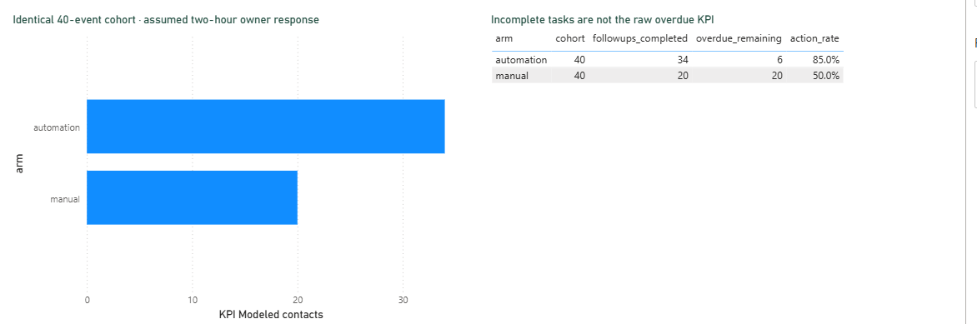
LEADREVIVE / MANAGEMENT REVIEW
The comparison is modeled, not a sales result
Manual reviews at hours 12 and 24; hourly automation scan; identical assumed two-hour owner response. No sales or revenue outcome modeled.
20 vs 34 contacts
Modeled at hour 24
Same 40 due events
Owner timing assumed
Raw overdue unchanged
Rescheduling still required
SYNTHETIC | 9a80207b950500a9 | d0b3c24632 | External live delivery disabled
06
Notes:
Evidence: snapshot 9a80207b950500a9; data revision d0b3c24632131978efcdfa1d8cb57f1d46347e76d109e3a596ef0f8c8084c401; export generation f03b072d3f984a95a83a34ccb865a534. All data synthetic. Figures use verified KPI fields; image hashes recorded in metadata.json. Original Power BI window screenshots are cropped to the report canvas in slide viewports only; original pixels/files are retained. No recovered revenue or external delivery claim.

Slide 7
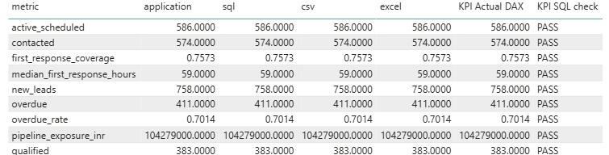
LEADREVIVE / MANAGEMENT REVIEW
Trust depends on matching definitions and versions
SQL vs Python; CSV/Excel readback; Desktop DAX; pinned immutable generations
13 KPIs reconciled
Selected rows enlarged
SQL / exports / DAX
Same snapshot and revision
Null is different from zero
Full detail in the report
SYNTHETIC | 9a80207b950500a9 | d0b3c24632 | External live delivery disabled
07
Notes:
Evidence: snapshot 9a80207b950500a9; data revision d0b3c24632131978efcdfa1d8cb57f1d46347e76d109e3a596ef0f8c8084c401; export generation f03b072d3f984a95a83a34ccb865a534. All data synthetic. Figures use verified KPI fields; image hashes recorded in metadata.json. Original Power BI window screenshots are cropped to the report canvas in slide viewports only; original pixels/files are retained. No recovered revenue or external delivery claim.

Slide 8
LEADREVIVE / MANAGEMENT REVIEW
Cost / benefit is a sensitivity exercise
Assumed capacity value, not observed cash savings or ROI
Assumed min saved/action | Capacity hours/month | Net capacity-equivalent INR/month
1 | 3.33 | -800
2 | 6.67 | 200
3 | 10.0 | 1,200
Assumptions: 200 actions/month; INR 300/hour; 24 setup hours; 4 maintenance hours/month; 12-month amortization. Hardware/electricity/licensing not measured.
SYNTHETIC | 9a80207b950500a9 | d0b3c24632 | External live delivery disabled
08
Notes:
Evidence: snapshot 9a80207b950500a9; data revision d0b3c24632131978efcdfa1d8cb57f1d46347e76d109e3a596ef0f8c8084c401; export generation f03b072d3f984a95a83a34ccb865a534. All data synthetic. Figures use verified KPI fields; image hashes recorded in metadata.json. Original Power BI window screenshots are cropped to the report canvas in slide viewports only; original pixels/files are retained. No recovered revenue or external delivery claim.

Slide 9
LEADREVIVE / MANAGEMENT REVIEW
What a permissioned pilot should measure
SYNTHETIC portfolio case
1 Assign ownership and require a next action after contact.
2 Measure owner response and actual administrative effort.
3 Separate induced test faults from ordinary operations.
4 Track completed follow-up before making revenue claims.
SYNTHETIC | 9a80207b950500a9 | d0b3c24632 | External live delivery disabled
09
Notes:
Evidence: snapshot 9a80207b950500a9; data revision d0b3c24632131978efcdfa1d8cb57f1d46347e76d109e3a596ef0f8c8084c401; export generation f03b072d3f984a95a83a34ccb865a534. All data synthetic. Figures use verified KPI fields; image hashes recorded in metadata.json. Original Power BI window screenshots are cropped to the report canvas in slide viewports only; original pixels/files are retained. No recovered revenue or external delivery claim.

Slide 10
LEADREVIVE / MANAGEMENT REVIEW
Review gate and limitations
Local single-user prototype; no public deployment or external email
Synthetic data and retained test fixtures
Model assumptions are not observed business outcomes
Current-state snapshots are not time-travel reporting
Tested duplicate protection is not a universal exactly-once guarantee
Phase 6, publishing and final sign-off require separate approval.
SYNTHETIC | 9a80207b950500a9 | d0b3c24632 | External live delivery disabled
10
Notes:
Evidence: snapshot 9a80207b950500a9; data revision d0b3c24632131978efcdfa1d8cb57f1d46347e76d109e3a596ef0f8c8084c401; export generation f03b072d3f984a95a83a34ccb865a534. All data synthetic. Figures use verified KPI fields; image hashes recorded in metadata.json. Original Power BI window screenshots are cropped to the report canvas in slide viewports only; original pixels/files are retained. No recovered revenue or external delivery claim.

