Slide 1


An Empirical Evaluation of Distributed Key/Value Storage Systems
Group#8
Yi Qu
Shivam Kulkarni
Yunan Zhang
Instructor: Dr. Ioan Raicu
TA: Alexandru Orhean

Slide 2


1.Introduction 2.System 3.Evaluation 4.Conclusion 5.References
Agenda

Slide 3
1. Introduction
Purpose:
In this project, we are going to evaluate various distributed key/value storage systems, and compare them to existing literature(ZHT).
Systems to Evaluate:
Cassandra
MongoDB
Redis
(All NoSQL, Non relational databases)
Testbed:
Chameleon Cloud (KVM). We created 8 medium instances to conduct our evaluation. 100,000 insert/lookup/remove operations per experiment.

Slide 4
Motivation Behind Choosing The Technologies
Well documented
2. Easy to install
3. Demand in industry
4. Community support

Slide 5

2. System
MongoDB:
Written in: C++
MongoDB is a high performance, easy to deploy, easy to use, document-based database based on distributed file storage
It supports master-slave, replica set. It stores the data in the hard disk, and all the data to be operated is mapped to an area of the memory by the mmap(memory-mapped file I/O) method for modification.
Data is grouped and stored in a data set and is called a collection. Each collection has a unique distinguished name in the database and can contain an unlimited number of documents.
Used MongoDB default API.

Slide 6

2. System
Cassandra:
Written in: Java
Cassandra is an open source distributed NoSQL database system. It is a distributed network service composed of a bunch of database nodes. All nodes act as seeds and aggregate into a cluster network.
The write operation to Cassandra will be copied to other nodes.
The read operation of Cassandra will also be routed to a node for reading.
Wide-Column store.
Used Datastax API.

Slide 7

2. System
Redis:
Written in: C
Redis is a fully open source, free, in-memory high-performance key-value database. Support for backup of data master-slave mode.
It supports the storage of multiple types of data，such as string, hash, list, set and zset(sorted set).
Used Jedis API

Slide 8
3. Evaluation
Latency:
System/Scale | 1 | 2 | 4 | 8
ZHT | 0.243 | 0.362 | 0.408 | 0.428
Cassandra | 0.953 | 0.960 | 0.970 | 1.100
Cassandra(Paper) | 1.199 | 1.870 | 1.875 | 1.994
MongoDB | 0.289 | 0.387 | 0.436 | 0.524
Redis | 0.033 | 0.281 | 0.357 | 0.285

Slide 9
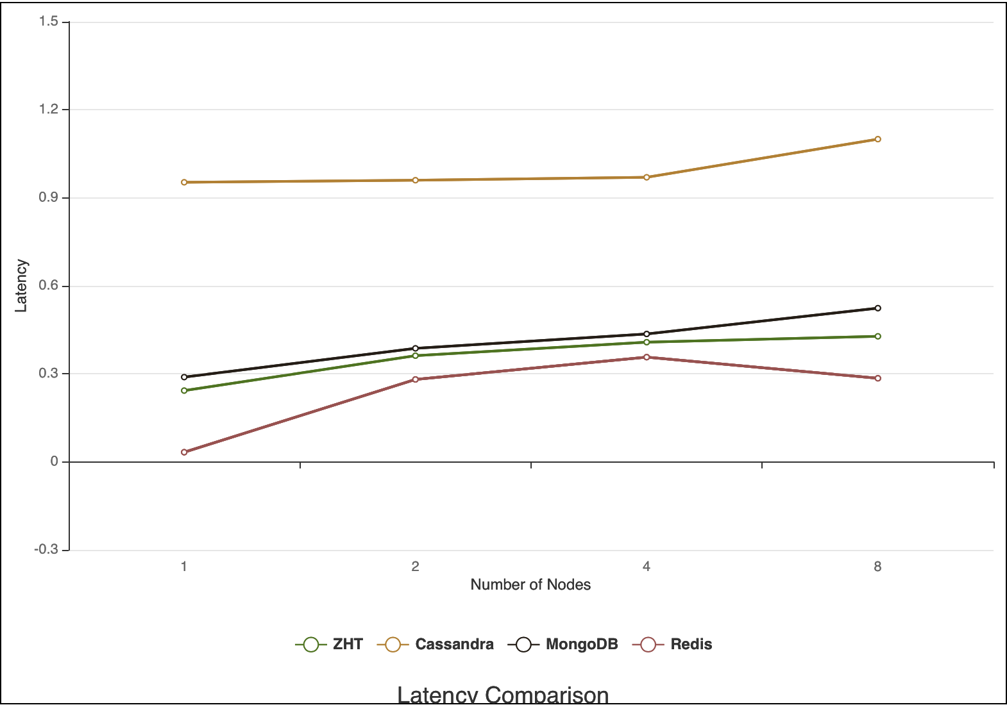
3. Evaluation
Latency:

Slide 10
3. Evaluation
Throughput:
System/Scale | 1 | 2 | 4 | 8
ZHT | 4117 | 5524 | 9813 | 18680
Cassandra | 1049 | 2047 | 4067 | 6818
Cassandra (Paper) | 926 | 1131 | 2189 | 4322
MongoDB | 2027 | 3002 | 5212 | 9782
Redis | 30000 | 5940 | 10256 | 16666

Slide 11
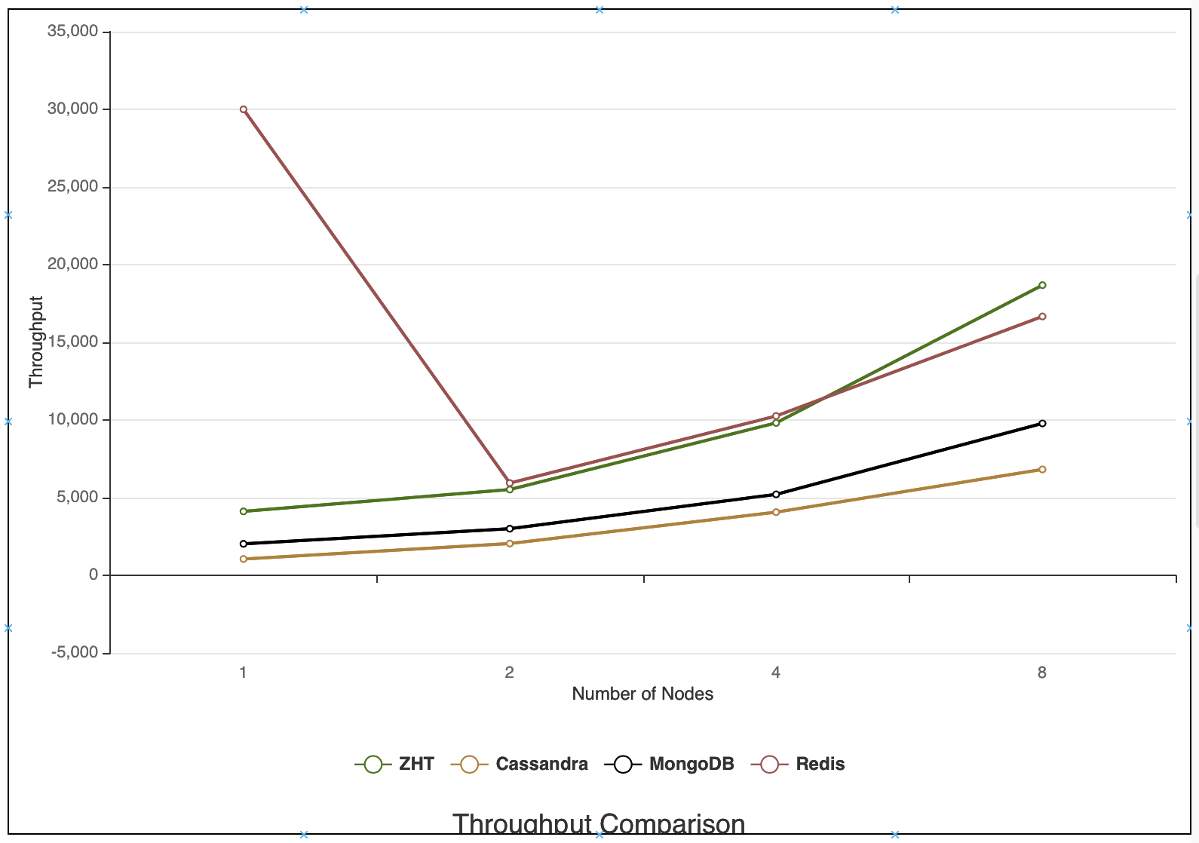
3. Evaluation
Throughput:

Slide 12
Observations
Insert operation takes more time than other operations. Remove is the fastest operation.
Remove is the most expensive operation.
Lookup performs the best.
Cassandra
MongoDB
Remove operation takes more time than other operations. Lookup is the fastest operation.
Redis

Slide 13
4. Conclusion
Redis has the best overall performance.
Cassandra’s performance is the worst.
Three systems we compared had trade-offs.
Every system has their own use cases.

Slide 14
4. Conclusion
System | Memory and store | Data backup | Best use | Example:
Cassandra | Distributed | Tunable trade-offs for distribution and replication | Store huge data, highly available, wide column storage cases | Bank, Web analytics
MongoDB | Write to RAM, then map to ROM | Master/slave replication (auto failover with replica sets) | need dynamic queries or define indexs, content management and document type of storage needs | Server logging
Redis | Data generally stored in RAM | Master-slave replication, automatic failover | store real-time data, has in-memory storage | Real-time communication, stock application

Slide 15
5. Reference
http://cassandra.apache.org/doc/latest/
https://redis.io/documentation
https://www.mongodb.com
https://community.pivotal.io/s/article/How-to-setup-Redis-master-and-slave-replication
https://www.guru99.com/nosql-tutorial.html
https://www.xplenty.com/blog/the-sql-vs-nosql-difference/
https://db-engines.com/en/system/Cassandra%3BMongoDB%3BRedis
"ZHT: A Light-Weight Reliable Persistent Dynamic Scalable Zero-Hop Distributed Hash Table," 2013 IEEE 27th International Symposium on Parallel and Distributed Processing, Boston, MA, 2013, pp. 775-787.

Slide 16
Thank you!

