Slide 1
IILM UNIVERSITY, GREATER NOIDA
INTERNSHIP REPORT PRESENTATION
Electric Vehicle Modeling and Simulation Design
Virtual Internship
AICTE – EduSkills Virtual Internship Program Supported by MathWorks
shivam kumar | B.Tech (Computer Science and Engineering)
June – August 2026
01

Slide 2
ABOUT THE STUDENT
Candidate Profile
Student Name
shivam kumar
Stream
B.Tech
Branch
B.Tech (Computer Science and Engineering)
Institute
IILM University, Greater Noida
Internship Domain
Electric Vehicle Modeling and Simulation Virtual Internship Program
Duration
8 Weeks | June – August 2026
AICTE Student ID
STU699ac8fcc6e891771751676
02

Slide 3
ABOUT THE PROGRAM
AICTE – EduSkills Virtual Internship Program
1
8-Week Program
2
Learning + Practice
3
Assessment
Selected for an 8-week virtual internship with a structured, week-wise learning plan.
The program combines structured learning with practical exposure and project documentation.
Weekly assessments, project submissions and a final assessment contribute to the final grade.
Successful completion of the required steps and assessments leads to a Virtual Internship Certificate.
03

Slide 4
LEARNING FOCUS
From MATLAB Fundamentals to EV-Oriented System Modeling
The internship progresses from MATLAB and Simulink fundamentals to control design, physical-system simulation, battery management, power systems, system architecture and application development.
1
LEARN
2
MODEL
3
SIMULATE
4
CONTROL
5
BUILD
MATLAB
Simulink
Simscape
Stateflow / PID
System & Apps
04

Slide 5
PROJECT OBJECTIVES
What the Internship Set Out to Achieve
1
MATLAB Fundamentals
2
Simulink Modeling
3
Control Design
Learn MATLAB®, its language, development environment and essential engineering-data tools.
Create, edit and simulate block-diagram models representing real-world systems and algorithms.
Learn feedback control design in Simulink®, including PID controller tuning.
4
Physical Simulation
5
Battery & Power Systems
6
System & App Development
Use Simscape® for physical systems, circuit simulation and power-electronics converters.
Explore battery management, thermal management, charging/discharging and microgrid simulation.
Learn system architecture with System Composer™ and build applications with App Designer.
05

Slide 6
TECHNOLOGIES & TOOLS
The Toolkit Behind the Internship
1
MATLAB®
2
Simulink®
3
Simscape®
4
Stateflow®
Programming, analysis and engineering data
Block-diagram modeling and simulation
Physical-system modeling and simulation
Supervisory control and decision logic
5
Simscape Battery
6
Simscape Electrical™
7
System Composer™
8
App Designer
Battery modeling, BMS and thermal management
Circuits, converters and power systems
System architecture and requirements tracing
User interfaces, callbacks and applications
06

Slide 7
SYSTEM ARCHITECTURE
Learning Pipeline: From Modeling to Application
FOUNDATION
MATLAB Onramp
↓
MODEL
Simulink Onramp + Control Design
↓
PHYSICAL SYSTEMS
Simscape • Circuit Simulation • Power Electronics
↓
CONTROL & BATTERY
Stateflow • Simscape Battery
↓
POWER & ARCHITECTURE
Power Systems • System Composer
↓
APPLICATION
App Designer
07

Slide 8
METHODOLOGY
The 8-Week Learning Journey
1
WEEK 1 — MATLAB Onramp
2
WEEK 2 — Simulink + Control Design
MATLAB language, development environment and tools for analyzing science and engineering data.
Block-diagram modeling, simulation and feedback control with PID tuning.
3
WEEK 3 — Simscape + Circuits + Power Electronics
4
WEEK 4 — Stateflow Onramp
Physical networks, electrical circuits and buck-converter simulation.
Supervisory control systems and decision logic using state machines and flow charts.
5
WEEK 5 — Simscape Battery Onramp
6
WEEK 6 — Power Systems Simulation
Battery modeling, BMS, thermal management and charging/discharging algorithms.
Microgrid modeling, Simscape Electrical and power-component control strategies.
7
WEEK 7 — System Composer Onramp
8
WEEK 8 — App Building Onramp
System architecture, requirements tracing and Simulink integration for verification.
MATLAB App Designer, user-interface design, callbacks and complete app development.
08

Slide 9
EXPECTED OUTCOMES
Skills & Capabilities Gained
1
Ability to use MATLAB for engineering-oriented analysis and learning.
2
Practical understanding of block-diagram modeling and simulation in Simulink.
3
Exposure to physical-system, circuit and power-electronics simulation with Simscape.
4
Understanding of supervisory control and decision logic using Stateflow.
5
Hands-on understanding of battery modeling, BMS and thermal-management concepts.
6
Experience with microgrid and electrical power-system simulation.
7
Understanding of system architecture and requirements tracing using System Composer.
8
Capability to build MATLAB applications using App Designer.
09

Slide 10
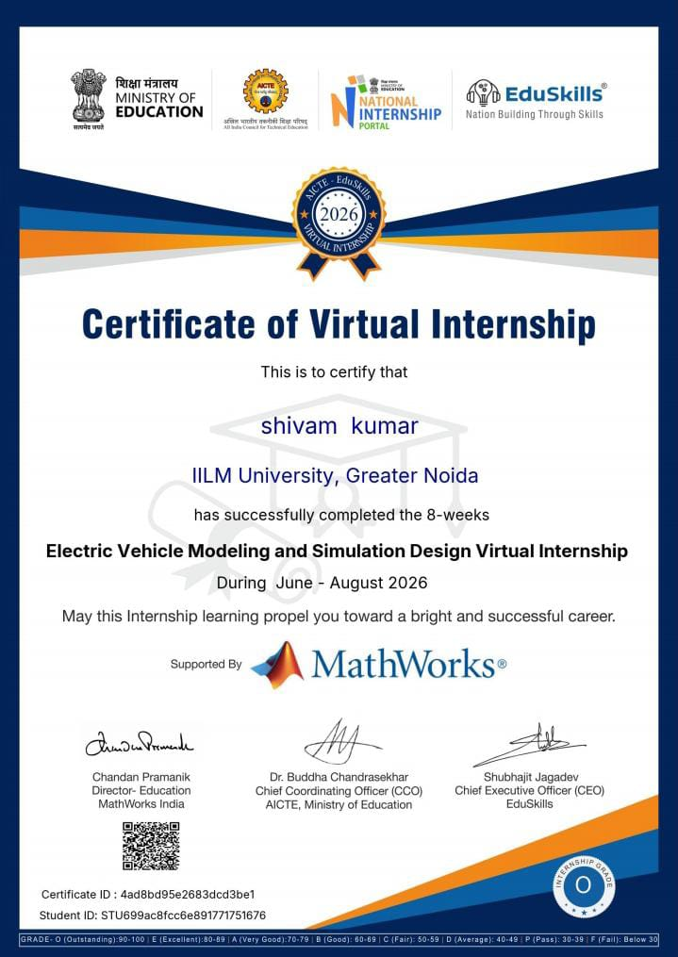
CERTIFICATION
Successfully Completed
Grade: O (Outstanding)
Certificate ID: 4ad8bd95e2683dcd3be1
Student ID: STU699ac8fcc6e891771751676
Duration: 8 Weeks | June – August 2026
Supported by MathWorks
10

Slide 11
THANK YOU
Electric Vehicle Modeling and Simulation Design Virtual Internship
shivam kumar | B.Tech (Computer Science and Engineering) IILM University, Greater Noida
11

