Slide 1

PROJECT NAME : AGE SURVEY ANALYZER
SUBMITED BY: GUIDENCE/SUBMITED TO:
SHIVAM KUMAR MISS.NAINA DEVI
1ST SEMESTER IBM SME
BTECH CSE (AI/ML) SESSION:2025-26
SECTION: B ERP=RU-25-11678
IBM

Slide 2
📌AGENDA
👤 To design a C program that’s collects age data from multiple users.
📊 To categorize users into different age using conditional statements.
🔁 To apply loop control for repetitive data input.
✅ To count and display the number of users in each age category.
💡To demonstrate the practical use of variables, loops, and if–else conditions in C…

Slide 3
🎯 OBJECTIVE
💻 To understand the basic structure of a C program.
📥 To collect age data from multiple users.
📊 To analyze and classify users into age groups.
🔁 To apply loops for repetitive data input.
🧠 To implement conditional (if–else) statements.
📈 To generate and display summarized survey results.

Slide 4
🧾 INTRODUCTION TO PROJECT
🧑‍🤝‍🧑Age Survey Analyzer Using c program
👋 Overview
This project is a simple console-based C application designed to collect age data from multiple users and analyze it by grouping users into different age categories such as Children, Teens, Adults, and Seniors.
💡 Purpose
The project helps in understanding the practical implementation of loops, conditional statements (if–else), and counter variables in the C programming language.
⚙️ Working Principle
The program takes user input using a loop, checks each age using conditions, and finally displays a summarized report of the survey.
🎯 Application
Such age-based analysis can be used in surveys, population studies, educational research, and basic data analysis systems.

Slide 5


🛠️ TOOLS & TECHNOLOGIES USED
💻 Visual Studio Code (VS Code)
Used as the source code editor for writing and managing the C program.
Provides syntax highlighting and an easy-to-use interface.
⚙️ GCC Compiler
Used to compile and execute the C program.
Converts C source code into executable machine code.
⌨️ C Programming Language
Used to implement program logic using loops, conditions, and variables.
🖥️ Windows Operating System
Provides the environment to run VS Code and GCC compiler.

Slide 6

⚙️ PROJECT WORKING
1️⃣ 🧑‍💻 User Input
The program first asks for the number of users and then takes age input for each user.
2️⃣ 🔁 Loop Execution
A for loop runs repeatedly to collect age data from all users one by one.
3️⃣ 🧠 Condition Checking
Each entered age is checked using if–else conditions to determine the age group.
4️⃣ 📊 Classification
Users are categorized into:
Children (0–12)
Teens (13–19)
Adults (20–59)
Seniors (60+)
5️⃣ 📈 Result Display
After processing all inputs, the program displays the final count of each age group.

Slide 7
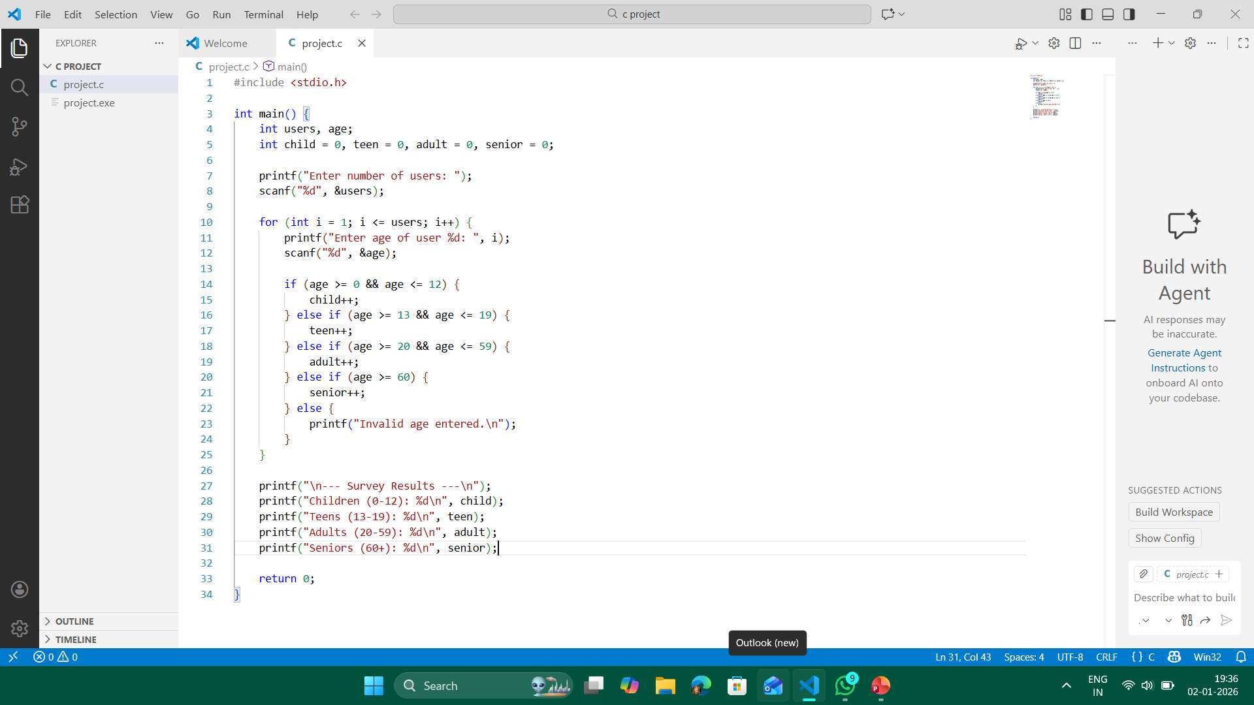
📸 SCREENSHOT (survey analyzer code)

Slide 8
3. Core Concepts Used
Loop (for) → to process multiple users
Conditional statements (if-else) → to classify age groups
Counters → to store survey results
User input/output (scanf, printf)
4. Core Idea in One Line
👉 The core of this project is to collect age data, categorize users into age groups, and generate a summarized survey report using C programming logic.

Slide 9
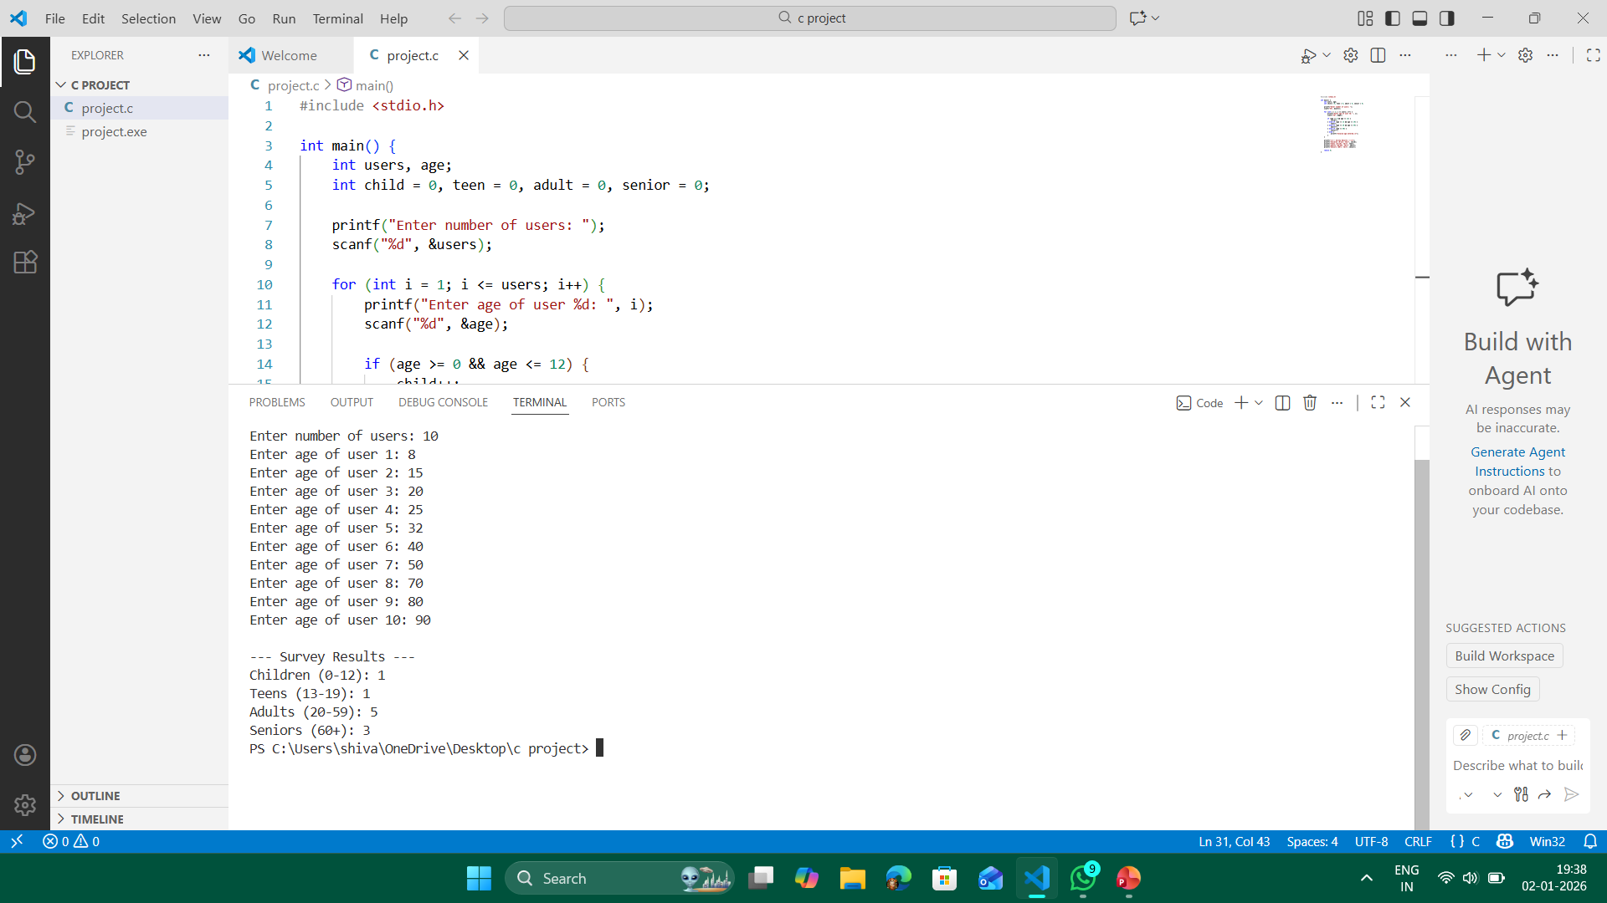
📊 Output

Slide 10

✅ Advantages of Age Survey Analyzer
1️⃣ Easy to Use
👤 The program is simple and easy to operate for users of any level.
2️⃣ Fast Data Processing
⚡ Automatically collects and classifies data quickly using loops and conditions.
3️⃣ Accurate Results
📊 Ensures correct counting of each age group using logical conditions.
4️⃣ Reusable
♻️ The program can be reused for any number of users.
5️⃣ Helps in Data Analysis
💡 Useful for surveys, population studies, and age-based research.

Slide 11
🔮 Future Scope of Age Survey Analyzer
1️⃣ Graphical User Interface (GUI)
🖥️ The program can be upgraded to have a GUI using tools like Java Swing for better user interaction.
2️⃣ Save & Export Data
💾 Ability to store survey data in files (CSV, Excel) for later analysis.
3️⃣ Advanced Data Analysis
📊 Integrate with charts and graphs to visually represent age statistics.
4️⃣ Web-Based Version
🌐 Can be developed as a web application for online surveys.
5️⃣ Integration with Databases
🗄️ Use SQL/NoSQL databases to handle large-scale survey data.

Slide 12


