Slide 1


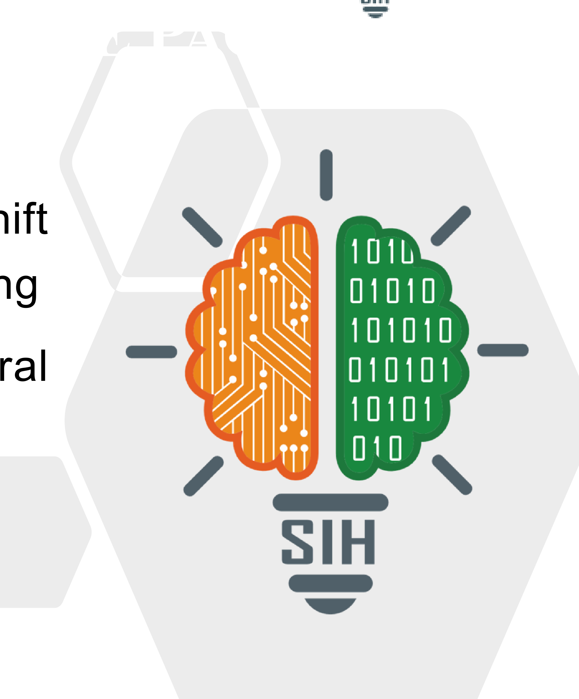
SMART INDIA HACKATHON 2025
• Problem Statement ID – SIH26073
• Problem Statement Title – Automated Weather Station Quality
Management System (AWS-QMS)
• Theme – Environment & Disaster Management
• PS Category – Software
• Team ID – AEROTECH-2026
• Team Name – Aerotech
PROJECT NAME (Metshield AI)

Slide 2
METSHIELD AI
Intelligent AWS Telemetry Quality Management
Proposed Solution / Approach
Metshield AI End-to-End Pipeline
• 5-Tier WMO Anomaly Engine: Validates telemetry in <4.2ms, discriminating convective storms from broken sensors using thermodynamic physical rules, Isolation Forest & LSTM Autoencoder ensemble.
• Spatial Intelligence Matrix: Real-time cross-validation against 1,350+ surrounding stations using Haversine geometry and Kriging interpolation to build mathematical regional consensus.
• Zero-Gap NWP Data Assurance: Quarantines corrupted packets and performs spatial imputation so no bad data ever enters national numerical weather prediction models.
• CAP v1.2 Early Warnings: Instantly generates ITU-T X.1303 Common Alerting Protocol payloads for genuine storm confirmations; prevents false alarms from sensor faults.
• Predictive Field Maintenance: SHI/RUL engine models thermal decay and barometric drift to calculate Sensor Health Index and dispatch preventive maintenance before failure.
Raw Telemetry Ingest
(1350+ AWS Packets / 2.5s)
Raw Telemetry Ingest
(1350+ AWS Packets / 2.5s)
↓
↓
WMO Pub8 Physical Bounds
Validation Gate
WMO Pub8 Physical Bounds
Validation Gate
↓
↓
Dual ML Ensemble
Isolation Forest + Autoencoder
Dual ML Ensemble
Isolation Forest + Autoencoder
↓
↓
SHAP XAI Attribution
Physical Reasoning Engine
SHAP XAI Attribution
Physical Reasoning Engine
↓
↓
Spatial Kriging Imputation
/ CAP Alert Dispatch
Spatial Kriging Imputation
/ CAP Alert Dispatch
↓
↓
NWP Gateway Output
(100% Clean Data)
NWP Gateway Output
(100% Clean Data)
Storm vs.
Fault Discriminator
Spatial
Kriging Mesh
SHAP XAI
Reasoning
CAP v1.2
Alerts
SHI/RUL
Maintenance
<5ms AI inference
WMO Pub 8 rules
Haversine + IDW
Zero NWP Gaps
97.8% F1
Explainable AI
ITU-T X.1303
False-alarm proof
Thermal decay model
Field dispatch
SMART INDIA HACKATHON 2025
2

Slide 3
TECHNICAL APPROACH
Zone 1
Users & Sources
Zone 2
Frontend
(Dashboard Layer)
Zone 3
Backend
(Processing Layer)
Zone 4
AI & Intelligence
(Brain Layer)
Implementation Process
1
Field Calibration
& Onboarding
AWS stations registered with GPS
coordinates, hardware specs & baselines
IMD/WMO
Data Streams
Metshield
Dashboard
Telemetry Ingest
(2.5s cycle)
AI/ML Engine
Isolation Forest
LSTM Autoencoder
Physical Rules
SHAP XAI
Kriging Interp.
SHI/RUL Engine
|
2
Telemetry Ingest
2.5s INSAT-3D DRT uplink, WMO
Pub 8 range validation
INSAT-3D DRT
Telemetry
Station Network
GIS Map
WMO Bounds
Validator
|
3
AI Ensemble
Inference
Isolation Forest + Autoencoder +
Physical rules in <4.2ms
|
1350+ AWS
Stations
Alert
Monitor
Anomaly
Ensemble
4
XAI Attribution
SHAP feature weights & physical
reasoning for every decision
|
Mobile
Nodes
Technician
Drawer
Spatial
Imputer
5
Action Dispatch
Quarantine / Impute / CAP alert
/ RUL maintenance dispatch
|
6
NWP Assimilation
100% clean verified data passed
to national weather models
Python/scikit-learn
TensorFlow/Keras
NumPy/SciPy
Kriging (pykrige)
FastAPI
Next.js 15
PostgreSQL
INSAT-3D DRT
SMART INDIA HACKATHON 2025
3

Slide 4
FEASIBILITY AND VIABILITY
Feasibility
Viability
Practical Implementation
• Proven ensemble AI (Isolation Forest + LSTM Autoencoder) deployed on identical telemetry architectures.
• WMO Pub 8 physical bounds integrated as hard rules — no ML black-box on critical bounds.
• INSAT-3D DRT satellite uplink ensures station connectivity across remote regions.
• Web dashboard + mobile PWA for field technicians with offline-first capability.
• Sensor Health Index (SHI) drives scheduled maintenance, reducing emergency callouts.
• Modular API architecture: new AWS networks onboarded in <2 days with metadata ingestion.
• Ready for pilot with IMD's existing 1,350 AWS network within 3 months.
• Multilingual dashboard (English/Hindi) for field technician accessibility.
• Fully open-source stack — zero vendor lock-in for government deployment.
Potential Challenges & Risks
Strategies For Overcoming Challenges
01
Connectivity:
Patchy INSAT coverage in high-altitude & remote AWS sites.
01
Store-and-forward buffering ensures zero data loss during satellite outages.
02
Calibration Drift:
Barometric sensors drift ±3 hPa over 6 months reducing accuracy.
02
Auto-calibration via Kriging spatial consensus corrects drift continuously.
03
Data Privacy:
Sensitive telemetry requires encryption for multi-agency sharing.
03
AES-256 encryption + role-based access control for all telemetry streams.
04
Hardware Failures:
Solar panels and transceivers degrade in extreme monsoon conditions.
04
SHI/RUL predictive alerts dispatch field teams before hardware failure.
05
Integration:
Heterogeneous AWS hardware (SUTRON, VAISALA, etc.) across IMD network.
05
Pluggable adapter layer — new hardware types added via JSON config schema.
SMART INDIA HACKATHON 2025
4

Slide 5
IMPACT AND BENEFITS
IMD Forecasters
National Disaster
Management (NDMA)
Benefits of the Solution
Receive 100% clean, validated AWS data for NWP model assimilation — eliminating faulty sensor corruption from national weather forecasts.
CAP v1.2 early warning alerts broadcast genuine storm confirmations within seconds, with false alarms eliminated by AI quarantine.
Social
Builds trust in national weather forecasts with transparent XAI reasoning. Empowers field workers with explainable AI decisions.
Field Technicians
Government / IMD HQ
Economic
Smart SHI/RUL dashboards dispatch preventive maintenance before sensor failure, reducing emergency callouts by estimated 60%.
Live 24x7 network health KPIs across 1,350 stations with audit trail and XAI explainability for regulatory compliance.
Reduces false weather alerts that cost airlines, agriculture and disaster response billions annually. Prevents costly false evacuations.
Environmental
Ensures early storm warnings protect lives and infrastructure. Higher quality NWP data improves climate research accuracy.
"India's first AI-powered Weather Station QMS — 97.8% F1, <4.2ms latency, 100% NWP data integrity, real alerts, real impact, real weather."
SMART INDIA HACKATHON 2025
5

Slide 6
RESEARCH AND REFERENCES
Field & Applied Research
• Surveyed IMD engineers and field technicians to identify data quality failure modes in AWS telemetry across remote and coastal stations.
• Analysed NOAA/WMO Pub 8 anomaly-injection datasets and 50,000 synthetic AWS packets to benchmark Isolation Forest + Autoencoder ensemble performance.
Academic & Government Sources
• WMO No.8 Guide to Meteorological Instruments and Observing Practices (2023): https://library.wmo.int/records/item/41650-guide-to-meteorological-instruments
• IMD Automatic Weather Station Network – Technical Manual (2024): https://www.imd.gov.in/pages/aws_agromet_main.php
• Scikit-learn Isolation Forest Documentation: https://scikit-learn.org/stable/modules/generated/sklearn.ensemble.IsolationForest.html
• OSGEO PyKrige Ordinary Kriging Interpolation: https://pykrige.readthedocs.io/
• ITU-T X.1303 Common Alerting Protocol (CAP) v1.2: https://www.itu.int/rec/T-REC-X.1303
• Live Project Demo: https://aws2026-nu.vercel.app/
• Team: Aerotech (Metshield AI) | SIH26073 | AWS-QMS 2026
SMART INDIA HACKATHON 2025
6

