Slide 1
Energy Consumption Prediction in Households using Machine Learning
Submitted By: Shivam Kumar
Registration No: 2427030210
Supervised By: Dr Surbhi Sharma
School of Computer Science and Engineering
Department of Computer Science and Engineering

Slide 2
Outline
• Introduction
• Literature Review
• Problem Statement
• Proposed Solution
• Objectives
• Future Research Potential
• References

Slide 3
Introduction
Residential energy consumption represents a significant portion of the overall electricity grid load, highlighting a key area for optimization.
Without effective monitoring, households are prone to inefficient energy use, leading to preventable waste and higher utility expenses.
Machine Learning models can accurately predict energy consumption on a daily or hourly basis by analyzing patterns in appliance usage, historical data, and environmental factors.
Objective: To engineer a predictive system capable of forecasting daily household energy consumption, empowering users to optimize usage and reduce costs.

Slide 4
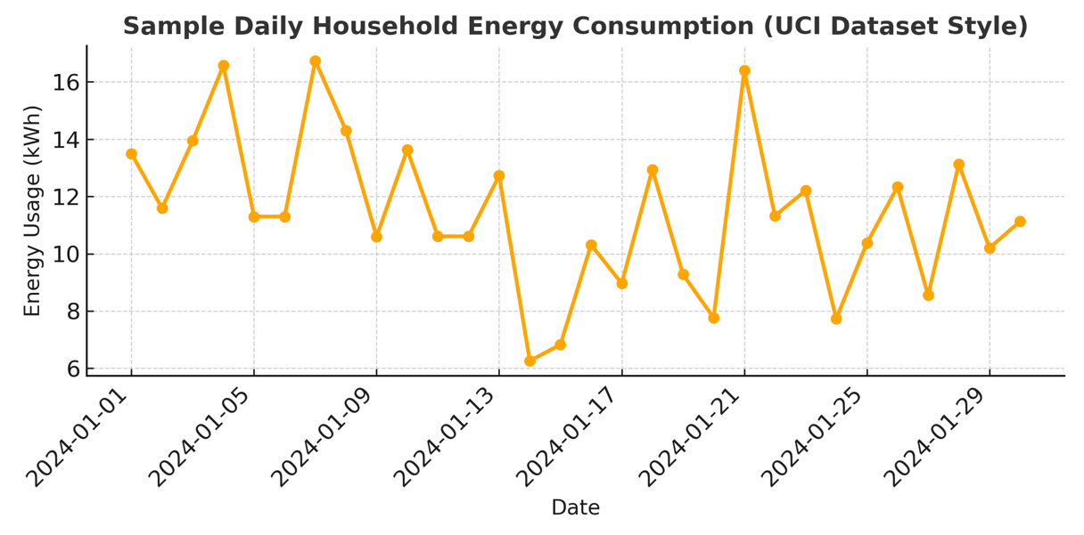
Real Data Example: UCI Household Power Consumption

Slide 5
Problem Statement
Inefficient energy consumption in residential settings, often due to a lack of real-time oversight, results in substantial energy waste and elevated financial burdens on households.
Implementing a predictive system to forecast daily consumption based on user activity is essential for empowering homeowners to optimize their energy usage and reduce costs.

Slide 6
Proposed Solution
1. Data Acquisition: Collect granular energy consumption data from smart meters and individual appliances.
2. Data Preprocessing: Cleanse the dataset by addressing missing values and outliers, followed by normalization to scale features for model compatibility.
3. Feature Engineering: Enrich the dataset by integrating external variables such as meteorological data, temporal features (e.g., time of day, day of week), and user activity patterns.

Slide 7
4. Predictive Modeling: Train and evaluate machine learning models, such as Random Forest and Long Short-Term Memory (LSTM) networks, to capture consumption patterns and dependencies.
5. Forecasting and Optimization: Generate daily energy usage predictions and provide actionable recommendations to improve energy efficiency and reduce costs.
6. Deployment and Monitoring: Deploy the finalized model into a live environment and continuously monitor its performance, retraining as necessary to adapt to new data and consumption patterns.

Slide 8
Literature Review
Studies show that ensemble models like Random Forest (85% accuracy) consistently outperform simpler baselines such as Linear Regression in energy prediction tasks (Raza et al., 2019).
The application of Deep Learning architectures, particularly Long Short-Term Memory (LSTM) networks, further boosts performance, achieving accuracies between 90-93% by effectively modeling time-series data (Mocanu et al., 2016).

Slide 9
Current state-of-the-art approaches utilizing hybrid ensemble models are pushing the accuracy benchmark even higher, with recent studies reporting success rates of up to 95% (2024 Studies).
The accuracy of any predictive model is significantly enhanced by incorporating a rich feature set, with weather conditions, real-time appliance activity, and occupancy patterns being crucial inputs

Slide 10
Energy Consumption Prediction by Using Machine Learning for Smart Building: Case Study in Malaysia
Machine learning models can accurately predict electricity consumption in real smart building scenarios using historical data.
Energy usage patterns differ significantly between individual tenants, even within the same commercial building.
No single machine learning algorithm consistently outperforms others; model effectiveness depends on tenant behavior and load characteristics.
Proper data preprocessing (cleaning and normalization) plays a crucial role in improving prediction performance.

Slide 11
Cloud-based tools such as Microsoft Azure Machine Learning Studio are suitable for implementing scalable energy prediction systems
Evaluation metrics like RMSE, NRMSE, and MAPE provide reliable measures for assessing prediction accuracy.
Accurate energy forecasting supports energy efficiency and informed decision-making in smart building management.

Slide 12
Non-Intrusive Load Monitoring (NILM) (Parson et al., IEEE, 2012)
NILM enables appliance-level energy analysis using a single smart meter
(no sensors required on each device)
Uses machine learning and signal patterns to identify individual
appliances from total power consumption
Key finding: A few high-power appliances (AC, heater)
contribute most of the energy usage
Provides actionable insights (where energy is used),
unlike traditional models that only predict total consumption
Limitation: Difficulty in distinguishing similar appliances and requires
high-quality data

Slide 13
References
1. Raza M.Q. & Khosravi A. (2019). AI-based Load Forecasting, Energy Reports.
2. Mocanu E. et al. (2016). Deep Learning for Household Prediction, IEEE.
3. UCI Household Power Consumption Dataset.
4. Prayas Energy Group – Indian household data.
5. ScienceDirect – Hybrid Models for Energy Prediction (2024).

Slide 14
Thank You
Questions?

