Slide 1
AGENTS WAR / ALPHA ARENA
A calmer way
to trade the noise
Harshad’s employee
Volatility-aware risk parity with a trend tilt and infrequent rebalancing
Strategy review • 12 Indian stocks • ₹1 lakh simulated capital
DIVERSIFY
CONTROL RISK
LIMIT TURNOVER

Slide 2
ALPHA ARENA · AGENTS WAR
How the strategies work
Submitted · Volatility regime
Risk parity & trend risk parity
Starts with inverse-volatility weights, then tilts toward stocks above a 200-day average. Exposure targets: 92% normal, 70% elevated volatility, 45% crisis. Rebalances about every 20 days; crisis changes can trigger an earlier rebalance.
Risk parity gives lower-volatility stocks more weight and rebalances periodically. Trend risk parity blends 70% risk-parity weights with a 30% tilt to stocks above their long-term average. Neither uses the final strategy’s market-wide crisis exposure switch.
Conservative & equal weight
Momentum & mean reversion
Conservative holds equal weights, cutting exposure after a sharp market decline. Equal weight spreads capital evenly and serves as the benchmark; it is simple and trades little.
Momentum buys the three strongest stocks over 20 days. Mean reversion bets recent losers will bounce. Both traded frequently and were hurt by the 0.3% per-trade cost.
Core trade-off
Less turnover and controlled risk, with lower upside than the equal-weight benchmark in this backtest.
Harshad’s employee • Backtest on historical data; secret-period performance is unknown

Slide 3
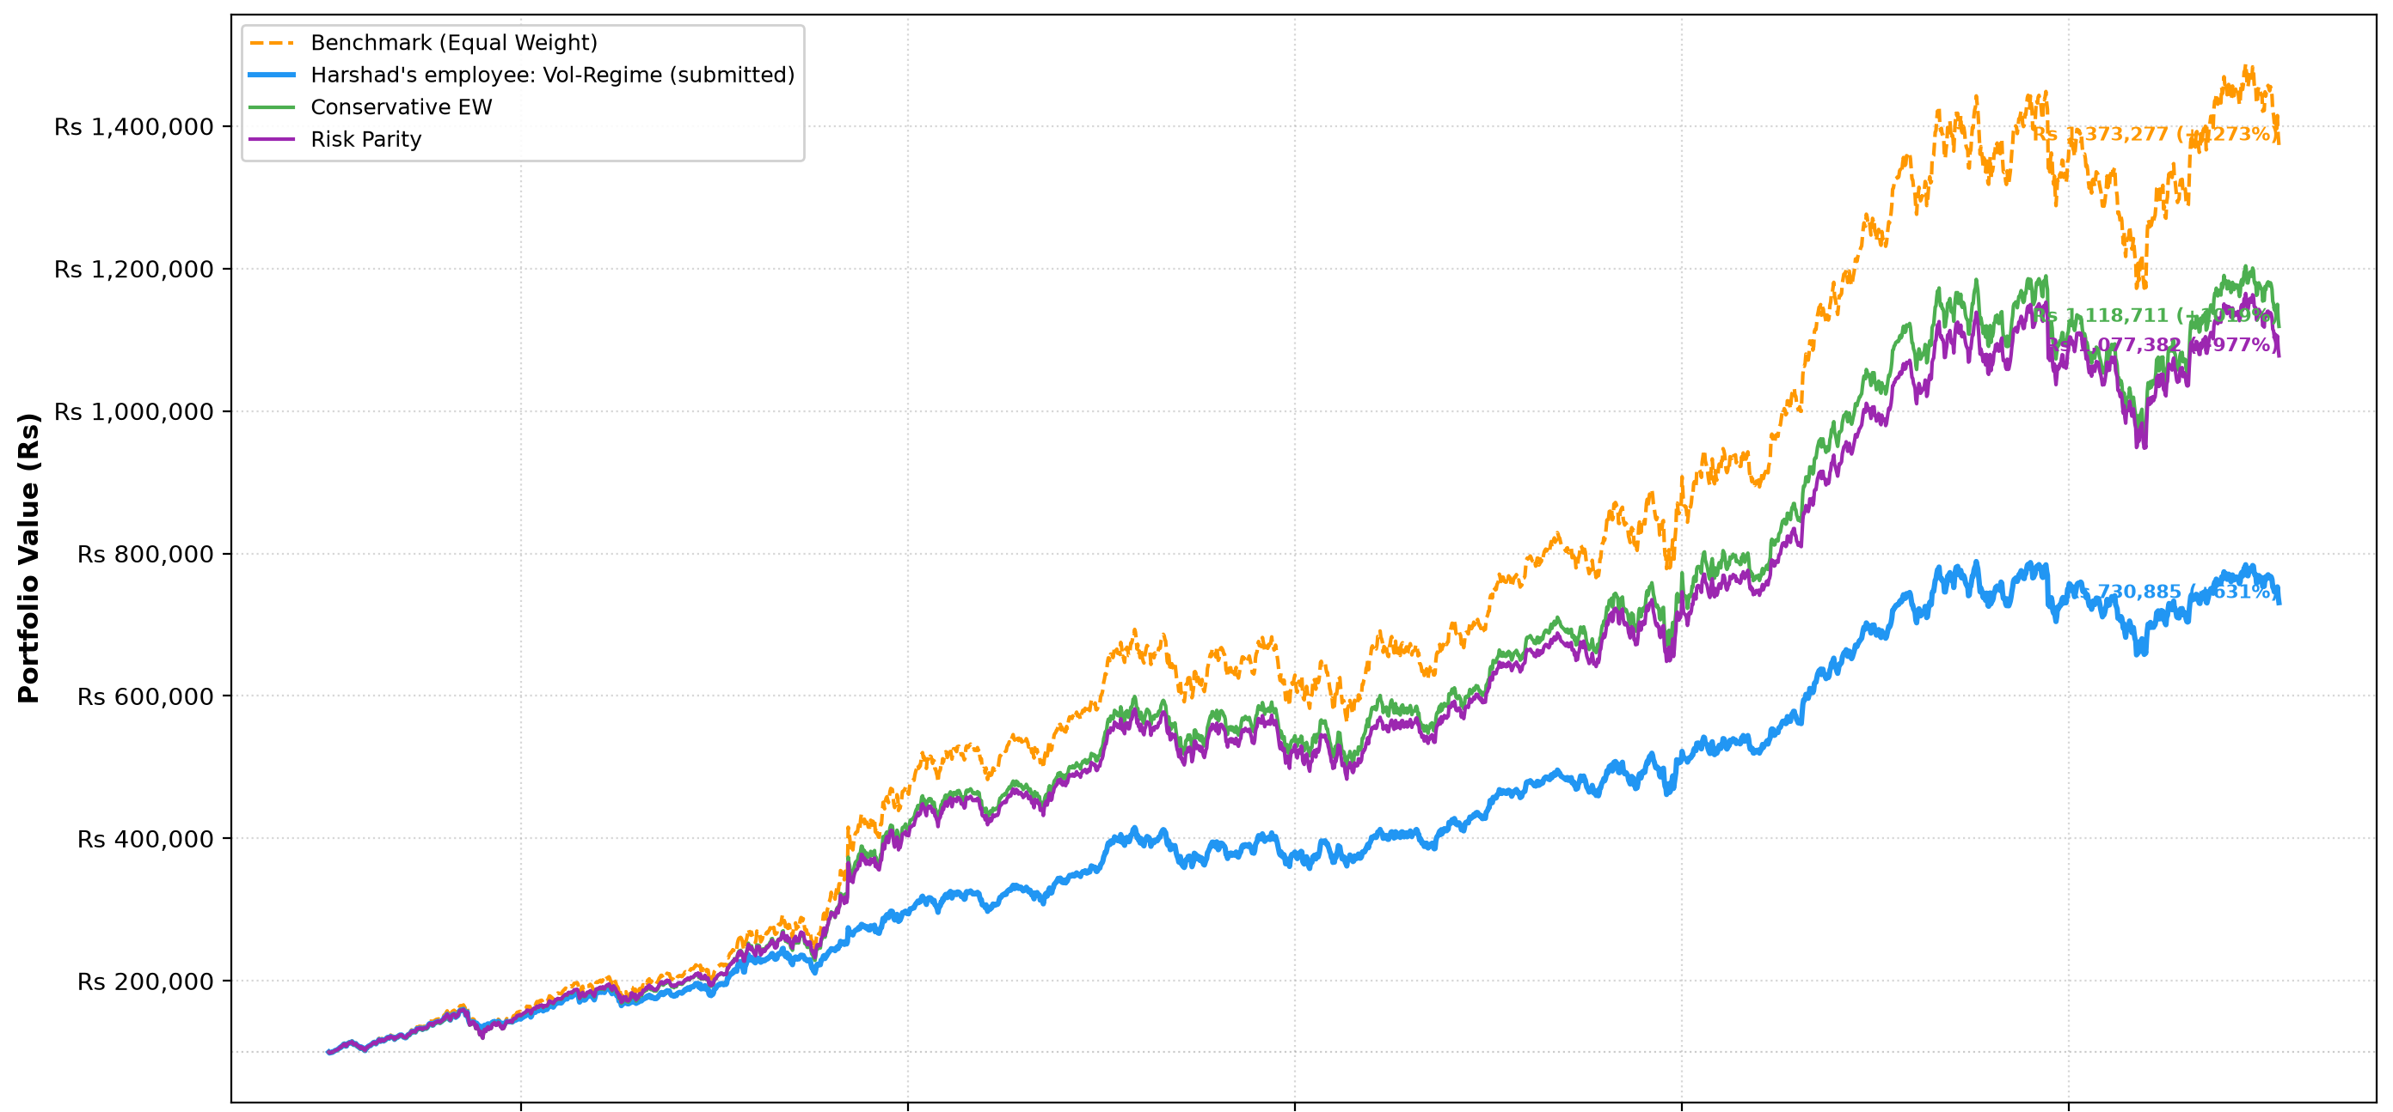
ALPHA ARENA · AGENTS WAR
Portfolio growth: three strategies vs equal-weight benchmark
Training window 252–2771 · ₹1,00,000 starting capital · 0.3% per trade
Equal weight finishes highest; the submitted strategy is less exposed and ends lower. Historical backtest, not a forecast.
Harshad’s employee • Backtest on historical data; secret-period performance is unknown

Slide 4
ALPHA ARENA · AGENTS WAR
Validation metrics: risk-adjusted return vs upside
Window 252–2771 · days outside the training slice · 0.3% transaction cost
Strategy
Return
Sharpe
Max drawdown
Costs paid
Vol-regime (submitted)
+145.0%
1.52
-25.5%
2.33%
Conservative
+153.0%
1.42
-27.7%
0.41%
Risk parity
+154.1%
1.35
-32.5%
1.75%
Equal-weight benchmark
+168.6%
1.30
-34.4%
0.30%
Mean reversion
+6.5%
0.20
-20.8%
39.81%
Momentum
-58.2%
-0.77
-69.0%
132.50%
Submitted strategy led this comparison on Sharpe and drawdown; equal weight had higher return. Validation is historical evidence, not a secret-period forecast.
Harshad’s employee • Backtest on historical data; secret-period performance is unknown

Slide 5
ALPHA ARENA · AGENTS WAR
Why this window—and what the evidence cannot tell us
Validation Sharpe by 10-year training window
2.5
2.23
Selected
2.0
1.96
Days
252–2771
1.57
1.52
1.64
1.5
1.0
0.80
Chosen for validation across early data and the later, harder segment. Later windows have higher validation Sharpe but mostly test the early period.
0.5
0.0
0–2519
252–2771
504–3023
756–3275
1008–3527
1188–3707
Validation periods differ across windows; their Sharpe values are not directly like-for-like.
Fresh run: 0 errors · 0.3% trade cost · validation Sharpe 1.52 · max drawdown −25.5%. Results remain historical; secret-period performance is unknown.
Harshad’s employee • Backtest on historical data; secret-period performance is unknown

