Slide 1
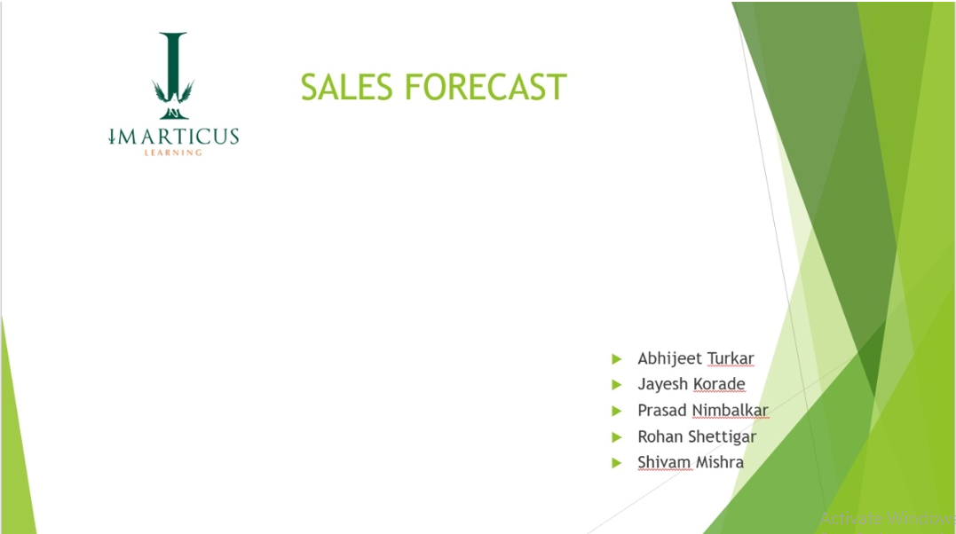

Slide 2
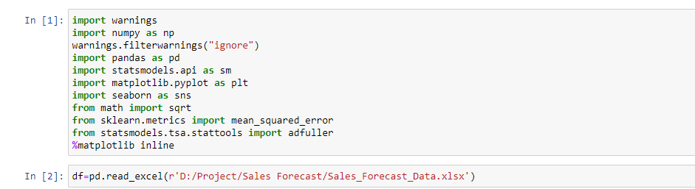
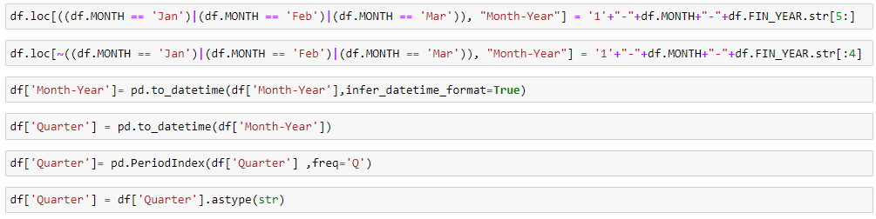

Slide 3
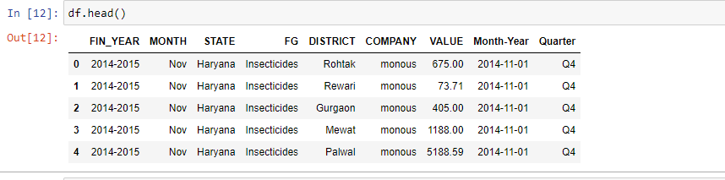

Slide 4
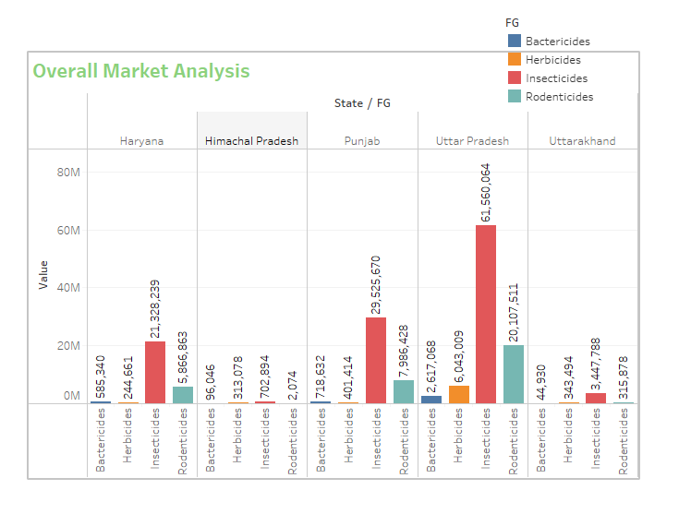
EDA
As per above graph that is overall market analysis following are the observations
1. Out of four Pesticide present in data Insecticides is the higher sold product across all states.
2. Out of five States Uttar Pradesh is highest sealing state.

Slide 5
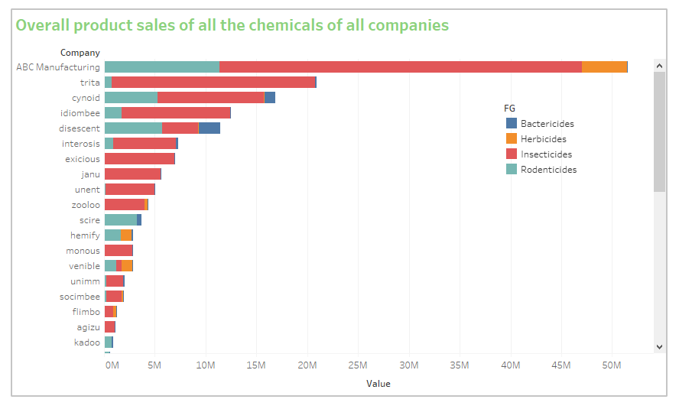
Overall product sales of all the chemicals of all companies
From above graph ABC Manufacturing is the highest selling company.

Slide 6
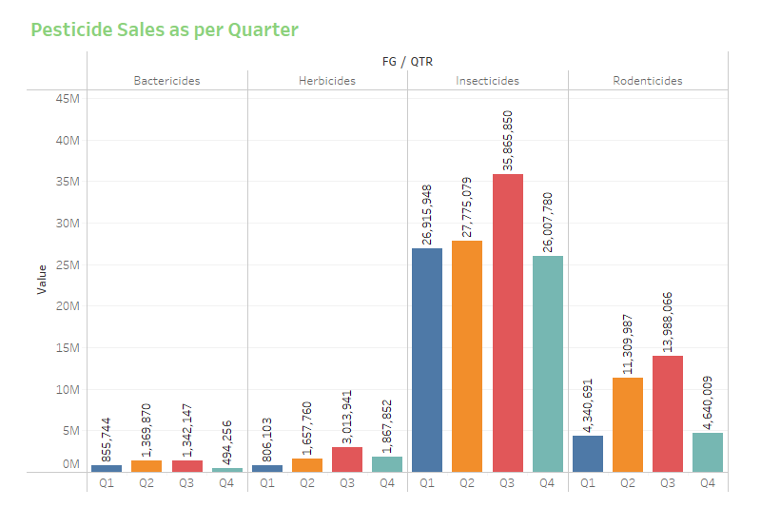
Market Analysis
Most sold chemicals in different quarters?
As per above graph that is Quarterly following are the observations
Out of four quarter Q3 is highest sold Quarter.
Out of four products Insecticides is most sale product.

Slide 7
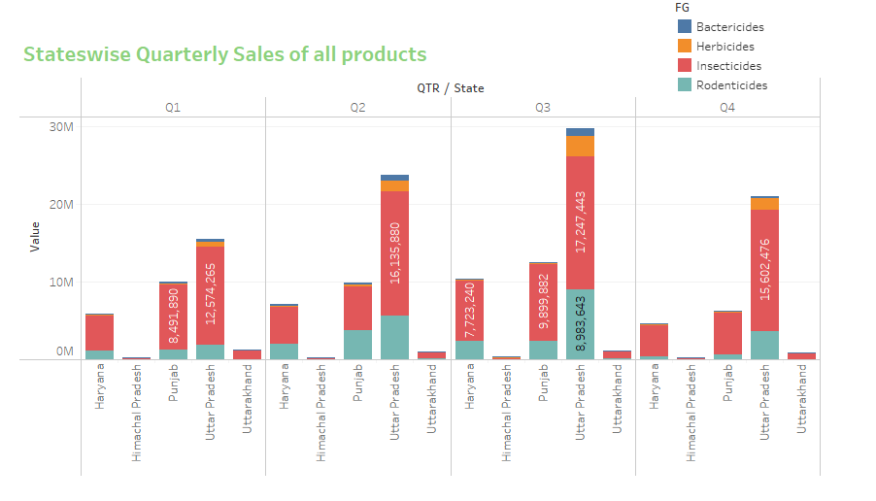
State level chemical sale in different quarters?
As per above graph that is States wise quarterly sales of all products following are the observations
Among all states Utter Pradesh is highest selling states in all quarter.
Among all Pesticide Insecticides is highest selling product in all states and all quarter.

Slide 8
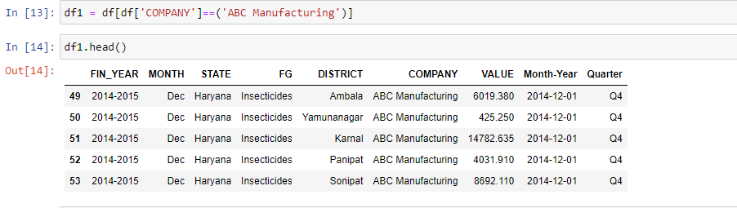

Slide 9
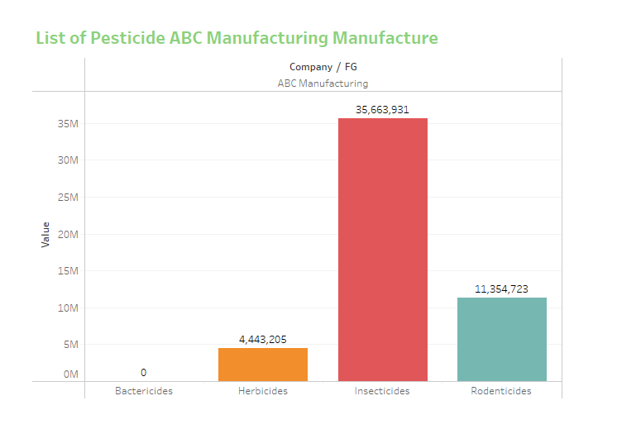
Data Analysis
Which all chemicals does Abc Manufacture sale?
ABC Manufacturing not selling Bactericides.
Insecticides is highest selling product of ABC Manufacturing.

Slide 10
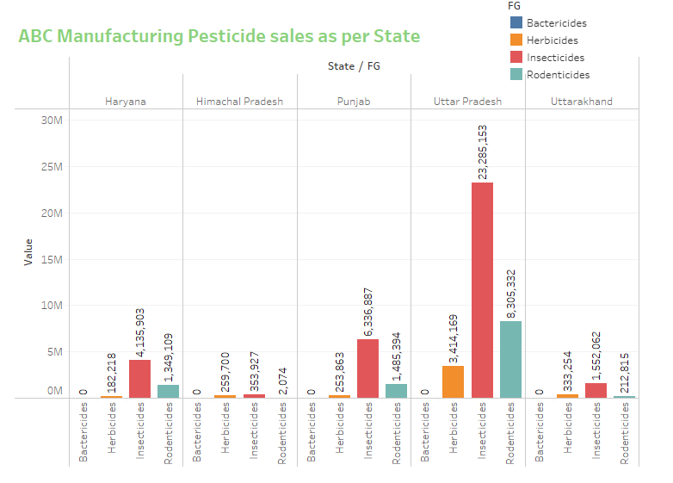
Which all states ABC manufacturing dominates and for which chemicals
As per above graph that is ABC Manufacturing Pesticide sales as per States following are the observations:-
For ABC Manufacturing Uttar Pradesh is highest selling states.
Insecticides is the highest selling product among all products.
For ABC Manufacturing Himachal Pradesh is lowest selling states.

Slide 11
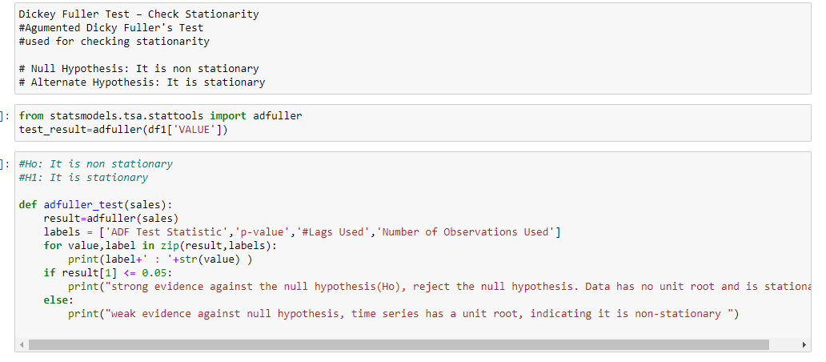
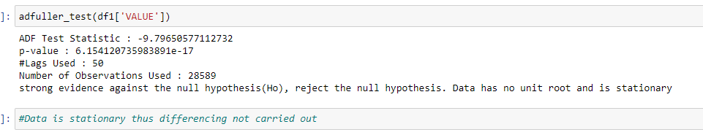

Slide 12
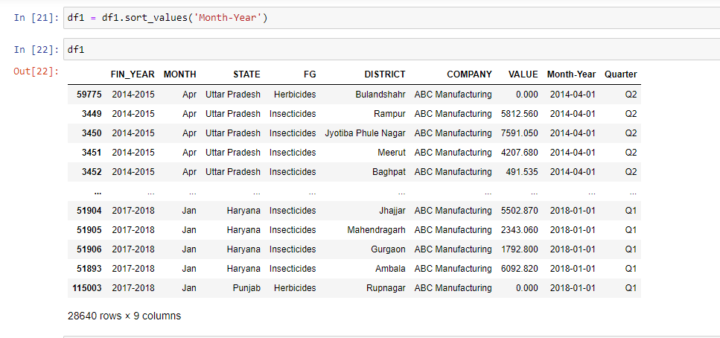
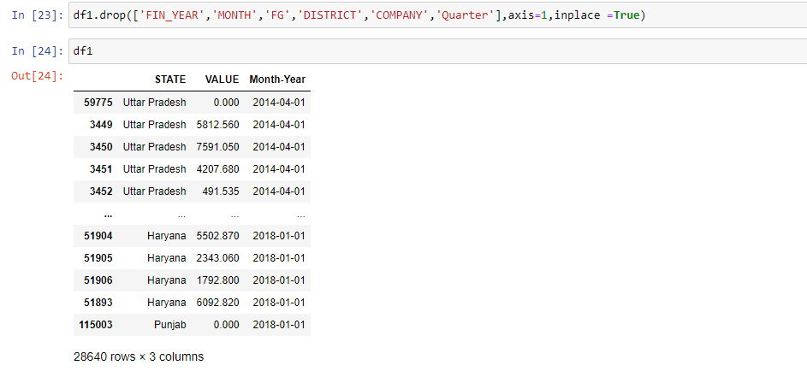

Slide 13
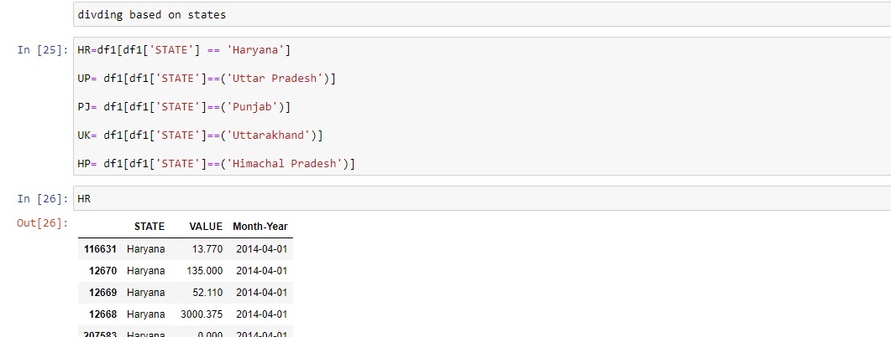
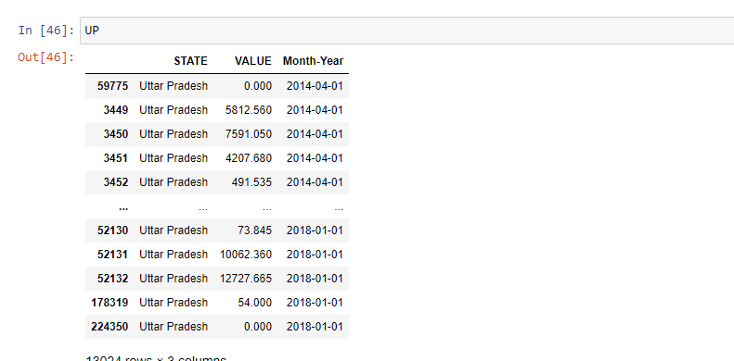

Slide 14
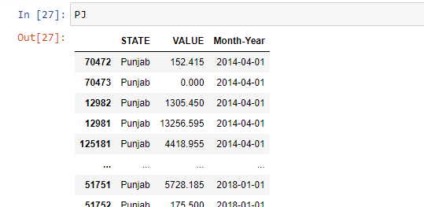
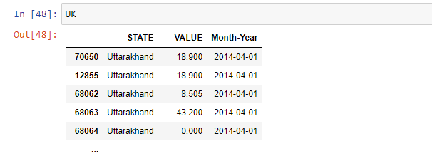
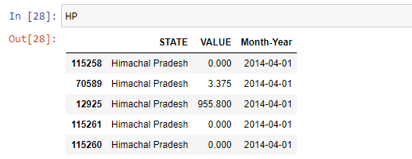

Slide 15
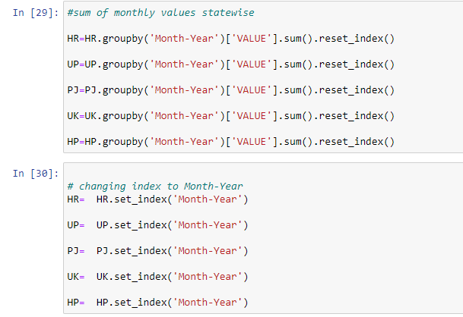
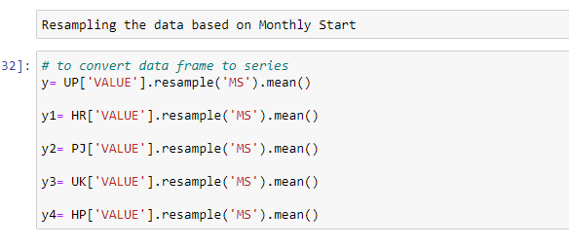

Slide 16
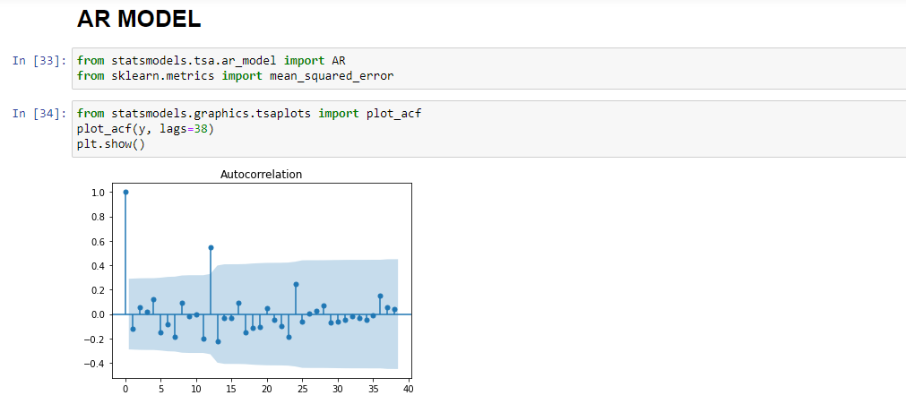

Slide 17
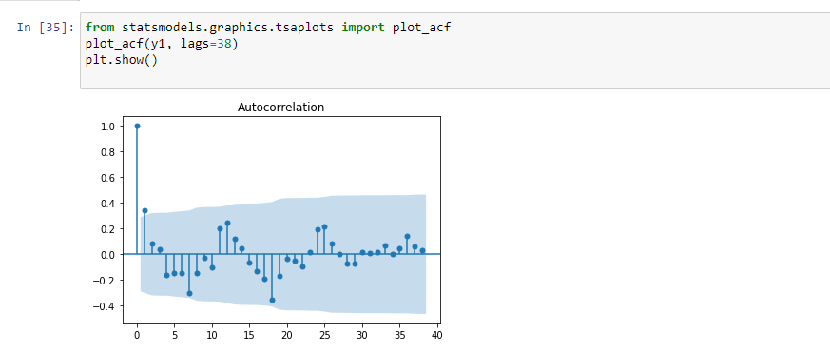
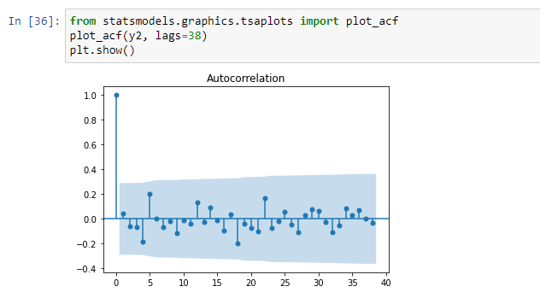
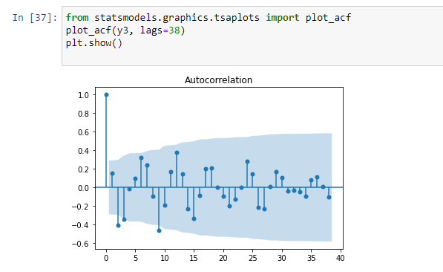
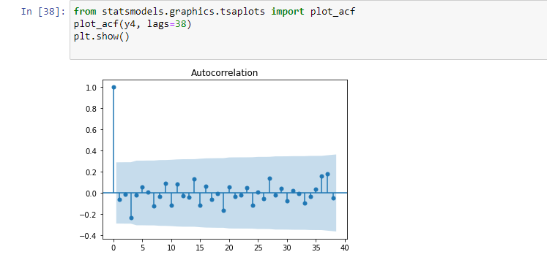

Slide 18
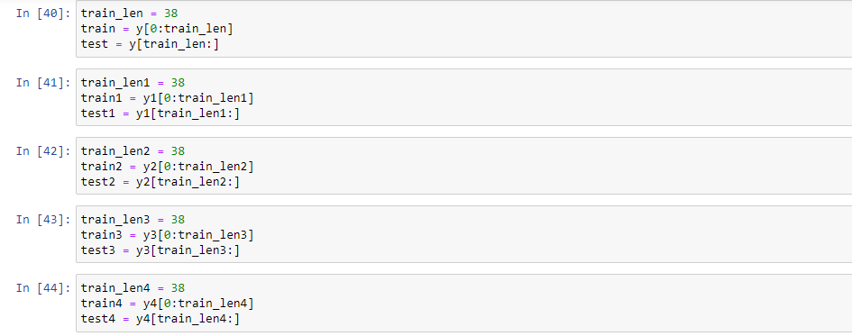
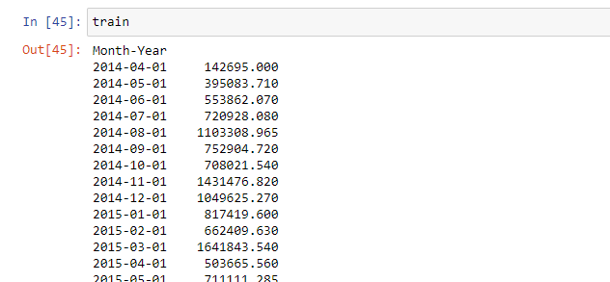
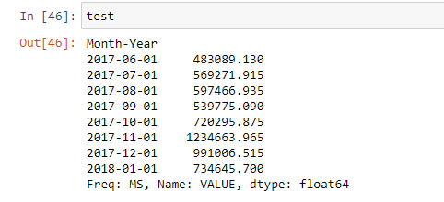

Slide 19

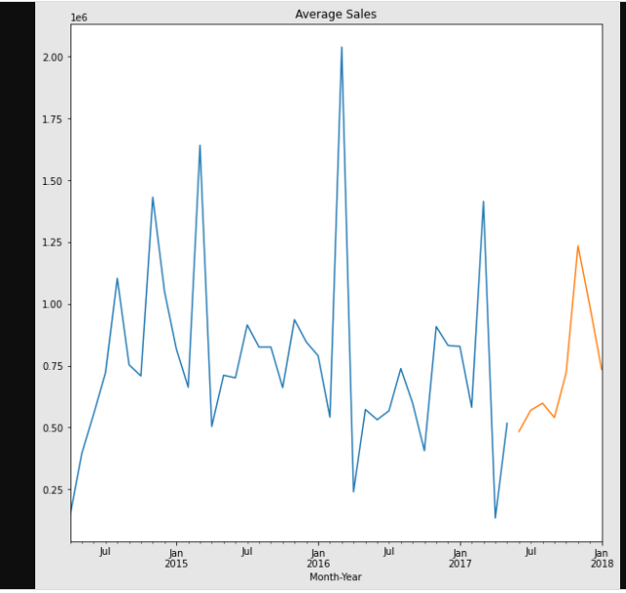

Slide 20

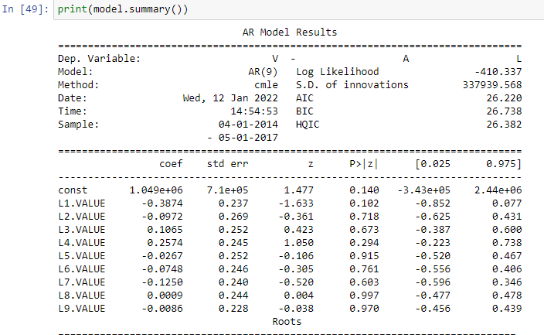
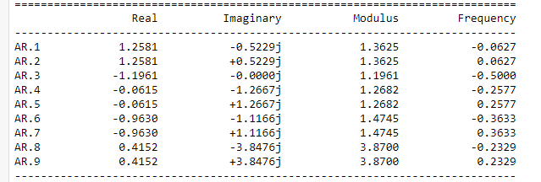

Slide 21
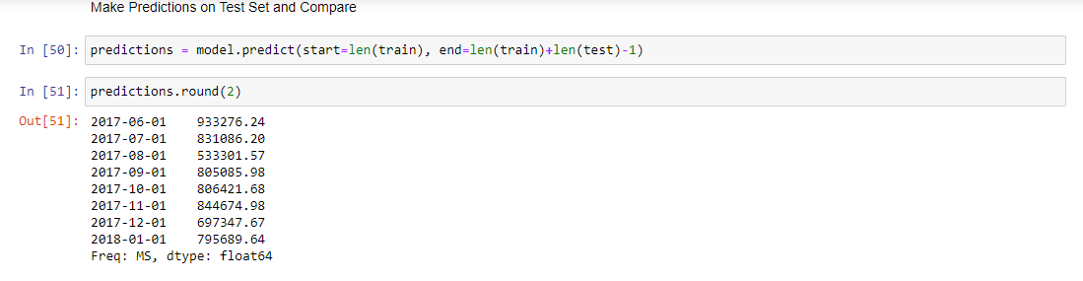
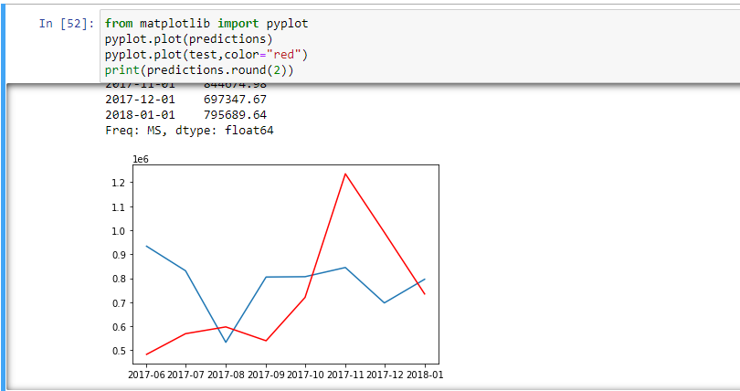

Slide 22
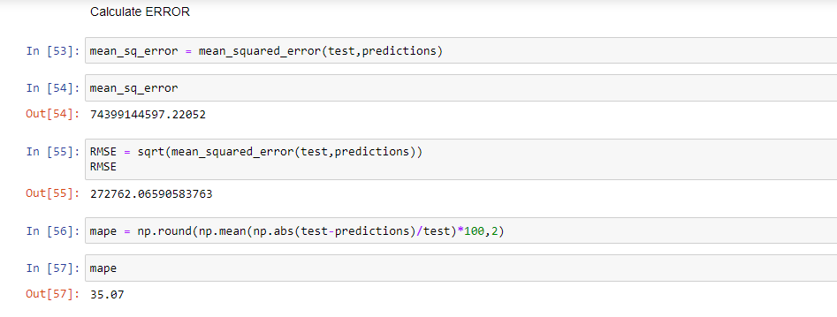

Slide 23
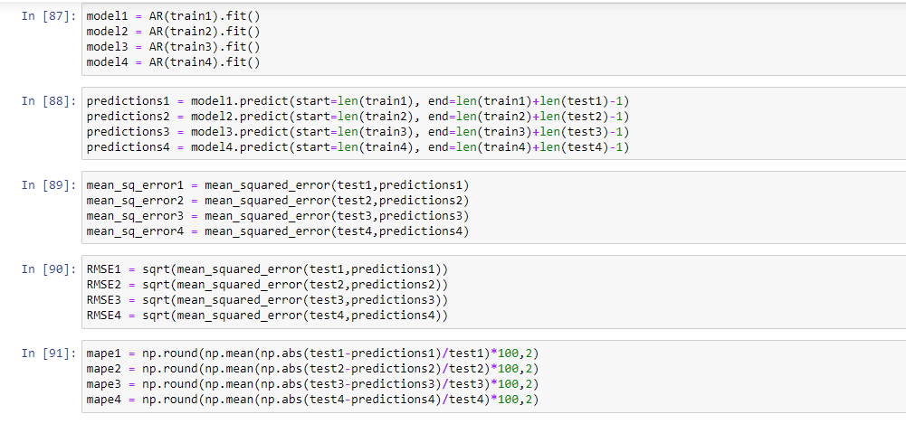

Slide 24
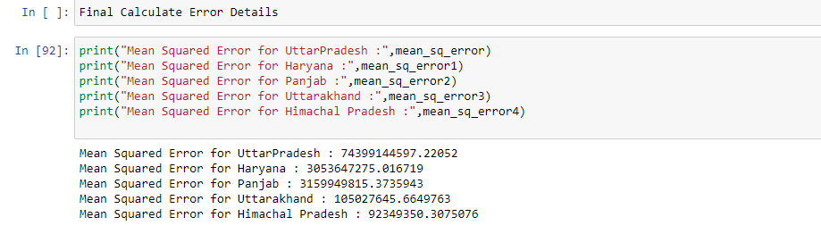
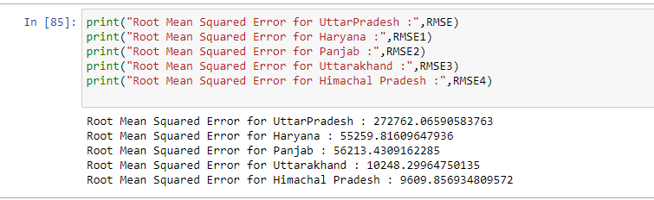
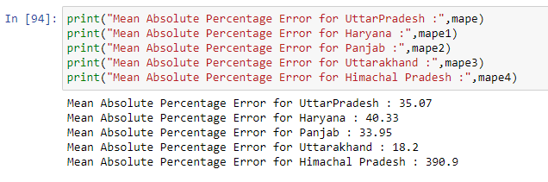

Slide 25
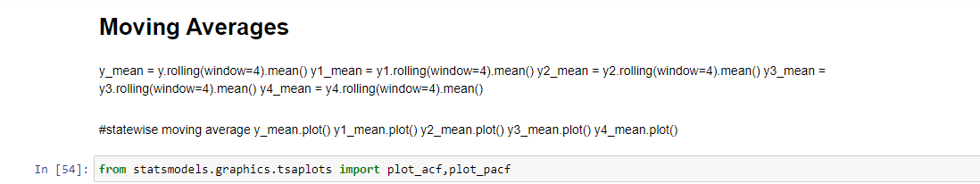
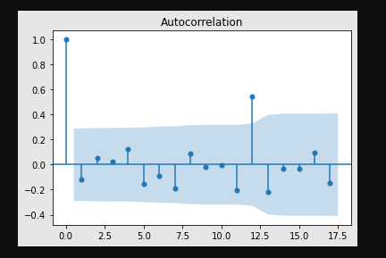
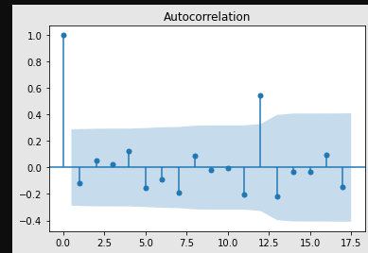

Slide 26
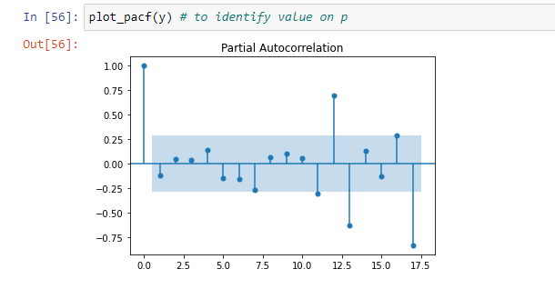
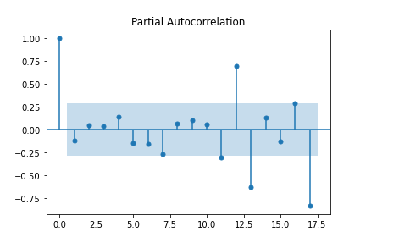

Slide 27
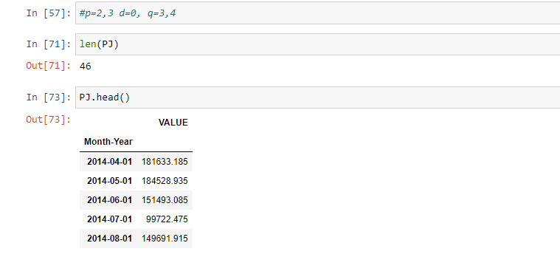
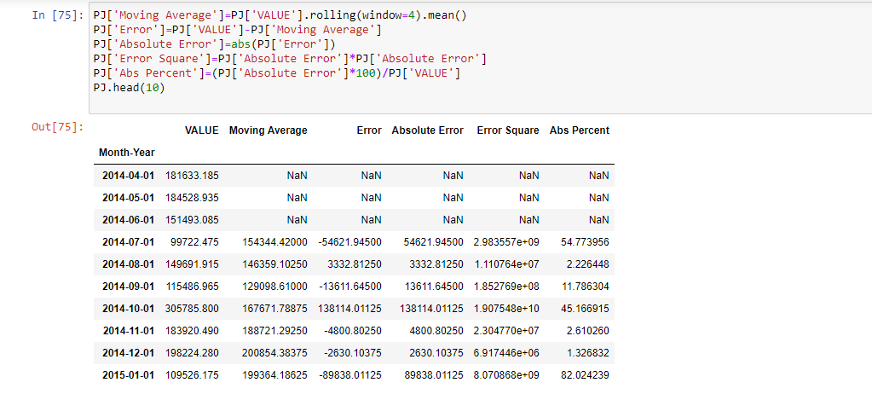

Slide 28
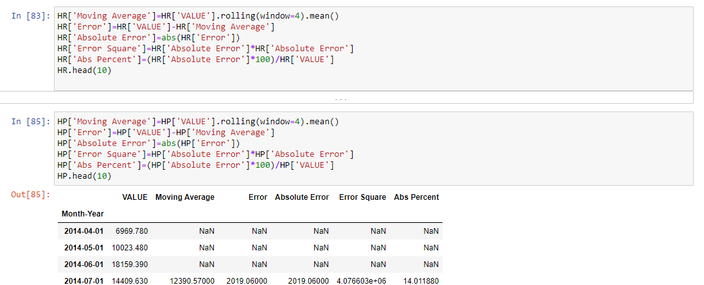

Slide 29
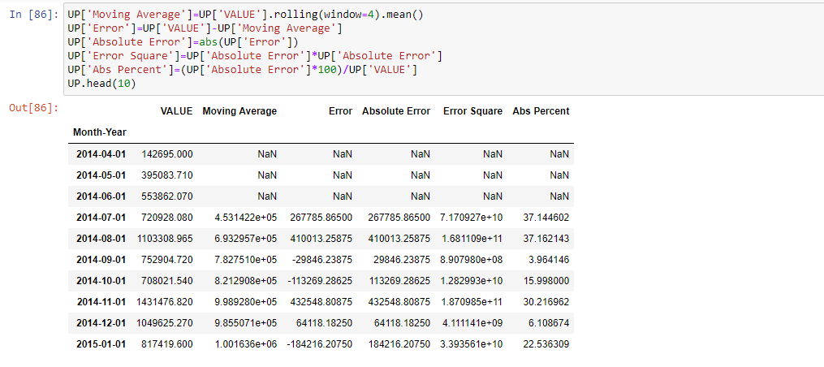

Slide 30
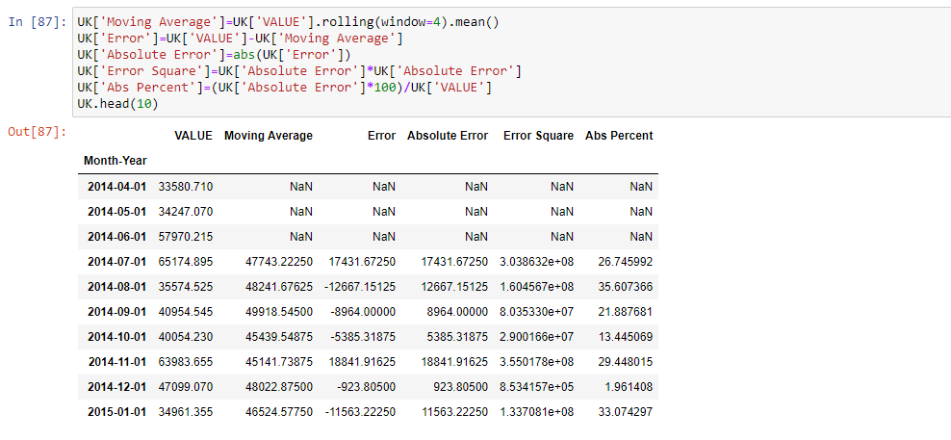

Slide 31



Slide 32



Slide 33


Slide 34



Slide 35



Slide 36



Slide 37



Slide 38



Slide 39



Slide 40


Slide 41



Slide 42


Slide 43



Slide 44


Slide 45



Slide 46


Slide 47



Slide 48


Slide 49



Slide 50


Slide 51



