Slide 1

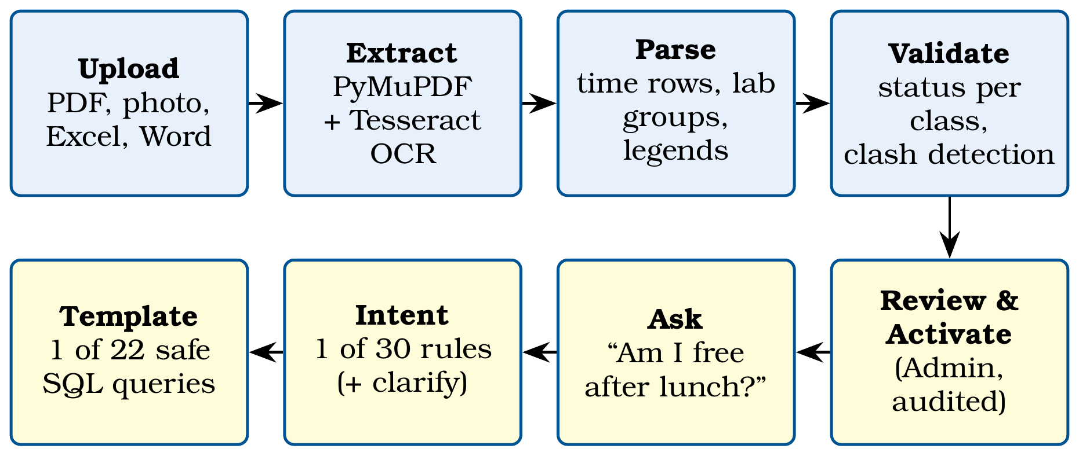
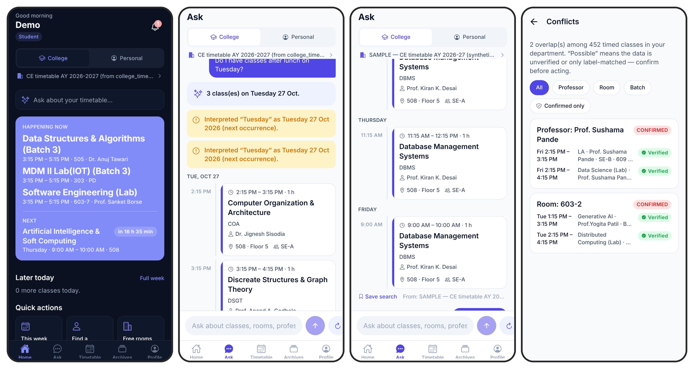
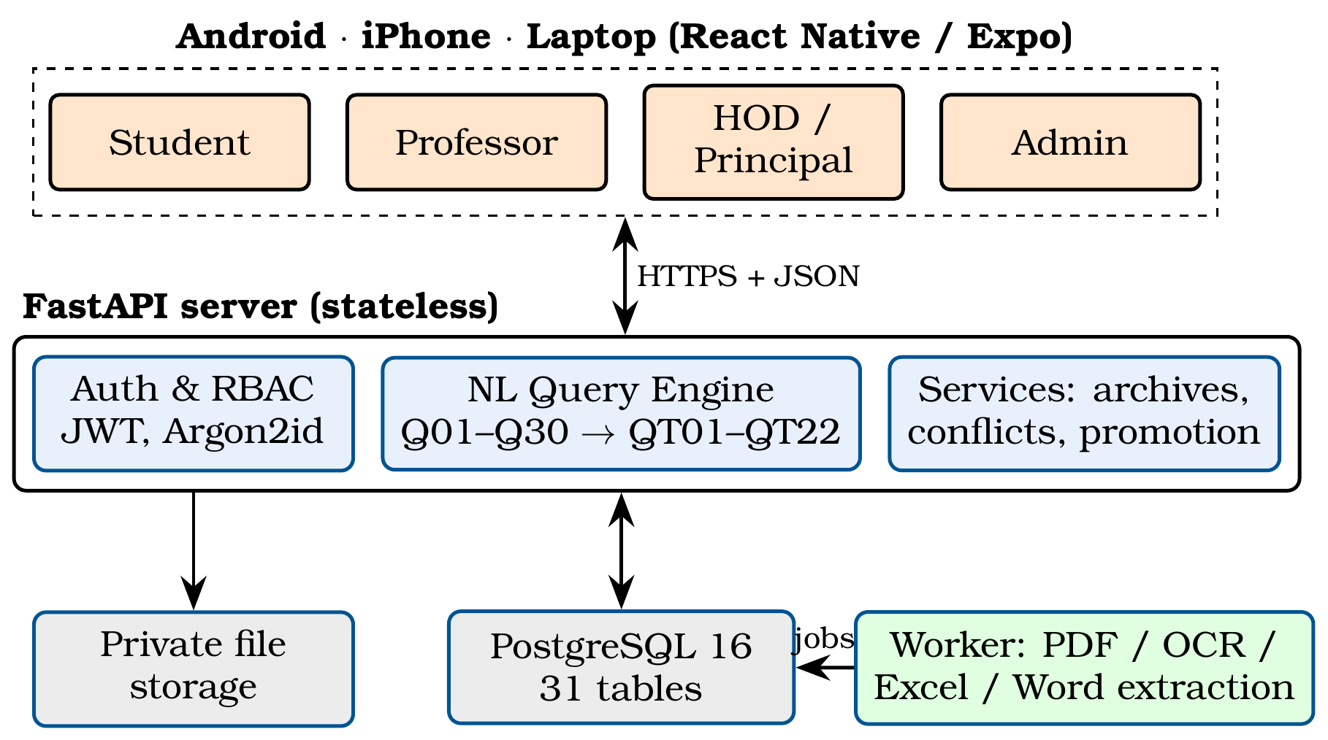
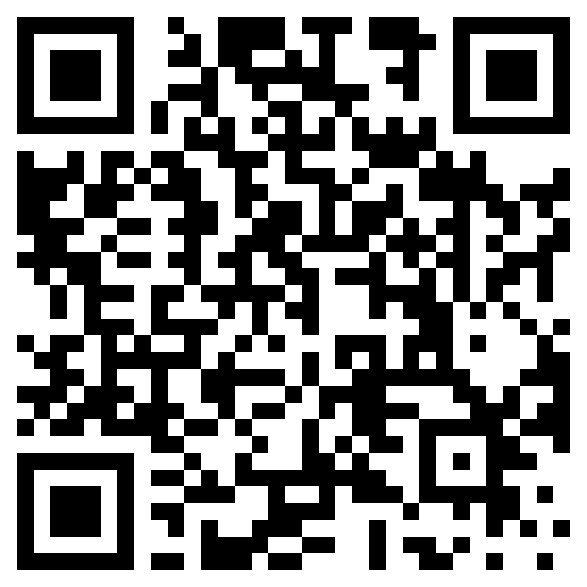
Sardar Patel Institute of Technology
Department of Computer Engineering
Academic Year 2026-27
Dynamic Timetable: A Role-Based Timetable Monitoring System with Automated Extraction and Natural-Language Queries
Shivam Mulani, Member 2 Name, Member 3 Name, Member 4 Name, B.Tech.(Comp.)
Project Guide: Prof. Guide Name | Group No. 86
Abstract
College timetables are published as dense multi-page PDFs that everyone reads by hand. We built Dynamic Timetable, a role-based mobile and web system that extracts the official timetable automatically (PDF, scans, Excel, Word), flags uncertain entries, detects clashes and answers plain-English questions through a safe rule-based engine. On the college's real 10-page timetable, 452 of 453 classes were verified automatically, exactly 2 genuine clashes were found, and a search takes about 40 ms.
Methodology/Algorithms
1. Upload: text with coordinates (PyMuPDF), or OCR (Tesseract) for scans and photos.
2. Time rows resolved by constrained backtracking; only a unique valid reading is accepted.
3. Cells split into lab groups, legend codes expanded; every class gets a status.
4. Clashes: group by teacher/room/batch, sort, sweep; overlap if s1 < e2 and s2 < e1.
5. Question → 1 of 30 intents → clarify if ambiguous → 1 of 22 safe queries.
Results
• Real PDF: 453 classes, 452 verified (99.8%); the remaining one has no time printed in the PDF
• Exactly 2 genuine clashes reported (a teacher on Friday, room 603-2 on Tuesday)
• Search 37-47 ms (median); 0 wrong answers with 32 concurrent users
• 10-page PDF extracted in 1.65 s; 159 + 18 automated tests and end-to-end tests pass
Conclusion
Dynamic Timetable turns the published PDF into a trustworthy, searchable app for every role. Showing uncertainty instead of guessing kept every automatic answer correct, and the clash report found real errors in the official timetable.
References
[1] R. Zanibbi et al., “A survey of table recognition,” IJDAR, 2004.
[2] R. Smith, “An overview of the Tesseract OCR engine,” ICDAR, 2007.
[3] I. Androutsopoulos et al., “Natural language interfaces to databases,” Nat. Lang. Eng., 1995.
Introduction
The department publishes its class timetable as a 10-page PDF: grids per division with stacked lab batches (A1-A4), teacher codes and page-wise legends. Everyone reads it by hand many times a day, and clashes are noticed only when they happen.
Objective(s)
• Read the real timetable automatically; flag every uncertain value
• Role-based views for Student, Professor, HOD, Principal, Admin
• Answer plain-English questions safely; detect clashes
• One app for Android, iPhone and laptop; free online demo
Problem Definition
Turn a human-formatted timetable (merged and stacked cells, missing a.m./p.m., legends, scans) into verified data, and give each user correct, role-scoped answers without guessing and without exposing personal data.
Contribution
• Timetable-aware parser (backtracking time-row resolver, lab groups, legends)
• Clash detector: 542 raw overlaps → 2 genuine clashes
• Question engine without generated SQL: 30 intents → 22 safe templates
Design
React Native app → stateless FastAPI server → PostgreSQL, plus a background extraction worker.
Scan: source code

