Slide 1















Quiz Application
Presented by Shivam Nath

Slide 2

Scope
The project involves developing a Django-powered quiz application with user authentication, quiz management, and result tracking features. Users can register, log in, and participate in quizzes, while administrators can create, manage, and analyze quiz content.

Slide 3
Introduction
01.
Topic Outline
Features
02.
Techonology
Used
03.

Slide 4
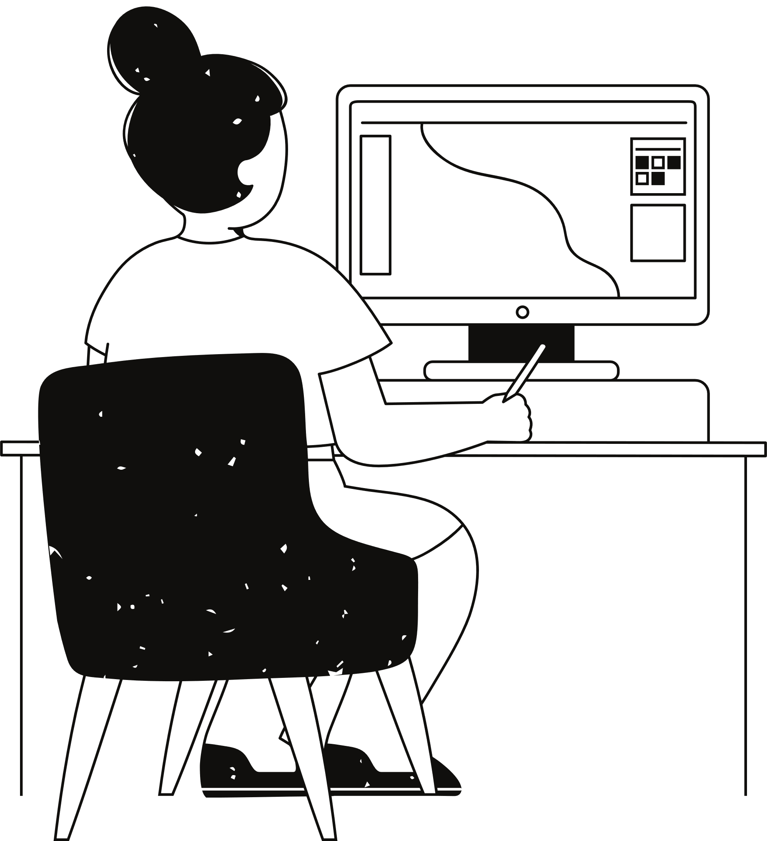
Introduction
Welcome to our Quiz Application, a centralized platform poised to transform the landscape of learning and assessment. With seamless connectivity for educators and learners, our application redefines the quiz experience, offering an intuitive interface and powerful features.
In today's fast-paced educational environment, quizzes are essential for gauging knowledge and tracking progress. Our Quiz Application provides a dynamic solution for educators, students, and lifelong learners, facilitating interactive learning experiences and empowering users to excel.

Slide 5

Features
User Authentication
Make Quiz
Course Addition
Take Quizzes
Responsive Design
Student Dashboard
Teacher Dashboard
Admin Panel

Slide 6
Functions
01
02
03
Admin:
Admin can view, approve, update teachers. Also can see marks. Add/delete courses and questions.
Teacher:
Teacher can apply for job in the system. Can Add/delete courses, exams and can also view questions.
Student:
Student can see courses and quizzes in their dashboard and can attempt multiple choice exam.

Slide 7

Technologies Used
HTML, CSS, Python, Django

Slide 8
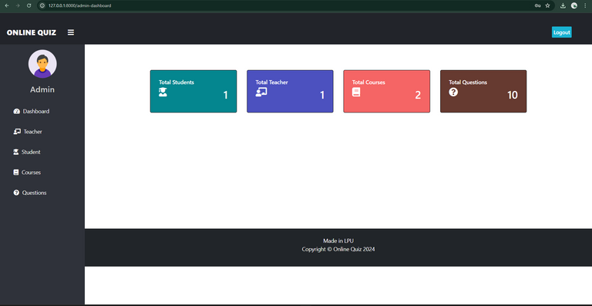
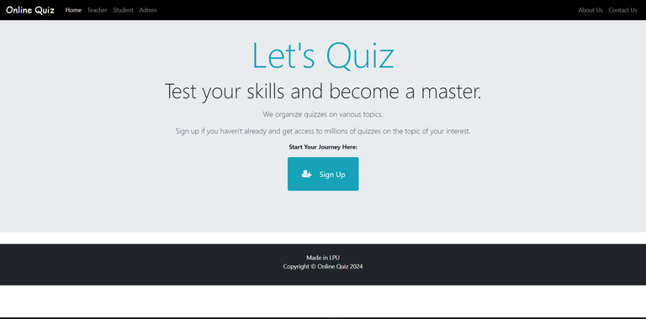
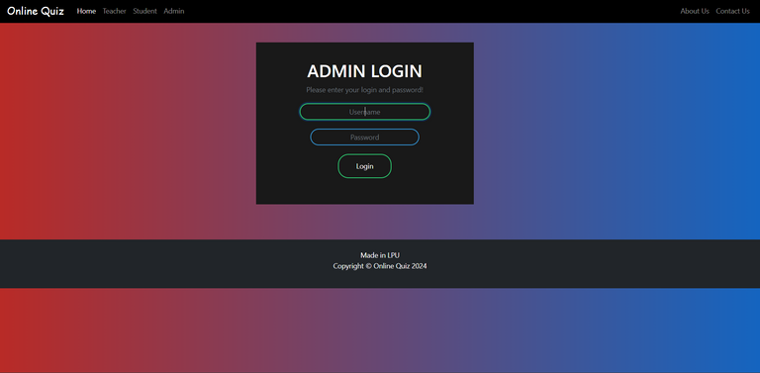
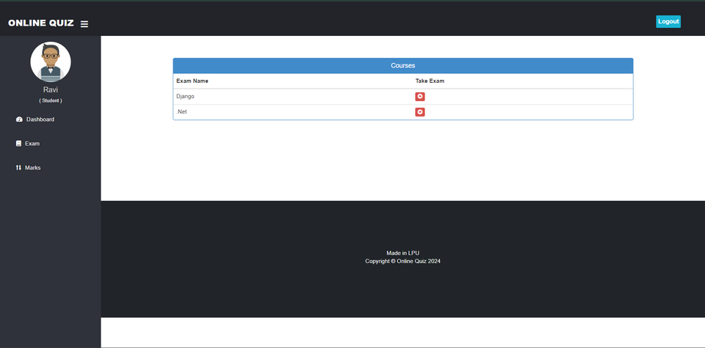
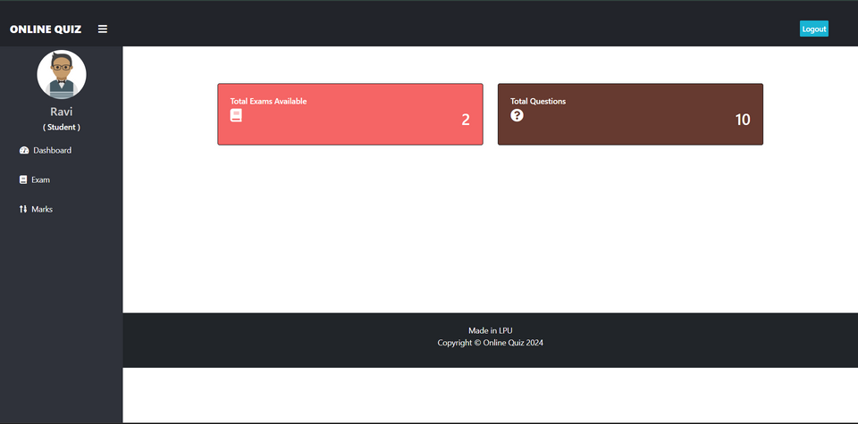
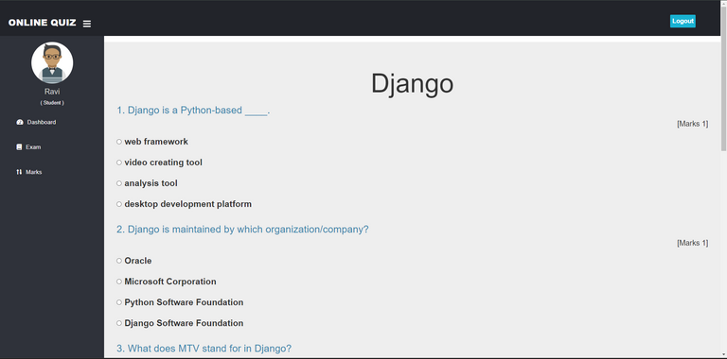
Output Screenshots

Slide 9
Thank you very much!
Have a Nice day!

