Slide 1
TruthLens
AI-Powered Fake News Detection System

Slide 2
The Challenge
📊 Misinformation spreads 6x faster than facts online
🎯 Manual fact-checking is slow and resource-intensive
⚠️ Bias and misleading claims are increasingly prevalent
🔓 Difficult to verify credibility at scale
💡 Need for intelligent, automated detection

Slide 3
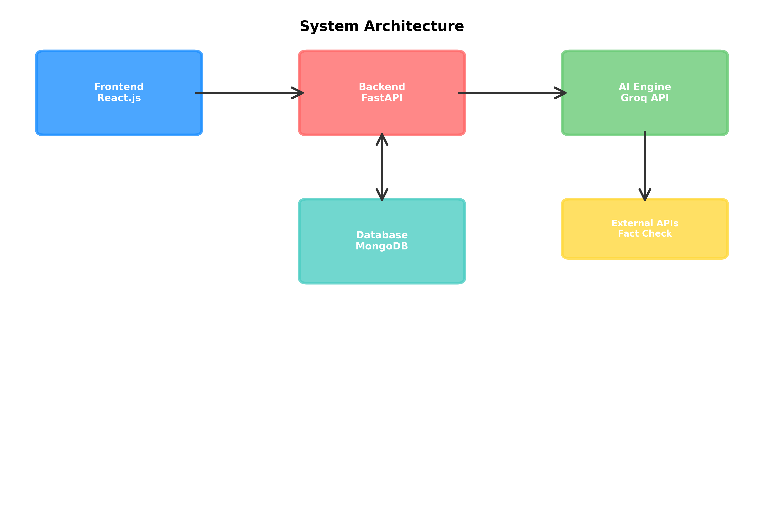
System Architecture

Slide 4
Our Solution
✅ AI-powered content analysis using Llama 3.3 model
✅ Multi-source input: Text content and URL articles
✅ Intelligent credibility scoring and bias detection
✅ Integration with Google Fact Check API
✅ Fast, scalable, and user-friendly interface

Slide 5
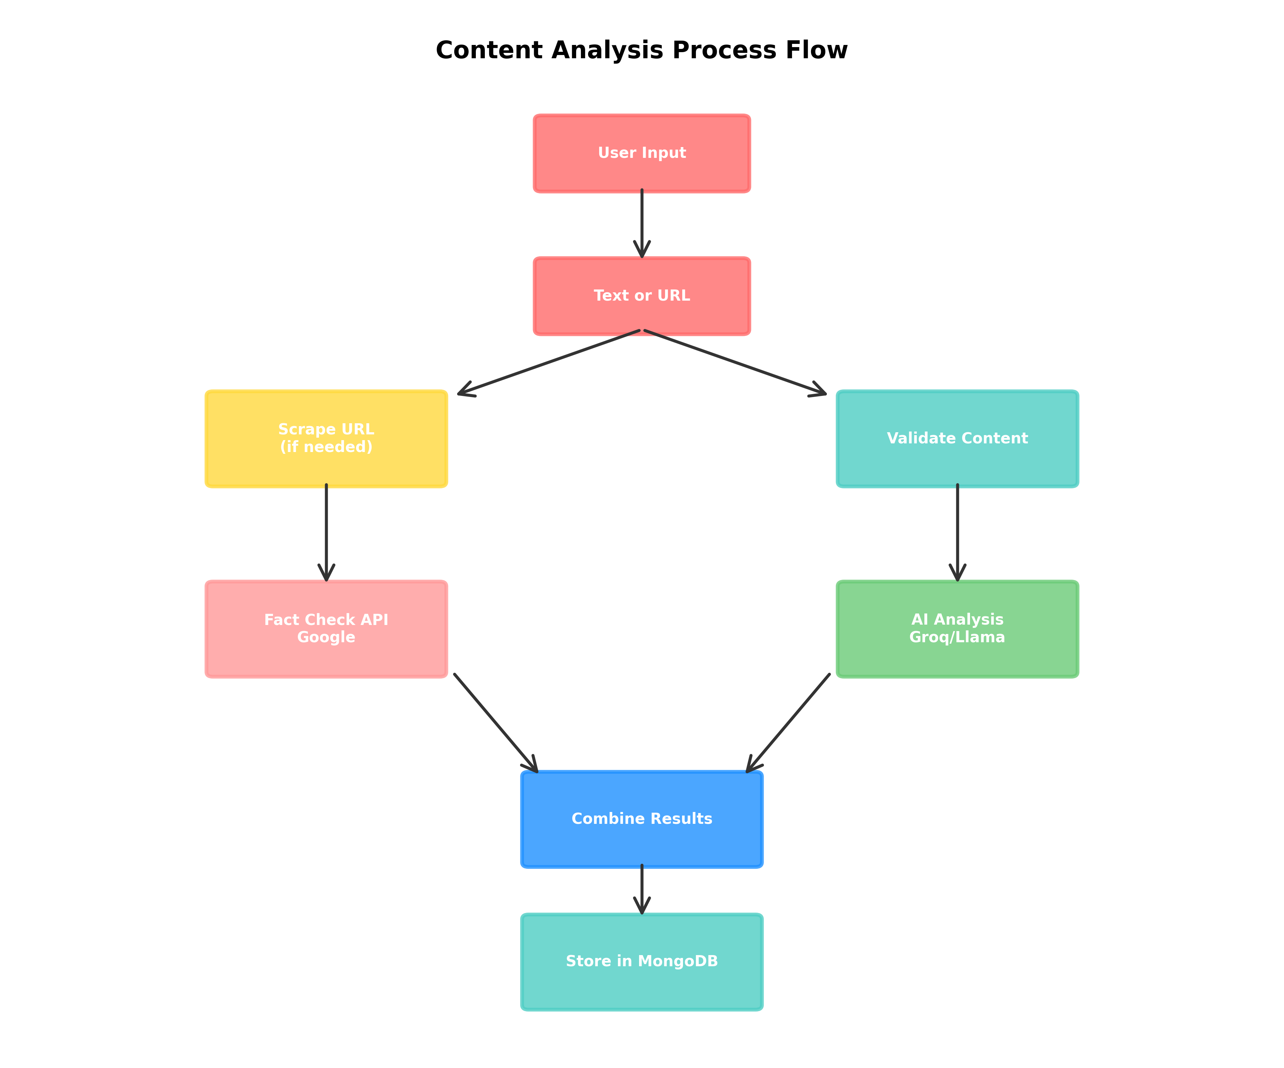
How It Works

Slide 6
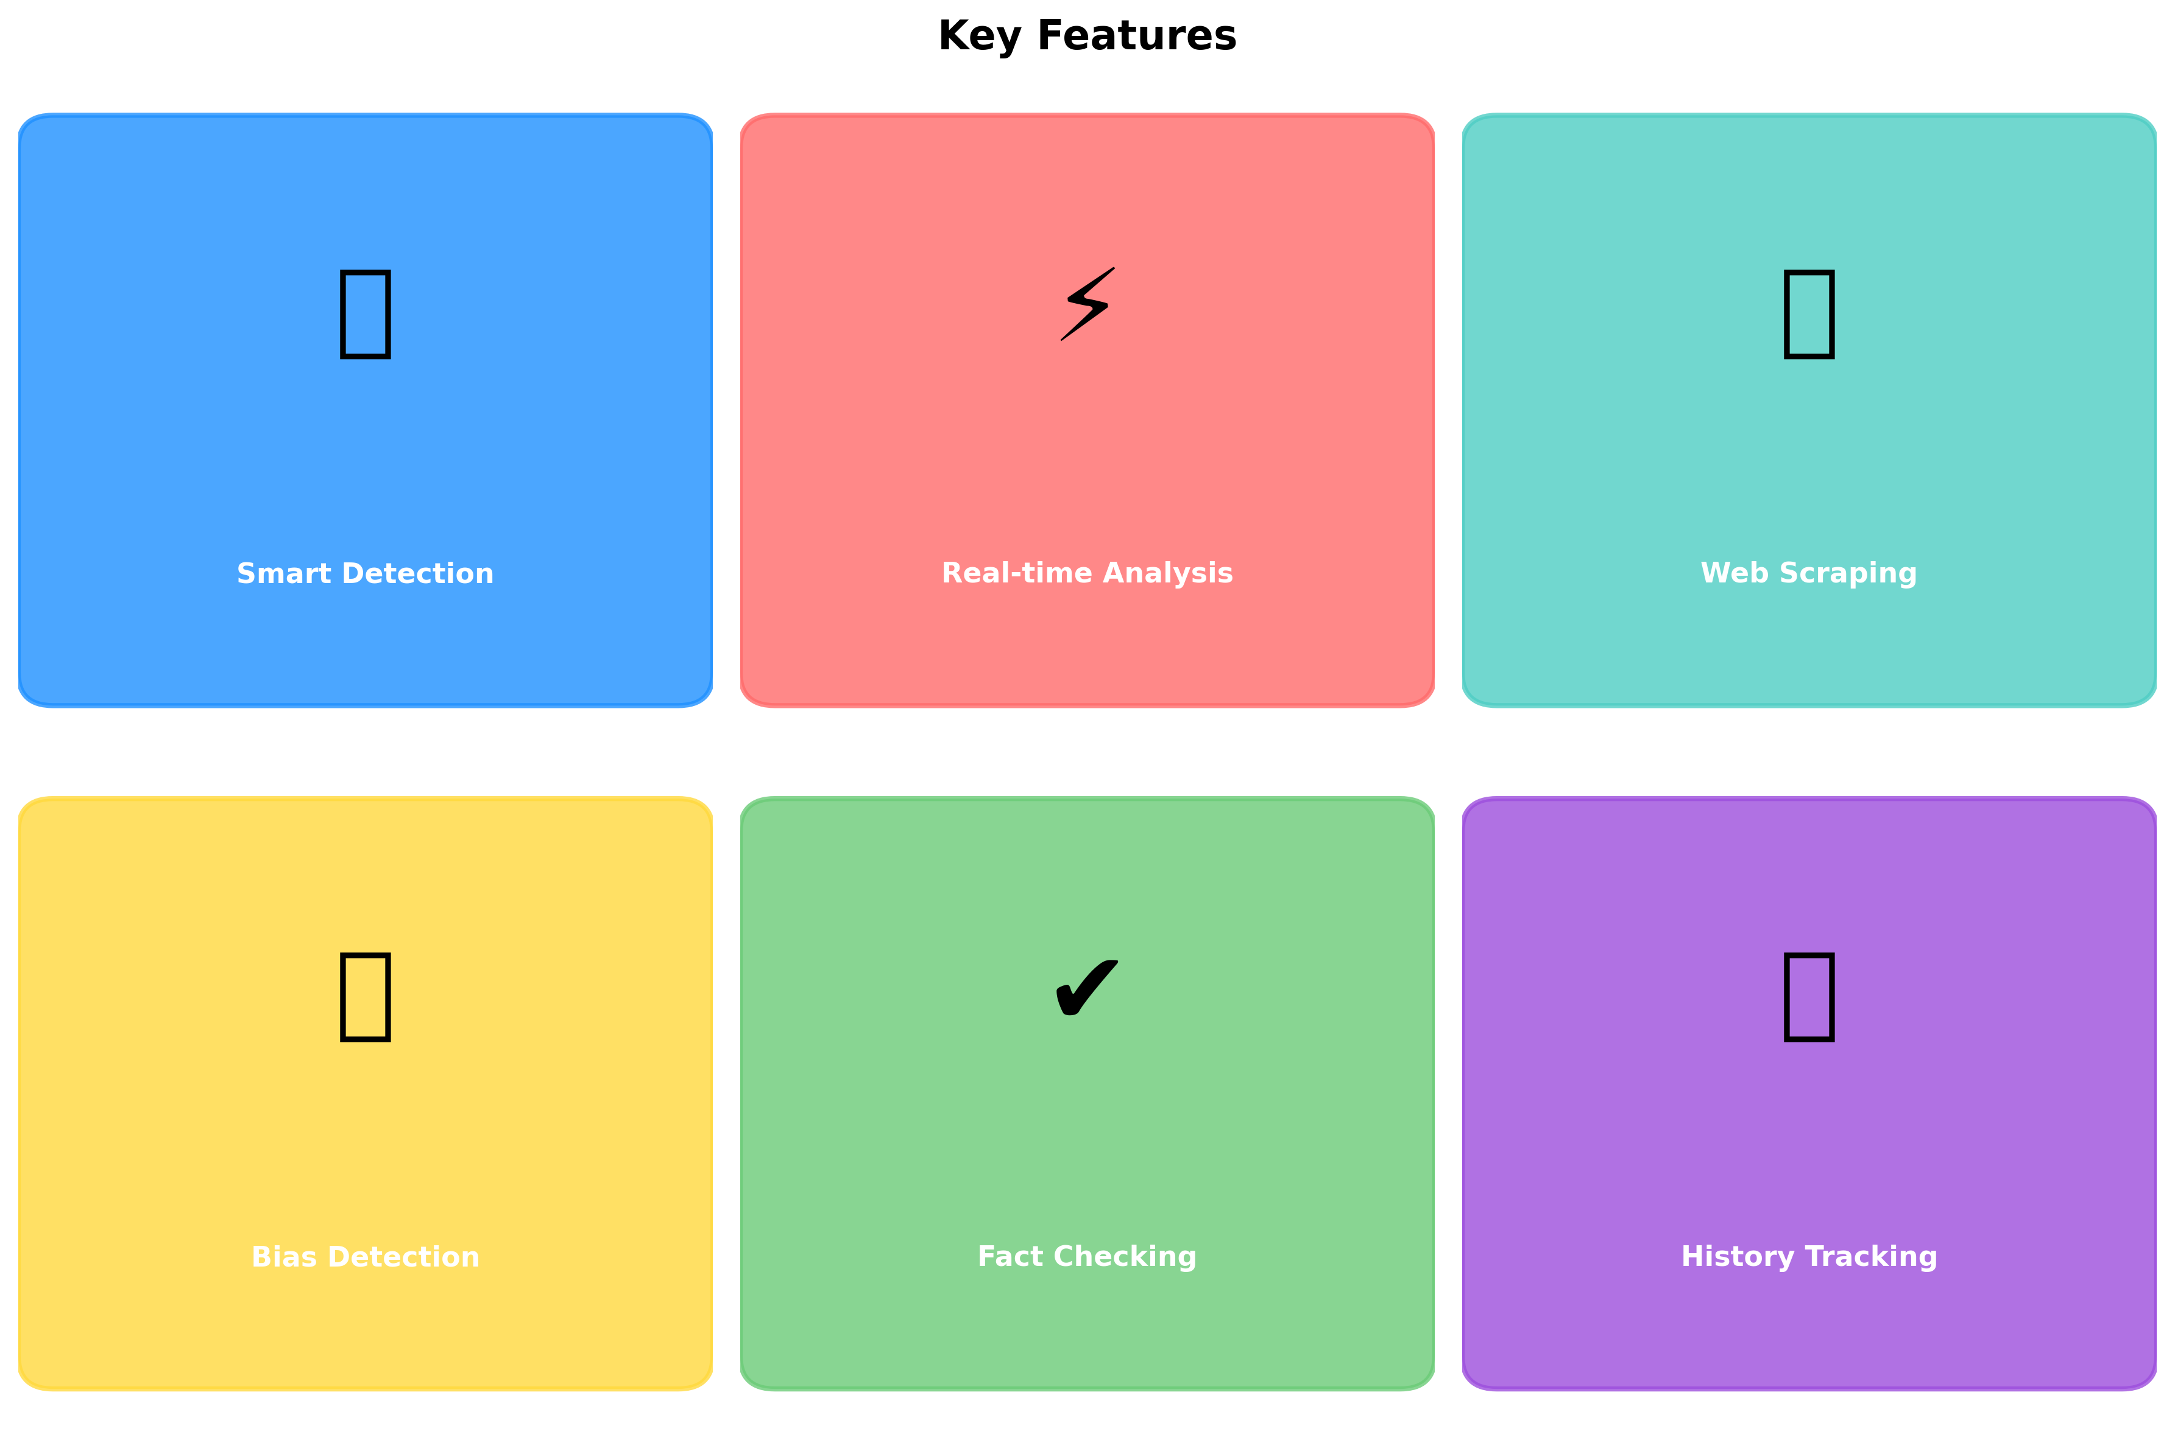
Key Features

Slide 7

Who Benefits?

Slide 8
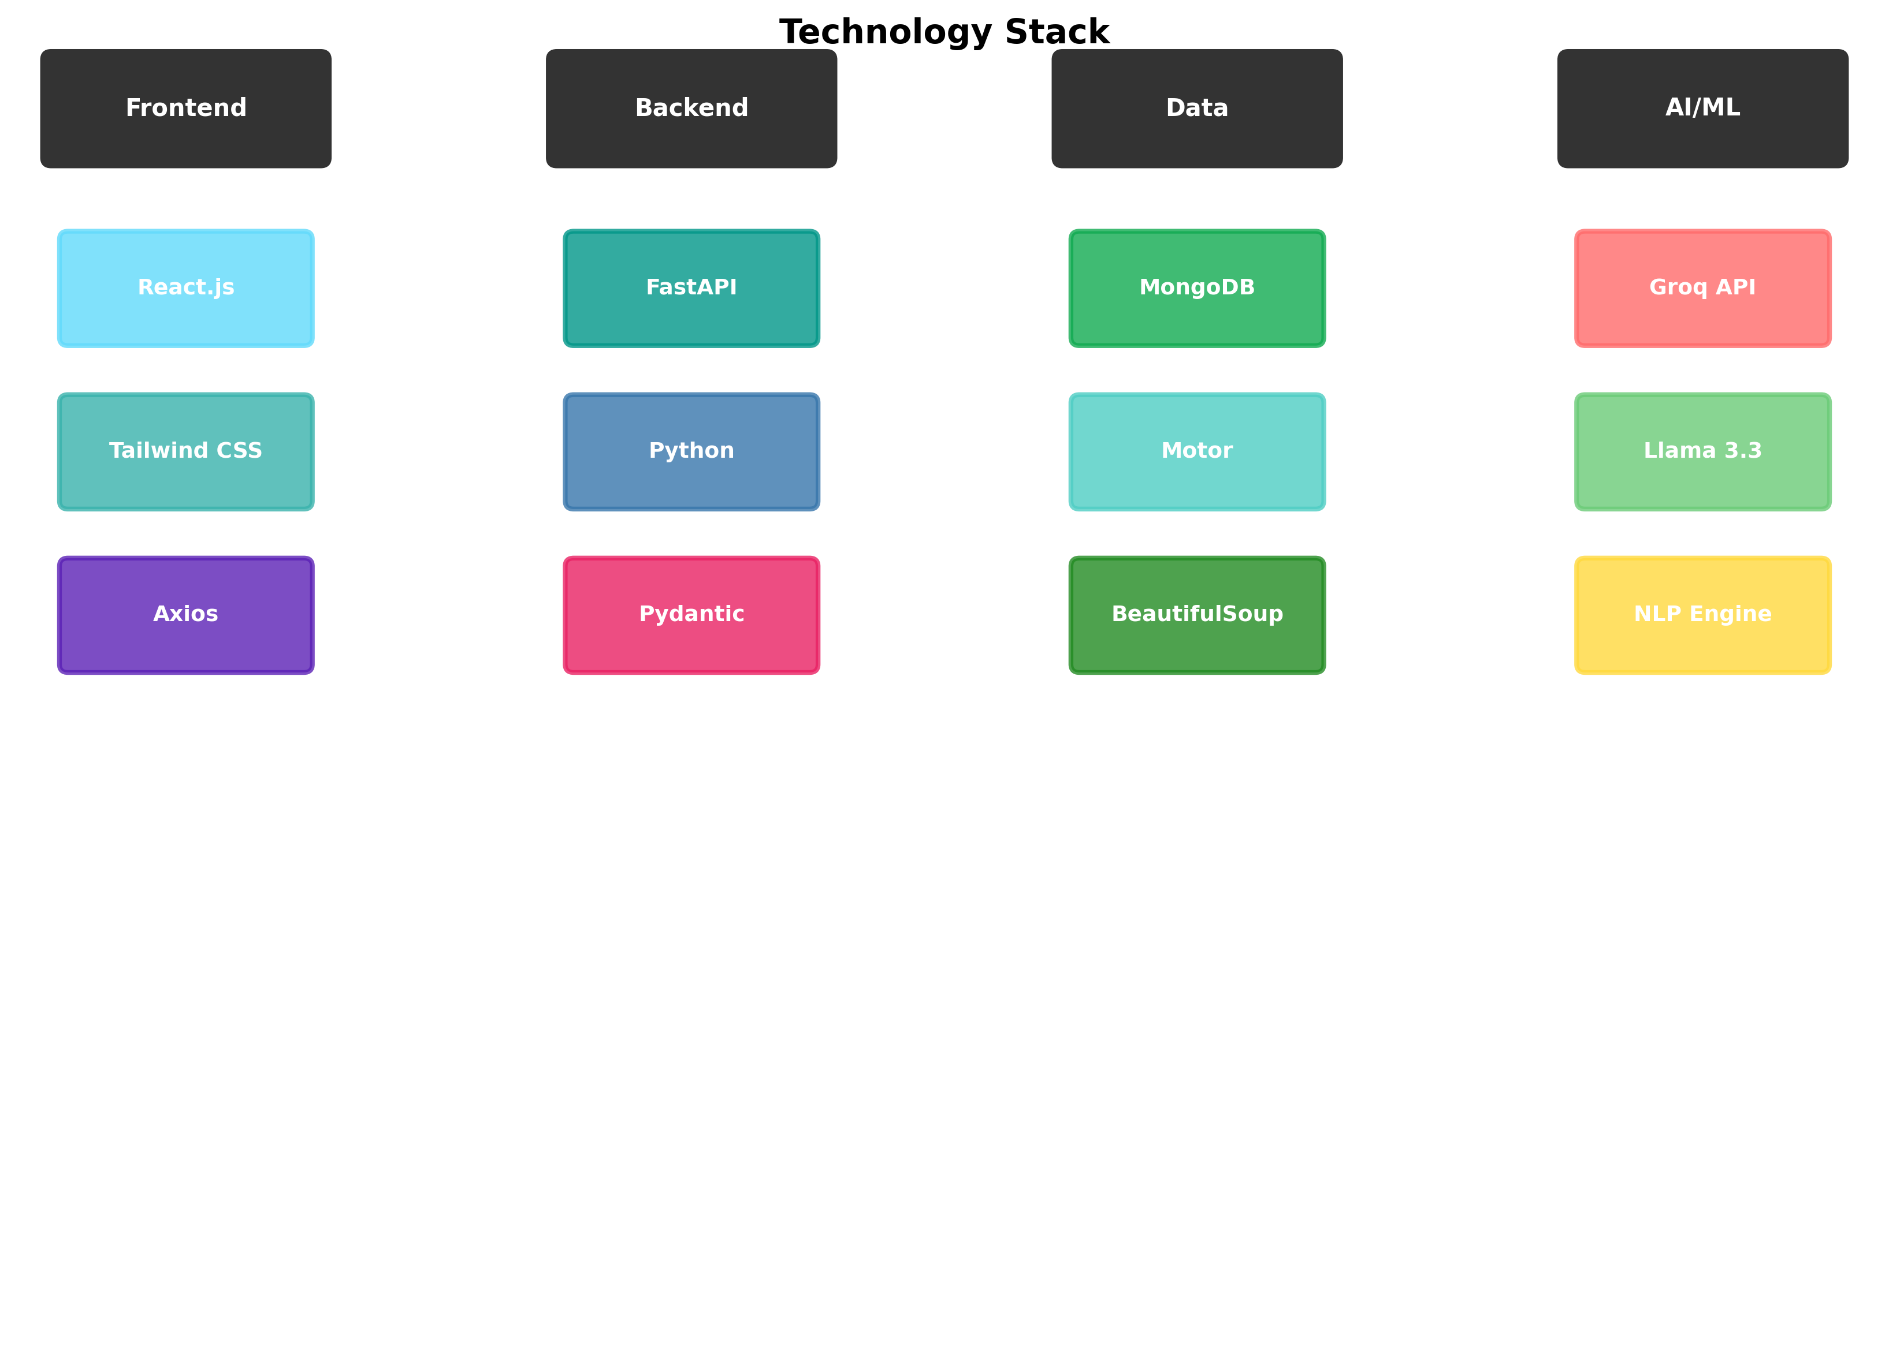
Technology Stack

Slide 9
Analysis Results

Slide 10
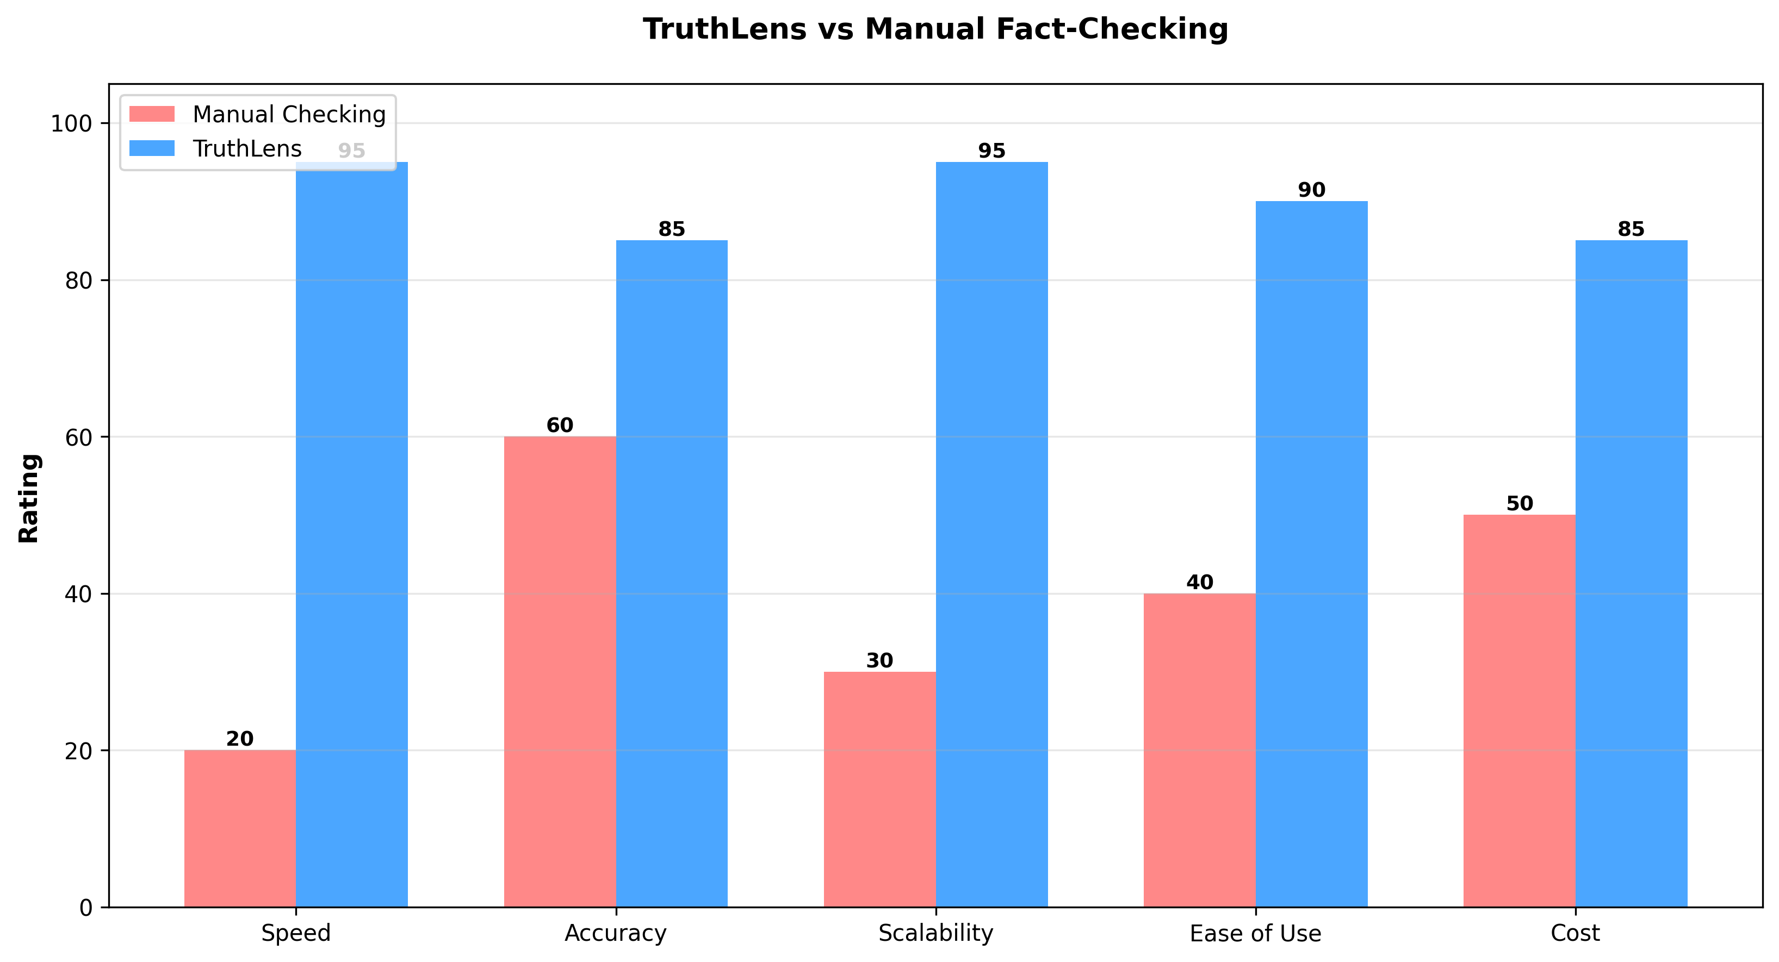
TruthLens vs Manual Checking

Slide 11
API Endpoints
🔌 POST /api/analyze
• Analyzes text or URL content
• Returns: trust_score, bias_level, key_findings, highlights
🔌 GET /api/history
• Retrieves last 10 analyses
• Sorted by timestamp

Slide 12
What Users Receive
📈 Trust Score (0-100) - Credibility rating
📊 Bias Level (0-100) - Detected bias amount
🏷️ Bias Label - Objective/Biased/Inflammatory
🔍 Key Findings - Main points identified
✏️ Highlights - Specific sections with explanations
📝 Credibility Notes - Summary with fact-check info

Slide 13
Backend Stack
⚙️ FastAPI - Modern, fast Python web framework
🗄️ MongoDB - Flexible document database
🚀 Motor - Async MongoDB driver
🧠 Groq API - LLM inference (Llama 3.3 70B)
🔗 BeautifulSoup - Web scraping and parsing
✓ Pydantic - Data validation and serialization

Slide 14
Frontend Stack
⚛️ React 19 - Modern UI library
🎨 Tailwind CSS - Utility-first styling
📡 Axios - HTTP client for API calls
📊 Recharts - Data visualization library
🎯 React Router - Client-side routing
🎭 Radix UI - Accessible component library

Slide 15
Advanced Capabilities
🌐 URL Web Scraping - Extract and analyze articles
🔐 Fact Verification - Google Fact Check integration
💾 Persistent Storage - MongoDB history tracking
⚡ Real-time Processing - Async operations
🛡️ CORS Security - Cross-origin request handling
📱 Responsive Design - Works on all devices

Slide 16
Sample Analysis
Input: 'Scientists discover miraculous cancer cure hidden by Big Pharma'
Output:
✗ Trust Score: 18/100 (Very Low)
✗ Bias Level: 92/100 (Extremely Biased)
✗ Bias Label: Inflammatory
✗ Key Findings: Conspiracy theory, unverified claims, sensational language

Slide 17
Why TruthLens?
⚡ Speed - Analyze articles in seconds
📈 Scale - Process unlimited content
🎯 Accuracy - AI catches subtle biases
💡 Insight - Comprehensive credibility analysis
👥 Accessibility - Simple, intuitive interface
🔄 Consistency - Unbiased automated evaluation

Slide 18
Real-World Impact
🌍 Combat misinformation at scale
📰 Support journalist verification workflows
🎓 Help students fact-check research
📱 Empower informed social media sharing
🏢 Support organizational content moderation
🔐 Build trust in information ecosystem

Slide 19
Future Roadmap
🌐 Multi-language support for global reach
📱 Native mobile apps (iOS & Android)
🔔 Real-time social media monitoring
🔌 Browser extension for quick checks
👥 Community verification consensus
🤖 Enhanced ML models with more training data

Slide 20
Security & Privacy
🔒 Input Validation - All content validated
🛡️ CORS Protection - Trusted origins only
🔐 Secure APIs - HTTPS connections
👤 Privacy-First - No personal data collected
📊 Encrypted Storage - MongoDB security
⚖️ Rate Limiting - Prevent abuse (coming soon)

Slide 21
How to Get Started
1. Visit TruthLens website
2. Select input type (text or URL)
3. Paste content to analyze
4. Click 'Analyze' button
5. Review detailed credibility report
6. Share findings or track history

Slide 22
Deployment & Access
☁️ Cloud-ready architecture
🚀 FastAPI server deployed on cloud platform
⚛️ React frontend hosted on CDN
📊 MongoDB Atlas for database
🔑 Environment variables for API keys
🌐 Accessible via web browser

Slide 23
Fight Misinformation with AI
TruthLens: Intelligent Content Verification for a Trustworthy Information Ecosystem

