Slide 1
EMPLOYEE ATTRITION ANALYSIS USING DIFFERENT CLASSIFICATION TECHNIQUES IN MACHINE LEARNING

Slide 2


Business Understanding
1

Slide 3
EMPLOYEE ATTRITION
What is the problem we are trying to solve?
We are trying to predict the possible reasons for an employee quitting the company and how the company can work towards improving the same.
Who is the target for business solution?
Corporate' (MNC) companies who want to optimise their market growth by increasing employee satisfaction as at the end of the day a successful company is founded upon a strong employee retention policy.
Why is Employee retention important?
An employee is company's most important resource and the absence of employee can cause disruption and lag in the work .
What is the data mining problem statement?
The data mining problem is as simple as a 2 level classification problem. We want to be able to predict the response of 'Attrition' from various input parameters like 'Monthly Income', 'Years Since Last Promotion', etc.

Slide 4
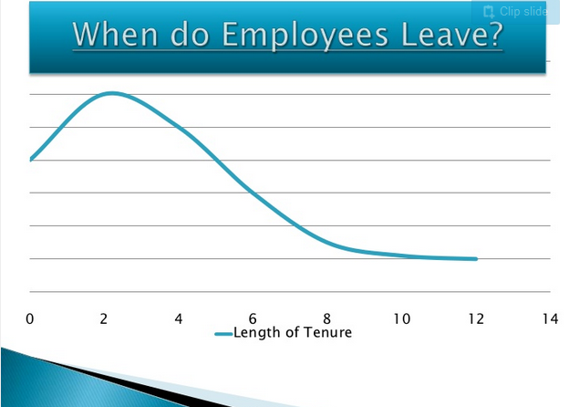
Large proportion of employees leave within two years of tenure.

Slide 5
2
Data Understanding

Slide 6
Data Understanding Phase
What is the source of this data set?
Although the dataset is fictitious, it has been generated by IBM specialists and was taken from Kaggle website.
Why only these attributes?
According to IBM specialists these were the 35 primary attributes to predict employee attrition, although only some of them may be the most relevant ones.
What is the significance of each attribute?
A large variety of socio-economic factors are responsible for an employee to leave a certain company. These attributes take into account most of these factors.
Is the data set balanced?
No, and we do not want to create any more data sets as it would cause the model to be biased.

Slide 7
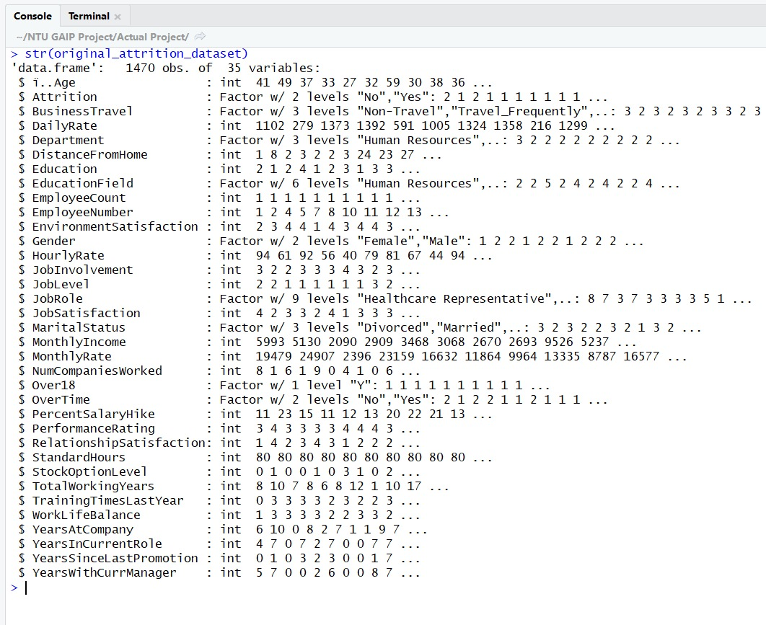
Attributes Details

Slide 8
Data Exploration Using Descriptive Analysis
3

Slide 9
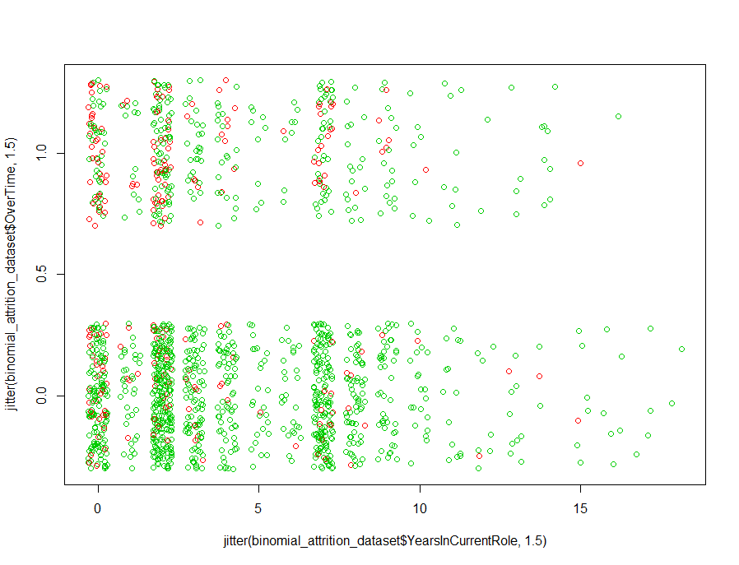
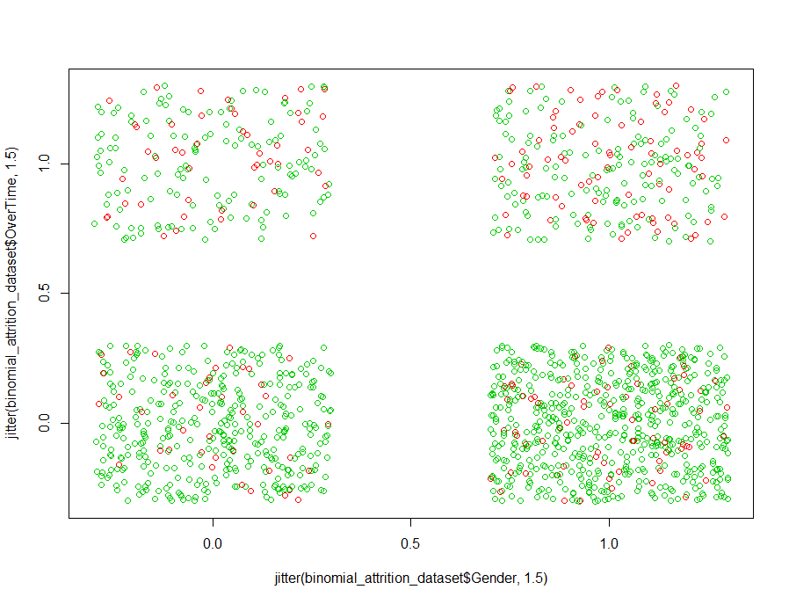
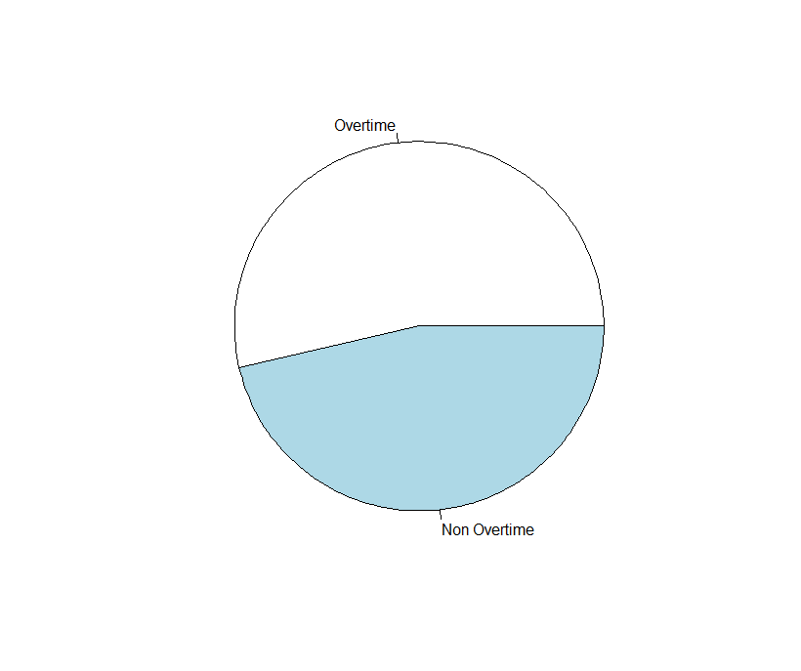
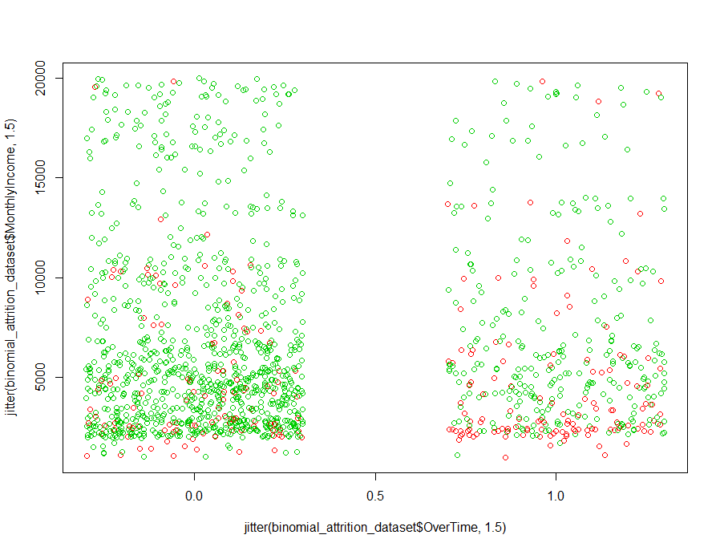
Significant Features Contributing To the Response
overtime
overtime
years in current role
gender
Monthly Income
overtime

Slide 10
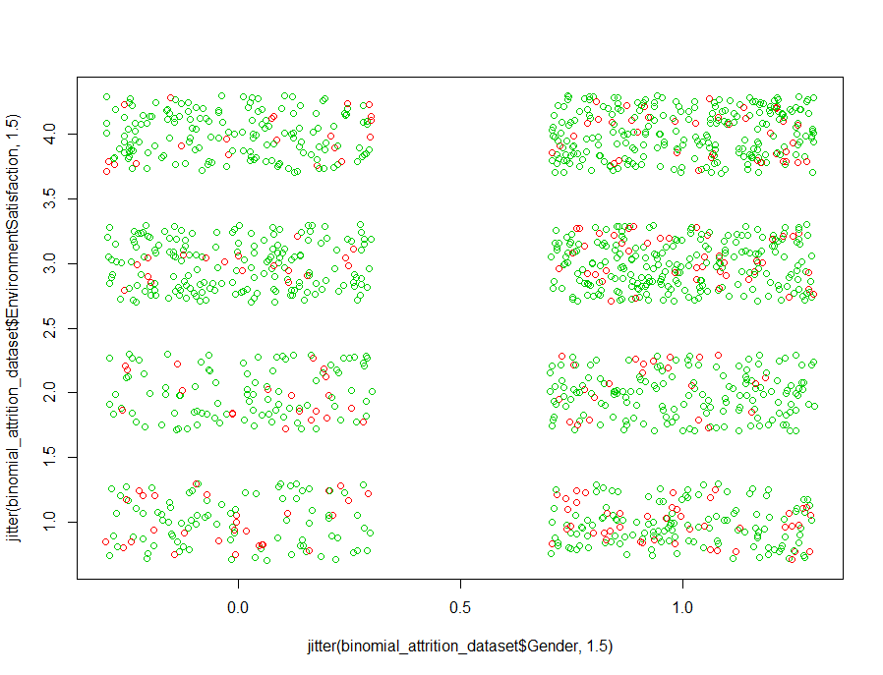
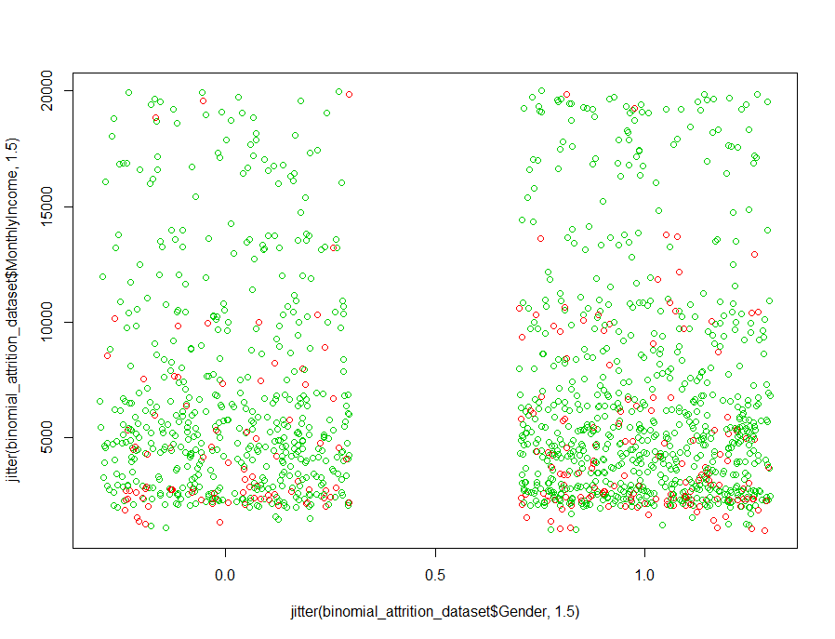
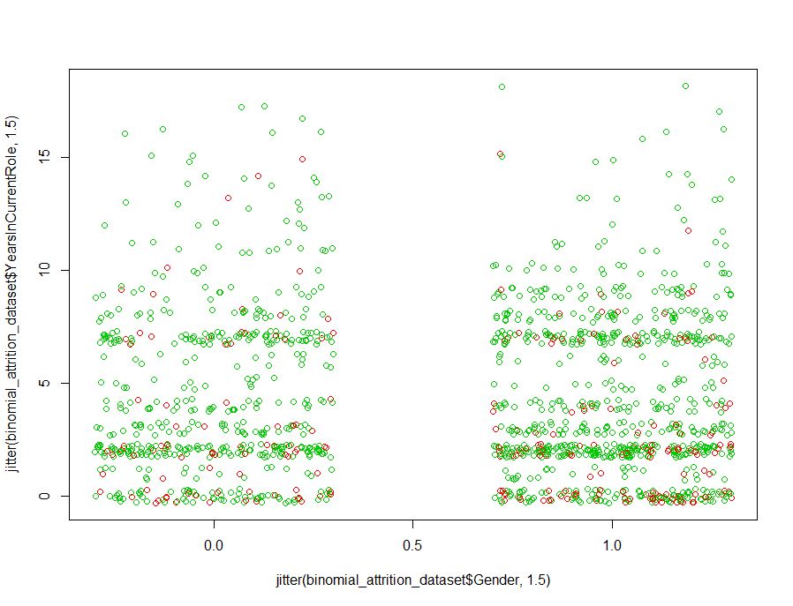
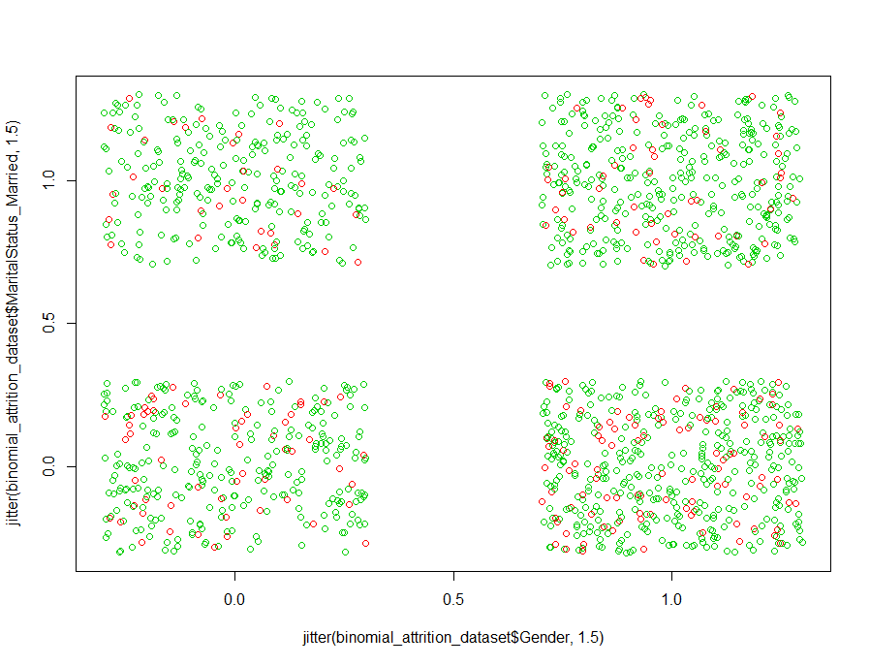
Env.
Satisfaction
Monthly Income
gender
gender
married
years in current role
gender
gender

Slide 11
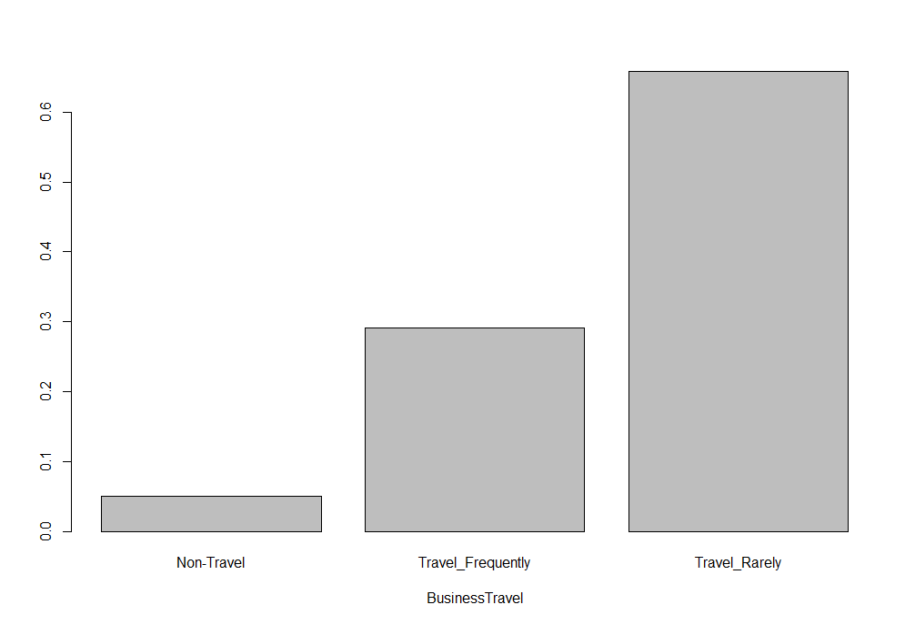
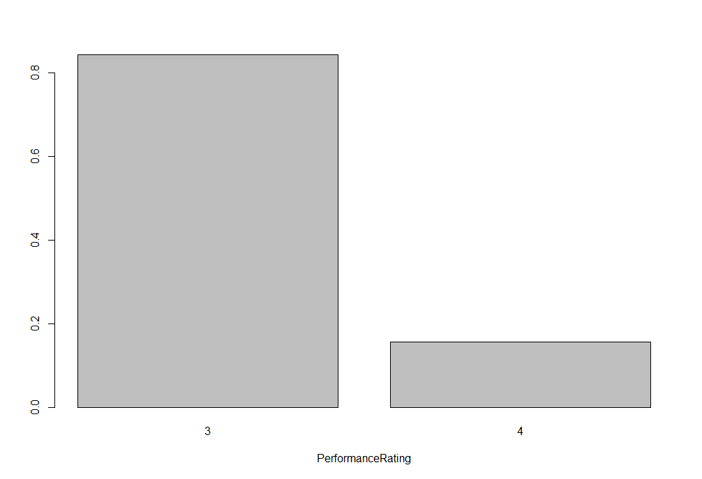
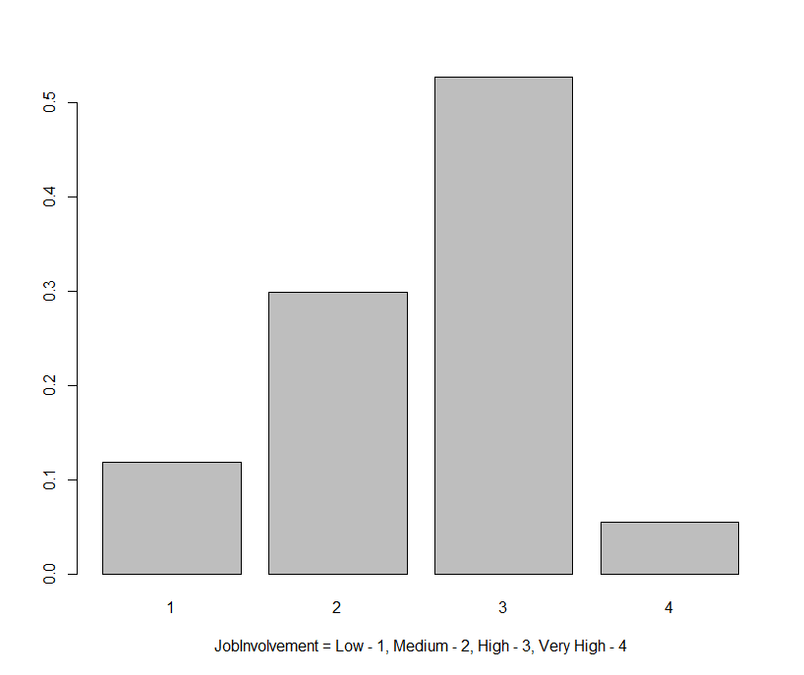
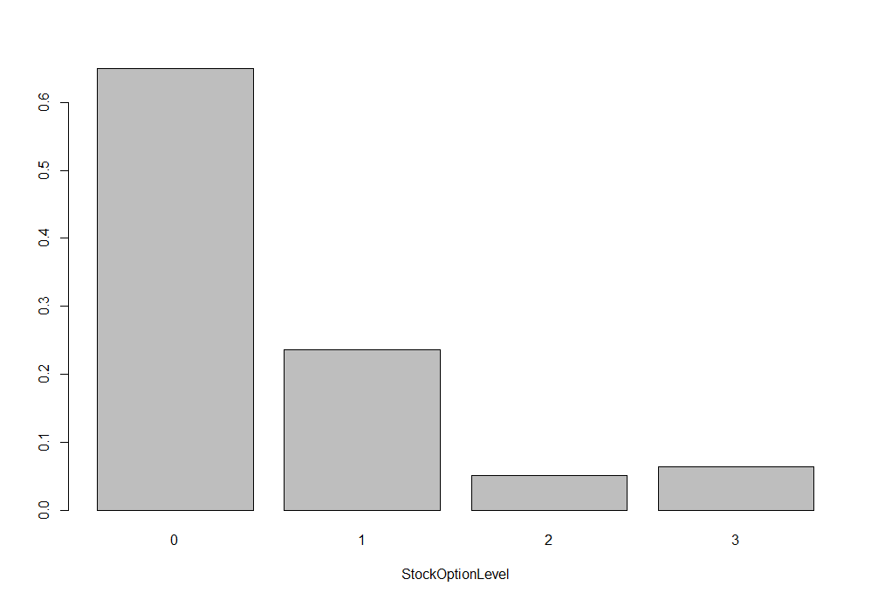
Business
Travel
Non-travel
Travel frequently
Travel Rarely
Analysis of employees leaving the company
Performance Rating
Job Involvement: 1-Low 2-medium 3-High 4 -Very High
Stock Option Level

Slide 12
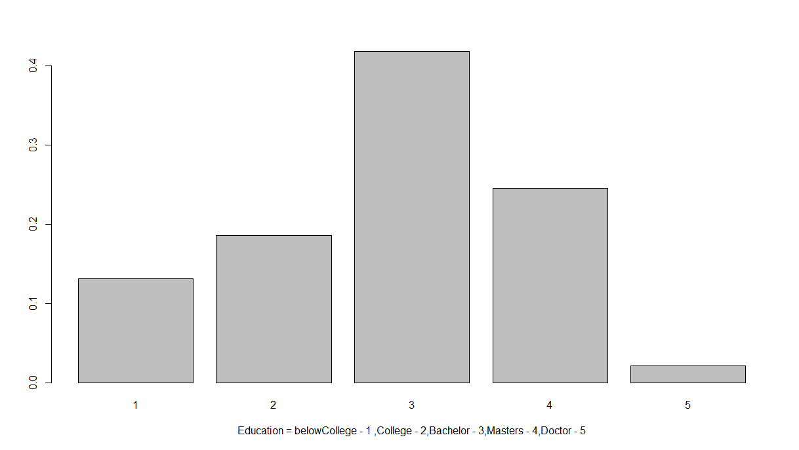
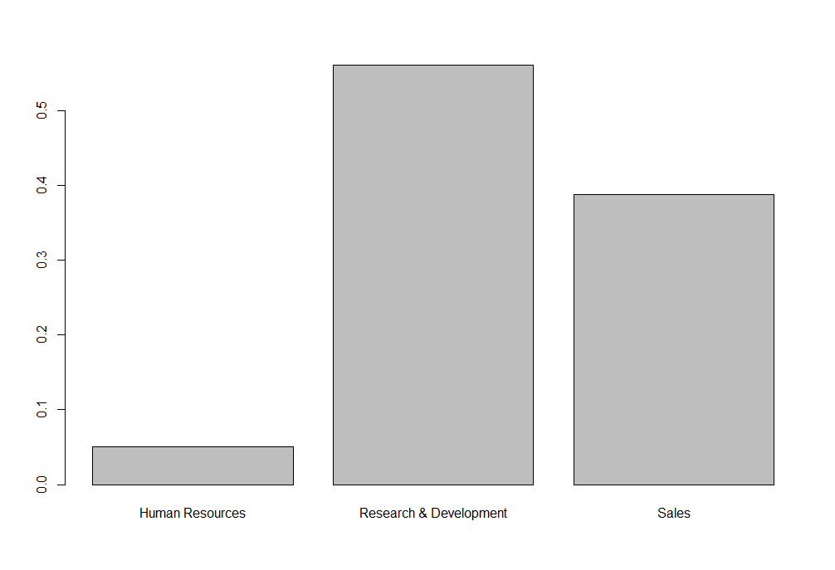
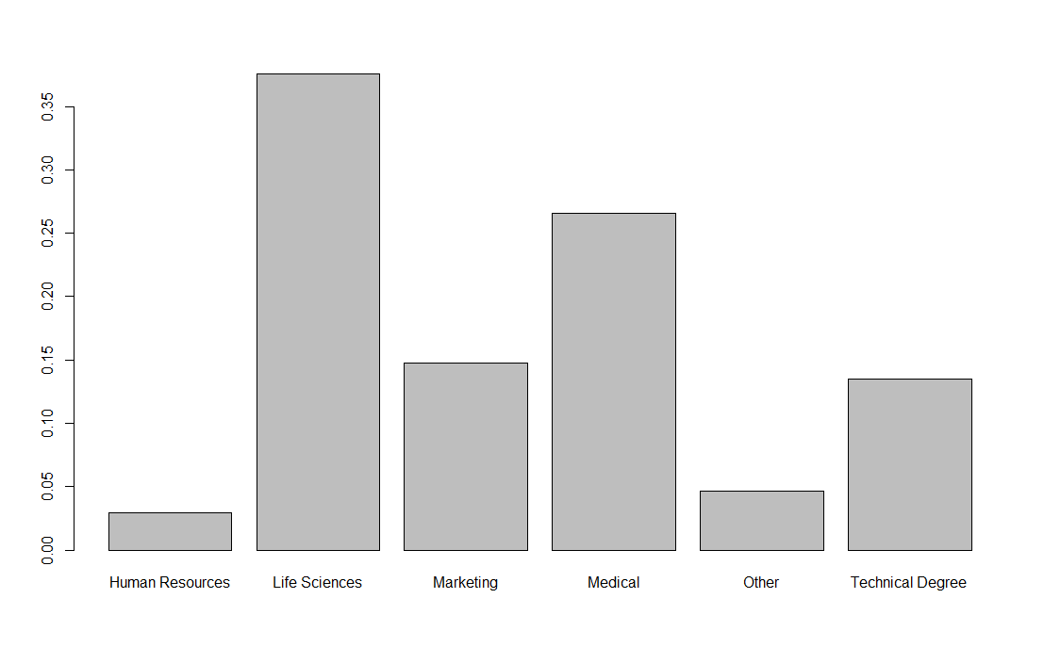
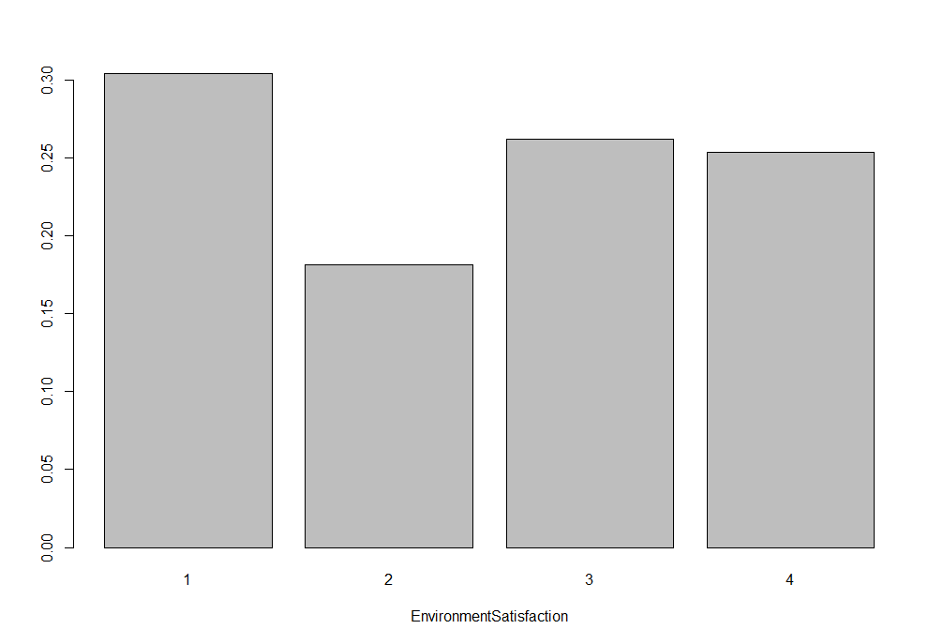
Analysis of employees leaving the company
Education: 1-Below College 2-College 3-Bachelor 4-Masters 5-Doctor
Human Resources
R & D
Sales
HR | Life Sciences | Marketing | Med | Other | Technical Degree
Environment Satisfaction

Slide 13
Summary
After looking at the above graphs we can come to a conclusion that the following factors mainly affect the attrition rate:
Over time
Monthly Income

Slide 14
Data Preparation
4

Slide 15
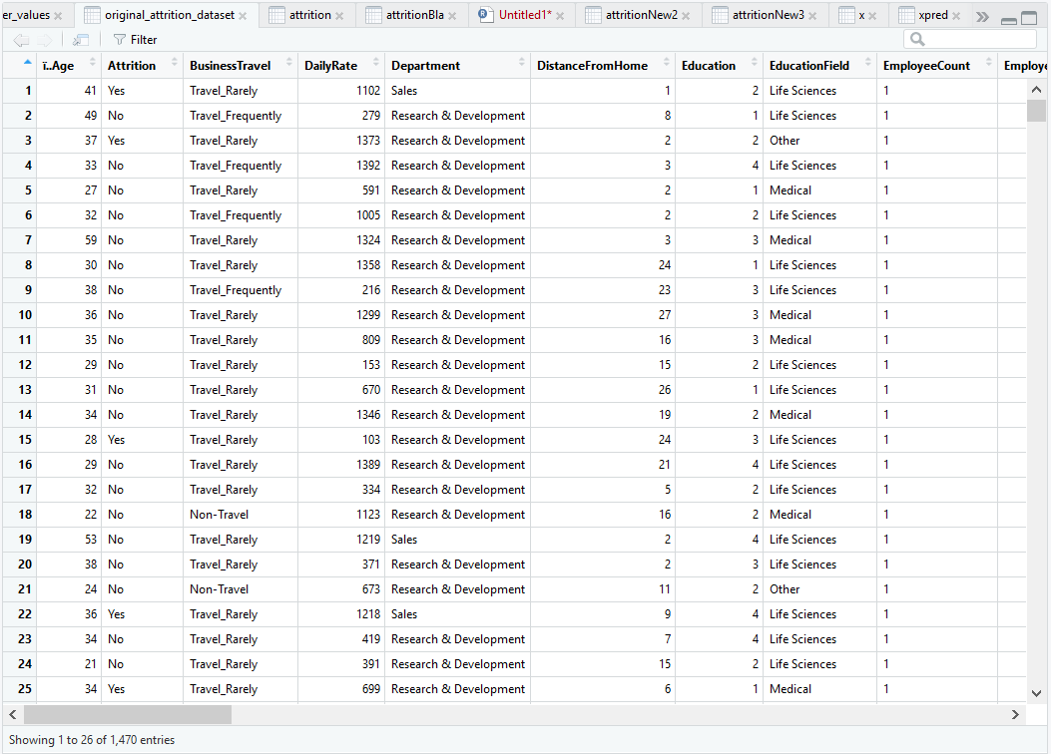
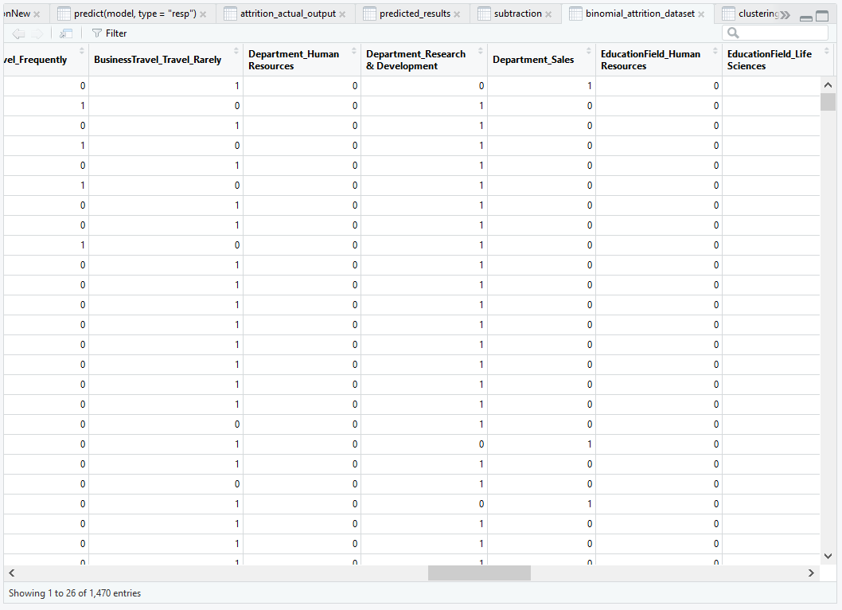
How did we filter the data?
All those attributes having same and unique values for all the employees were filtered off. For example: Standard Hours, Employee count etc.
Changes made to the dataset?
All the attributes of factor type had more than two levels, these attributes were split into individual columns one for each level.

Slide 16
5
Modelling Phase

Slide 17
Different Modelling Techniques used
Logistic Regression
K-Means Clustering
Hierarchical Clustering
Support Vector Machine(SVM)

Slide 18
Why these models?
--Since we are dealing with classification problem i.e. a yes or no problem so these are the best methods to use.
What kind of data is demanded by each model?
--For logistic regression and SVM we require Numeric data
--For Clustering we require unsupervised data so we got rid of attrition column

Slide 19
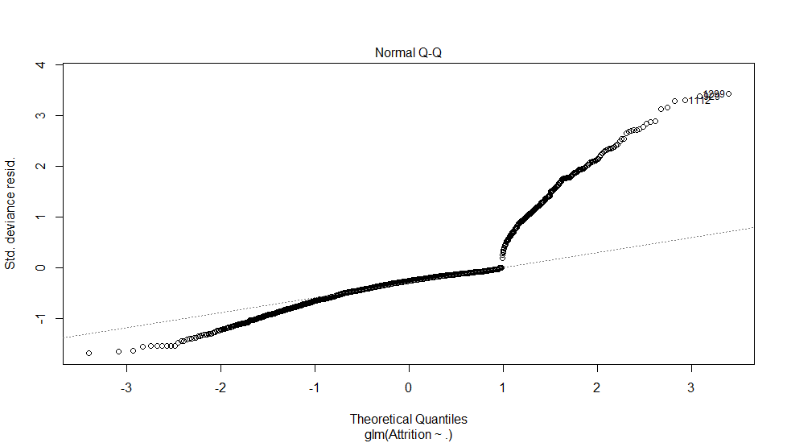
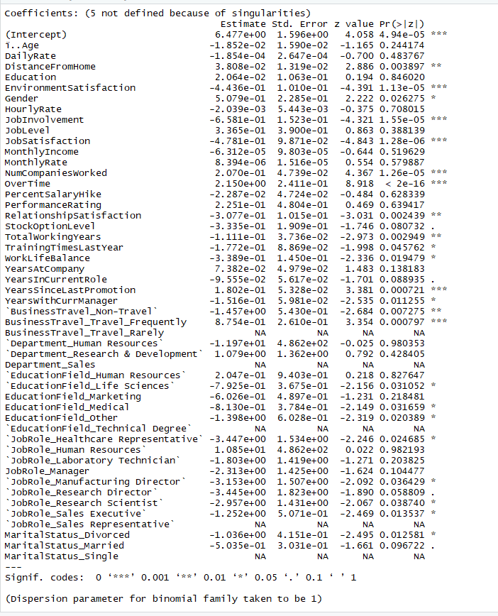
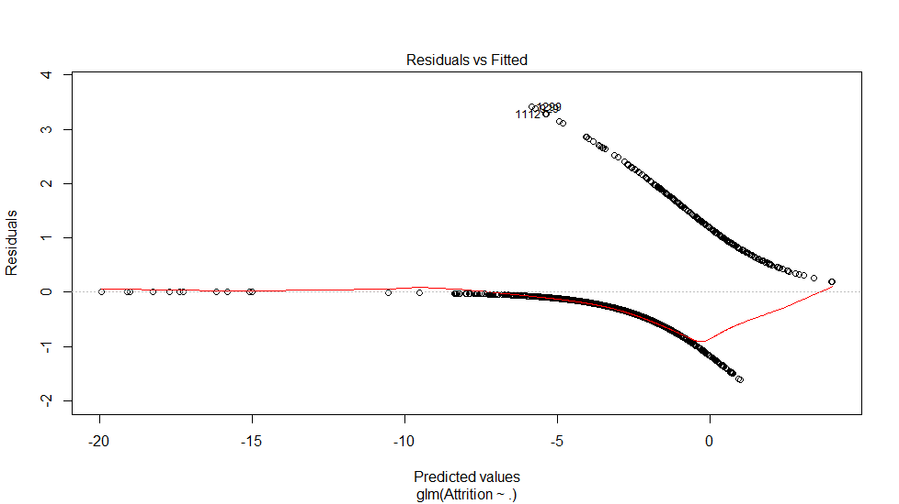

Slide 20
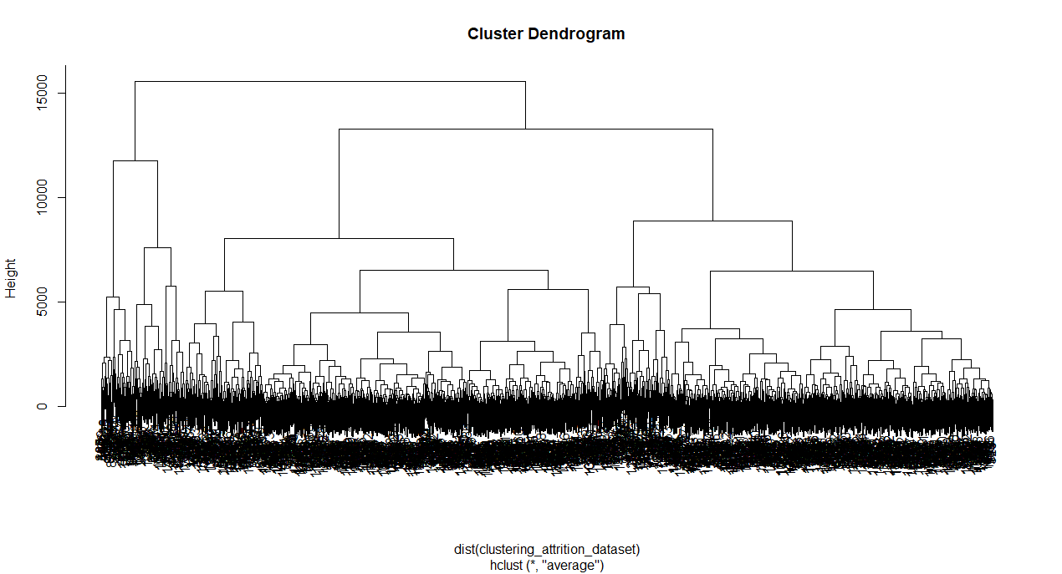

Slide 21
Evaluation Phase
5

Slide 22
Accuracy Over Training Data
We divided the over all data into a ratio of 70:30
70% of the data was used for training the model.
30% of the data was used for testing the model.

Slide 23
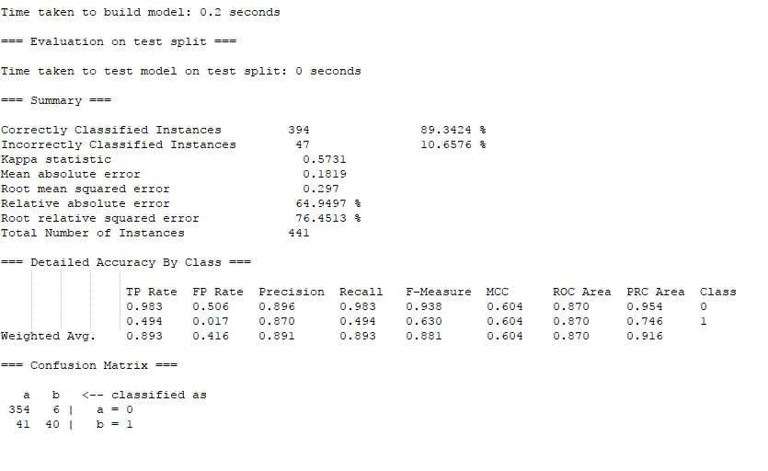
Logistic Regression

Slide 24
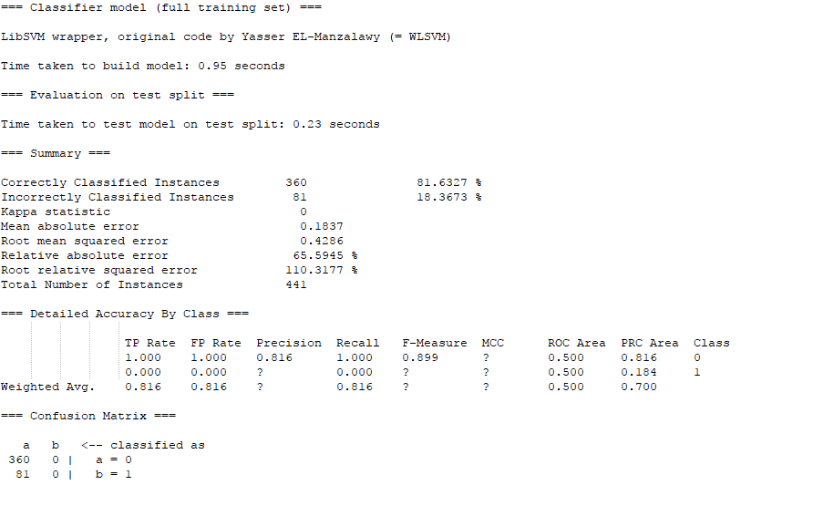
Support Vector Machine(SVM)

Slide 25
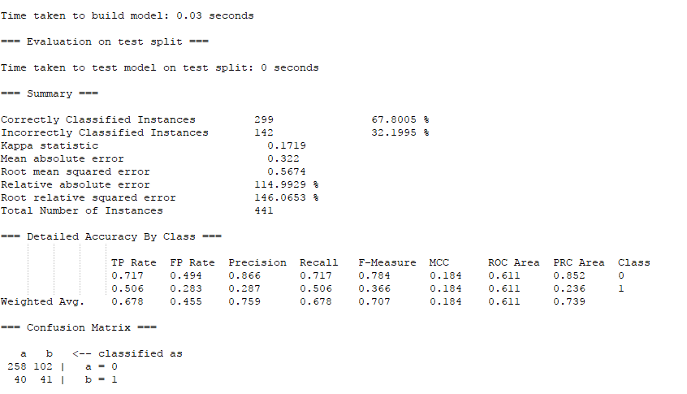
K-Means Clustering

Slide 26
Deployment and Conclusion
6

Slide 27
Conclusion
The chances of underpaid and over working employees quitting the company is more.
Males in Life Sciences and R&D department tend to leave the company mostly.
Some of the Employees like executives are getting overpaid.

Slide 28
Solution
The Company must increase pays, increase frequency of promotions.
The Company Should give stock options to all employees.
The company should reduce executive pay and spend that money on research and development in order to encourage employees from the life sciences background and hence increase innovation and productivity of the company.

Slide 29


