Slide 1
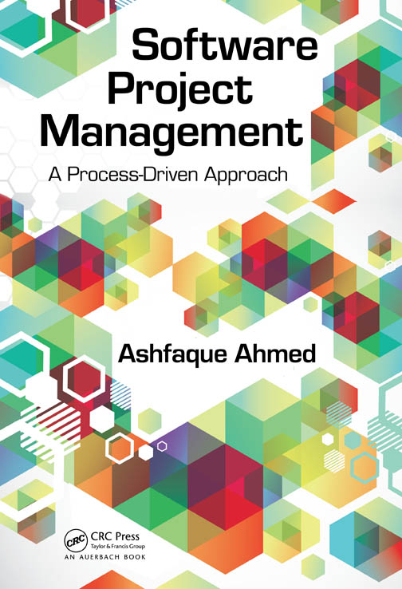
Teaching material for a course in Software Project Management & Software Engineering – Part I

Slide 2
Chapter 4
In the previous chapter, we learned
How is an effort estimate for a project made?
What are the different effort estimation techniques?
How is a cost estimate for a project made?
What are the different cost estimation techniques?
How can a schedule estimate for a project be done?
How can a resource estimate for a project be done?
In this chapter, we will learn
What is a risk on a project?
What kinds of risks exist for a project?
What kind of impact may risks have on a project?
What strategy is needed to deal with risks?

Slide 3
Part 1: Project Management Fundamentals
Chapter 4 (Risk Management)
Any project needs to start and end at the pre defined dates. There could be risks like resource unavailability, service breakdown problems, technology obsolescence, wrong selection of project tools etc. These risks can occur and can hamper project progress. Finding chances of occurrences of risks and finding ways to tackle them is important. So risk management is very important for any project.

Slide 4
ISO/IEC definitions
Risk: The combination of the probability of an event and its negative consequence.
1—The term “risk” is generally used only when there is at least the possibility of negative consequences.
2—In some situations, risk arises from the possibility of deviation from the expected outcome or event.
Risk category: A class or type of risk (e.g., technical, legal, organizational, safety, economic, engineering cost, schedule).
NOTE—A risk category is a characterization of a source of risk.

Slide 5
Part 1: Project Management Fundamentals
Chapter 4 (Risk Management)
Risk can hamper a project either affecting product quality or rate of production. Product quality can go down if software engineers lack adequate skills or not enough time could be allotted for testing. Rate of production may go down if adequate resources are not allocated on the project.

Slide 6
Risk assessment
Risk Identification
Risk analysis
Risk prioritization
Can be performed at the beginning of the project development and reassessed at the beginning of the iterations

Slide 7
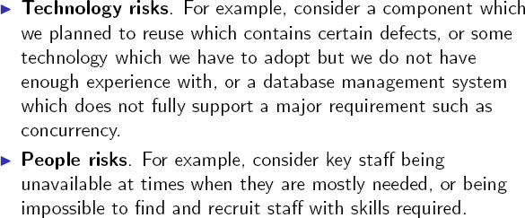
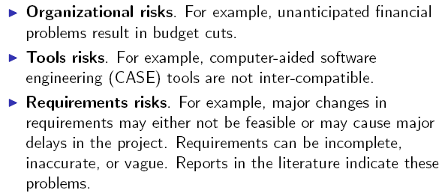
Risk Categories
Estimation risks. For example, the time required to complete the project has been underestimated.

Slide 8
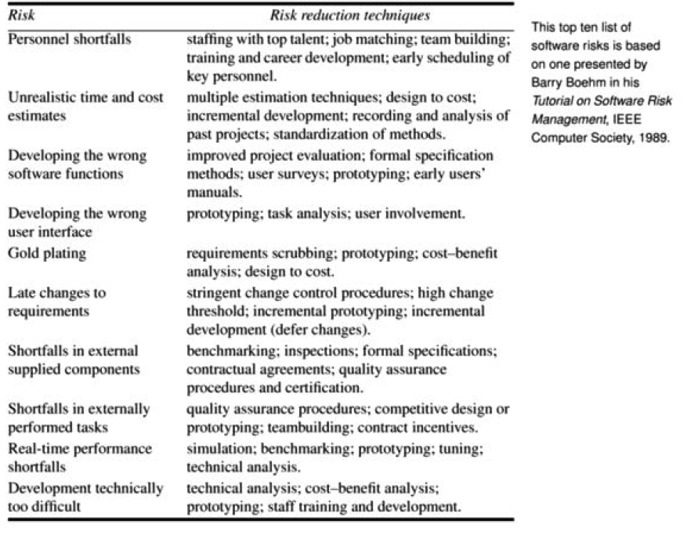
Notes:
In time management, gold plating is the phenomenon of working on a project or task past the point of diminishing returns. For example: after having met the requirements, the project manager or the developer works on further enhancing the product, thinking the customer will be delighted to see additional or more polished features, rather than what was asked for or expected. The customer might be disappointed in the results, and the extra effort by the developer might be futile.

Slide 9
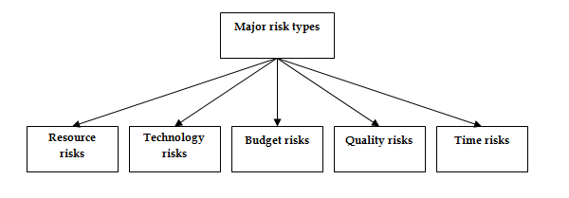
Part 1: Project Management Fundamentals
Chapter 4 (Risk Management)
Major risk types on projects

Slide 10
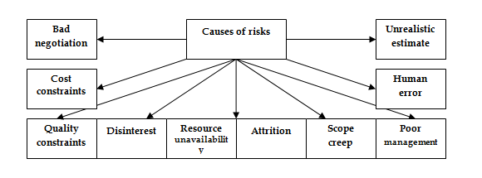
Part 1: Project Management Fundamentals
Chapter 4 (Risk Management)
Major causes of risks on projects

Slide 11
Risk assessment: Risk identification
Risk identification: Identify risks related to the overall project, to the product and to the business.
The outcome of this step is a collection of risk items.
Example:
You are a project manager and have been assigned to a high- profile, mission-critical project that has high-revenue potential in a new market segment.
After an initial assessment, you have determined that it is a risky project since it relies heavily on new technology

Slide 12
Risk assessment: Risk analysis
Assess:
the likelihood of occurrence
Qualitative: Scale (for example: Low, Moderate, Significant, High)
Quantitative: probability of occurrence
the impact on project, product and business of each risk item
Qualitative: Scale (for example: Low, Moderate, Significant, High)
Quantitative: where data is available.
– Example: fire can cause 0.5 millions of damage in a facility
Which risks do we consider really serious?

Slide 13
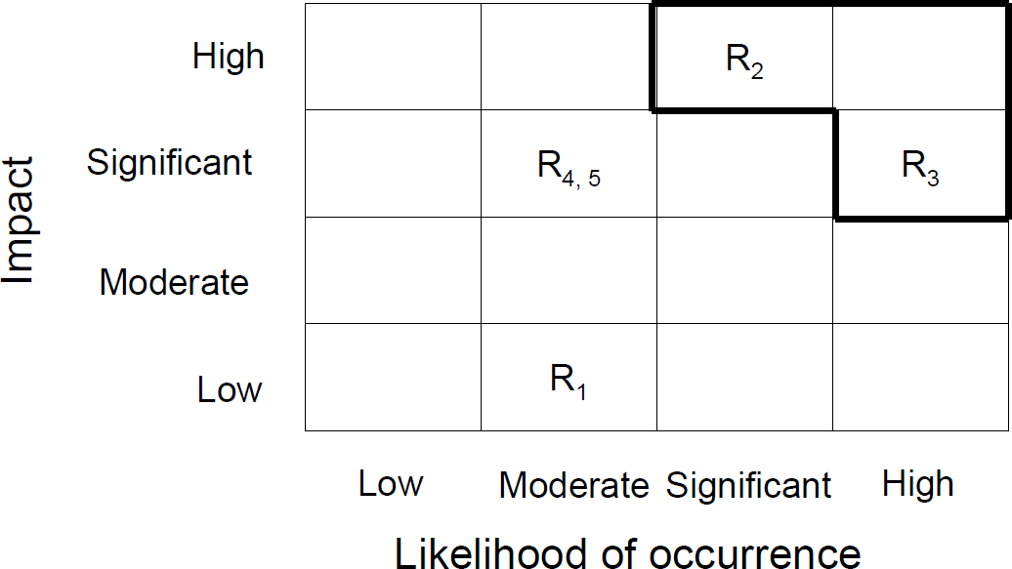
Impact v.s. Likelihood of Occurrence: Qualitative assessment
Risks of high concern

Slide 14
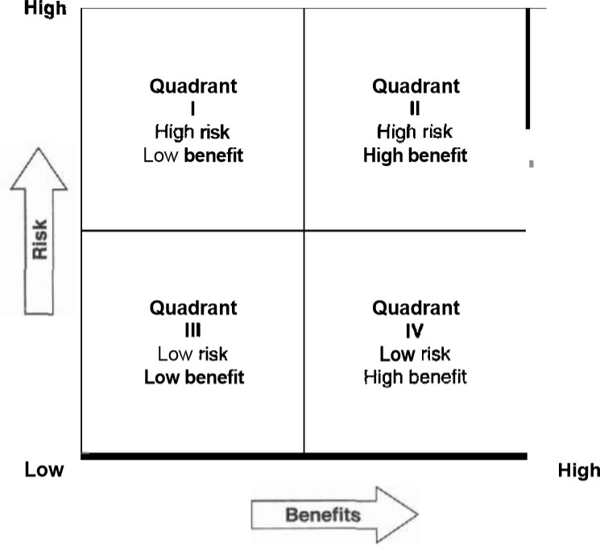
Risk/Benefits: tradeoffs
(“project risk management”, Bruce Barkley)
Notes:
Quadrant I: High risk, low benefit Projects which fall into this quadrant are not worth doing simply because there is uncertainty about outcomes and little foreseeable payoff. Of course, companies typically support a Limited number of exploratory R&D projects, some of which can move from this quadrant to the next when unexpected payoffs are uncovered.
Quadrant II: High risk, high benefit Projects here are major investments with high risks of failure, but with outcomes that could substantially improve market share, company growth, and profitability. A good example of such a project would be an investment project in the field of space exploration.
Quadrant Ill: Low risk, low benefit Projects in this quadrant are not worth doing simply because there is no foreseeable payoff, even though the cost or risk involved is minimal. An example would be a superficial landscaping improvement to a plant location when the permanence and viability of the plant itself is in question.
Quadrant IV: Low risk, high benefit Here the projects are very attractive because for minimal risk there is a potential high benefit. An example would be installation of a proven technology in manufacturing that promises to double productivity of a current plant or facility.

Slide 15
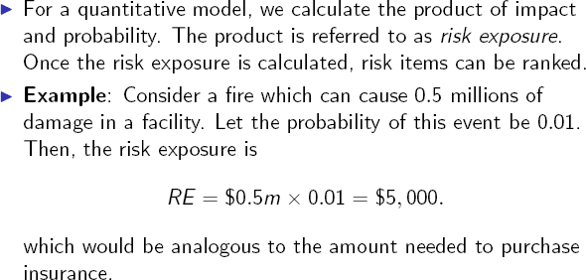
Quantitative model: example
Risk exposure = risk probability × impact

Slide 16
Risk assessment: Risk prioritization
Once risk items have been identified and analyzed (in terms of their likelihood of occurrence and impact), we need to set priorities in order to determine where to focus risk mitigation efforts
Furthermore, some of the risk items may be unlikely to occur, and others may not be serious enough to raise any concern
To determine the priority of each risk item in a quantitative model, we combine the two values, likelihood and impact
This priority scheme helps push the big risks to the top of the list and the small risks to the bottom

Slide 17
Risk control
Risk planning
Can be performed at the beginning of the project development and reassessed at the beginning of the iterations
Resolution
The assignment of a risk item to a person/ date by which it has to be
resolved.
Can be performed throughout the project development
Risk monitoring
Can be performed throughout the project development

Slide 18
Risk Control: Risk planning
Consider each negative risk item and develop a strategy to manage it
Types of strategies:
Acceptance
Avoidance
Risk transfer
Mitigation
Contingency measures

Slide 19
Risk response strategies: Acceptance
(“project Risk management”, Bruce Barkley)
Acceptance means that the project has decided not to change the project plan to deal with a risk or is unable to identify any other suitable response strategy.
Examples include:
1. Develop contingency plans
2. Identify risk-trigger points
3. Periodic review of risks and trigger points
4. Use contingency allowance (e.g., time, budget, staff)

Slide 20
Risk response strategies: Avoidance
(“project Risk management”, Bruce Barkley)
SOLUTION: Avoidance is defined as changing the project plan to eliminate the risk of the condition to protect the project goals and objectives from its impact. Examples include:
Do not use unfamiliar subcontractors
Reduce scope to eliminate high-risk activities
Add resources or time to critical tasks during planning
Use familiar approaches rather than innovative ones

Slide 21
Risk response strategies: Transference
(“project Risk management”, Bruce Barkley)
Transference involves shifting the consequence of a risk to a third party, together with ownership of the risk response. Transferring a risk gives someone else the responsibility for its management. It does not eliminate the risk. Examples include:
Use of insurance and performance bonds
Use of warranties and guarantees
Use of contracts to transfer liability
Use of a fixed-price contract with subcontractors

Slide 22
Risk response strategies: Mitigation
(“project Risk management”, Bruce Barkley)
Mitigation reduces the probability and/or consequences of an adverse risk to an acceptable level. Taking early action to reduce a risk’s probability and/or impact is more effective than reacting later. Examples include:
Adopt less complex processes
Plan for additional testing of complex elements
Use a more reliable or more stable vendor
Use a prototype in the development process

Slide 23
Risk response strategies: Mitigation
We can take measures to reduce the risk exposure factor of a given risk item
However, we need to take into consideration that these measures incur a cost

Slide 24
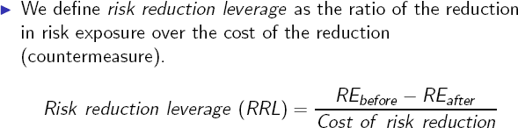
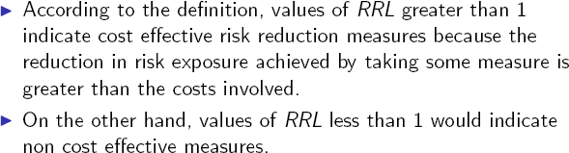
Risk reduction leverage (RRL)

Slide 25
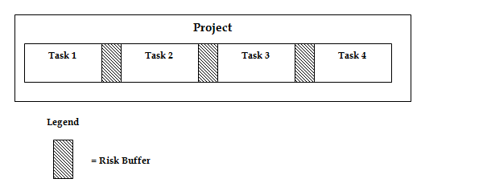
Part 1: Project Management Fundamentals
Chapter 4 (Risk Management)
Mitigating risks through schedule buffer on projects

Slide 26
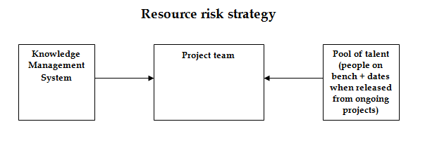
Part 1: Project Management Fundamentals
Chapter 4 (Risk Management)
Mitigating resource risks through knowledge management system

Slide 27
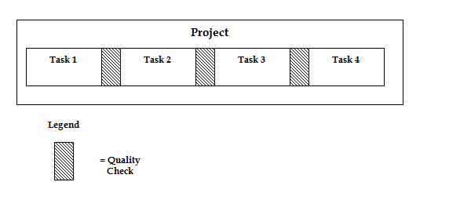
Part 1: Project Management Fundamentals
Chapter 4 (Risk Management)
Mitigating quality risks through quality gates on projects

Slide 28
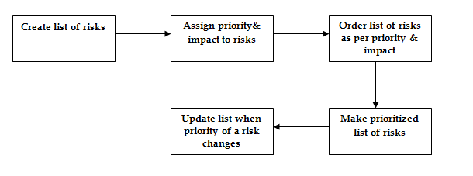
Part 1: Project Management Fundamentals
Chapter 4 (Risk Management)
Risk management through risk prioritization

Slide 29
Part 1: Project Management Fundamentals
Chapter 4 (Risk Management)
Each kind of risk which can occur on a project should be identified and then evaluated for the kind of impact it can have on the project. Probability for the risk to occur should also be identified. Together with impact and probability, the risk factor can be devised for each risk on the project.

Slide 30
Part 1: Project Management Fundamentals
Chapter 4 (Risk Management)
The biggest benefit of iterative software development lifecycle model is that it minimizes risks. In the waterfall model, the software product is available for end user review only after the complete software product is built. If there were misunderstandings in getting end user requirements right then the software product built will not be suitable to the end users. In iterative models, this risk is minimized by building small set of features and getting them reviewed by end users. If any features are not correct then making the required changes at this stage is not costly.

Slide 31
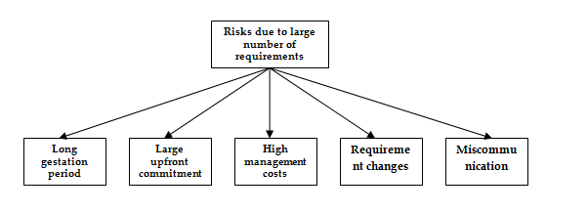
Part 1: Project Management Fundamentals
Chapter 4 (Risk Management)
Risks of waterfall model

