Slide 1

Teaching material for a course in Software Project Management & Software Engineering – Part I

Slide 2
Chapter 5
In the previous chapter, we learned
What is a risk on a project?
What kinds of risks exist for a project?
What kind of impact may risk have on a project?
What strategy is needed to deal with risks?
In this chapter, we will learn
What is a configuration management system?
What are the parts of a configuration management system?
Why is a configuration management system required on a software project?
What strategies can be made to deploy a configuration management system successfully for a project?

Slide 3
Part 1: Project Management Fundamentals
Chapter 5 (Configuration Management)
Software product features need to be changed if end users make a request. This is not unusual and is a common practice on software projects. There could be many change requests during the entire project duration. Thus many different versions of the software product results. Managing change requests and different versions of the software product is done in configuration management.

Slide 4
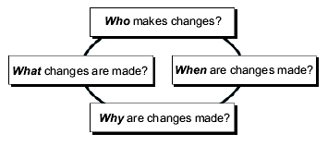
Configuration Management
Configuration Management (CM) is the process of controlling and documenting change to a system.

Slide 5
‘CM is a foundation of a project. Without it, no matter how talented the staff, how large the budget, how technically superior the development tools, project discipline will collapse, and success will be left to chance.’
Source: SPMN, Little Book of Configuration Management.
www.spmn.com
CM as a Speed Bump

Slide 6

Sources of Changes
Requirements.
Note: The longer the delivery cycle, the more likely requirements will change (e.g. 1% per month).
Changes in funding.
Technology advancements.
Solutions to problems.
Scheduling constraints.
Customer expectations.
Unexpected opportunities for an improved system.

Slide 7
Why Bother With Software CM ?
Software is easy to change
Uncontrolled change is a common source of project chaos, schedule slippages and quality problems.
Software is invisible
Types of components to keep trace
Non executable components
Documentation
Executable components
Code
Tools used to develop and test software products
Software is often changed during the life cycle
IKIWISE (I’ll Know It When I See It)
Customer is not sure what they want
Scope creep (i.e. additional requirements)
Rework (i.e. because of errors)

Slide 8
Why Bother With SCM ?
Examples of poor practices:
The latest version of source code cannot be found.
A difficult defect that was fixed at great expense suddenly reappears.
A developed and tested feature is mysteriously missing.
A fully tested program suddenly does not work.
The wrong version of the code was tested.
There is no traceability between the software requirements, documentation, and code.
Programmers are working on the wrong version of the code.
The wrong versions of the configuration items are being baselined, delivered or installed in a product
No one knows which modules comprise the software system delivered to the customer.

Slide 9
Benefits of CM to a Project
Reduces confusion and establishes order.
Organizes the activities necessary to maintain product integrity.
Ensures correct product configurations.
Limits legal liability by providing a record of actions.
Reduces life-cycle costs.
Enables consistent conformance with requirements.
Provides a stable working environment.
Enhances compliance with standards.
Enhances status accounting.

Slide 10
Distribution of Rework During
Development
Rework 44%
Production 56%
8%
19%
12%
4%
16%
1%
12%
12%
10%
6%
Requirements
Prelim.
Detailed
Code & Unit
Integr. &
Design
Design
Test
System Test
Data from IEEE

Slide 11
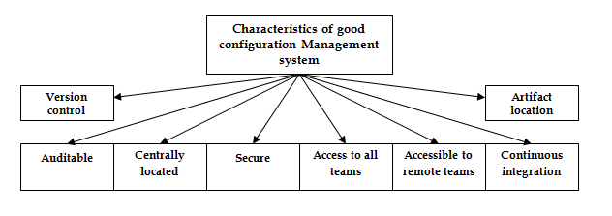
Part 1: Project Management Fundamentals
Chapter 5 (Configuration Management)
Characteristics required for a good configuration management system

Slide 12
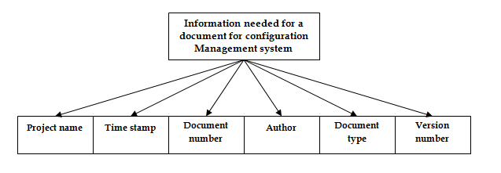
Part 1: Project Management Fundamentals
Chapter 5 (Configuration Management)
Document attributes needed to keep documents unique

Slide 13
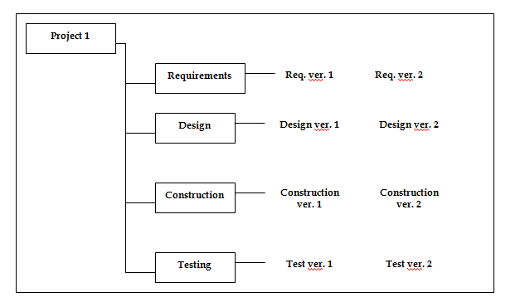
Part 1: Project Management Fundamentals
Chapter 5 (Configuration Management)
Document version control in configuration management system

Slide 14
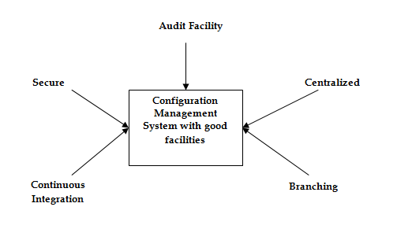
Part 1: Project Management Fundamentals
Chapter 5 (Configuration Management)
Characteristics of a good configuration management system

Slide 15
Part 1: Project Management Fundamentals
Chapter 5 (Configuration Management)
Characteristics go a good configuration management system

Slide 16
Purpose of Configuration Management
To establish and maintain the integrity of work products using:
configuration identification,
configuration control,
configuration status accounting,
configuration audits.

Slide 17
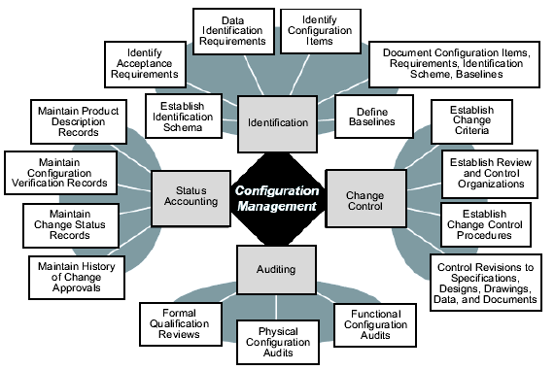
Four Key Functions of CM

Slide 18
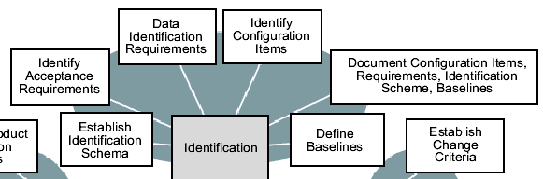
Functions of CM 1. Configuration Identification
Role: To define baseline components
Question: What is my system configuration ?
Your system configuration consists of the following items: Item1, Item2, Item3,…
Major Activities

Slide 19
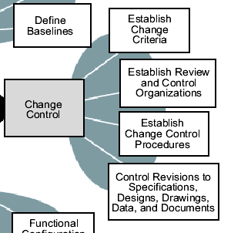
Functions of CM 2. Configuration Control
Role: To provide a mechanism (i.e. documentation, organizational body, procedures) for preparing, evaluating, approving or disapproving all changes throughout the lifecycle
Question: How do I control changes to my configuration ?
The steps in processing changes are: Step1, Step2,…*

Slide 20
Elements of Change Control Process
Who can initiate the change requests
The individuals, group, or groups who are responsible for evaluating, accepting, and tracking the change proposals for the various baselined products
What the criteria are for placing the software components under formal change control
The “change impact” analysis expected for each requested change
How revision history should be kept
The check-in/check-out procedures
The process the software configuration control board (SCCB) follows to approve changes
How change requests will be linked to the trouble-reporting system
How change requests are tracked and resolved
The reviews and/or regression tests that must be performed to ensure that changes have not caused unintended effects on the baseline
The procedure that will be followed to update all affected software.

Slide 21
Flow of a Change Request
Business Requirement
Modifies
drives specification of
System Requirement, Use Case, External Interface Requirement,
Quality attributes
Change Request
Modifies
Business Rules
is origin of
is origin of
Modifies
Software Functional Requirement
Modifies
depends on another
is satisfied by
is verified by
Leads to creation of
Architecture, User Interface, Functional Design
Project Plan Task
System Test
is verified by
is implemented in
Integration test
Code
is verified by
Unit test

Slide 22
Impact Analysis Report Template.
Change Request ID:______________Title:___________________
Description:__________________ Analyst: _________________
Date Prepared: _______________
Prioritization Estimates:
Relative Benefit: (1-9)___
Relative Penalty: (1-9)___
Relative Cost: (1-9) ___
Relative Risk: (1-9) ___
Calculated Priority:______
Estimated total effort:___________ labor hours
Estimated lost effort:___________ labor hours
Estimated schedule impact:___________ days
Additional cost impact:___________ dollars
Quality impact:_______________________________
Other requirements affected:________________________
Other tasks affected:__________________________
Plans to be updated:__________________________
Integration issues:_________________________________
Life cycle cost issues:_________________________

Slide 23
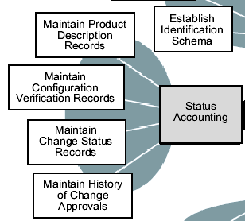
Functions of CM 3. Configuration Status Accounting
Question:
What changes have I made to the system ?
Your configuration and related changes at this time are: (Item1, Item2) + (Change1, Change2) + (Pending Change1, …)
What changes remain to be implemented ?

Slide 24
Functions of CM
3. Configuration Status Accounting
Role
Provide a mechanism for maintaining a record of the evolution of a system (e.g. history) at any time:
Is this specification approved ?
Is this subsystem tested ?
Has a change request been approved or rejected by the SCCB?
Which version of an item implements an approved change request?
What is different about a new version of a system?
How many faults are detected each month and how many are fixed?
What is the cause of the trouble report?
Report on the traceability of all changes to the baseline throughout the software lifecycle

Slide 25
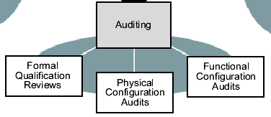
Functions of CM
4. Configuration Auditing
Question: Does the system I am building satisfy the stated needs ?
Your system, as currently built, differs from the stated needs as follow: Difference1, Difference2, …

Slide 26
Functions of CM
4. Configuration Auditing
Roles
Provide a mechanism for determining the degree to which the current state of the system mirrors the system pictured in baseline and requirements documentation
Verify that the software product is built according to the requirements, standards, or contractual agreement
Verify that all software products have been produced, correctly identified and described, and that all change requests have been resolved
Provide the mechanism for establishing a baseline
Ensure SCM process and procedures are performed

Slide 27
Change Control Policy -1
Elements of a change control policy:
All requirement changes must follow the process.
If a change request is not documented according to this procedure, it will not be acted upon.
The change control board (CCB) designated for each project will decide which changes to implement.
Simply requesting a change does not guarantee that it will be made.
The contents of the change database shall be visible to all project stakeholders.

Slide 28
Change Control Policy -2
Elements of a change control policy:
4. The original text of a change request shall not be modified or deleted from the database.
5. Every incorporated requirement change shall be traceable back to an approved change request.
6. No design or implementation work will be performed on unapproved requirement changes other than feasibility exploration to assist with making the approval decision.

