Slide 1

Teaching material for a course in Software Project Management & Software Engineering – Part I

Slide 2
Chapter 6
In the previous chapter, we learned
What is a configuration management system?
What are the parts of a configuration management system?
Why is a configuration management system required on a software project?
What strategies can be made to deploy a configuration management system successfully for a project?
In this chapter, we will learn
What is software project plan?
What are the parts of a software project plan?
What are the types of software project plans?
What inputs go in making a software project plan?
What techniques are used in making a software project plan?

Slide 3
Project planning
Probably the most time-consuming project management activity.
Continuous activity from initial concept through to system delivery.
Plans must be regularly revised as new information becomes available.

Slide 4
Part 1: Project Management Fundamentals
Chapter 6 (Project Planning)
In project planning phase, elaborate planning for all project components are made. You create baseline structure here which is used to execute, monitor and control the project.
Project planning consists of project scheduling, project budgeting, manpower planning, communication planning, quality planning etc.
Project scheduling can be done in 2 ways. Top down planning and bottom up planning. But first of all you need to break the entire project work into manageable small tasks. In top down planning you first assign time duration for the entire project. Later you assign time duration for smaller tasks within the time periods of their respective container bigger tasks. In bottom up planning, time duration is assigned to small tasks first. Later, the time duration of all smaller tasks are added up to come up with time duration of their container larger task.

Slide 5
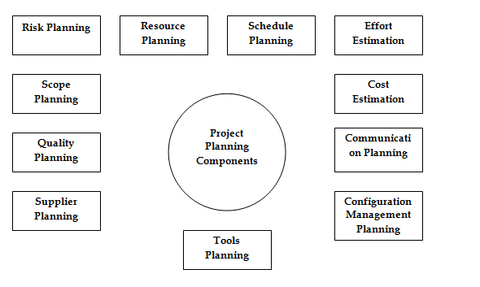
Part 1: Project Management Fundamentals
Chapter 6 (Project Planning)
Software Project planning components

Slide 6
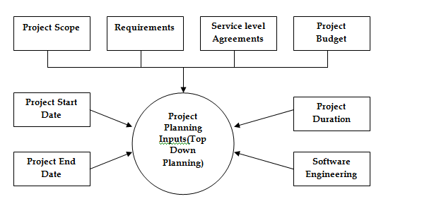
Part 1: Project Management Fundamentals
Chapter 6 (Project Planning)
Software Project planning inputs for top down planning technique

Slide 7
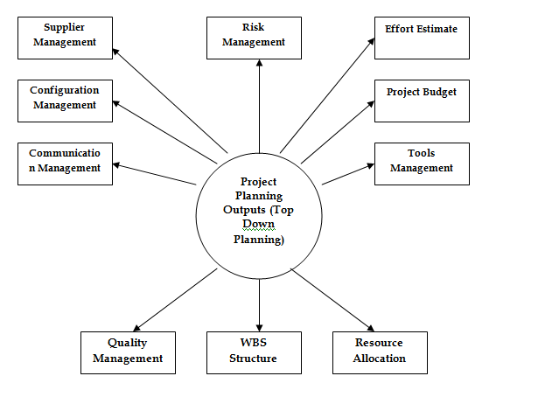
Part 1: Project Management Fundamentals
Chapter 6 (Project Planning)
Software Project planning ouputs for top down planning technique

Slide 8
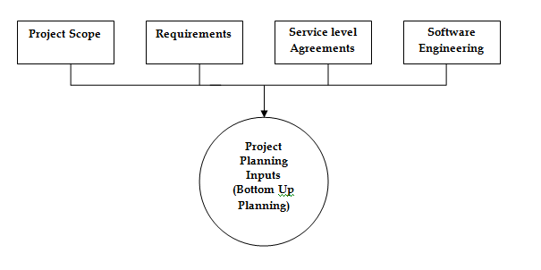
Part 1: Project Management Fundamentals
Chapter 6 (Project Planning)
Software Project planning inputs for bottom up planning technique

Slide 9
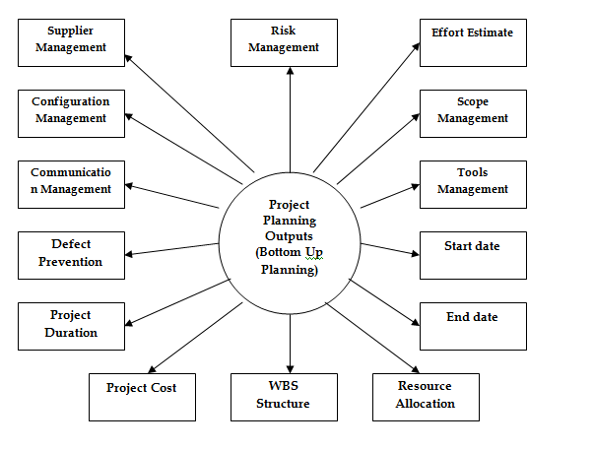
Part 1: Project Management Fundamentals
Chapter 6 (Project Planning)
Software Project planning outputs for bottom up planning technique

Slide 10
Part 1: Project Management Fundamentals
Chapter 6 (Project Planning)
Work breakdown structure (WBS) is the systematic way of breaking down the complete project work into smaller tasks. WBS also maintains relationship among tasks so that it is possible to know which tasks precede another tasks, which tasks can not start before completion of some other task etc.
Once WBS structure for tasks is ready then you can allocate resources for each task. Resource allocation should be based on closely matching required skills with those available. How many resources should be allocated on a task will depend on the amount of effort required and for how long the task will run. For example, if a task requires 50 hours of work and should be completed in 2 days (16 hours) then you should assign 3 resources on this task. Still you will need to over burden any resource for 2 hours of overtime work.

Slide 11
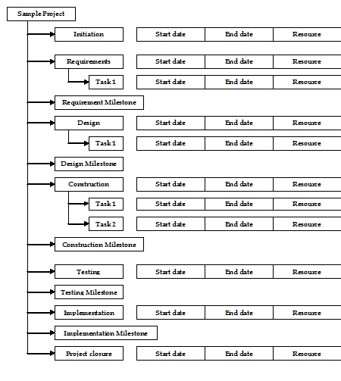
Part 1: Project Management Fundamentals
Chapter 6 (Project Planning)
Software Project work breakdown structure

Slide 12
Scheduling problems
It is hard to estimate the difficulty of problems
Difficulty = the cost of developing a solution
Productivity is not proportional to the number of people working on a task.
Adding people to a “late” project makes it “later” because of communication overheads.
The unexpected always happens. Always allow contingency in planning.
Notes:
need systematic way to do scheduling

Slide 13
Activity organization
Activities in a project should be organized to produce tangible outputs for management to judge progress.
Milestones are the end-point of a process activity.
Deliverables are project results delivered to customers.
The waterfall process allows for the straightforward definition of progress milestones.

Slide 14









































Milestones and deliverables
ACT IVITIES
Feasibility
Requir ements
Prototype
Design
Requir ements
study
analysis
development
study
specification
Feasibility report
Requir ements definition
Evaluation report
Architectural design
Requir ements specification
MILESTONES

Slide 15
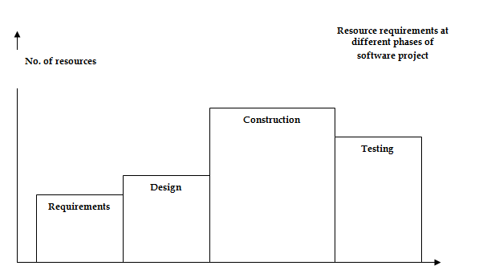
Part 1: Project Management Fundamentals
Chapter 6 (Project Planning)
Resource requirements at various software tasks

Slide 16
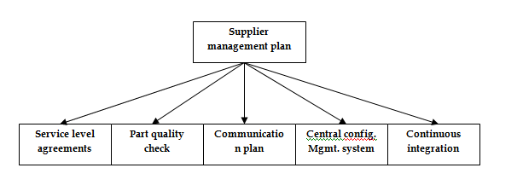
Part 1: Project Management Fundamentals
Chapter 6 (Project Planning)
Supplier management plan

Slide 17
Project scheduling
Split project into tasks and estimate time and resources required to complete each task.
Organize tasks concurrently to make optimal use of workforce.
Minimize task dependencies to avoid delays caused by one task waiting for another to complete.
Dependent on project managers intuition and experience.

Slide 18
Presenting schedule
Graphical notations are normally used to illustrate the project schedule.
These show the project breakdown into tasks.
Tasks should not be too small. They should take about a week or two.
Calendar-based
Bar charts are the most commonly used representation for project schedules. They show the schedule as activities or resources against time.
Activity networks
Show task dependencies

Slide 19
Project activities
Project activities (tasks) are the basic planning element. Each activity has:
a duration in calendar days or months,
an effort estimate, which shows the number of person-days or person-months to complete the work,
a deadline by which the activity should be complete,
a defined end-point, which might be a document, the holding of a review meeting, the successful execution of all tests, etc.

Slide 20
Milestones and deliverables
Milestones are points in the schedule against which you can assess progress
E.g., the handover of the system for testing.
Deliverables are work products that are delivered to the customer
E.g. a requirements document for the system.
Notes:
waterfall deliverable: documents

Slide 21
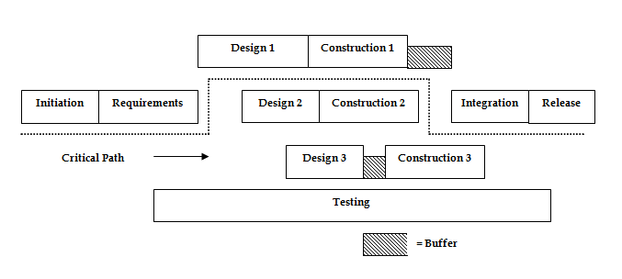
Part 1: Project Management Fundamentals
Chapter 6 (Project Planning)
Goldratt’s critical chain method (unnecessary buffer to be removed)

Slide 22
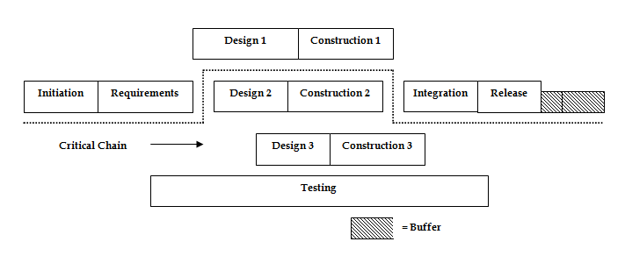
Part 1: Project Management Fundamentals
Chapter 6 (Project Planning)
Goldratt’s critical chain method (unnecessary buffer removed)

Slide 23
Bar charts and activity networks
Graphical notations used to illustrate the project schedule.
Show project breakdown into tasks. Tasks should not be too small. They should take about a week or two.
Activity charts show task dependencies and the the critical path.
Bar charts show schedule against calendar time.

Slide 24
Task durations and dependencies
Task Duration Dependencies
(days)
T1 8 T2 15
T3 15 T1
T4 | 10
T5 | 10 | T2, T4
T6 | 5 | T1, T2
T7 | 20 | T1
T8 | 25 | T4
T9 | 15 | T3, T6
T10 | 15 | T5, T7
T11 | 7 | T9
T12 | 10 | T11

Slide 25
Activity bar (Gantt) chart
Project milestone

Slide 26
Staff allocation chart
Part-time
assignment
Notes:
Mary works only on T5. This can cause scheduling problems.
If one project is delayed while a specialist (Mary) is working on it, this may have a knock-on effect on other projects where the specialist is also required.
part-time assignments using a diagonal line crossing the bar (they may work on other projects, too)

Slide 27
Precedence networks (or activity-on-node networks)
A graph (network), where…
Nodes represent activities.
Edges represent precedence (or sequencing) requirements.

Slide 28
Notation, rules and conventions
Activity description
Activity label
Duration
Earliest start time
ES
Earliest finish
time
EF
Latest start time
LS
LF
Latest finish
time
Float
Notes:
Float: The difference between an activity’s earliest start date (ES) and its latest start date (LS)
How much buffer do we have
Draw to illustrate how they connect

Slide 29
Critical Path
There will be (at least) one path through the network joining those critical activities: known as the critical path.
The critical path is determined by adding the times for the activities in each sequence and determining the longest path in the project.
The critical path determines the total calendar time required for the project.
If activities outside the critical path speed up or slow down (within limits), the total project time does not change.
Notes:
Longest path and no float

Slide 30
Part 1: Project Management Fundamentals
Chapter 6 (Project Planning)
If you have hardware or software suppliers (outsourcing partners etc.) on the project then you need to make a supplier planning for the project. Which tasks the supplier will perform on the project and how these tasks are dependent on other tasks should be clearly defined and communicated to the supplier. Also quality planning should be clearly outlined with the supplier so that quality does not differ on software products made by the supplier to the ones made inhouse.

Slide 31
Part 1: Project Management Fundamentals
Chapter 6 (Project Planning)
When you plan for configuration management, you decide how you are going to create and maintain a repository for all your project documents as well as how you will branch out various versions of your software product.
Communication on a project is both formal and informal. Most of informal communication is lost as it is often not saved. The other problem on projects is that even formal communication is lost or leads to wrong communication as wrong communication tools and techniques are deployed. Communication planning for the project must include which channels of communications are used, which communication tools are used, how communication with customers and suppliers will be done and how to ensure that miscommunication does not occur.

Slide 32
Part 1: Project Management Fundamentals
Chapter 6 (Project Planning)
Quality assurance is one of the most important aspects of any project. How software product with required level of quality should be produced on the project is one of the topmost considerations on software projects. Quality assurance plan is thus made to ensure the required level of quality of the software product produced.
Project schedule planning is again one of the most important aspects of any project. Using techniques like WBS, CPM (critical path method), Goldratt’s critical chain method or any suitable technique, a complete project schedule structure should be made for the project.
Project budgeting is again one of the most important project planning tasks. If project costs exceed project budget then it can jeopardize the project. Proper budget planning is thus very important.

Slide 33
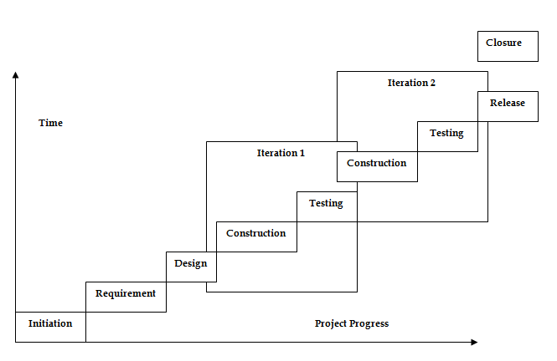
Part 1: Project Management Fundamentals
Chapter 6 (Project Planning)
Project planning in partial iteration model

Slide 34
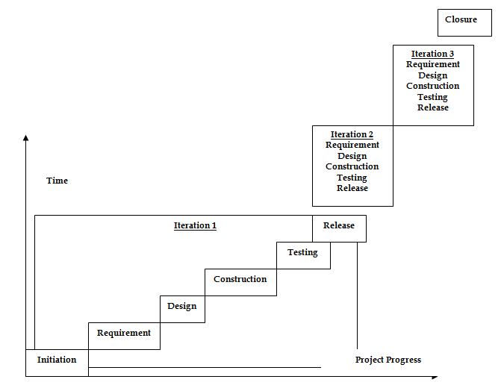
Part 1: Project Management Fundamentals
Chapter 6 (Project Planning)
Project planning in full iteration models

Slide 35
Part 1: Project Management Fundamentals
Chapter 6 (Project Planning)
Project planning in iterative software lifecycle model is different from project planning in waterfall model environment. For iterative projects, the entire project plan spans several iterations. Depending on the lifecycle model, these iterations can be full or partial.

