Slide 1
AUDITAI
PRESENTS
AUDIT AI
AI-Powered Smart Contract Security Platform
Static Analysis • Symbolic Execution • AI Detection • Continuous Monitoring
Team Unfiltered Devs | Securithm Product Line
2026 • SaaS Security Audit Platform • auditai.io

Slide 2
AUDITAI
SECTION 01
Product Overview
What is AuditAI?
Why Now
An AI-powered SaaS platform that audits smart
contracts in seconds — combining 500+ static
rules, symbolic execution, and an LLM engine,
with A–F risk scoring and on-chain monitoring.
$3.8B+
$100B+
47 days
lost to DeFi hacks
TVL at stake
avg. to exploit
Audits cost $50K–$500K and take 4–8 weeks. We do it in 45 seconds.
94.7%
45s
6
500+
DETECTION RATE
AVG. SCAN TIME
CHAINS SUPPORTED
VULN PATTERNS
One-line pitch: Ship secure contracts — before the hackers find the bugs.

Slide 3
AUDITAI
SECTION 02
Problem Statement & Target Users
The Problem
• Manual audits take 4–8 weeks and cost $50K–$500K+ — critical bugs get exploited in as little as 6 hours.
• Even expert auditors miss 15–20% of vulnerabilities; static tools drown teams in false positives.
• Point-in-time audits go stale: 32% of exploits are reentrancy, 21% flash-loan attacks, 18% oracle manipulation.
TARGET USERS
Protocol Teams
Security Auditors
Instant CI/CD scans on every push & PR before deployment
Auto-triage findings; focus human effort on business logic
→ Faster, safer shipping
→ Higher coverage per hour
Investors & DAOs
Exchanges & Launchpads
A–F risk score any contract before investing or voting
Screen listings at scale with the Risk Score API
→ Data-driven decisions
→ Automated due diligence

Slide 4
AUDITAI
SECTION 03
Existing Solutions & Their Limitations
Slither
Mythril
Static analyzer
Symbolic executor
High false positives; misses cross-contract & economic bugs
Slow on large contracts; shallow business-logic coverage
Manual Audit Firms
Basic LLM Checkers
Human experts
AI chatbots
$50K–$500K, 4–8 weeks, point-in-time only, hard to scale
Generic, no exploit grounding, no monitoring, no CI/CD
The Gap AuditAI Fills
• Multi-engine depth of an audit firm — automated, repeatable, and 100x faster.
• AI semantic layer catches business-logic & economic attacks that pattern tools miss (+23% logic-vuln detection, −35% false positives).
• Continuous monitoring keeps verdicts fresh — no more point-in-time audit decay.
• API-first & CI/CD-native: security embedded in the dev workflow, not bolted on.

Slide 5
AUDITAI
SECTION 04
Proposed Solution & Key Innovations
01 Multi-Engine Analysis
02 AI Fix Suggestions
Static rules (500+) + symbolic execution (10^6 paths) + AI semantic analysis — consensus scoring across engines
Context-aware patches with code, tests & deployment notes for every finding — not just an alert
03 Continuous Monitoring
04 Risk Score API
On-chain surveillance of deployed contracts with 2.3s alert latency across 6 chains
A–F grade for any contract address in one call — for investors, exchanges & DAOs
Competitive Edge
94.7%
−35%
45s
$29
vs 74.8% industry
false positives
vs 4–8 weeks
vs $50K+ audits

Slide 6
AUDITAI
SECTION 05
Technical Approach — System Workflow
INPUT
PARSE
STATIC
SYMBOLIC
Paste code / .sol,.rs upload /
on-chain address
Solidity • Vyper • Rust → unified
AST + CFG
500+ rules: reentrancy, access
control, oracle bugs
Z3 constraint solving, 10^6 path
exploration
AI ENGINE
AGGREGATE
OUTPUT
MONITOR
Fine-tuned LLM + RAG — logic &
economic attacks
Dedup, severity (CVSS),
cross-engine consensus
Findings + AI fixes + A–F Risk
Score + report
Deployed-contract watch, 2.3s
alerts, CI/CD hooks
Avg. full-pipeline scan: 45 seconds standard contract • 3–8 min complex protocol
Detection Performance
Reentrancy 99.2%
Access Control 96.8%
Flash Loan 94.1%
Business Logic 89.3%
vs 87% industry
vs 82%
vs 76%
vs 58%

Slide 7
AUDITAI
SECTION 06
Technology Stack — What Powers AuditAI
FRONTEND
BACKEND API
DATA & CACHE
Next.js 15 + React 19 + TypeScript
Tailwind CSS 4 + Radix UI components
Three.js / GSAP visualizations
Lucide icon system
FastAPI (Python 3.12) · 14+ REST endpoints
JWT auth · API keys · Pydantic v2 schemas
Versioned /api/v1 · Uvicorn ASGI
reportlab PDF reports · Resend email
PostgreSQL 16 + SQLAlchemy ORM
Alembic migrations
Redis 7 cache + task broker
Celery background scan workers
AI / ML ENGINE
BLOCKCHAIN LAYER
DEVOPS & CI/CD
Fine-tuned security LLM + RAG
Z3 symbolic constraint solver
500+ static detection rules
CVSS severity scoring model
Solidity 0.4–0.8 · Vyper · Rust/Anchor
eth-account · Risk Score API (A–F)
6 chains: ETH, Base, Arbitrum,
Polygon, BSC, Solana
GitHub Actions scan bot on PRs
Docker Compose infra (PG + Redis)
Vercel frontend deploys
Sentry monitoring + Resend email
END-TO-END REQUEST FLOW
Next.js Dashboard
FastAPI REST
Celery + Redis Queue
Analysis Engines
PostgreSQL
Alerts + Reports

Slide 8
AUDITAI
SECTION 07
System Architecture
CLIENT — Next.js 15 Dashboard (React 19, Tailwind, GSAP)
API GATEWAY — FastAPI (Uvicorn ASGI) + JWT / API keys
Team seats, scan UI, remediation workflow, API console
/api/v1: scans, findings, monitoring, risk-score, billing
JOB QUEUE — Redis 7 broker + Celery workers
ANALYSIS ENGINES — Static + Symbolic (Z3) + AI LLM/RAG
Async scan pipeline, retries, scheduled monitor sweeps
500+ rules · 10^6 paths · CVSS scoring · fix generation
DATA — PostgreSQL 16 (SQLAlchemy + Alembic)
BLOCKCHAIN WATCHERS — eth-account RPC polling
Orgs, scans, findings, monitors, usage meters, audit trails
Ethereum, Base, Arbitrum, Polygon, BSC, Solana
CI/CD: GitHub Action scans every push/PR with inline findings
ALERTS: Slack / Discord / Email / Webhook (2.3s latency)
DEPLOYMENT & SCALE
Vercel
Docker Compose
Worker autoscale
Sentry
99.97%
frontend + edge
PG + Redis infra
10k+ scans/hour
error telemetry
API uptime, 12 mo

Slide 9
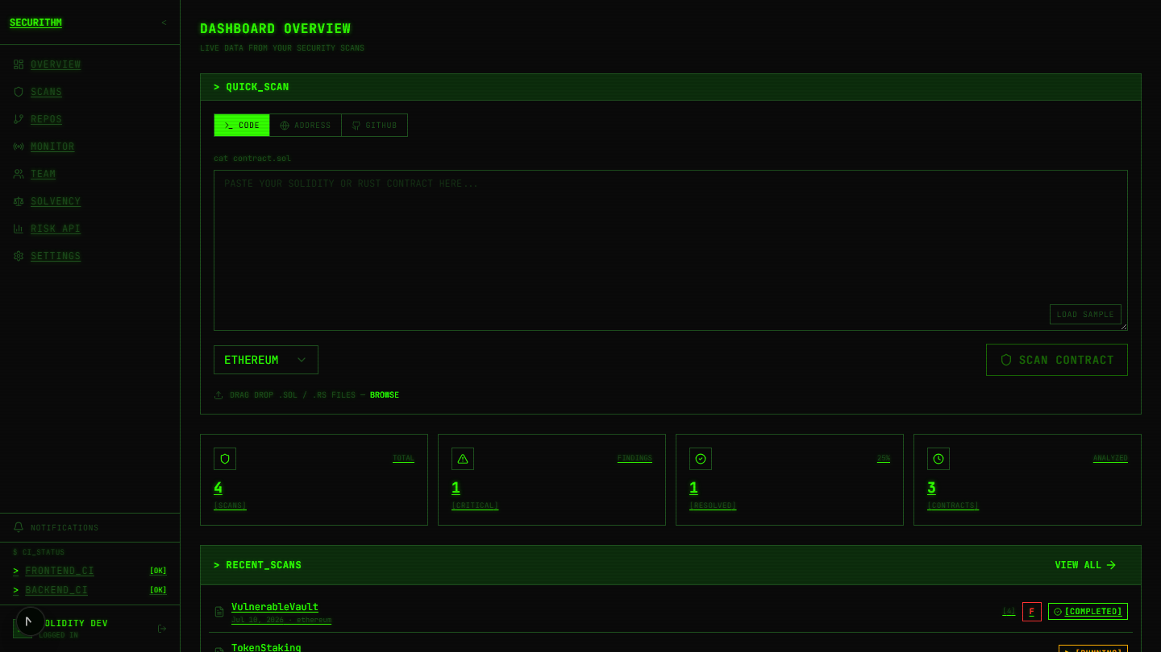
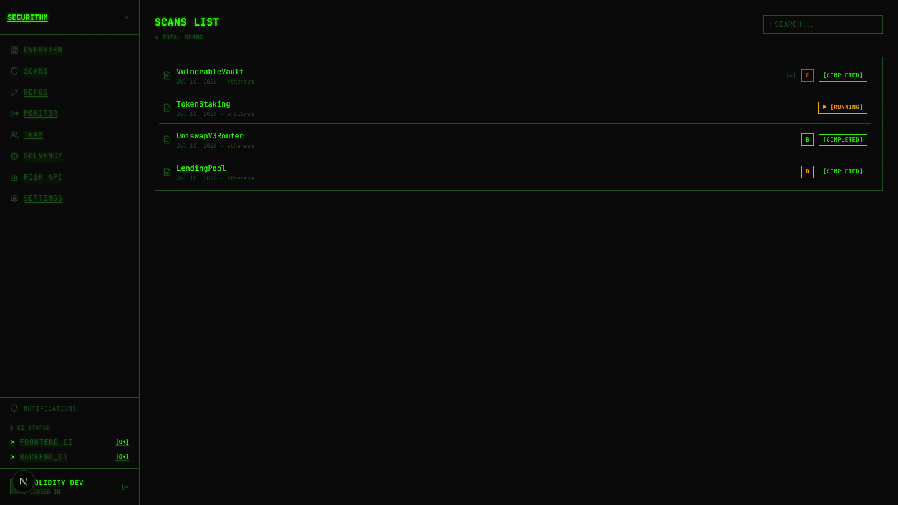
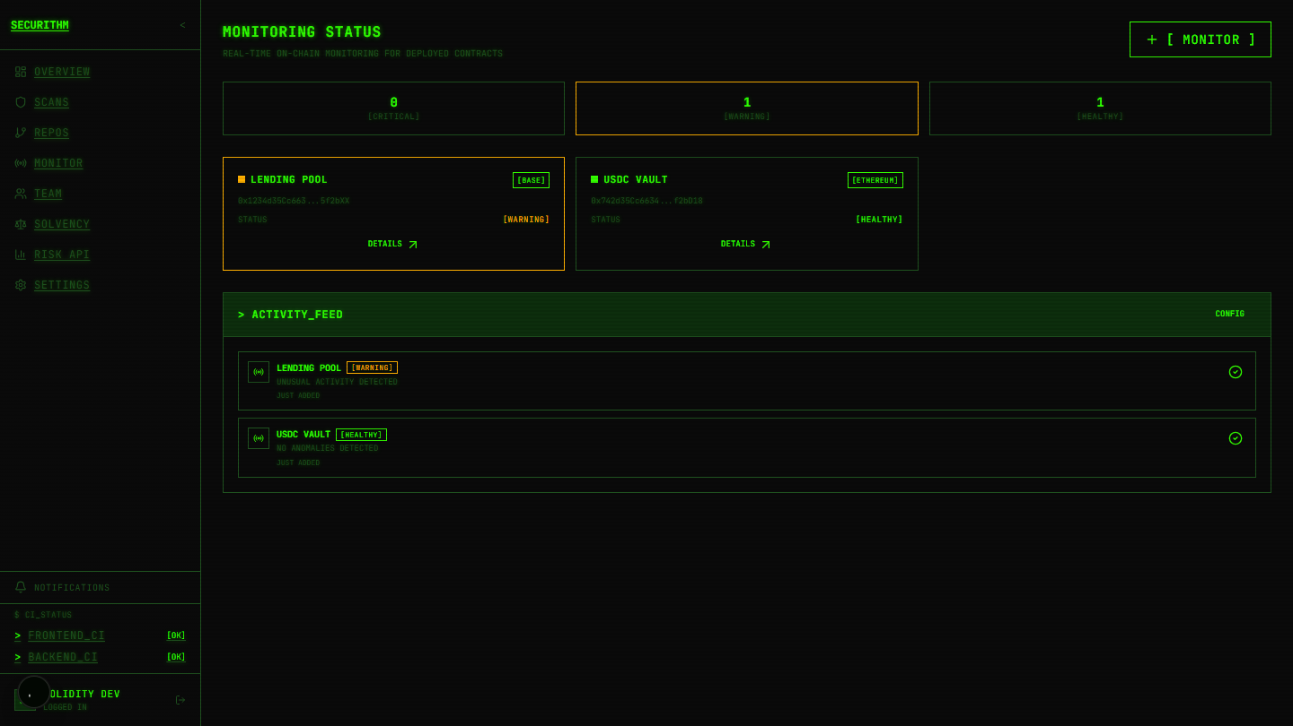
AUDITAI
SECTION 08
Product Walkthrough — Live Dashboard
Real product UI · demo org data · scans, monitoring & alerting in production shape
Dashboard Overview
Scans & Risk Grades
Continuous Monitoring
Quick scan (code / address / GitHub), live
usage meters, CI status
A-F risk grades per contract —
VulnerableVault graded F
On-chain watchtowers with health status +
activity feed alerts
SHIPS TODAY
Next.js dashboard (11 pages) · FastAPI (14+ REST endpoints) · GitHub Action CI bot ·
A-F Risk Score API · remediation workflow with sign-off & audit-trail export

Slide 10
AUDITAI
SECTION 09
Tokenomics — SCRT Utility Token
Token Utility
Token Distribution
PAY
scans, monitoring, API & enterprise plans
Ecosystem Fund
35%
STAKE
discounts, priority access, higher API limits
Community Rewards
25%
Team & Advisors
20%
GOVERN
vote on features, fees, ecosystem fund
Private Sale
10%
EARN
bug bounties, referrals, community rewards
Public Sale
5%
Liquidity
5%
Vesting: Team 1y cliff / 3y linear • Private 6m cliff / 1y • Public 25% TGE
Economic Model — The Flywheel
Deflationary Mechanisms
1. Demand: teams need constant security coverage
2. Utility: SCRT pays for scans, staking, governance
3. Value accrual: fee burning + revenue buybacks
4. Growth: rewards attract auditors & contributors
5. Platform improves → more demand → repeat
• Fee Burning
share of every SCRT service fee burned forever
• Buyback & Burn
fiat revenue used to buy & burn SCRT
• Staking Lockups
loyalty tiers reduce circulating supply
• Bounty Escrow
treasury SCRT reserved for bounties & grants

Slide 11
AUDITAI
SECTION 10
Business Model & Pricing
MOST POPULAR
FREE
PRO
TEAM
ENTERPRISE
$0/mo
$29/mo
$99/mo
Custom
• 50 scans/mo
• 500 scans/mo
• 2,000 scans/mo
• Unlimited scans
• 1 monitored contract
• 10 monitored contracts
• 50 monitored contracts
• Risk Score API
• GitHub Action
• AI fix suggestions
• Remediation workflow
• 99.95% SLA
• Community support
• Slack/Discord alerts
• Unlimited seats
• Dedicated support
Revenue Streams & Unit Economics
• Subscription SaaS
• Usage-based
core recurring revenue across 4 tiers
$0.10 per extra scan; volume discounts
• API Licensing
• Enterprise
Risk Score API for exchanges & wallets
custom infra, compliance docs, SLAs

Slide 12
AUDITAI
SECTION 11
Development Roadmap
Q3 2026
Q4 2026
Q1 2027
Q2 2027
• Cross-chain invariant monitoring
• Advanced fuzzing engine
• Formal verification module
• MEV protection analysis
• Gas optimization recommender
• Custom rule creation SDK
• ZK-proof verification
• Move language support
• Automated exploit simulation
• WASM contract support
• AI exploit prediction
• Decentralized audit marketplace
Long-Term Vision
A fully automated security layer for the entire blockchain ecosystem — every contract continuously
monitored and protected against emerging threats in real time.

Slide 13
AUDITAI
SECTION 12
Team & Why We Win
TEAM UNFILTERED DEVS
A
R
S
P
Ajay Yadav
Rangesh Gupta
Shivam Prajapati
Poornita Sahu
Team Lead & Frontend
AI/ML & Backend
UI/UX & Frontend
Research & Presentation
Why We Win
• Only platform combining static + symbolic + AI engines with continuous monitoring at SaaS pricing
• Working product: Next.js dashboard, FastAPI backend, GitHub Action CI/CD — already scanning contracts
• AI fix suggestions close the loop from detection to remediation — a category first at this price point
The Ask
Raising to scale go-to-market, expand chain coverage, and grow the AI detection research team.
Contact: team@auditai.io • auditai.io • github.com/securithm

Slide 14
AUDITAI
SECTION 13
References & Disclosure of Existing Work
01
SWC Registry
02
OWASP Smart Contract Top 10
Smart Contract Weakness Classification
Industry vulnerability taxonomy
swcregistry.io
owasp.org/www-project-smart-contract-top-10
03
Slither
04
Mythril
Static analysis framework reference
Symbolic execution approach reference
github.com/crytic/slither
github.com/Consensys/mythril
05
Rekt News
06
Certora
DeFi attack database & case studies
Formal verification of smart contracts
rekt.news
certora.com
07
ZEUS / S-gram Research
08
Securithm Whitepaper v1.0
Academic smart-contract analysis papers
Full technical methodology document
IEEE S&P / ACM
securithm.com/whitepaper

