Slide 1
AI-Powered IVR Automation Platform
Business Flow, Architecture & Execution Overview

Slide 2
Project Objective
Automate customer conversations using AI IVR
Reduce human dependency while improving experience
Enable secure, scalable, compliant voice workflows

Slide 3
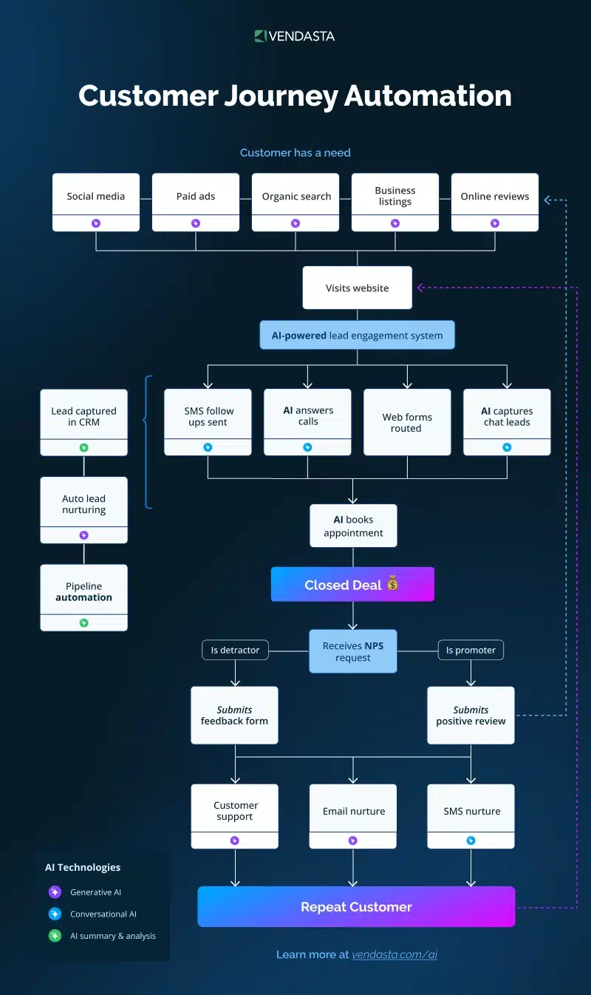
Customer Journey Automation
Customer lifecycle from awareness to repeat engagement.

Slide 4
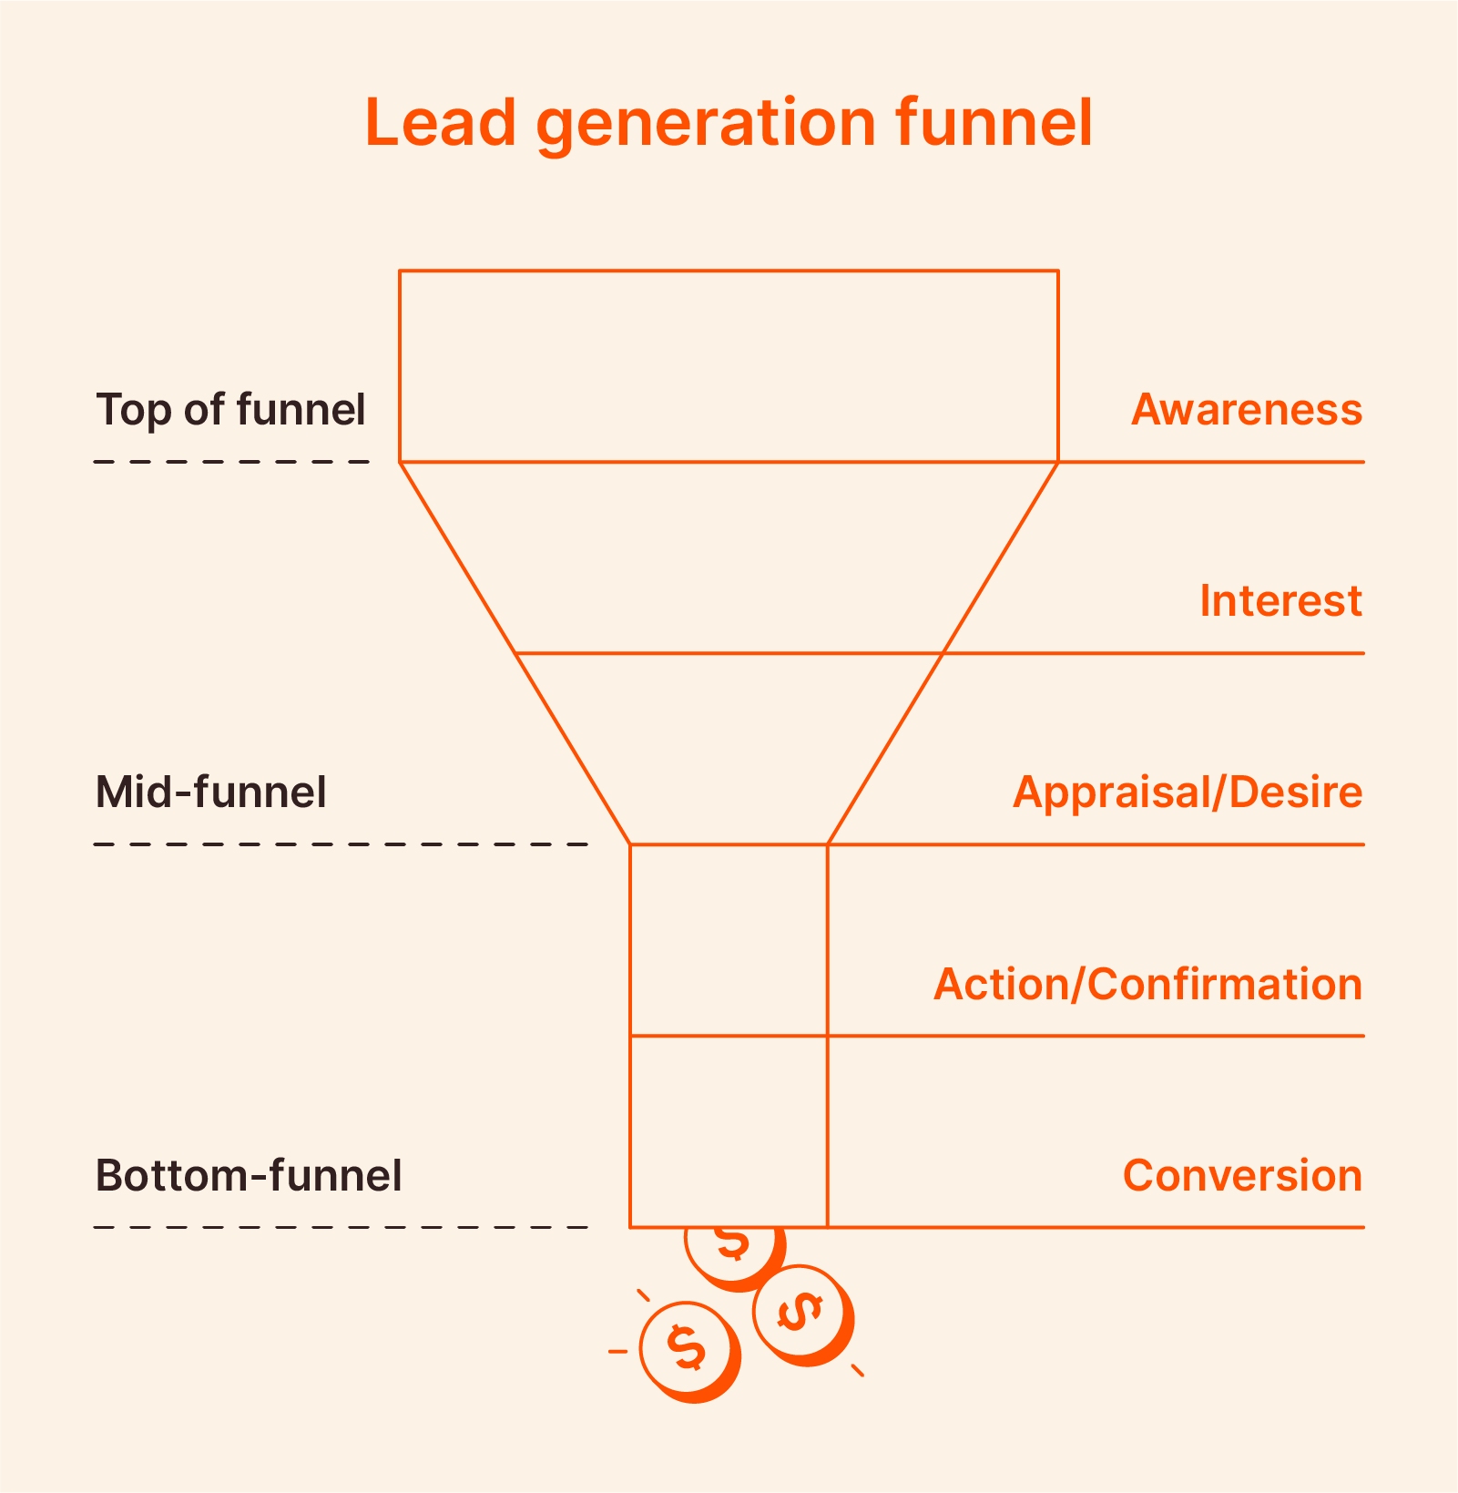
Lead Generation Funnel
Awareness → Interest → Action → Conversion funnel.

Slide 5
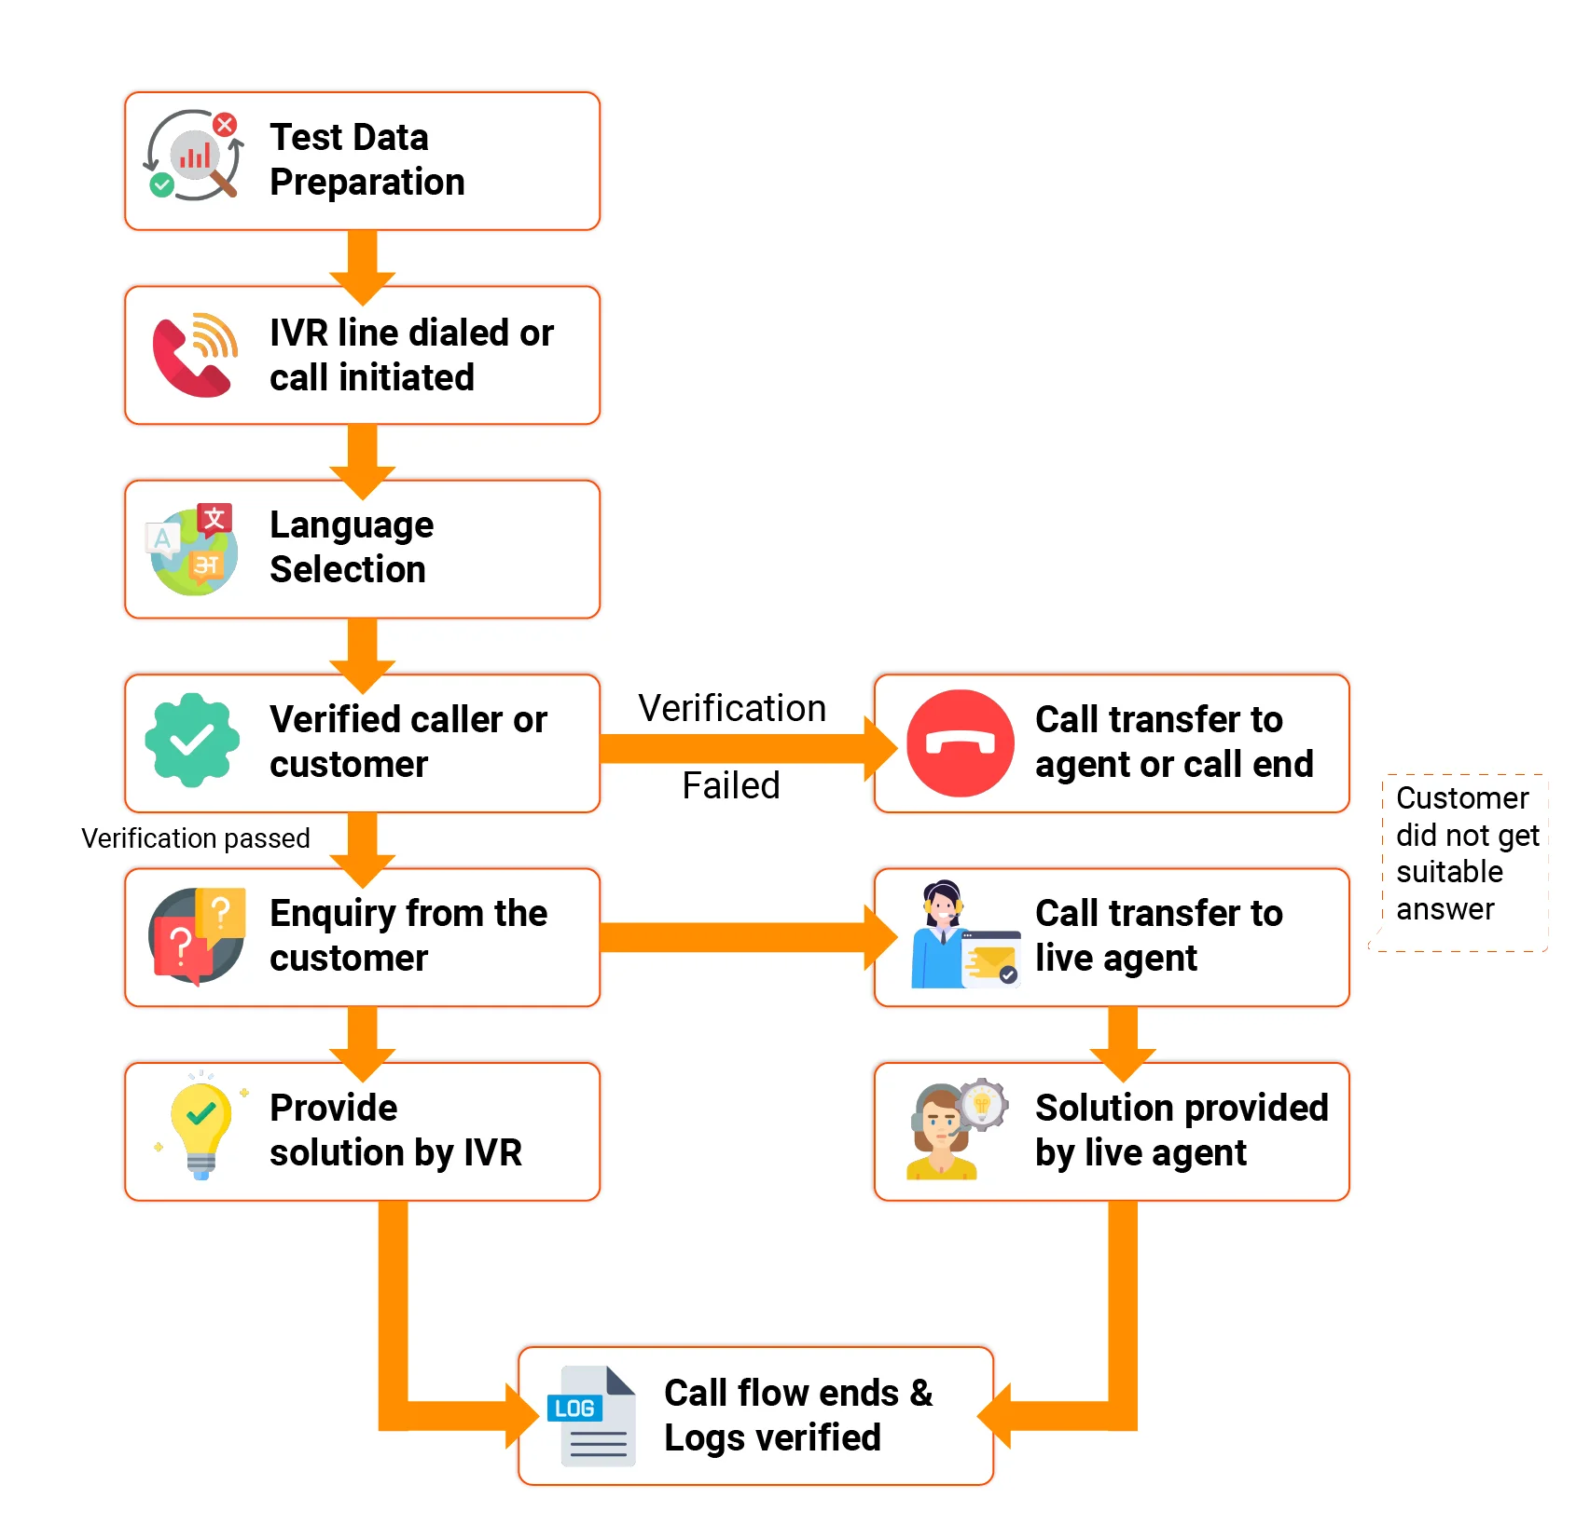
AI IVR Call Flow
Verification, AI handling, and agent fallback flow.

Slide 6
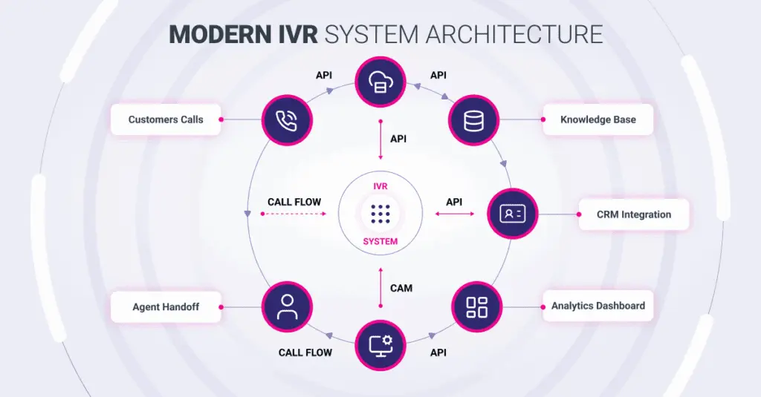
Modern IVR Architecture
IVR with Azure Communication Services, CRM, Azure Monitor, APIs.

Slide 7
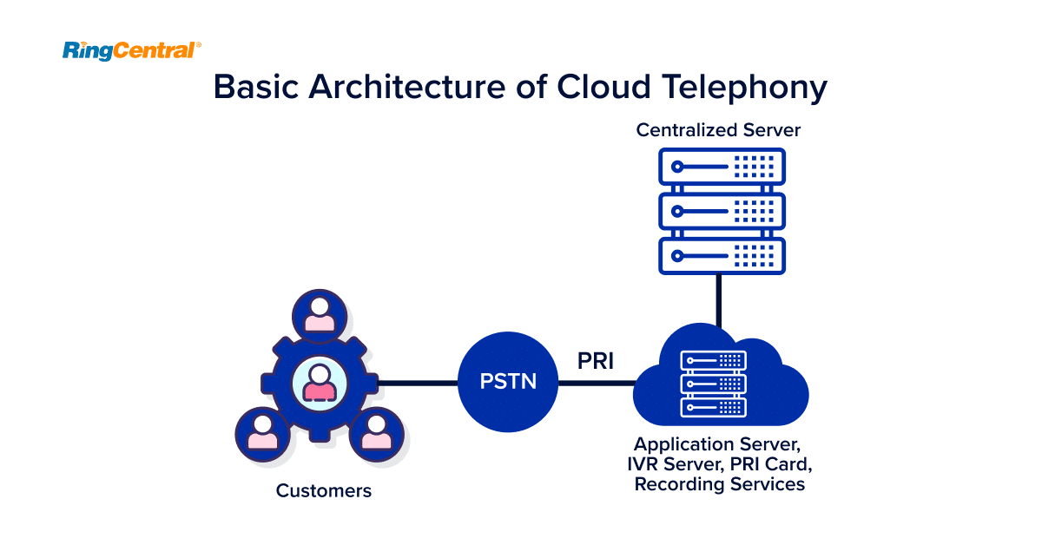
Cloud Telephony Architecture
PSTN, IVR server, and recording services.

Slide 8
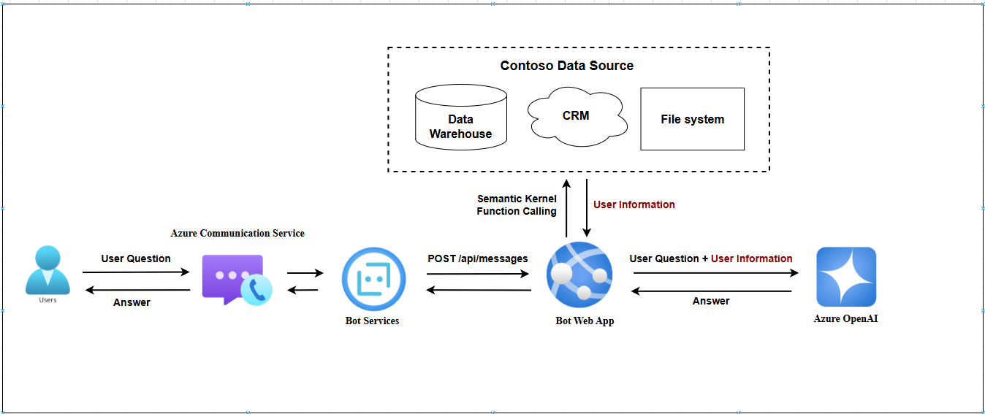
Azure Communication Services Routing

Slide 9
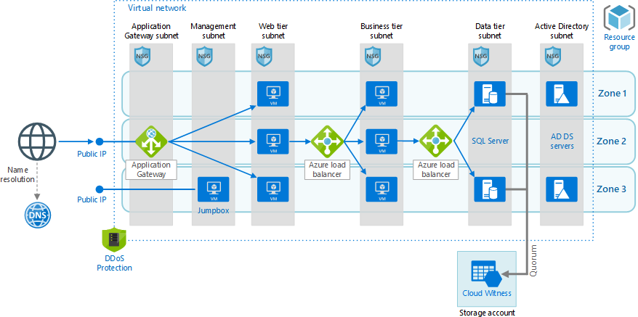
Azure 3-Tier Architecture

Slide 10
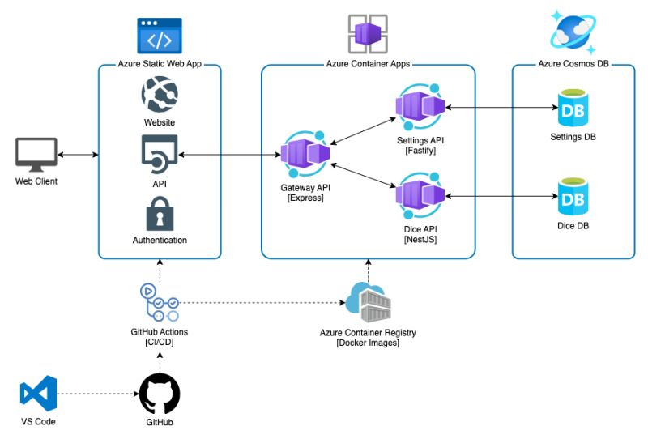
Microservices Architecture
Containerized services with independent scaling.

Slide 11
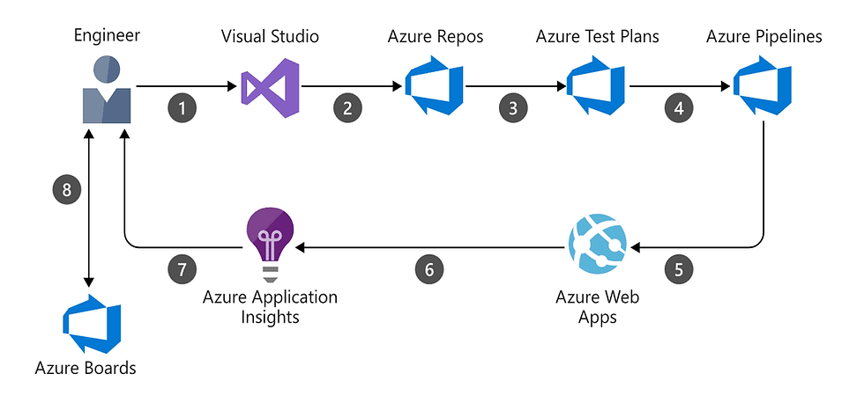
CI/CD Pipeline
Automated build, test, and deployment pipeline.

Slide 12
Phase-wise Automation
Phase 1: Lead capture & IVR entry
Phase 2: AI qualification & booking
Phase 3: Compliance confirmations
Phase 4: Orders, payments & logistics

Slide 13
Security & Compliance
Encrypted communication
Consent-based recordings
Audit logs and traceability
Role-based access control

Slide 14
Executive Cost Summary (INR) – Azure – Azure
Total Estimated Cost (First Year)
• Team Cost (8 members × 5 months): ₹65,00,000
• One-time Technology & Setup Cost: ₹4,50,000
• First-Year Azure Cloud & AI Operations: ₹5,50,000
NET TOTAL PROJECT COST: ₹75,00,000 (Approx.)
Includes complete build, deployment, and first-year operation on Azure on Azure

Slide 15
Phase-1 cost (Azure)
Component | Cost (USD) | Cost (INR approx)
Landing page design & dev | $1,500 – $2,500 | ₹1.2 – 2 L
Lead form + consent logic | $500 – $1,000 | ₹40k – 80k
CRM integration | $1,000 – $2,000 | ₹80k – 1.6 L
Email automation setup | $500 – $1,000 | ₹40k – 80k
A2P 10DLC Campaign Fee: Mandatory carrier fee for maintaining an active messaging use case. | $10 - $100 | ₹1K –11 K
PSTN / SIP Trunking Usage: Inbound and outbound audio streaming via a CPaaS (e.g., azure CS,). | $300 – $400 | ₹30K – 40k
Speech-to-Text (STT): Real-time streaming transcription of the caller's audio. | $100 – $150 | ₹10k – 18 k
Text-to-Speech (TTS): Neural voice synthesis with sub-second latency for the AI's spoken responses. | $100 – $150 | ₹10k – 15k

Slide 16
Phase-2 cost (Azure)
Item | Cost
Backend & workflow development | ₹4,00,000
AI intent detection & IVR flows | ₹5,00,000
Appointment booking logic | ₹2,00,000
QA & testing | ₹1,50,000
Project management | ₹1,00,000
Subtotal (People) | ₹13,50,000
Item | Cost
Azure OpenAI / model usage | ₹1,50,000
Azure Communication Services (IVR) | ₹1,00,000
Scheduling integrations | ₹50,000
Subtotal (Tech) Total Phase-2 | ₹2,75,000 ₹16,50,000(approx.)

Slide 17
Phase-3 cost (Azure)
Item | Cost
Compliance IVR flow development | ₹4,00,000
Backend audit & storage logic | ₹3,00,000
Security & access control | ₹1,50,000
QA & compliance testing | ₹2,00,000
Documentation & PM | ₹1,00,000
Subtotal (People) | ₹11,50,000
Item | Cost
Call recording (Azure Blob) | ₹1,50,000
Transcription (Azure Speech) | ₹1,00,000
Monitoring (Azure Monitor) | ₹1,00,000
Subtotal (Tech) Total | ₹3,50,000 ₹15,00,000 (Approx.)

Slide 18
Phase-4 cost (Azure)
Item | Cost
Order & workflow backend | ₹5,00,000
Payment gateway integration | ₹3,00,000
Logistics & tracking integration | ₹3,00,000
Admin dashboards | ₹2,00,000
QA & UAT | ₹2,00,000
Project management | ₹1,00,000
Subtotal (People) | ₹16,00,000
Item | Cost
Payment gateway setup & testing | ₹1,00,000
Logistics API usage | ₹1,00,000
Notifications (Logic Apps) | ₹50,000
Additional Azure infra | ₹1,50,000
Subtotal (Tech) Total | ₹4,00,000 ₹20,00,000 (Approx.)

Slide 19
Monthly Opex break down
Month | Project Phase | OPEX: Telecom & AI Usage (USD) | Phase Description
Month 1 | Architecture & Foundation | 50 | Initial dev sprint, cloud infra setup, and one-time A2P 10DLC registration fee. Base numbers provisioned.
Month 2 | Core AI & Dialogue Engineering | 100 | Heavy engineering sprints. Minimal OPEX for developer sandbox API testing (STT, TTS, LLM).
Month 3 | CRM / Backend Integration | 150 | Connecting agentic logic to databases. API usage increases slightly for integration testing.
Month 4 | UAT & Soft Launch | 1,200 | Dev scales down to bug fixes. Soft launch to pilot group causes first spike in live voice/AI usage.
Month 5 | Production Go-Live | 3,500 | Final code freeze and handover. System scales to full 500 users (approx. 50k minutes), hitting standard run-rate.
TOTAL | 5-Month Cumulative | 5,000 | Total project cost from day one through the end of the first fully operational month.

Slide 20
Conclusion
End-to-end AI IVR automation on Azure on Azure
Enterprise-grade cloud & telephony with Azure Communication Services with Azure Communication Services
Scalable, secure, future-ready

