Slide 1
AI-Powered IVR Automation Platform
Business Flow, Architecture & Execution Overview

Slide 2
Project Objective
Automate customer conversations using AI IVR
Reduce human dependency while improving experience
Enable secure, scalable, compliant voice workflows

Slide 3
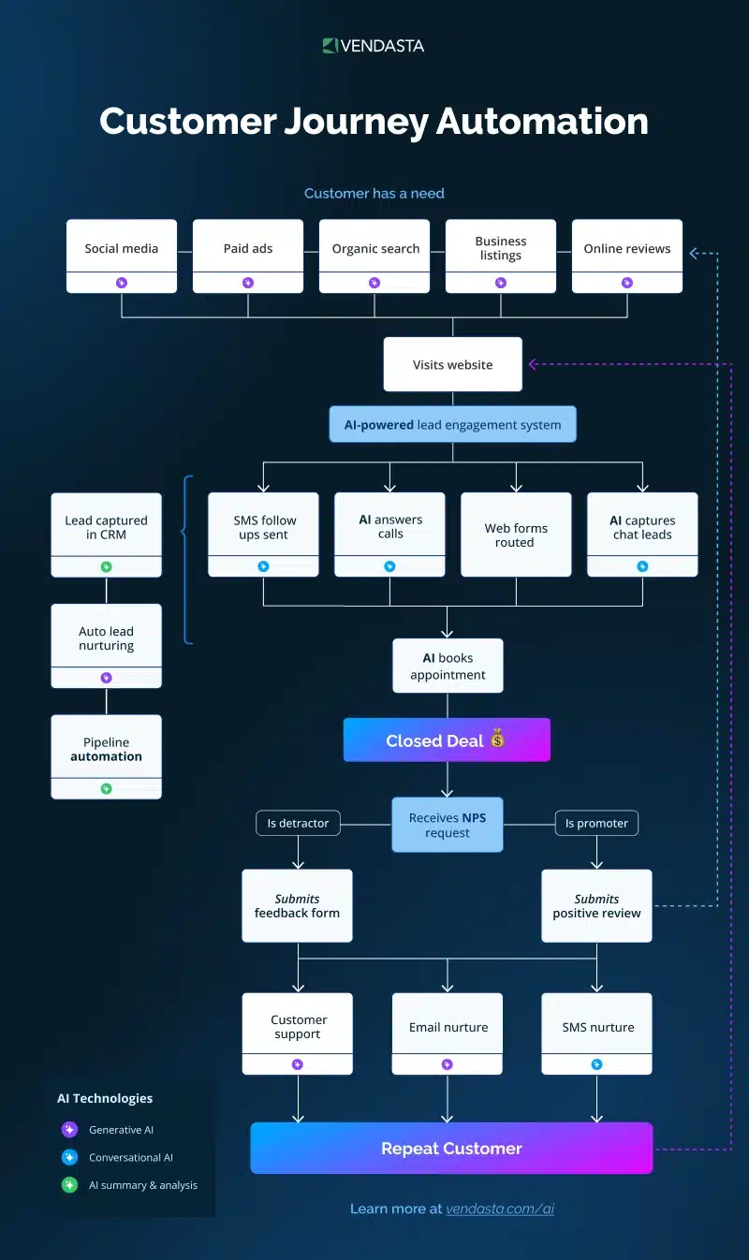
Customer Journey Automation
Customer lifecycle from awareness to repeat engagement.

Slide 4
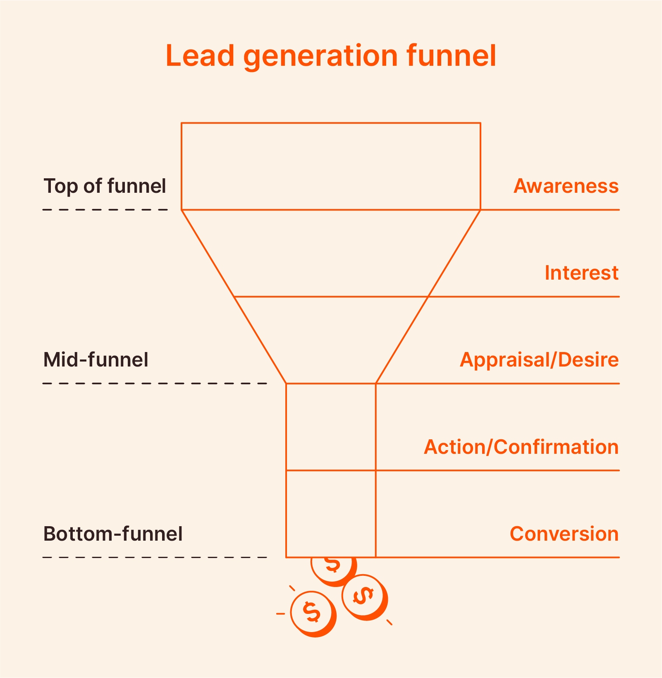
Lead Generation Funnel
Awareness → Interest → Action → Conversion funnel.

Slide 5
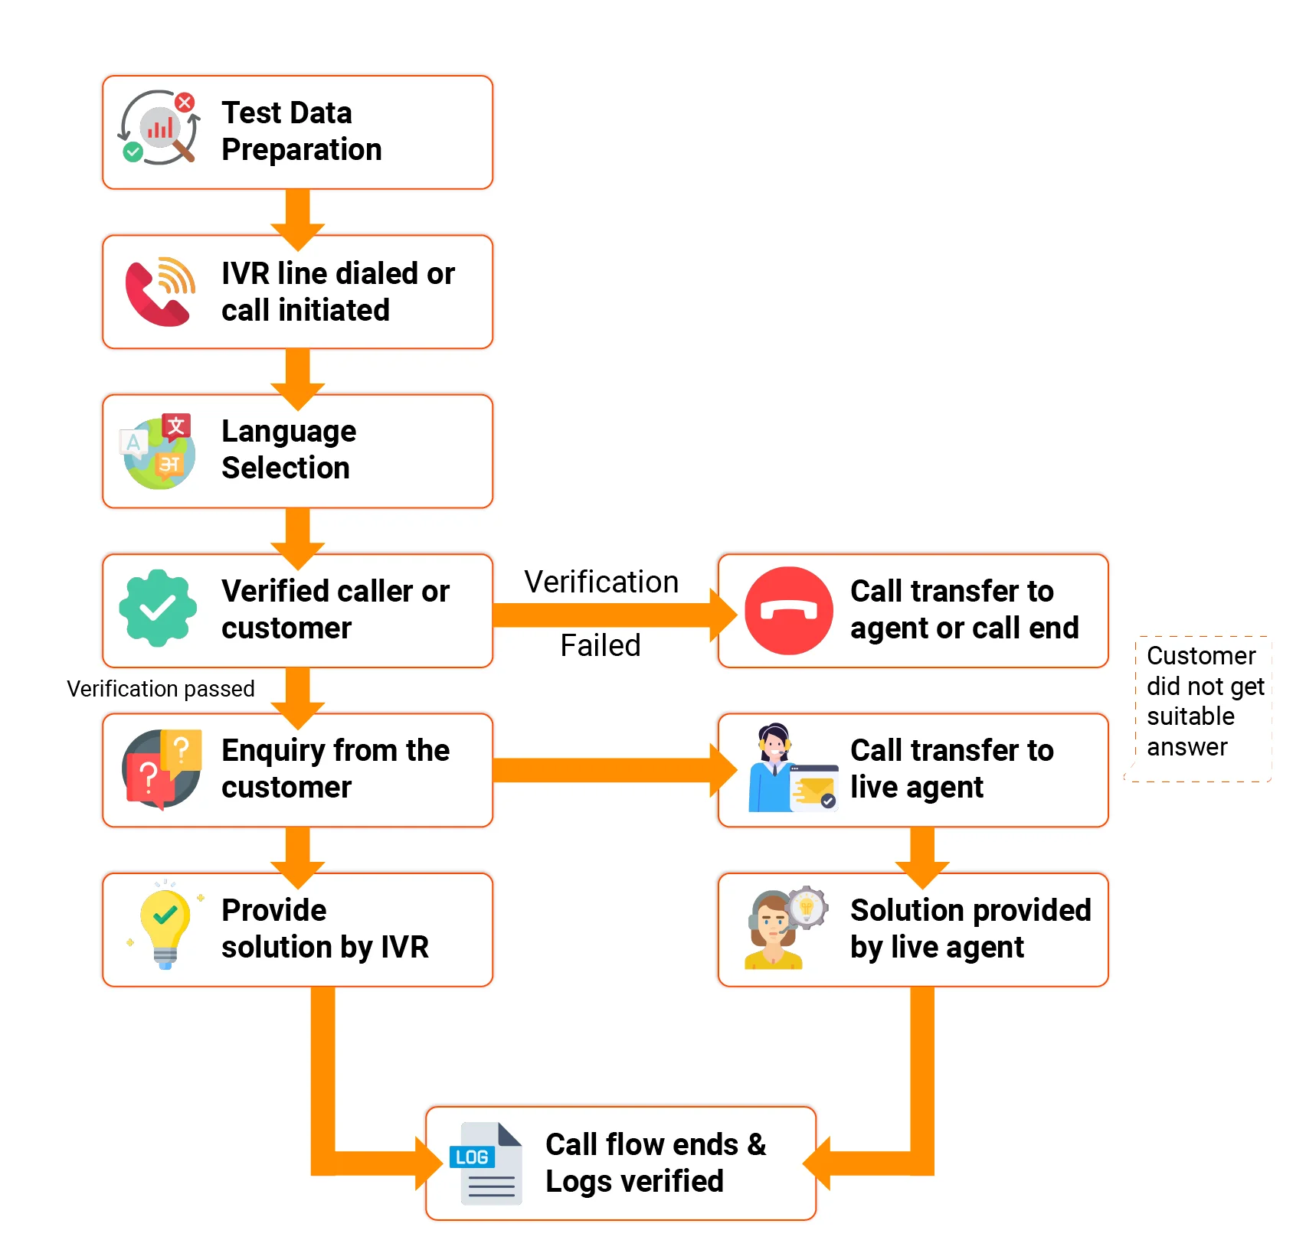
AI IVR Call Flow
Verification, AI handling, and agent fallback flow.

Slide 6
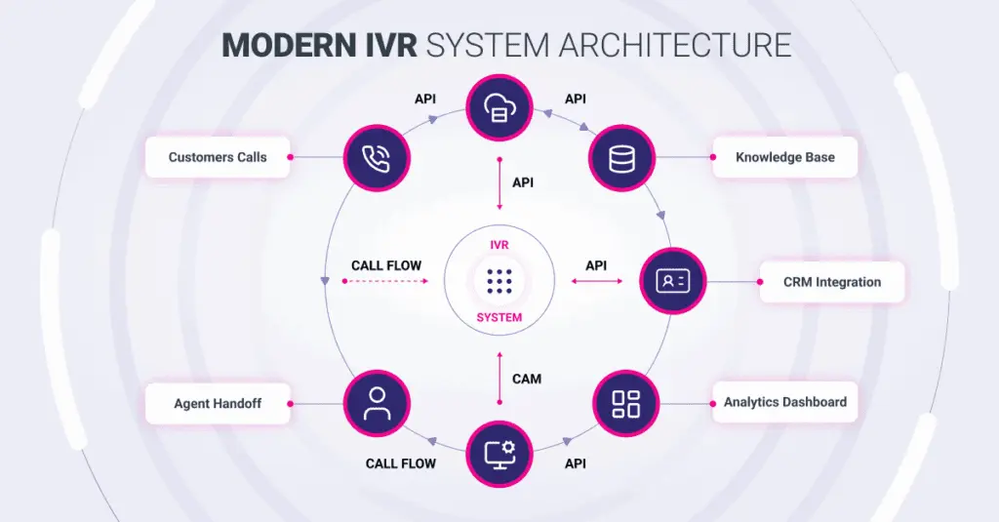
Modern IVR Architecture
IVR with Azure Communication Services, CRM, Azure Monitor, APIs.

Slide 7
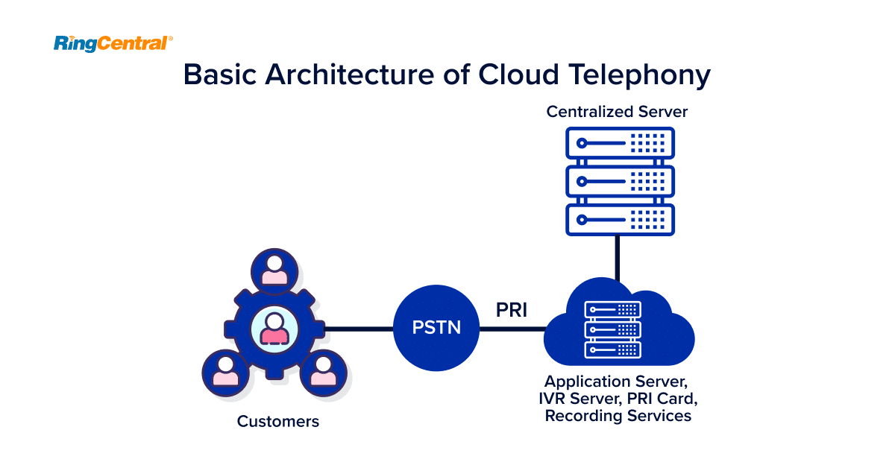
Cloud Telephony Architecture
PSTN, IVR server, and recording services.

Slide 8
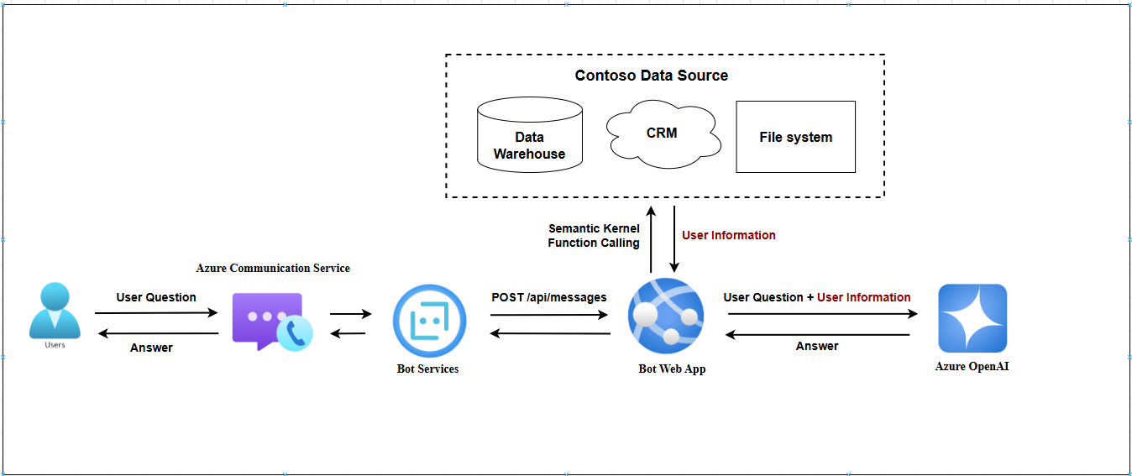
Azure Communication Services Routing

Slide 9
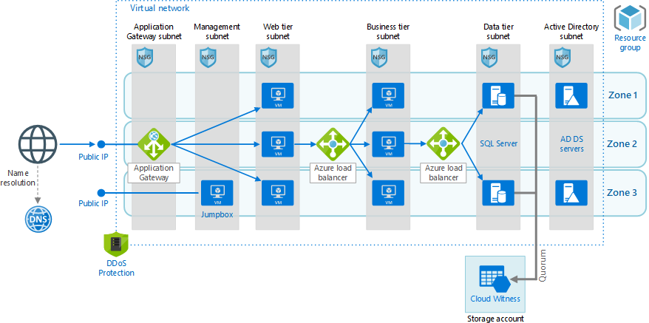
Azure 3-Tier Architecture

Slide 10
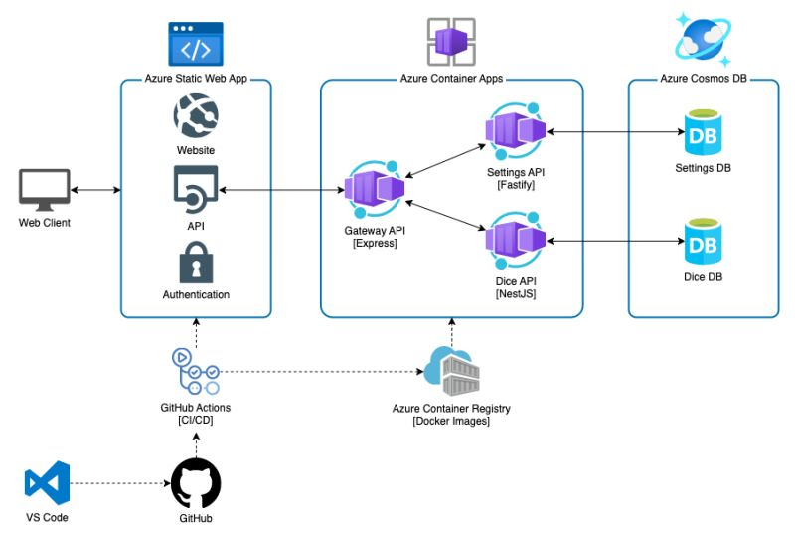
Microservices Architecture
Containerized services with independent scaling.

Slide 11
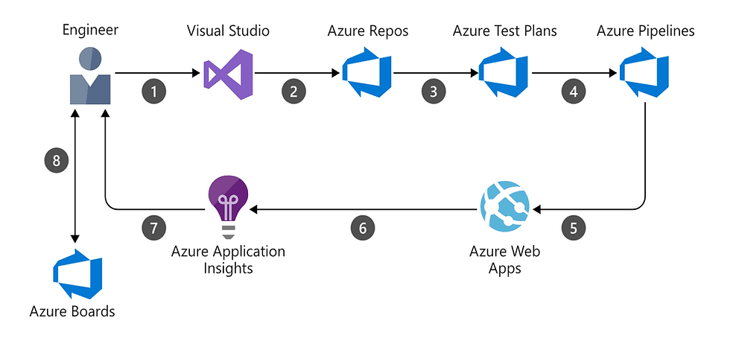
CI/CD Pipeline
Automated build, test, and deployment pipeline.

Slide 12
Phase-wise Automation
Phase 1: Lead capture & IVR entry
Phase 2: AI qualification & booking
Phase 3: Compliance confirmations
Phase 4: Orders, payments & logistics

Slide 13
Security & Compliance
Encrypted communication
Consent-based recordings
Audit logs and traceability
Role-based access control

Slide 14
Executive Cost Summary (INR) – Azure – Azure
Total Estimated Cost (First Year)
• Team Cost (8 members × 5 months): ₹65,00,000
• One-time Technology & Setup Cost: ₹4,50,000
• First-Year Azure Cloud & AI Operations: ₹5,50,000
NET TOTAL PROJECT COST: ₹75,00,000 (Approx.)
Includes complete build, deployment, and first-year operation on Azure on Azure

Slide 15
Phase-1 cost (Azure)
Component | Cost (USD) | Cost (INR approx)
Landing page design & dev | $1,500 – $2,500 | ₹1.2 – 2 L
Lead form + consent logic | $500 – $1,000 | ₹40k – 80k
CRM integration | $1,000 – $2,000 | ₹80k – 1.6 L
Email automation setup | $500 – $1,000 | ₹40k – 80k
AI IVR click-to-call (Azure ACS) Subtotal | $1,800 – $2,800 $5,300 – $8,300 | ₹1.4 – 2.2 L ₹4.2 – 6.6 L

Slide 16
Phase-2 cost (Azure)
Item | Cost
Backend & workflow development | ₹4,00,000
AI intent detection & IVR flows | ₹5,00,000
Appointment booking logic | ₹2,00,000
QA & testing | ₹1,50,000
Project management | ₹1,00,000
Subtotal (People) | ₹13,50,000
Item | Cost
Azure OpenAI / model usage | ₹1,50,000
Azure Communication Services (IVR) | ₹1,00,000
Scheduling integrations | ₹50,000
Subtotal (Tech) Total Phase-2 | ₹2,75,000 ₹16,50,000(approx.)

Slide 17
Phase-3 cost (Azure)
Item | Cost
Compliance IVR flow development | ₹4,00,000
Backend audit & storage logic | ₹3,00,000
Security & access control | ₹1,50,000
QA & compliance testing | ₹2,00,000
Documentation & PM | ₹1,00,000
Subtotal (People) | ₹11,50,000
Item | Cost
Call recording (Azure Blob) | ₹1,50,000
Transcription (Azure Speech) | ₹1,00,000
Monitoring (Azure Monitor) | ₹1,00,000
Subtotal (Tech) Total | ₹3,50,000 ₹15,00,000 (Approx.)

Slide 18
Phase-4 cost (Azure)
Item | Cost
Order & workflow backend | ₹5,00,000
Payment gateway integration | ₹3,00,000
Logistics & tracking integration | ₹3,00,000
Admin dashboards | ₹2,00,000
QA & UAT | ₹2,00,000
Project management | ₹1,00,000
Subtotal (People) | ₹16,00,000
Item | Cost
Payment gateway setup & testing | ₹1,00,000
Logistics API usage | ₹1,00,000
Notifications (Logic Apps) | ₹50,000
Additional Azure infra | ₹1,50,000
Subtotal (Tech) Total | ₹4,00,000 ₹20,00,000 (Approx.)

Slide 19
Conclusion
End-to-end AI IVR automation on Azure on Azure
Enterprise-grade cloud & telephony with Azure Communication Services with Azure Communication Services
Scalable, secure, future-ready

