Slide 1

Sentiment Analysis of Product Reviews
CENTRE FOR DISTANCE & ONLINE EDUCATION CHANDIGARH UNIVERSITY
SUBMITTED BY:
Name : Shivam Rai
Enrolment No: O23MCA110089
Subject Code : 23ONMCR-753

Slide 2
Project Overview
This project analyzes product reviews to determine customer sentiment.
It uses Natural Language Processing (NLP) and machine learning to classify reviews as positive or negative, and presents the results through an interactive Streamlit web app.

Slide 3
Project Objectives
Collect and preprocess product reviews
Build a machine learning model for sentiment classification
Visualize sentiment distribution and model performance
Enable real-time user review submission and sentiment prediction

Slide 4
Tools and Technologies Used
Python
Streamlit
pandas
nltk
scikitlearn
matplotlib, seaborn
WordCloud

Slide 5
Data Preprocessing
Convert reviews to lowercase
Remove stop words using NLTK
Assign sentiment: Positive (rating >= 4), Negative (rating < 4)
Use TFIDF for text vectorization

Slide 6
Model Training
Train/Test split (80/20)
Train Decision Tree Classifier
Evaluate with Accuracy Score and Confusion Matrix

Slide 7
Visualizations
Sentiment Distribution (Bar Chart)
Word Cloud for Positive Reviews
Model Accuracy Confusion Matrix

Slide 8
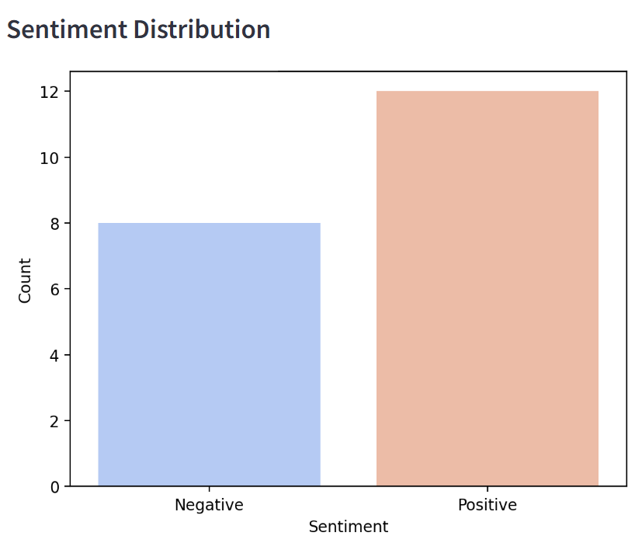
Sentiment Distribution (Bar Chart)

Slide 9
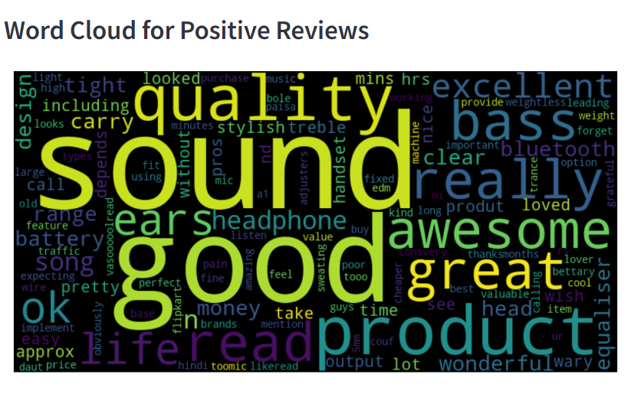
Word Cloud for Positive Reviews

Slide 10
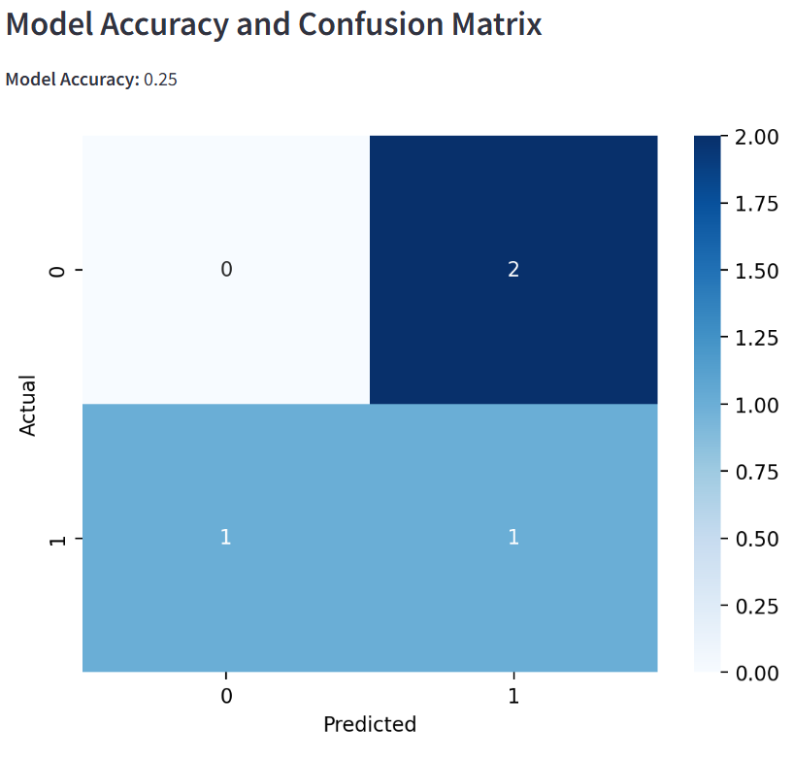
Model Accuracy & Confusion Matrix

Slide 11
Calculation of Confusion Matrix
 | (Predicted Negative ) | (Predicted Positive)
Actual Negative | ( True Negative ) | ( False Positive )
Actual Positive | ( False Negative ) | ( True Positive )
TP + TN
Accuracy =
TP+TN+FP+FN
Note : - (a) In confusion matrix 0 for Negative and 1 for Positive Review.
(b) Sentiment analysis applied only 20 % test data and used 80%
for training model.

Slide 12
Web Application Features
Interactive UI using Streamlit
View full dataset
Visual summaries and performance metrics
Add new review and get sentiment instantly

Slide 13
Conclusion
This system offers a practical and interactive approach to sentiment analysis.
It helps users quickly understand customer feedback through data visualizations and real-time prediction.
The model can be improved further with larger datasets and advanced ML techniques.

Slide 14
THANK YOU

