Slide 1


RESUME
GENERATOR
By: Shivam Jayswal
START PRESENTATION

Slide 2

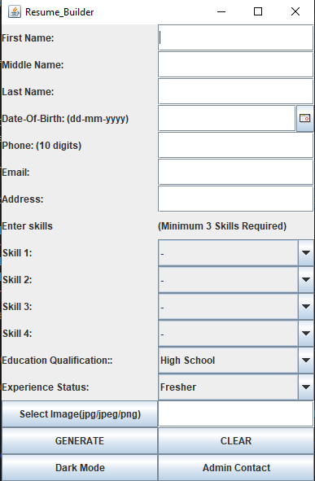

WELCOME
TO RESUME SYSTEM
Introduce the system as a user-friendly, GUI-based software application designed to simplify the process of creating professional resumes.
System offers the flexibility to generate resumes in both PDF and TXT format, .and stores to the databse also
INTRODUCTION

Slide 3

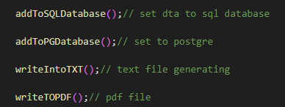

FEATURES
CONTENT MANAGEMENT
Enable users to input and organize their resume content, such as education, work experience, skills
PDF AND TXT EXPORT:
Implement functionality to generate resumes in both PDF and plain text (TXT) formats based on the selected template and content.
Allow users to download or save their resumes in PDF and TXT files for offline access and sharing.
DATABASE INTEGRATION:
Design and implement an efficient database schema to store and organize candidate data effectively.

Slide 4
PROCESS
Through GUI interface interactions will be easy, candidates provide details on their education, work experience, skills, qualification and other relevant data.
Insert The proper details
select suitable options from Option menu.
Upload profile picture
Click Generate Button
Resume is Ready.

Slide 5
CONCLUTION
The envisioned system offers a seamless experience for candidates to input their professional and personal information through an intuitive and user-friendly graphical user interface (GUI). Users can effortlessly navigate the platform, providing details such as education, work experience, skills, certifications, and more, all in a structured manner.
This streamlined solution empowers users to create impressive resumes while maintaining a centralized database of candidate profiles, optimizing efficiency in the hiring process.

Slide 6

CONTACT
Social Media :
@shivamrj_1035
Phone Number :
+91 9054401780
Email :
srjtheinfinity1035@gmail.com
Address :
Mansa
QUICK RESUME

Slide 7

THANK
YOU

