Slide 1




RECRUTEE
(Recruitment Management System)
Presented by :Shivam Jayswal

Slide 2
WELCOME TO MY PRESENTATION
Here, Explain the purpose and structure of the three candidate data tables, focusing on storing comprehensive information about candidates in different stages of the recruitment process..

Slide 3
Tables for Candidates
1
Candidate Table
Describe the structure and attributes of the table dedicated to storing candidate data, including personal and professional details.
Depended Tables
1. Selected Candidate Data Table:
Detail the structure and purpose of the table that will hold data for candidates who have been selected for a job position.
2. Deleted Candidate Data Table::
Using Trigger to design to store information about candidates who were initially considered but later removed from the recruitment process.

Slide 4
AVAILABLE JOB_POSITIONS
jobid | title | department | description | requiredskills | experiencelevel | salary
1 | Software Engineer | Engineering | Develop and maintain software applications | Java, SQL, Spring | Intermediate | 75000
2 | Data Analyst | Analytics | Analyze and interpret complex data sets | SQL, Python, Data Visualization | Entry-Level | 60000
3 | Product Manager | Product Management | Define product roadmap and features | Product Strategy, Project Management | Senior | 95000
4 | UX/UI Designer | Design | Create intuitive and visually appealing user interfaces | UX Design, UI Design, Adobe XD | Intermediate | 70000
5 | Network Engineer | Engineering | Design and implement network solutions | Cisco, TCP/IP, Firewalls | Intermediate | 80000
6 | HR Manager | Human Resources | Oversee HR activities and employee relations | HR Policies, Employee Engagement | Senior | 90000
7 | Content Writer | Marketing | Create engaging and SEO-friendly content | Copywriting, Content Strategy | Entry-Level | 55000
8 | Financial Analyst | Finance | Analyze financial data and create reports | Financial Modeling, Excel | Intermediate | 75000
9 | Sales Executive | Sales | Generate sales leads and close deals | Sales, Customer Relationship Management | Entry-Level | 60000
10 | Quality Assurance Engineer | Engineering | Ensure product quality and performance | Testing, Automation | Intermediate | 70000
11 | Project Manager | Project Management | Oversee project planning and execution | Project Management, Agile | Senior | 95000
12 | Customer Support Representative | Customer Support | Assist customers and resolve issues | Customer Service, Communication | Entry-Level | 55000
13 | Database Administrator | IT | Manage and optimize databases | SQL, Database Management | Intermediate | 75000
14 | Graphic Designer | Design | Create visually appealing graphics and designs | Adobe Creative Suite, Graphic Design | Intermediate | 70000
15 | Systems Analyst | IT | Analyze and improve information systems | System Analysis, Troubleshooting | Senior | 90000
16 | Marketing Manager | Marketing | Develop and execute marketing strategies | Marketing Strategy, Digital Marketing | Senior | 95000
17 | Legal Counsel | Legal | Provide legal advice and support | Legal Research, Contract Negotiation | Senior | 90000
18 | Business Analyst | Business Analysis | Analyze business processes and requirements | Business Analysis, Requirement Gathering | Intermediate | 75000
19 | DevOps Engineer | Engineering | Automate and streamline deployment processes | DevOps, CI/CD | Intermediate | 80000
20 | IT Support Specialist | IT | Provide technical support and troubleshoot issues | Technical Support, Troubleshooting | Entry-Level | 60000
21 | Operations Manager | Operations | Oversee day-to-day operations and processes | Operations Management, Process Improvement | Senior | 95000
22 | UI Developer | Engineering | Create user interfaces for web applications | HTML, CSS, JavaScript | Intermediate | 70000
23 | Pharmacist | Healthcare | Dispense medications and provide healthcare advice | Pharmacy, Health Services | Entry-Level | 65000
24 | Electrical Engineer | Engineering | Design and maintain electrical systems | Electrical Engineering, Circuit Design | Intermediate | 80000
25 | Logistics Coordinator | Logistics | Coordinate and monitor logistics operations | Logistics, Supply Chain Management | Entry-Level | 60000
26 | HR Coordinator | Human Resources | Assist in HR activities and coordination | HR Administration, Recruitment | Entry-Level | 55000

Slide 5
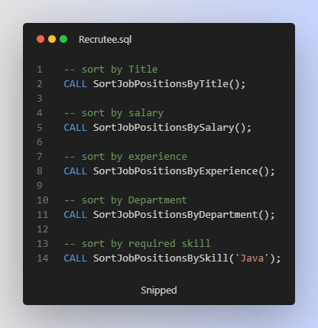
Table of available Job Positions
This table provides a structured way to store information about various job positions, including their titles, associated departments, descriptions, required skills, experience levels, and salary details.
Additionally this table provides Sorting Procedures

Slide 6
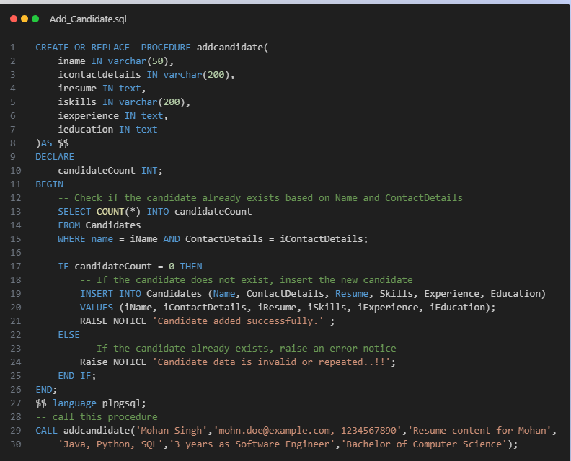
Procedure for add candidate to the Database

Slide 7
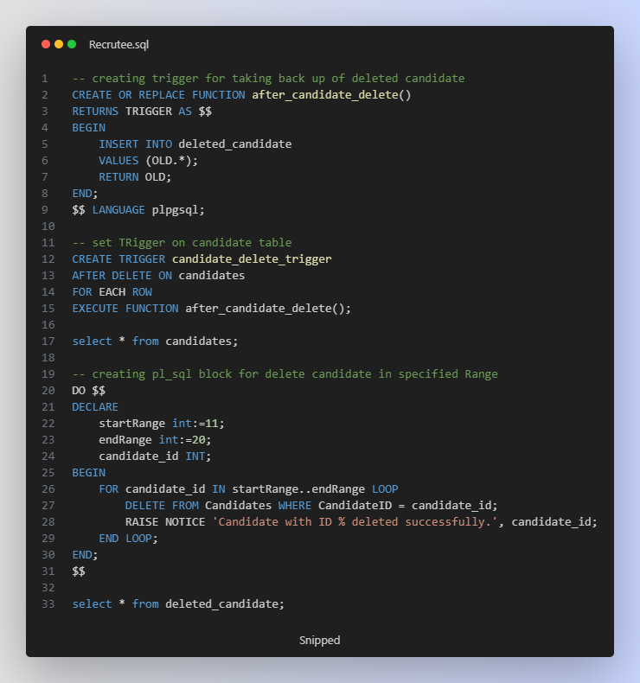
Set Trigger & pl sql Block for deleting candidates
GET READY TO EXPLORE....!!

Slide 8
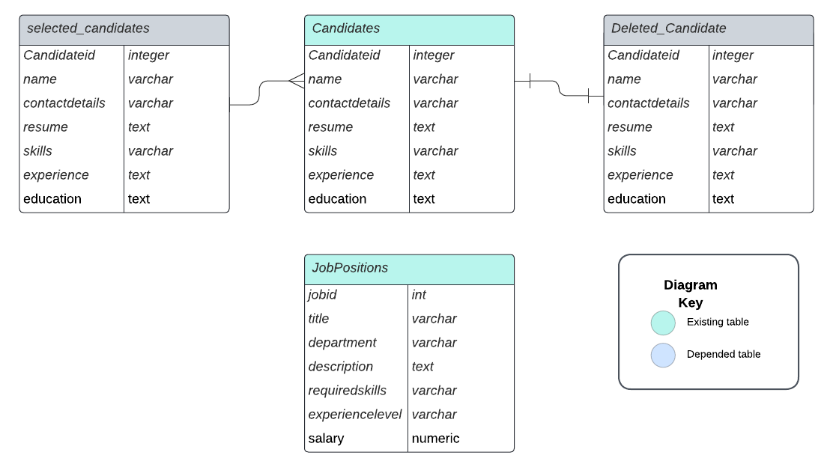
ER Diagram
GET READY TO EXPLORE....!!

Slide 9
THANK YOU..!!
NAME: Shivam R Jayswal
Mo NO:+91 9054401780
Roll No.: 98
Enrollment NO: 22002170210031
*=*=*=*=*=*=*=*=*=*=*=*=*=*=*=

