Slide 1

Session : 2024-2025
Rajkiya Engineering College, Bijnor, Uttar Pradesh 246725 Affiliated to Dr.
APJ Abdul Kalam Technical University, Lucknow, U. P.
PRESENTATION
ON
INDUSTIAL TRAINING FROM
132 KV SUB-STATION,CHANDPUR,BIJNOR
Submitted By – SHIVAM Roll No-2107350200010
Electrical Engineering (4 th Year)
Submitted To –
Dr. Archana Sharma & Dr.
Mohmmad Ahmad
(Assistant Professor, Department of
Electrical Engineering)

Slide 2
WELCOME TO PRESENTATION OF INDUSTIAL TRAINING

Slide 3
Content Of My Presentation
Introduction
Some Key Data
Single Line Diagram
Control Room
Transformer
Current Transformer
Potential Transformer
Isolator
Protection Used In Sub-Station
Lightning Arrester
CVT (Constant Voltage Transformer)
Circuit Breaker
Important Circuit Breakers
Relays
Earthing
Conclusion

Slide 4
INTRODUCTION
India has been divided into five regions for power system planning and operation. These regions are the Northern region, Western region, Eastern region and North- eastern region.
Present almost 70% of the population is enjoying the fruits of electricity.
The present day electricity power system is AC i.e. electric power is generated, transmitted and distributed in the form of alternating current.
The electric power is produced at the power station, which are located at favourable place, generally quite away from the consumers

Slide 5
SOME KEY DATA
Sub-station Capacity - 33/11 KV
The equipment's shall be suitable for the system whose are as below-
Nominal System Voltage - 132/32 KV
Highest System Voltage - 145KV/36KV 50 Hz
Frequency - 50 Hz
Number of phases - 3
Neutral Earthing - Solidly effectively earthing

Slide 6
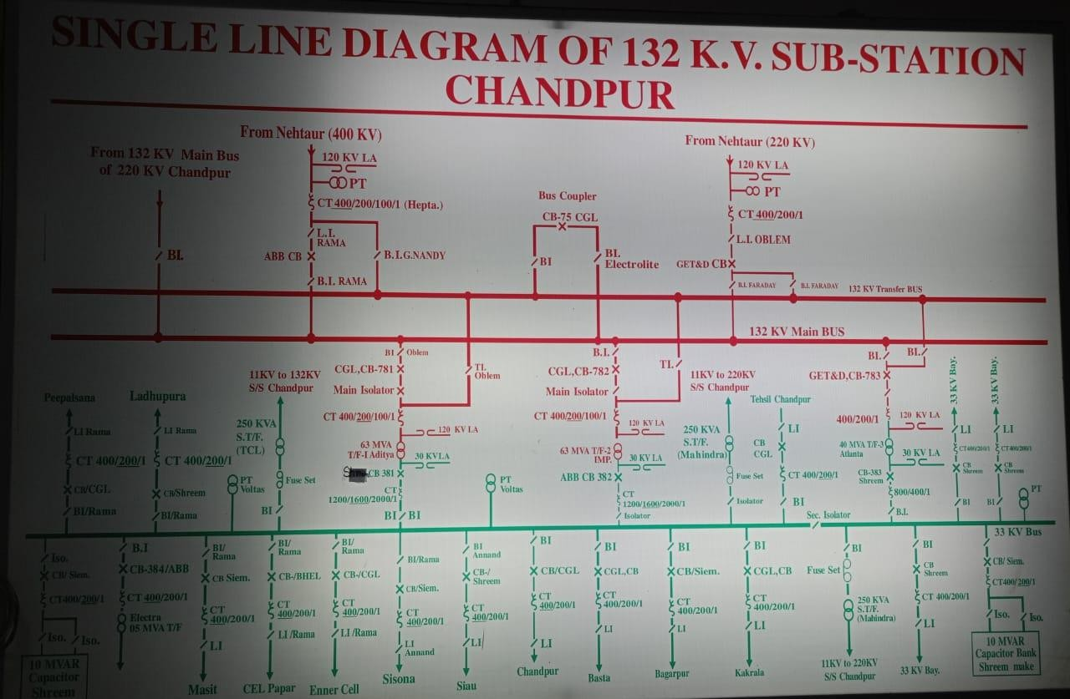
SINGLE LINE DIAGRAM
A Single Line Diagram (SLD) of an Electrical System is the Line Diagram of the concemed Electrical System which includes all the required Electrical Equipment connection sequence wise from the point of entrance of Power up to the end of the scope of the mentioned Work

Slide 7
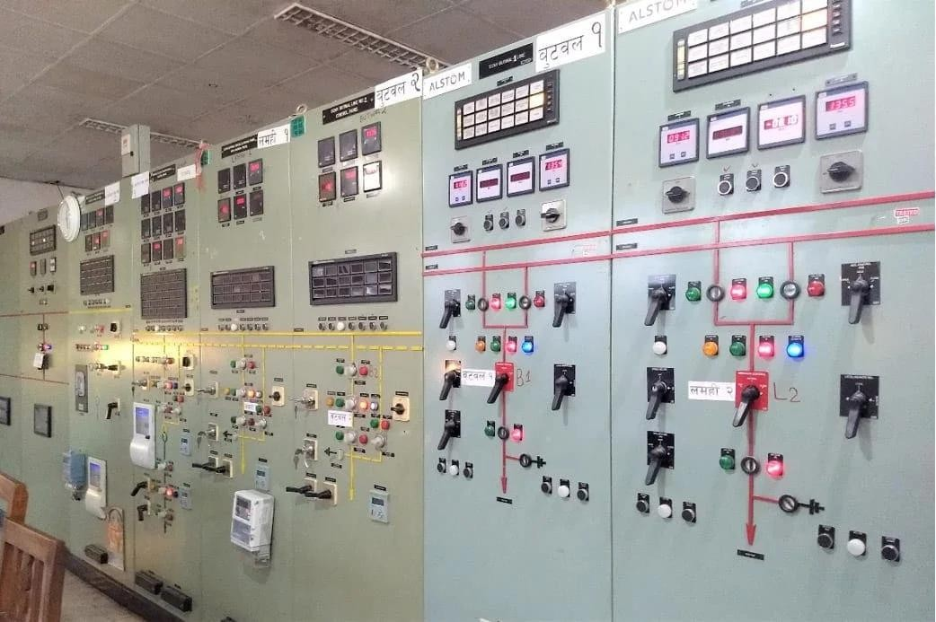
CONTROL ROOM
The diagram made on the control panel is known as mimic diagram. Colors of signals are synchronized as follows -
Red-For circuit breaker or isolator switch is in closed position.
Green-For circuit breaker is in open condition.
Amber-Indicates spring is charged.

Slide 8
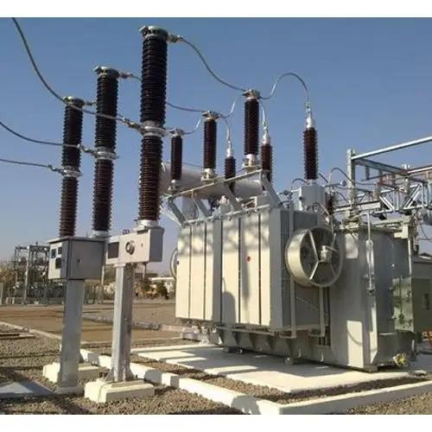
TRANSFORMER
A transformer is an electrical device that transfers energy between two or more circuits through electromagnetic induction.
In 132/33 KV Sub-station at Chandpur, Bijnor (U.P),
two types of transformers are provided -
Inter Connecting transformer.
Miscellaneous Transformer.

Slide 9
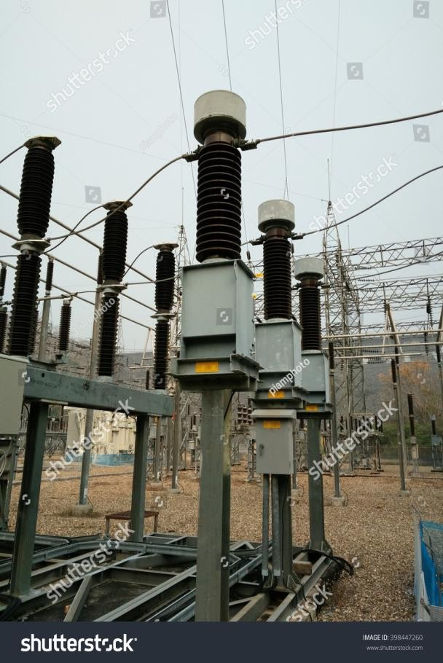
CURRENT TRANSFORMER
They are commonly used in metering and protective relaying in the electrical power industry where they facilitate the safety measurement of large currents, often in the presence of high voltages.
The CT acts as constant current series device with an apparent power burden a fraction of that of high voltage primary circuit.

Slide 10
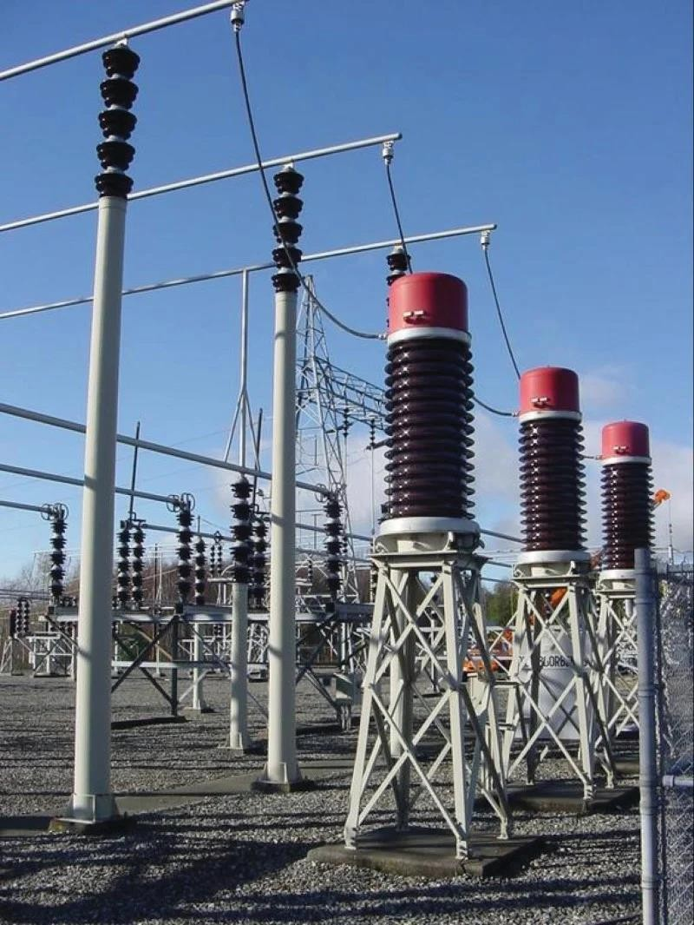
POTENTIAL TRANSFORMER
Potential transformer is designed for monitoring single- phase and three- phase line voltages in power metering application.
A Potential Transformer is a special type of transformer that allows meters to take reading from electrical service connections with higher voltage.
Potential Transformer has an accuracy of ± 5% from 0 to 130% of their rated voltage.

Slide 11
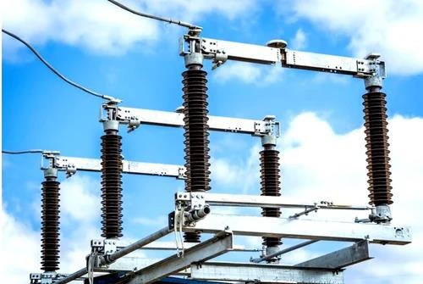
ISOLATOR
An Isolator is a manually operated mechanical switch which separates a part of the electrical power system normally at off load condition.
While opening the circuit, circuit breaker opens first and then isolator & while closing the circuit the isolator closed first and then circuit breaker.

Slide 12
PROTECTION USED IN SUB-STATION
Following are the main protections used in substation:
Distance Protection.
Differential Protection.
Over voltage Protection.
Over current Protection.
Earth fault Protection.
Breaker lock-out Protection.

Slide 13
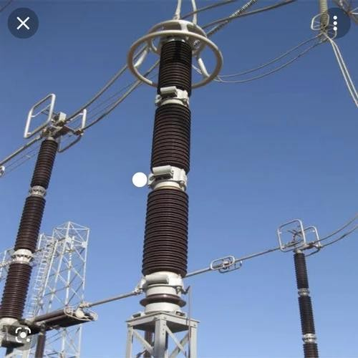
LIGHTNING ARRESTER
It is a protective device that reduces excessive voltage resulting from lightning to a safe level by grounding the discharge.
It shows dual characteristics.
During Lightning it works as super conductor whereas normally it works as insulator.

Slide 14
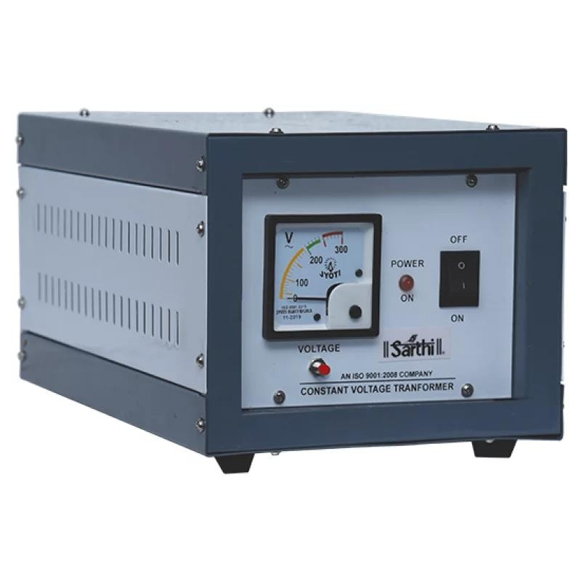
CONSTANT VOLTAGE TRANSFORMER (CVT)
CVT in a substation is used for measurement, protection and as coupling device in PLCC.
In its basic form the device consists of three parts-
Two capacitors across which the transmission line signal is split, inductive element to tune the dev to line frequency;
A transformer to isolate and furth step down the voltage for instrumentation or protective relay.

Slide 15
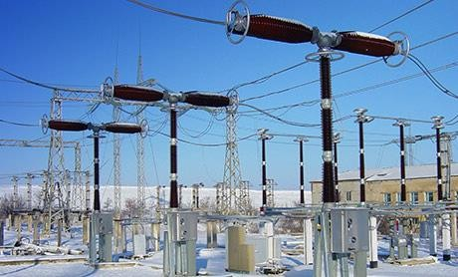
CIRCUIT BREAKER
A Circuit Breaker is an automatically operated electrical switch designed to protect an electrical circuit from damage caused by excess current from an overload or short circuit.
Its basic function is to interrupt current flow after a fault is detected.

Slide 16
IMPORTANT CIRCUIT BREAKERS
Oil Circuit Breaker
Air-Blast Circuit Breaker
SF6 Circuit Breaker.
Vacuum Circuit Breaker

Slide 17
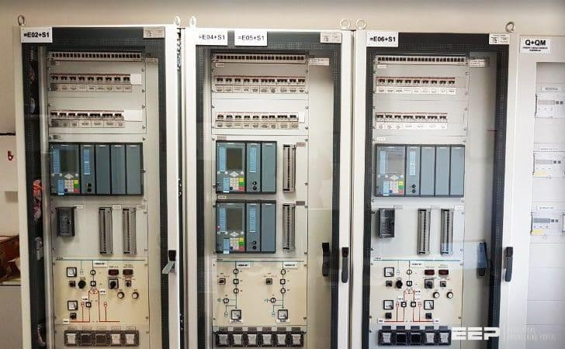
RELAYS
It is an electrically operated switch.
Major types of Relay are Electromagnetic & Static type.
It controls High Voltage Electrical Circuits
with low voltage signal.
In GSS control panels consisting of Relay operates at 110V DC.

Slide 18
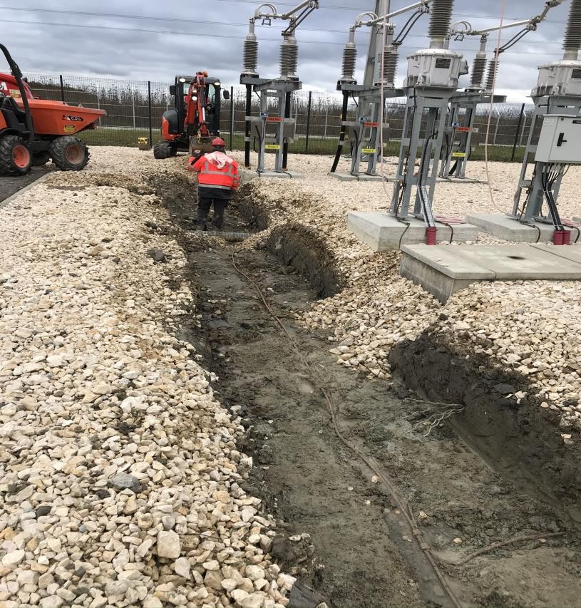
EARTHING
It provides a surface under the substation which has uniform potential nearly equal to zero or Absolute Earth Potential.
It is of two types -
Neutral Earthing.
Equipment Body Earthing.

Slide 19
CONCLUSION
The training at grid substation has improved my understanding of the subject electrical power transmission and distribution. During the training period, I came to know that, there is a much difference between theoretical understanding and practical approach to the subject.
If we see the transformer it is shown in textbooks two windings changing
the voltage level which seems very easy concept.
But of course to design new technology, theoretical knowledge has its
own importance but without practical touch, it is of no use.

Slide 20
THANK YOU

