Slide 1



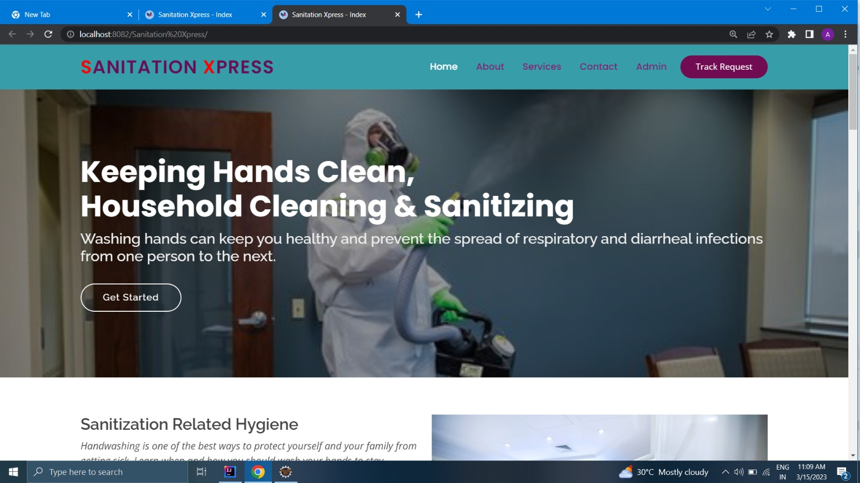
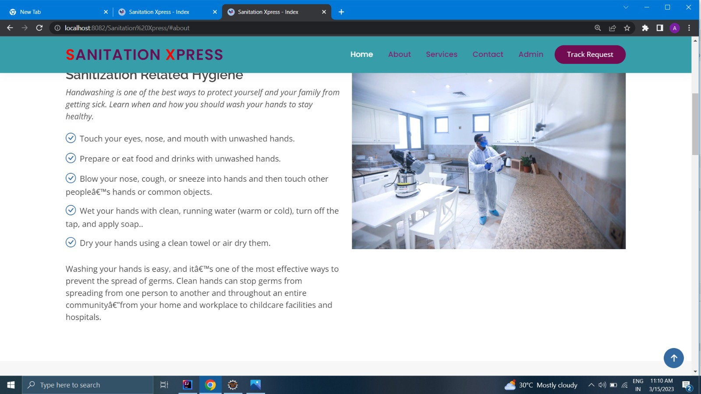
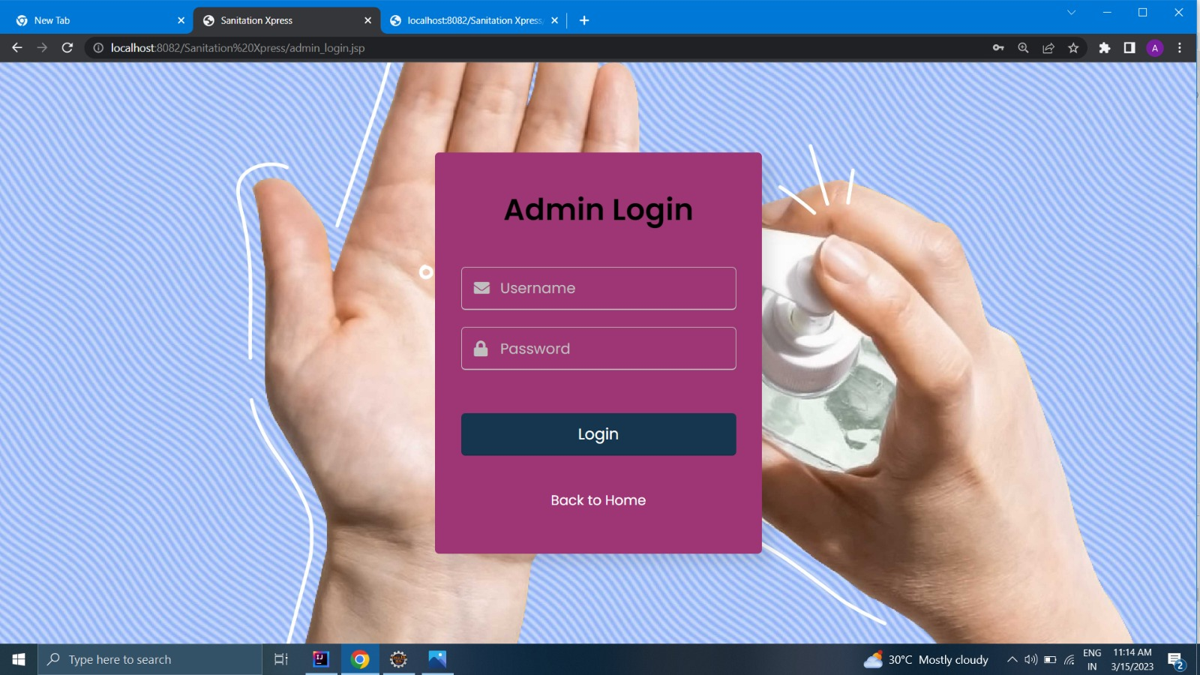
Sanitation Xpress
ORIENTAL INSTITUTE OF SCIENCE AND TECHNOLOGY
Problem Statement
Future Scope
Government is building water and sanitation infrastructure in rural areas but its operation and maintenance will be challenge in the long term . Sustainable model to be developed for providing operation and maintenance service to local populations.
This web application has very lots of scope. This Project can be used by any sanitization company for keeping record of users. This project is easy, fast and accurate. It requires less disk space. “Sanitization Managements System” uses Sqlite database as backend so there is not any chance of data loss or data security
Abstraction
Sanitation Xpress is a web based application which is developed in JSP and Mysql. Nowadays it is very important to sanitize and disinfect each every thing. The main purpose of this system is to provide sanitization services to clean and disinfect of environment.
Introduction
The main purposes of “Sanitation Xpress” to solve the problem of users who want sanitize their home or offices and also reduce the manual work for managing the details of users.
Tools and Technology
1. Java Server Package(JSP)
2. Apache Tomcat
3. Eclipse
4.My sql workbench
Conclusions
This Project can be used by any sanitization companies for keeping record of users. This project is easy, fast and accurate. It requires less disk space. “Sanitation Xpress” uses Sql as backend so there is not any chance of data loss or data security
Team Members
Shivam Sen
Shubhi Patel
Amisha Chandel
Aastha Suryawanshi

