Slide 1

SMART INDIA HACKATHON 2026
Problem Statement ID –SIH26083
Problem Statement Title-Extreme Heatwave Early Warning and Human Thermal Stress Index
Theme-Disaster Management
PS Category- Software
Team ID- 161620
Team Name- DataShield

Slide 2


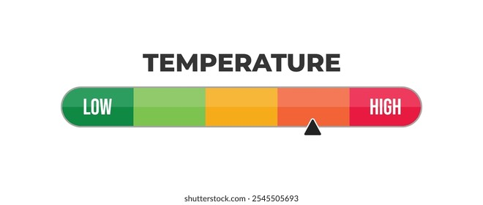

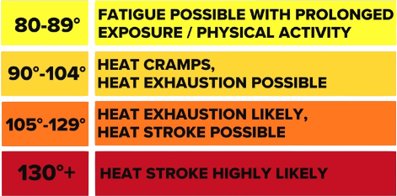
ThermoSafe
DataShield
"From Temperature to Human Impact"
Problem Overview
Proposed Solution
India’s heat warnings rely mainly on dry-bulb temperature, overlooking humidity, wind, and solar radiation that drive actual heat stress.
IMD heat-wave thresholds are temperature-based, not physiological measures of heat stress.
40°C dry vs. humid heat can cause very different health risks.
No system links 3–5 day hyperlocal weather forecasts to predicted hospitalizations or mortality rate.
ThermoSafe predicts heat stress 3-5 days ahead using UTCI,WBGT.
Ward-level mortality and hospitalization alert based on demographics, housing, and health data.
It includes color coded GIS dashboard to guide cooling centers, health posts, and ambulance placement.
ThermoSafe pushes timely heatwave alerts before the danger arrives, not after.
Uniqueness & Novelty
Refined 'temperature feel’: Additionally use vegetation or tree density (NDVI) and building density (built-up%) to measure the ‘temperature feel’.
Corrected air temp: Uses SUHI-to-air scaling (unlike standard models).
Comprehensive risk model: Dual mortality + hospitalization tracking with transparent proxies.
Ward-level insights: Infers outdoor-worker density via OpenStreetMap where census data lacks.
Self-calibrating thresholds: Mortality/hospitalization cutoffs come from the city's own historical summer data, not another city's climate.
Beyond Weather Apps: ThermoSafe goes beyond coarse-grid estimates by using ward-level satellite data on vegetation and built-up density to map heat risk and drive targeted action.

Slide 3
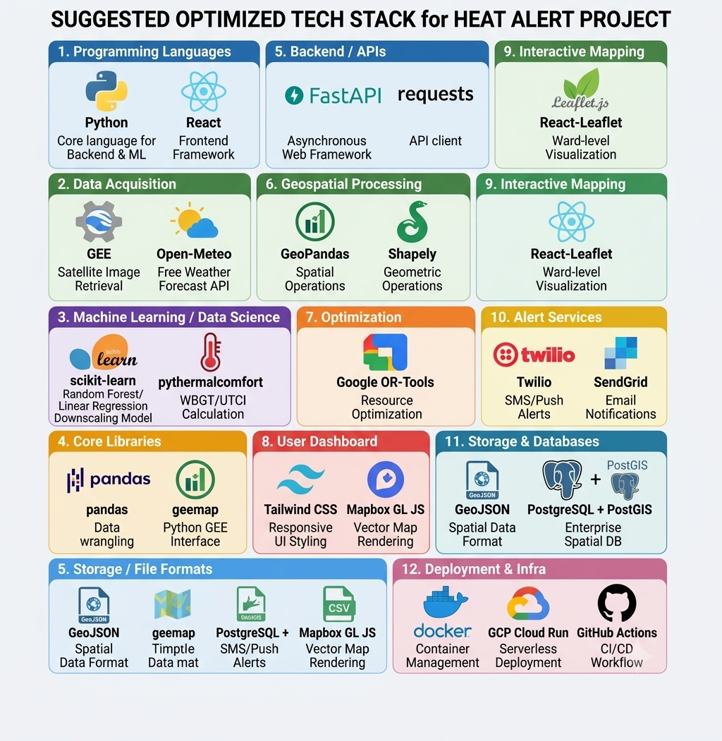
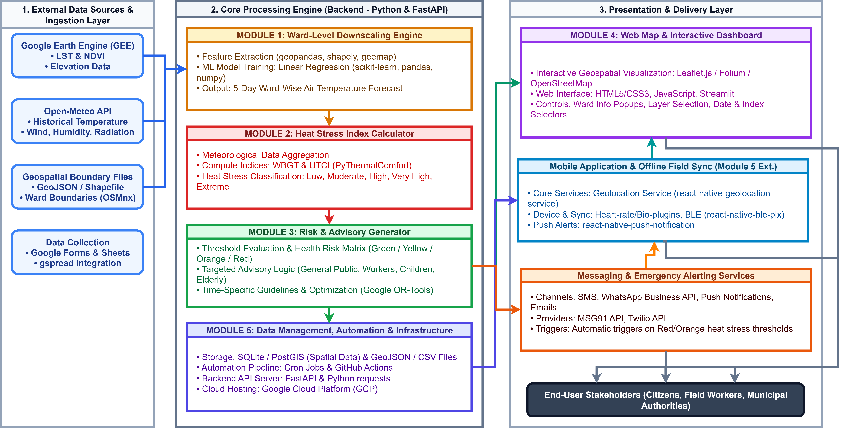
TECHNICAL APPROACH
DataShield
Tech Stack:
System architecture :
@SIH Idea submission- Template
3

Slide 4

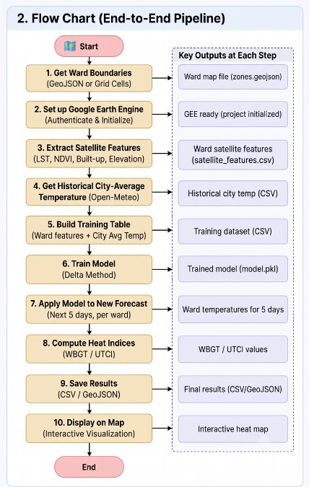



FEASIBILITY AND VIABILITY
DataShield
Feasibility of the Idea
Potential Challenges & Risks​
Data & Prediction Uncertainty​
Weather/satellite gaps and AI model errors can affect ward-level accuracy.​
Tech & Language Barriers​
Patchy internet, low smartphone access, local dialects & code-mixing limit reach.​
Privacy & Govt. Integration​
Consent, secure data handling, API changes & coordination delays complicate rollout.​
Proven, Ready APIs
Open-Meteo, IMD, GEE & WhatsApp/SMS APIs plug in directly — no need to build from scratch.
Human-Centered Indices
UTCI & WBGT capture true physiological heat stress, not just air temperature.
Rich Public Data
Combines weather, satellite, population & vulnerability datasets.
Strategies to Overcome Them
Continuous AI Validation​
Explainable models, confidence thresholds, human-in-the-loop review & fallback alerts boost reliability.​
Built for Low Connectivity​
Offline/SMS support, compressed alerts, multilingual NLP & gradual local calibration close the gap.​
Privacy-First Integration​
Data minimization, encryption, role-based access & cached government data ensure a secure rollout.​
Lean & Scalable
Open-source software & standard cloud infra GPU optional — the same pipeline expands new cities.
Mass-Reach Channels
SMS/WhatsApp alerts plus a citizen dashboard for wide accessibility.
@SIH Idea submission- Template
4

Slide 5












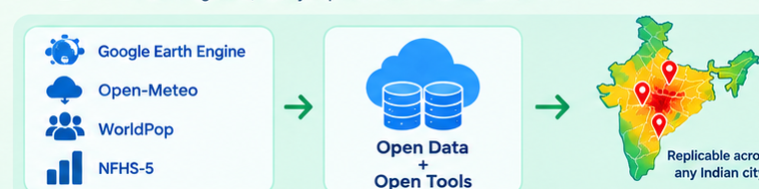
IMPACT AND BENEFITS
DataShield
Potential impact on the target audience
Benefits of the solution
Citizens
Hyperlocal precision over blanket warnings
Receive hyperlocal heat-risk alerts in advance with personalized safety guidance.
Replaces city-wide forecasts with ward-by-ward risk maps so dense wards get flagged even when the official forecast looks moderate.
Local Communities
Lives-based prioritization, not just heat maps
Access timely information in local languages for better awareness and preparedness.
Folds in elderly population, housing vulnerability & health-insurance access to show which wards need help most.
Hospitals
Physiologically accurate risk
Get early alerts to prepare for a possible increase in heat-related patients.
Uses UTCI/WBGT (humidity, wind, radiation) instead of raw °C — critical where 'feels like' differs sharply.
Healthcare Teams
Quantified, defensible impact estimates
Improve resource and staff planning based on predicted heat-related health risks.
Outputs expected excess deaths per ward using peer-reviewed dose-response relationships for concrete planning.
Authorities
Built on free, open & scalable infrastructure
Gain ward-level risk visibility for data-driven heat-action planning and timely interventions.
Google Earth Engine, Open-Meteo, WorldPop & NFHS-5 — zero licensing cost, easily replicated across Indian cities.
@SIH Idea submission- Template
5

Slide 6
RESEARCH AND REFERENCES
DataShield
Market Research
Urban Vulnerability, Micro-Climate & Downscaling
Rajiva, A., et al. (2021). Assessment of urban heat island effects and thermal discomfort across major Indian cities. Environmental Research, 198, 111260.
Mahadevia, D., & Lathia, S. (2020). Testing urban vulnerability: Factors affecting informal settlements and slum density in Indian metros. Down To Earth Report / CEPT University.
Features | ThermoSafe | IMD Heat Bulletins | NWS HeatRisk | Commercial Apps (Tomorrow.io)
Hyperlocal Ward-Level Precision | ✅ | ❌ | ❌ | ✅
Physiological Indices | ✅ | ❌ | ✅ | ❌
GIS Emergency Resource Optimization | ✅ | ❌ | ❌ | ❌
Self-Calibrating Local City Thresholds | ✅ | ❌ | ✅ | ❌
Demographic & Worker Vulnerability Proxies | ✅ | ❌ | ❌ | ❌
Low-Bandwidth & Offline Communication | ✅ | ❌ | ❌ | ❌
Extreme Heat, Mortality & Physiological Stress Metrics
Azhar, G. S., et al. (2014). Heat-related mortality in India: Excess all-cause mortality associated with the 2010 Ahmedabad heat wave. PLoS ONE, 9(3), e91831.
Spangler, K. R., Liang, S., & Wellenius, G. A. (2022). Wet-Bulb Globe Temperature, Universal Thermal Climate Index, and other heat metrics for US counties, 2000–2020. Scientific Data, 9(1), 306.
@SIH Idea submission- Template
6
@SIH Idea submission- Template
6

