Slide 1

Caesar Cipher
SYNOPSIS
Submitted in partial fulfillment of the requirement of the degree of
BACHELOR OF TECHNOLOGY
In
Computer Science and Engineering
by
Shubh Gaur (1/18/FET/BCS/185)
Harsh Vardhan (19/FET/CS(L)/003)
Shivam Sharma (1/18/FET/BCS/207)
Madhusudhan Mishra(1/18/FET/BCS/199)
Under the supervision of
Ms. Pronika Chawla
Associate Professor
Faculty of Engineering & Technology
Manav Rachna International Institute of Research and Studies
SECTOR-43, SURAJKUND –DELHI ROAD, FARIDABAD – 121001

Slide 2
Contents
Introduction
Problem Statements
Objectives
Hardware and software requirements
Literature Review
System Design
Methodology
Expected Outcome Of project /Result
Conclusion & Future Scope
References

Slide 3
Introduction
The Caesar-cipher is an ancient encryption algorithm used by Julius Caesar. It encrypts letters by shifting them over by a certain number of places in the alphabet order. We call the length of shift as the key. For example, if the key is 3, then A becomes D, B becomes E, C becomes F, and so on. To decrypt the message, you must shift the encrypted letters in the opposite direction. This tool lets the user encrypt and decrypt messages according to this algorithm.

Slide 4
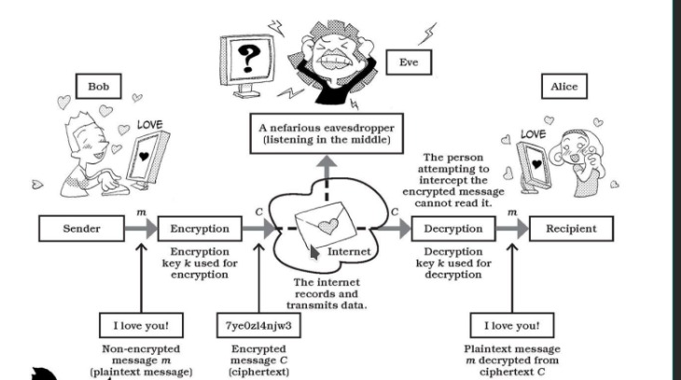

Slide 5
Problem Statement
As data is considered a public wealth in the today’s technological era and is very vulnerable, it needs to be secured so that it doesn’t end up in hands of wrong people.
Because there are only 25 possible keys, Caesar ciphers are very vulnerable to a “brute force” attack, where the decoder simply tries each possible combination of letters.

Slide 6
Objectives
1.The main purpose of our project is to protect digital data confidentiality using an old school encryption technique known as Caesar-Cipher.
2. Another objective of our project can be to make an interactive app which shows the decryption of various messages (Cipher-Text) in real time so that students, professors and many others can benefit from our app as it would give them a platform to learn about this amazing technique not just briefly but in a detailed manner and using this they can dive deep into the world of cryptography as it would help in establishing a foundation for various enthusiasts who want to enter the world of cryptography, cybersecurity, etc. which can further open doors for many fields like blockchain technology, encrypted networking etc.

Slide 7
Hardware and software requirements
PC/Laptop
Software: Visual Studio Code/ Jupyter-Notebook/Sublime/Pycharm.
All modern operating systems viz. Windows,Linux,MacOS,RedHat CentOS etc.
2GB RAM

Slide 8
Literature Review
Cryptology, which is the investigation of cryptosystems, includes two disciplines: cryptography and cryptanalysis. Cryptography is worried about the plan of cryptosystems, while cryptanalysis concentrates on the breaking of cryptosystems (Henk and Van, 2000).The part of science which manages secure correspondence on presence of gatecrashers is cryptography(Henk& Van, 2000).It is one of the significant spaces of study in data security. Others incorporate, yet not restricted to, steganography and organization security. Cryptography is characterized as the science and specialty of encoding and unscrambling information utilizing some extraordinary measures. Encryption is the strategy for masking plaintext so as to conceal its substance while unscrambling (which is something contrary to encryption) is unhiding the substance by changing the ciphertext to its unique plaintext (Rhodes-Ousley, 2013). Cryptanalysis, then again, is the part of science which manages breaking the codes and removing the profound significance, while the entire framework which involves both cryptography and cryptanalysis is called cryptosystem (Paar& Pelzl, 2010).

Slide 9
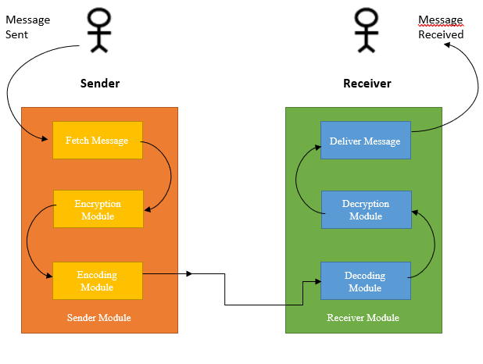
System Design
Use-Case Diagram

Slide 10
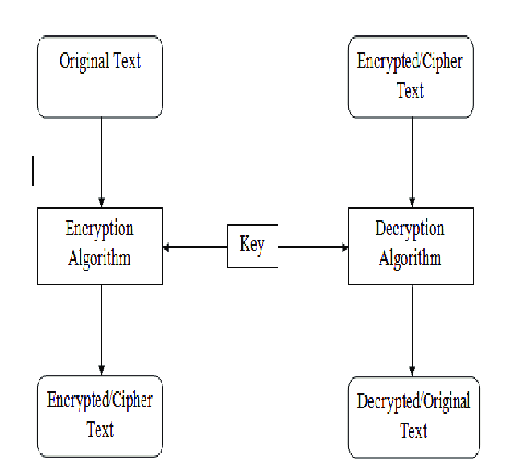
System Design
Working Diagram

Slide 11
System Design
Caesar Cipher Project/
│
├── Caesar Cipher/
│ ├── __init__.py
│ ├── source.py
│ └── helpers.py
| └──encryption.py
| └──decryption.py
│
├── tests/
│ ├── project_test1.py
│ └── project_test2.py
│
├──. gitignore
├── LICENSE
├── README.md
├── requirements.txt
└── setup.py
File System Architecture

Slide 12
Methodology
First, we will start by loading the required packages. Then we will make a basic template for our Graphical User Interface (GUI). We will utilise tkinter and pygame library to make out project interactive by creating a root widget, which is a window where we are going to attach our radio buttons and the text bar. We will set the dimensions of our window. We will use the mainloop() method when we want to run our program to get a window as displayed
Add a canvas to our window. Canvas is a rectangular area where we can place our text and widgets. We do attach our canvas to the root window, or the parent window and we give the same dimensions as our root window. We will also give a background colour to our canvas.
Then, we will create instances to set the font properties like size and style.
We will create a text bar where the user can enter the text. We use the Entry widget to enter and display single line of text.
We will create another text label which tells the user to “choose an operation” from the given options.
We now define a function in which will get the value of the radio button selected by the user and will perform either encryption or decryption based on the option selected by the user. The value of the radio button selected is stored in the variable we created above. To retrieve the value, we use get() method.
Now we define our Encryption and decryption function. The function basically traverses through the given text character by character. For each character, we convert it according to the algorithm we defined earlier. Then we return the newly generated text. We also create text labels which will show the output after the execution of the function.
We will create the radio buttons and link the radio buttons to the encryption and decryption function defined above.
Lastly, we will create a text label “Converted Text” below which the user can find the converted text.

Slide 13
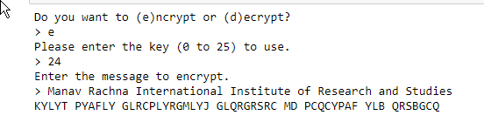
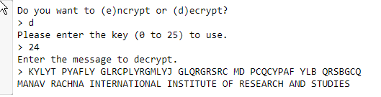
Caesar Cipher Working

Slide 14
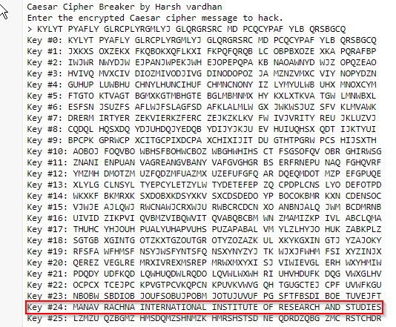
Brute forcer Working

Slide 15
Expected Outcome Of project /Result
A simple to use cryptography application written on the Caesar cipher algorithm which can encrypt and decrypt data and visualize it in Realtime and a Brute-forcer of Caesar Cipher which is able to crack any cipher encrypted using this technique without needing the key.

Slide 16
Conclusion & Future Scope
This tool hides the data in transit so that it cannot be intercepted by an attacker and in case if it is intercepted then he won’t be able to make any sense out of it as the data is encrypted
This tool also provides an interactive interface which shows encryption and decryption in Realtime so that students, professors and many others can benefit from our app as it would give them a platform to learn about this amazing technique not just briefly but in a detailed manner and using this they can dive deep into the world of cryptography as it would help in establishing a foundation for various enthusiasts who want to enter the world of cryptography, cybersecurity, etc. which can further open doors for many fields like blockchain technology, encrypted networking etc.
Caesar cipher can be used today in children's toys such as secret decoder rings. A Caesar shift of thirteen is also performed in the ROT13 algorithm, a simple method of obfuscating text used in some Internet forums to obscure text (such as joke punchlines and story spoilers), but not used as a method of encryption.

Slide 17
References
Champakamala B.S, Padmini K and Radhika D.K 2014 Least Significant Bit Algorithm for Steganography Int. J. of Advance Computer Technology 3 4
Emam, Marwa M, Aly Abdelmgeid A and Omara Fatma A 2016 An Improved Image Steganography Method Based on LSB Technique with Random Pixel Selection Int.l J. of Advanced Computer Science and Applications 7 17-22
Inan, Y. (2019). Analyzing the Classic Caesar Method Cryptography. 4th International Conference on Computational Mathematics and Engineering Sciences(pp. 213-220)
Monika,A.,& Pradeep,M. (2012). A Comparative Survey on Symmetric Key Encryption Techniques.International Journal on Computer Science and Engineering (IJCSE), 877-882.
Senthil, K.,et al. (2013). A modern avatar of Julius Caesar and Vigenere cipher. IEEE International Conference.Computational Intelligence and Computing Research (ICCIC)
Verma, O.P et al. (2011). Performance Analysis Of Data Encryption Algorithms. IEEE.Delhi Technological University India
Atish,J.,et al.(2015).Enhancing the Security of Caesar Cipher Substitution Method using a Randomized Approach for more Secure Communication. International Journal of Computer Applications, 129(13),6-11.DOI: 10.5120/ijca201590706
Sahai A, Waters B (2005) Fuzzy identity-based encryption. In: Annual international conference on the theory and applications of cryptographic techniques. Springer, Berlin, Heidelberg

Slide 18
References Continued..
Han F et al (2014) A general transformation from KP-ABE to searchable encryption. Future Gener Comput Syst 30:107–115
Rachmawati Dian and Candra Ade 2015 Implementation of the combination of Caesar Cipher and Affine Cipher for text data security Informatics Research and Education Journal (JEPIN) 1
Ariyus D. 2008 Introduction to Cryptography: Theory, analysis and implementation (Yogyakarta: Andi)
Basuki, Paranita and Hidayat 2016 Design of Layered Cryptography Applications Using Caesar Algorithms, Transpositions, Vigenere and Block Cipers Based on Mobile National Seminar on Information and Multimedia Technology. STMIK AMIKOM (Yogyakarta,)
Bellare, M., Desai, A., Jokipii, E., Rogaway, P.: A concrete security treatment of symmetric encryption: analysis of the DES modes of operation. In: Proceedings of the 38th Symposium on Foundations of Computer Science. IEEE (1997)
K. Senthil, K. Prasanthi and R. Rajaram, "A modern avatar of Julius Caesar and Vigenere cipher", Computational Intelligence and Computing Research (ICCIC) 2013 IEEE International Conference, pp. 1-3, 2013.

Slide 19

Thank You.

