Slide 1


Hiring Process Analytics
Statistics
Shivam Singh

Slide 2
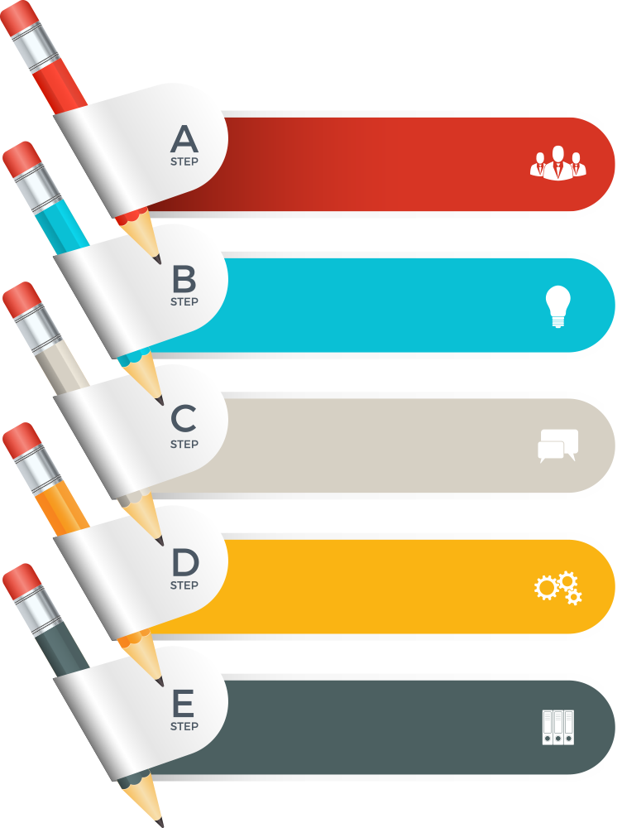
Introduction
This analysis will involve handling missing data, detecting and addressing outliers, and summarizing the findings to provide actionable recommendations for optimizing the hiring process.
Using excel, examining trends such as rejections, interviews, job types, and vacancies, I aim to identify areas for improvement and support the hiring department in making more informed decisions.
Hiring Analysis
Salary Analysis
Salary Distribution
Department Analysis
Position Tier Analysis

Slide 3
A. Hiring Analysis
Determine the gender distribution of hires
Use function : COUNTIFS : The COUNTIFS function applies criteria to cells across multiple ranges and counts the number of times all criteria are met.
Gender Number of Hired Formula
Male 2563 =COUNTIFS(C:C,"Hired",D:D,"Male")
Female 1856 =COUNTIFS(C:C,"Hired",D:D,"Female")

Slide 4
B. Salary Analysis
Analyzing the average salary provided by the company, as well as identifying the maximum and minimum salaries offered.
Use Function : AVERAGE : the average (arithmetic mean) of a range of numbers
MIN : Minimum number in a range of numbers
MAX: Maximum number in a range of numbers
Equation Salary Amount Formula
Average 49983.03 =AVERAGE(G:G)
Maximum 400000 =MIN(G:G)
Minimum 100 =MIN(G:G)

Slide 5
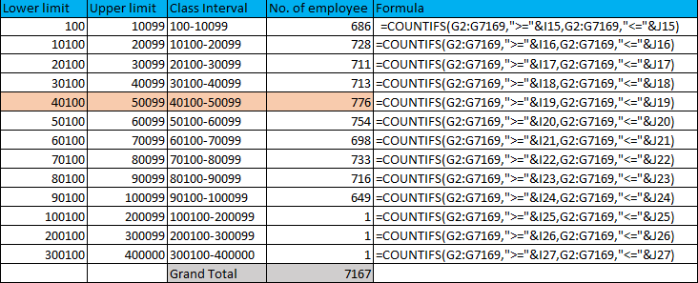
C. Salary Distribution
Analyzing Salary Distribution by Classifying Salaries into Intervals and Checking the Number of Employees in Each Salary Class
Use Function: The COUNTIFS function applies criteria to cells across multiple ranges and counts the number of times all criteria are met.

Slide 6
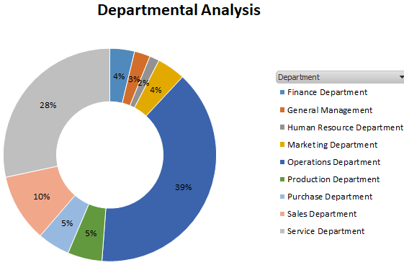
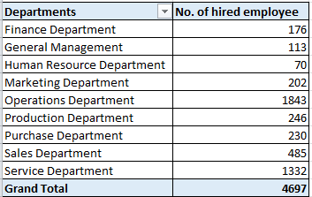
D. Departmental Analysis
Departmental analysis is done by creating a pivot table with the department in the rows, the count of application IDs in the values, and the status in the filter, filtering by "Hired".
In departmental analysis, two departments have the highest employee numbers, totaling 67%. The operations department has 1,843 employees, accounting for 39%, and the service department has 1,332 employees, accounting for 28%.

Slide 7
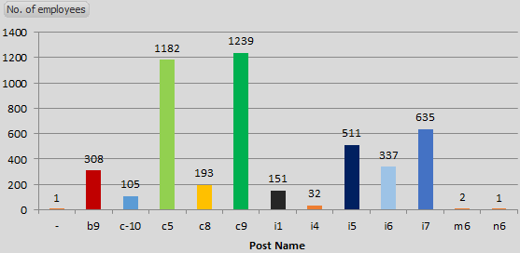
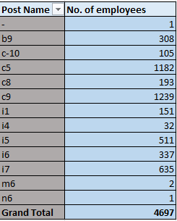
E. Position Tier Analysis
In Position Tier Analysis is done by creating a pivot table with the post name in the rows, the count of application IDs in the values, and the status in the filter, filtering by "Hired".
In the analysis, we found the number of employees by post name, with 1,239 employees in C9 and 1,182 in C5.

Slide 8
Insights and Results
We gained significant insights into Excel formula implementation, pivot table creation, and chart visualization, which enabled us to analyze hiring trends, salary distribution, and departmental and position tier structures.
Key findings include identifying departments with the highest hiring rates, understanding salary ranges and distributions, and visualizing the balance of position tiers within the company.
Through this project, we achieved a comprehensive understanding of hiring process analytics by leveraging Excel formulas, pivot tables, and charts. This enabled us to identify hiring trends, salary distributions, and departmental hiring patterns, significantly enhancing our ability to analyze and improve recruitment strategies.

Slide 9
Thank you

