Slide 1

INSTAGRAM USER
ANALYTICS
Analyzing user interactions and Engagement : SQL Fundamentals
Shivam Singh

Slide 2

Introduction
In this project, we analyze user interactions and engagement data from Instagram to provide actionable insights. By leveraging SQL and MySQL Workbench, we aim to inform marketing strategies and investor metrics.
Approach
Our approach involves querying the Instagram database to extract meaningful patterns and trends.
Tech-Stack
MySQL Workbench

Slide 3
MARKETING
ANALYSIS
1 . Loyal User Reward
2 . Inactive User Engagement
3 . Contest Winner Declaration
4 . Hashtag Research
5 . Ad Campaign Launch

Slide 4
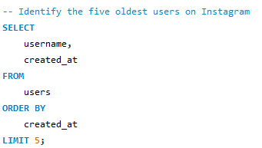
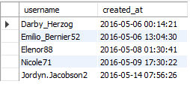
Loyal User Reward

Slide 5

Loyal User Reward
Rewarding the most loyal users
1
Darby_Herzog 2016-05-06 00:14:21
Top
5
Oldest Users
2
v
Emilio_Bernier52 2016-05-06 13:04:30
3
v
Elenor88 2016-05-08 01:30:41
4
vz
Nicole71 2016-05-09 17:30:22
5
v
Jordyn.Jacobson2 2016-05-14 07:56:26

Slide 6
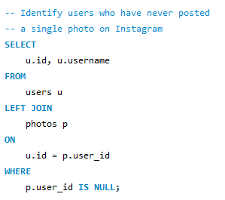
Inactive User Engagement
We identified 26 users who have never posted a single photo on Instagram, So that we can send promotional emails to encourage their participation.
ID USERNAME ID USERNAME
5 Aniya_Hackett 57 Julien_Schmidt
7 Kasandra_Homenick 66 Mike.Auer39
14 Jaclyn81 68 Franco_Keebler64
21 Rocio33 71 Nia_Haag
Maxwell.Halvorson 74 Hulda.Macejkovic
Tierra.Trantow 75 Leslie67
Pearl7 76 Janelle.Nikolaus81
Ollie_Ledner37 80 Darby_Herzog
Mckenna17 81 Esther.Zulauf61
David.Osinski47 83 Bartholome.Bernhard
Morgan.Kassulke 89 Jessyca_West
Linnea59 90 Esmeralda.Mraz57
Duane60 91 Bethany20

Slide 7

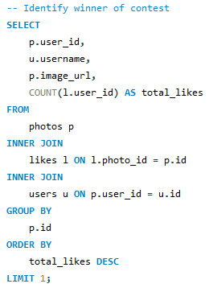
Contest Winner Declaration
The winner of the contest
User id
52
Username
Zack_Kemmer93
Image url
https://jarret.name
Likes
48

Slide 8

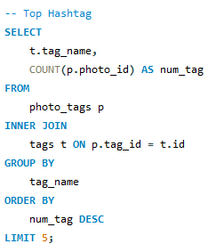
# Hashtag Research
Top 5 most commonly used hashtags on instagram
#smile
59
#beach
42
#party
39
#fun
38
#concert
24
#smile
#beach
#party
#fun
#concert

Slide 9

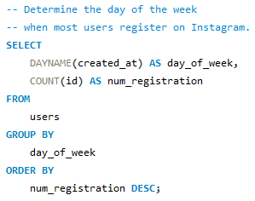
Ad Campaign Launch
The day of the week when most users register on Instagram.
Best day of week to launch ad
Thursday
No. of users registered : 16
Sunday
No. of users registered : 16

Slide 10
INVESTOR
METRICS
User Engagement
Bots & Fake Accounts

Slide 11
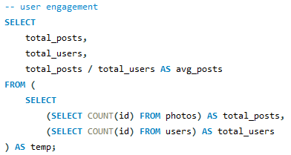
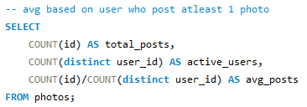
User Engagement
257
Total post made
Total users
Total post/ Total users
Average no. of post
100
2.57
2-3
Total post(photos)
Total users who post
At least 1 photo
Total post/Total
user (at least 1post)
Average no. of post
based on active user
257
74
3.473
3-4

Slide 12


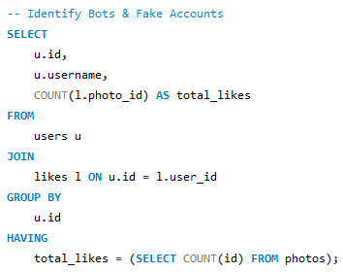
Bots & Fake Accounts
13 users (potential bots) who have liked every single photo (257) on the site, as this is not typically possible for a normal user.
ID | USERNAME | ID | USERNAME
5 | Aniya_Hackett | 57 | Julien_Schmidt
14 | Jaclyn81 | 66 | Mike.Auer39
21 | Rocio33 | 71 | Nia_Haag
24 | Maxwell.Halvorson | 75 | Leslie67
36 | Ollie_Ledner37 | 76 | Janelle.Nikolaus81
41 | Mckenna17 | 91 | Bethany20
54 | Duane60

Slide 13
Insights and Results
While this project, I discovered several valuable patterns in Instagram user behavior. the platform has a segment of highly loyal users who have been active for a long time, and there exists a subset of inactive users who have never posted. Popular hashtags and optimal days for user registration were identified, which can guide future marketing strategies.
Through this project, I successfully identified the oldest users, inactive accounts, contest winners, popular hash tag and potential bot activity. These findings have provided actionable insights for the marketing team and investor to take strategic decisions.

Slide 14
Thank you

