Slide 1


OPERATION ANALYTICS
&
INVESTIGATING METRIC SPIKE CASE STUDY
Advanced SQL
Shivam Singh

Slide 2
INTRODUCTION
Description: Operation Analytics and Investigating Metric Spike. Utilize operation analytics to investigate metric spikes by cleaning and analyzing data. Generate insights on user engagement, growth, and retention, providing actionable recommendations to improve operations and address sudden changes in key metrics.
Approach
Prepare & Process
Prepare data in MySQL Workbench by cleaning and formatting it for analysis, ensuring it is accurate and ready for insights extraction.
Analyze
Conduct detailed analysis on job reviews per hour, throughput, and user engagement growth to identify trends and patterns.
Visualize & Share
Provide answers to tasks and visualize the data effectively, sharing insights with stakeholders for informed decision-making.
Tech-Stack Used
MySQL Workbench : To prepare , analyse and results.
Microsoft Excel: To visualize and charts insights.

Slide 3
CASE STUDY : 1
Job Data Analysis
This case study focuses on using SQL to derive insights from job data and understand operational metrics.
01 Jobs Reviewed Over Time
02 Throughput Analysis
03 Language Share Analysis
04 Duplicate Rows Detection

Slide 4
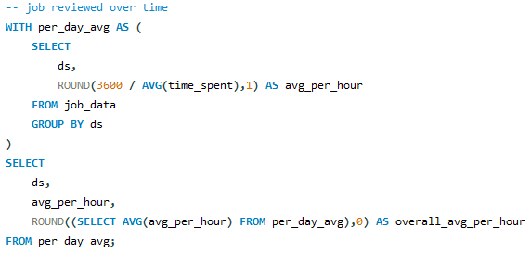
01 Jobs Reviewed Over Time
Jobs reviewed per hour in November 2020 : 126
Nov
180
29 Nov
180
28 Nov
218
27 Nov
34
Highest number of jobs 218 were reviewed per hour on:
28 November 2020
26 Nov
64
25 Nov
80
0 30 60 90 120 150 180 210 240
Jobs reviewed per hour
Lowest number of jobs 34 were reviewed per hour on:
27 November 2020

Slide 5
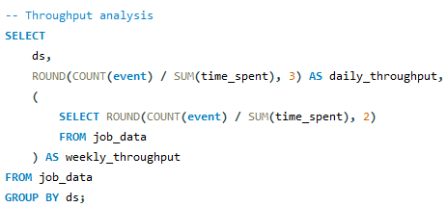
02 Throughput Analysis
0.06
Daily avg throughput
0.05
The graph of 7-day rolling average vs daily average of throughput trend line.
0.04
0.03
0.02
7-day rolling avg throughput
0.01
0.00
I prefer using the 7-day rolling average for throughput because it provides a more consistent view of the data, smoothing out daily fluctuations. This helps in understanding long-term trends and patterns more effectively compared to the daily metric, which can be highly variable and less reliable for trend analysis.
25 Nov 26 Nov 27 Nov 28 Nov 29 Nov 30 Nov

Slide 6
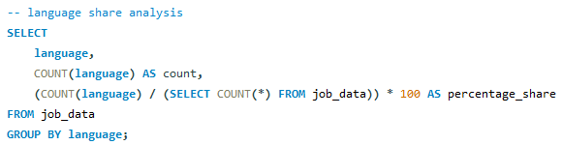
03 Language Share Analysis
Arabic12.5%
Hindi12.5%
Most used language is
Persian with 37.5% share
Persian
37.5%
English12.5%
Other rest language Hindi, Arabic, English, French and Italian share is 12.5%
Italian12.5%
French12.5%

Slide 7
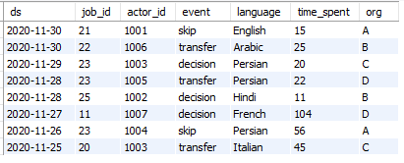
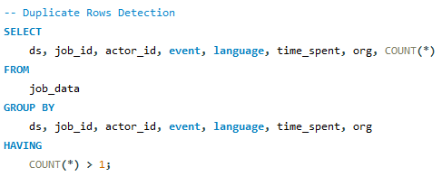
04 Duplicate Rows Detection
No Duplicate Rows Found
In the table job_data

Slide 8
CASE STUDY : 2
Investigating Metric Spike
In this investigation, we use SQL to analyze weekly engagement, growth, and retention by querying the users, events, and email_events tables. This approach helps us identify patterns and understand sudden changes in key metrics, providing insights.
01 Weekly User Engagement
02 User Growth Analysis
03 Weekly Retention Analysis
04 Weekly Engagement/Device
05 Email Engagement Analysis

Slide 9
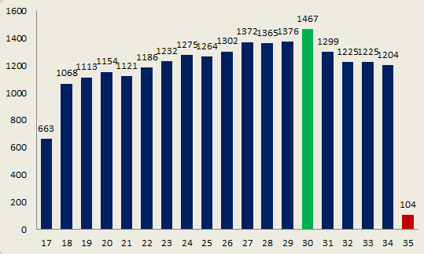
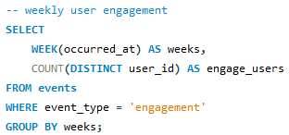
01 Weekly User Engagement
Average weekly user engagement : 1158-9
Highest weekly user engagement : Week 30
1467 user engaged
Lowest weekly user engagement : Week 35
104 user engaged
User engagement vs Week

Slide 10
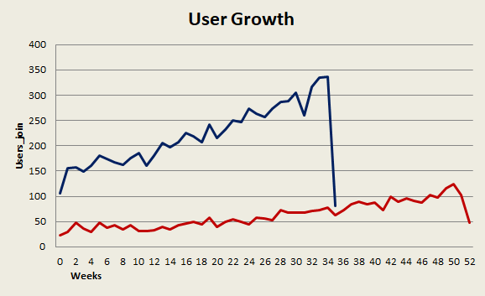
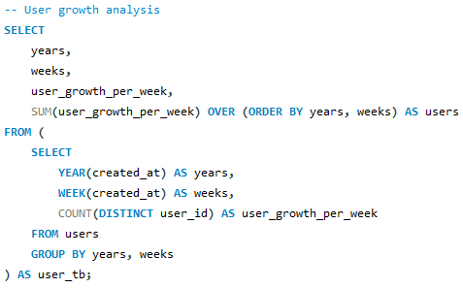
02 User Growth Analysis
Average weekly user growth :
105-6
Average monthly user growth:
469
Maximum weekly user growth : 33 week 2014 - 261 users join
Maximum monthly user growth:
August 2014 1031 users
Users growth 2013 Users growth 2014
Minimum weekly user growth : 35 week 2014 - 18 users join

Slide 11
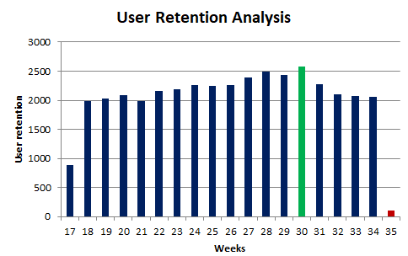
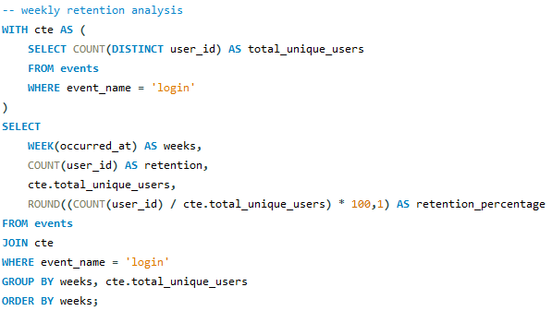
03 Weekly Retention Analysis
Approach: In events table, I choose event name ‘login’ as retention of user and total users is count of distinct users
Average weekly user retention :
2032 users weekly average user retain
Maximum user retain : on ,
Week 30 and user retain 2583
Minimum user retain : on,
Week 35 and user retain 104

Slide 12
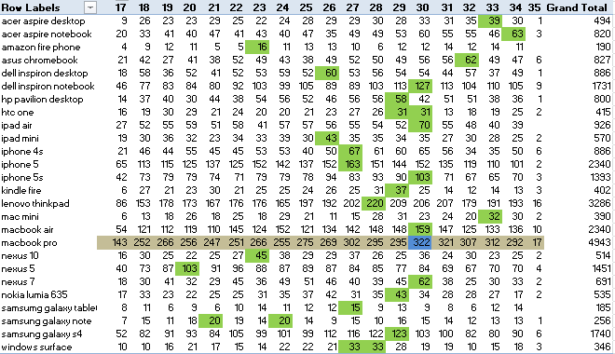
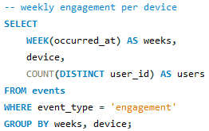
04 Weekly Engagement per Device
Highest weekly engagement device used : Macbook Pro
with average engagement 260 and highest engagement
week 30 with 322 user engage with Macbook pro
Lowest weekly engagement device used : Samsung Galaxy
Tablet with average engagement 10-11

Slide 13
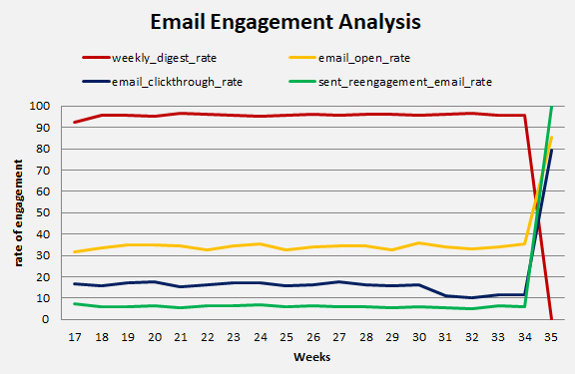
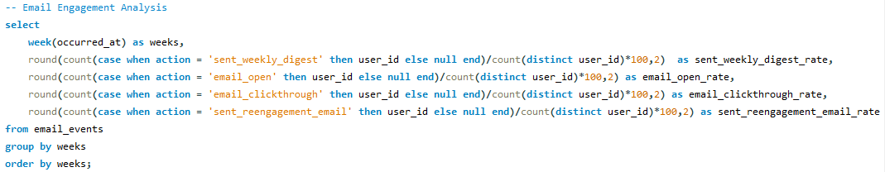
05 Email Engagement Analysis
Weekly digest engagement sent is averagely is 3014 and Highest sent on 34 week 4111
On average, 1076-7 users open the email 36.77% email open rate
On average, 474 emails click through rate 18.68% click through rate
On average, 192 reengagement emails sent to users 11% reengagement emails send rate

Slide 14
Results
Job Data Analysis: Improved understanding of job review patterns and throughput trends, aiding in better resource allocation and performance monitoring.
User Engagement Analysis: Insights into user activity, growth, retention, and email engagement, enabling targeted strategies to enhance user experience and engagement.
Through these analyses, I learned how to extract valuable insights from large datasets, identify trends and patterns, and effectively use SQL queries to solve real-world business problems and use excel and r to generate charts and sharing of result views. This enhanced my ability to make data-driven decisions and optimize operational performance.

Slide 15
Thank You

