Slide 1
CSE202-Lec#26
Object slicing, Object composition and delegation

Slide 2
Outline
Object slicing
Object composition and
Object delegation

Slide 3
introduction
In C++, a derived class object can be assigned to a base class object, but the other way is not possible.
class Base { int x, y; };
class Derived : public Base { int z, w; };
int main()
{
Derived d;
Base b = d; // Object Slicing, z and w of d are sliced off
}

Slide 4
Object slicing
When a Derived Class object is assigned to Base class, the base class' contents in the derived object are copied to the base class leaving behind the derived class specific contents. This is referred as Object Slicing.
That is, the base class object can access only the base class members.
This also implies the separation of base class members from derived class members has happened.

Slide 5
Program to demonstrate object slicing
#include <iostream>
using namespace std;
class Base
{
protected:
int i;
public:
Base(int a) { i = a; }
virtual void display()
{ cout << "I am Base class object, i = " << i << endl; }
};
class Derived : public Base
{
int j;
public:
Derived(int a, int b) : Base(a) { j = b; }
virtual void display()
{ cout << "I am Derived class object, i = "
<< i << ", j = " << j << endl; }
};

Slide 6
// Global method, Base class object is passed by value
void somefunc (Base obj)
{
obj.display();
}
int main()
{
Base b(33);
Derived d(45, 54);
somefunc(b);
somefunc(d); // Object Slicing, the member j of d is sliced off
return 0;
}

Slide 7
Output:
I am Base class object, i = 33
I am Base class object, i = 45

Slide 8
Object Composition and delegation
Object composition: simpler form of composition.
Object send message to other object asking for support;
Outer and inner objects, forwarding
Differences to implementation inheritance;
Outer object does not re implement inner object functionality
‘Implicit self-recursion’ or ‘possession of common self’

Slide 9
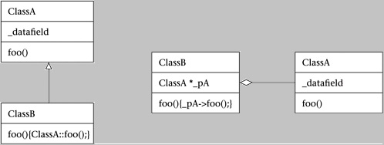
Object composition
Suppose ClassB is composed with ClassA if ClassB has a ClassA or ClassA* member; for short we can say ClassB has a ClassA.
And, as before, ClassB inherits from ClassA if ClassB is derived from ClassA as a child class; for short we say ClassB is a ClassA.

Slide 10
Object delegation
If ClassB has a ClassA member object *_pA, then
a ClassB object gets a set of ClassA data fields wrapped up inside *_pA and,
(b) ClassB can implement the same methods as ClassA simply by passing these method calls off to *_pA.
When you pass method calls to a composed object, this is called object delegation.

Slide 11
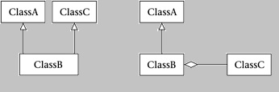
Use composition to avoid multiple inheritance
If you have a ClassB that you'd like to have inherit from both ClassA and ClassC, you can use composition instead of inheritance for ClassA or ClassC.

Slide 12
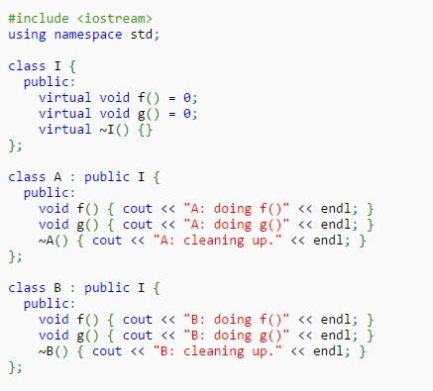
program to demonstrate object decomposition and object slicing

Slide 13
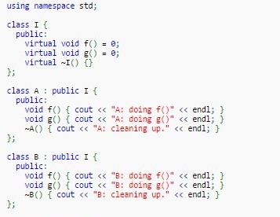

Slide 14

Next Class: Overriding member functions, Order of execution of constructors and destructors
@LPU CSE202 C++ Programming

