Slide 1

Deep Learning for Smoker Detection: Enhancing Public Health Surveillance with Advanced Algorithms

Slide 2

Introduction
Smoking remains a global public health challenge, contributing to myriad of preventable disease and premature death annually. Despite concerted efforts to curb tobacco consumption, the prevalence of smoking persists, necessitating innovative approaches for effective detection and intervention.
Smoker detection, the process of identifying individuals engaged in smoking behaviour, plays a crucial role I public health surveillance, smoking cessation interventions, and environmental monitoring.

Slide 3

Project Aim
This project investigates the application of transfer learning techniques in smoker detection, aiming to improve accuracy and adaptability across diverse datasets. Through empirical evaluations and comparative analyses, the study explores various transfer learning strategies, model architectures, and fine-tuning approaches to optimize performance. Additionally, the thesis examines the impact of domain adaptation and transferability of learned representations in different smoking contexts. The findings contribute to advancing the state-of-the-art in smoker detection technology and provide insights into the practical implementation of transfer learning methods for real-world applications.

Slide 4
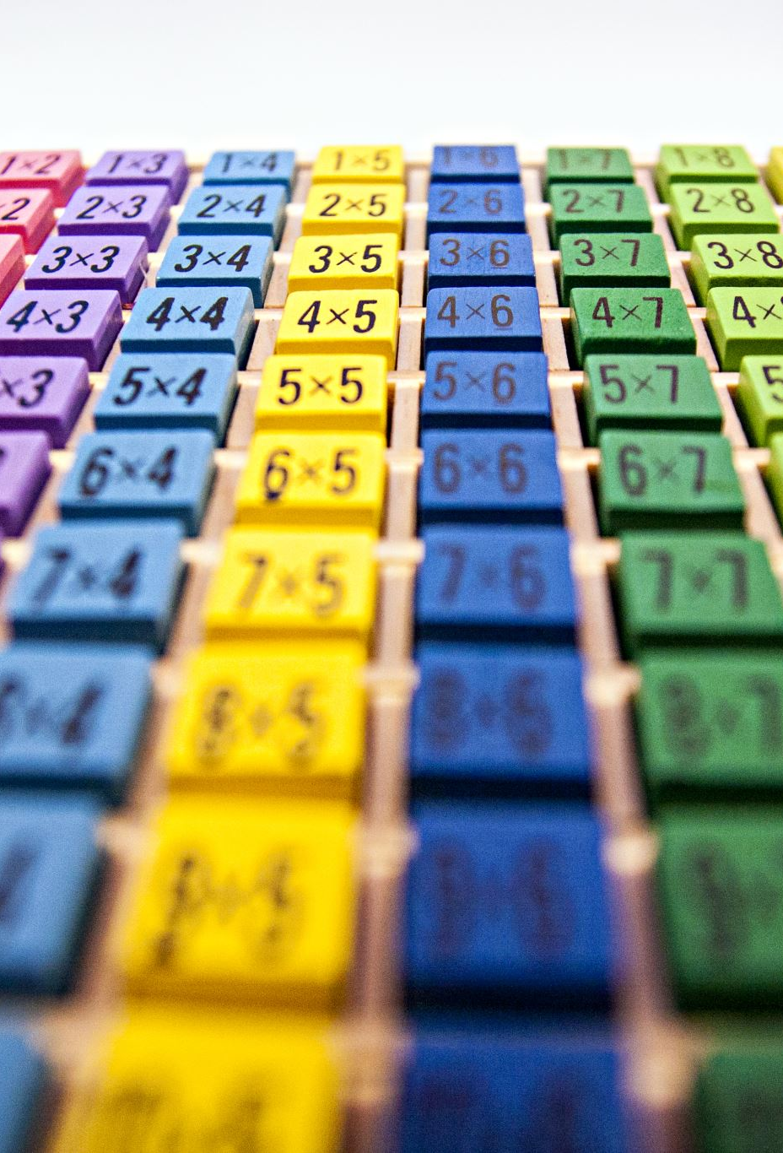
Methodology
Data Collection : The dataset contains 1120 images equally divided in two classes as 560 images belongs to smokers and remaining 560 images belongs to non-smokers.
Data Preparation: Image Resizing, Normalization, Label Encoding, and Data Augmentation
Modeling: VGG16, ResNet-50, MobileNetV2, EfficientNetV2 and Vision Transformer (ViT).
Model Comparison: Comprehensive analysis of model performance and trade-offs

Slide 5
Data Augmentation
Data augmentation is a technique used to increase the diversity of training data without collecting new data. This is particularly useful in image classification tasks to improve the model's robustness and generalizability by artificially enlarging the training dataset.
Augmentation techniques involve applying various transformations to the original images, such as rotations, translations, flips, and changes in brightness and contrast.
These transformations help the model become invariant to these changes, making it more reliable when encountering variations in real-world data.

Slide 6
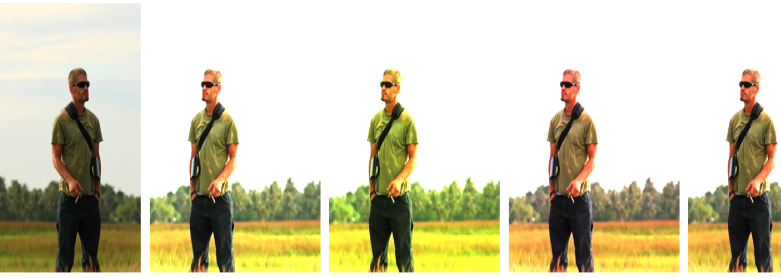
Augmented Images

Slide 7
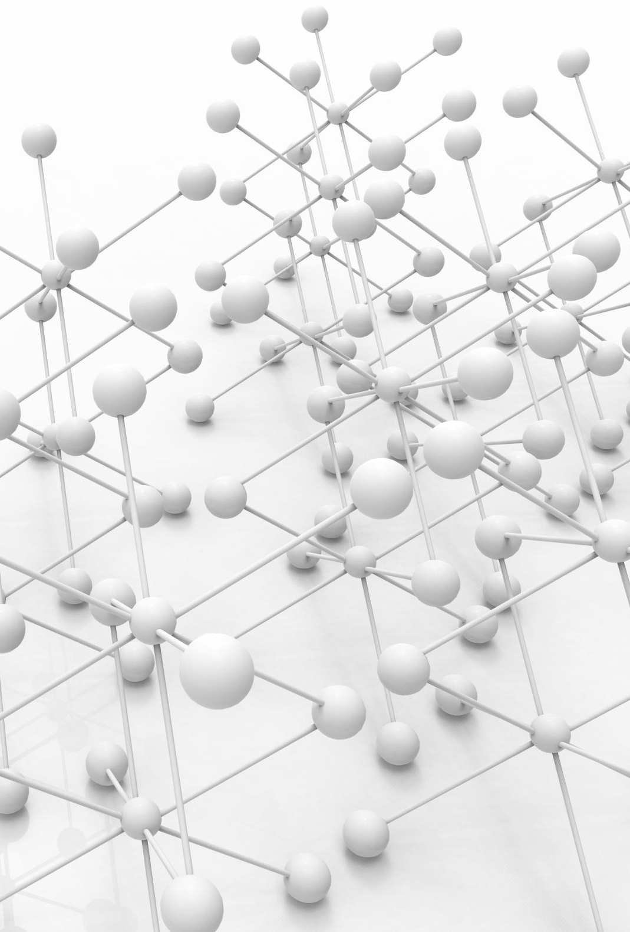
VGG 16
A popular Convolution Neural Network (CNN) architecture that has been widely used for image classification tasks. Developed by Visual Geometry Group (VGG) at the University of Oxford, VGG16 is known for its simplicity and depth, consisting of 16 layers with learnable weights. VGG16 follows a straightforward architecture with a series of convolutional layers followed by fully connected layers

Slide 8

ResNet-50
This Convolutional Neural Network (CNN) architecture, is a part of the Residual Networks family, which introduced the concept of residual learning. ResNet-50 is a specifically designed to address the vanishing gradient problem that hampers deep neural networks, allowing them to train effectively even with very deep architectures. This makes it highly suitable for complex image classification task, including smoker detection

Slide 9

Mobile Net V2
MobileNetV2 is a lightweight convolutional neural network architecture designed specifically for mobile and edge device applications. It achieves a good trade-off between latency and accuracy, making it an ideal choice for real-time image classification tasks, such as smoker detection, where computational resources may be limited

Slide 10
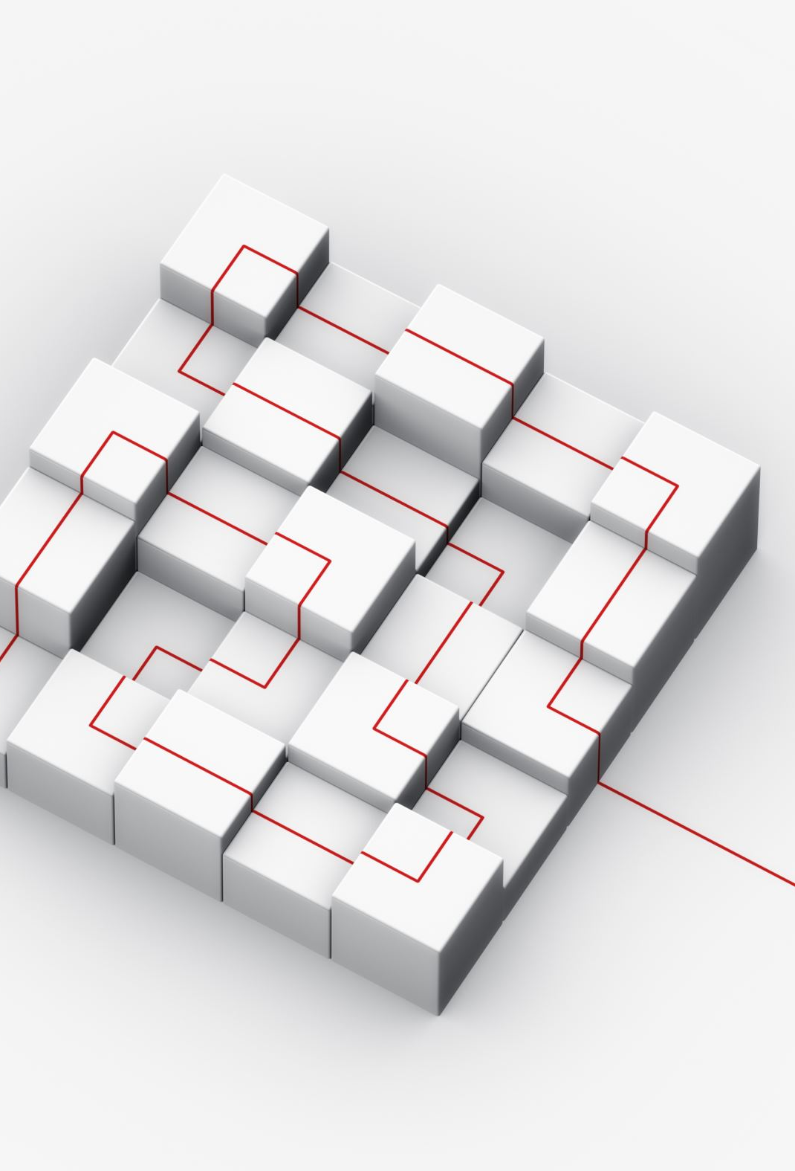
Efficient Net V2
This is a state-of-the-art Convolutional Neural Network (CNN) architecture designed for efficient scaling and improved performance in image classification tasks. Developed by Google Research, Efficient NetV2 incorporates advancements in both the architecture design and training techniques, making it powerful tool for the task like smoker detection.

Slide 11

Vision Transformer (ViT)
Vision Transformer (ViT) is a novel deep learning architecture that leverages the principles of transformers, which have revolutionized natural language processing, for image classification tasks. Unlike traditional Convolutional Neural Networks (CNNs), ViTs treat images as sequence of patches and apply transformer mechanisms to capture spatial dependencies and global context more effectively

Slide 12
Results
Metric | VGG16 | ResNet-50 | Efficient NetV2 | Vision Transformer
Accuracy | 79.8% | 89.29% | 93.96% | 91.62%
Precision | 70.7% | 85.48% | 88.85% | 97.89%
Recall | 97.3% | 94.64% | 100% | 84.04%
F1-Score | 81.4% | 89.83% | 94.16% | 90.86%
AUC | 78.7% | 89.29% | 93.96% | 91.62%

Slide 13
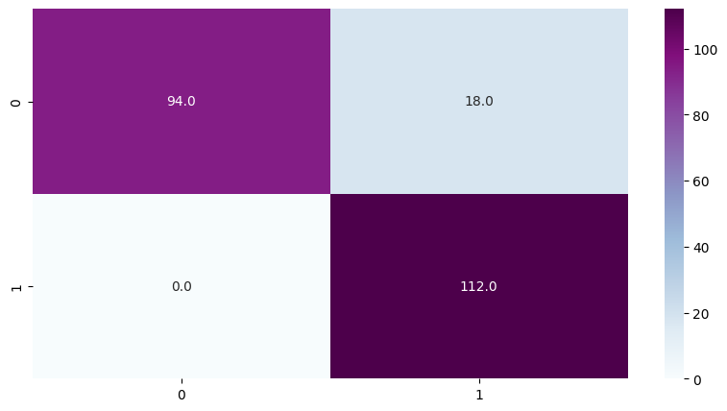
Confusion Matrix A confusion matrix is a table that is used to describe the performance of a classification model. It shows the counts of true positives, true negatives, false positives, and false negatives.

Slide 14
Key Findings
Efficient NetV2 achieved the highest accuracy, indicating its robustness in classifying both smokers and non-smokers accurately.
The balance between precision and recall in Efficient NetV2 suggests it minimizes the both false positives and false negatives more effectively.
The recall score in Efficient NetV2 is 100%, indicates that the model is perfectly able to identify the smoker image in the given dataset.
A higher F1-score in Efficient NetV2 confirms it overall better performance in handling classification task.
The Vision Transformer showed promising results, demonstrating the potential of transformer based models in image classification tasks traditionally dominated by CNN. However, it slightly lagged behind Efficient NetV2 in most metrics.

