Slide 1
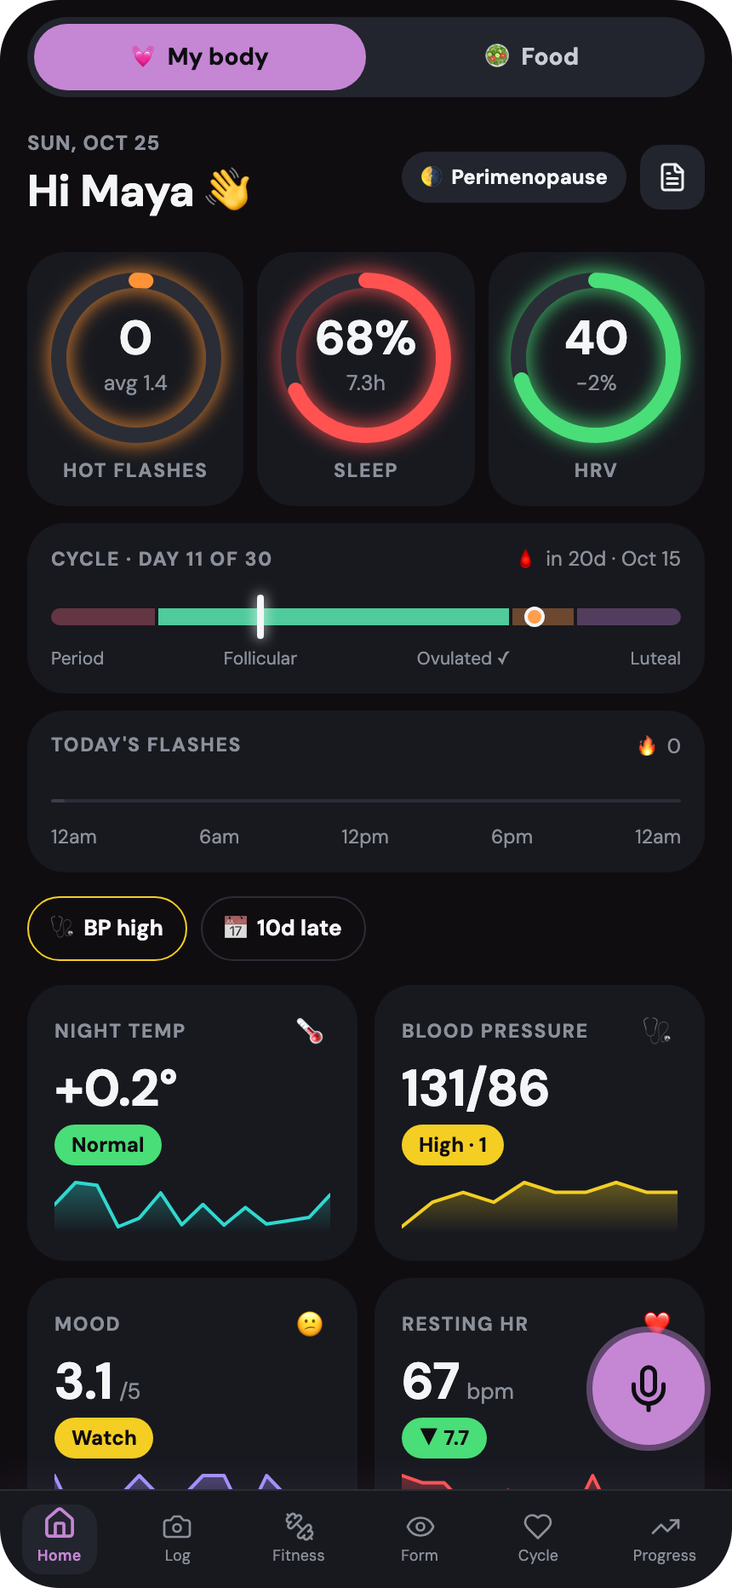
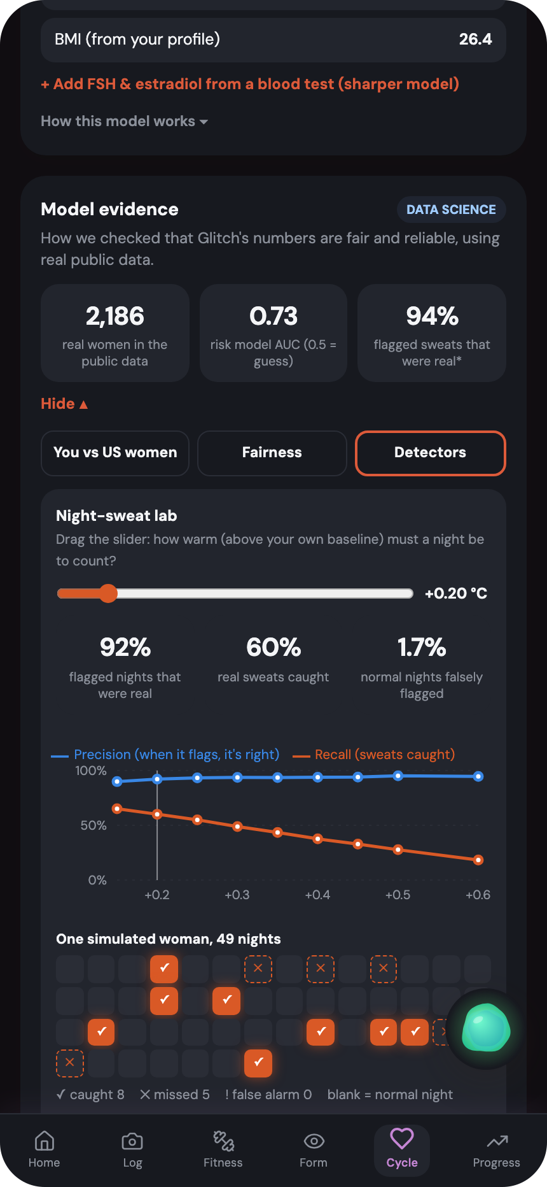
BU SPARK! DS+X HACKATHON 2026 · HEALTHHACK
Glitch
Find the bug. Fix your health.
A voice-first health coach for women in perimenopause and menopause, built on wearable data.
TSHS · 375 women
NHANES · 1,811 women
131 tests
Real public data, audited for fairness
Notes:
0:00. Hi, we're team Glitch. Glitch is a voice-first health coach for women in perimenopause and menopause. In the next four minutes: the problem, a live demo, the data science behind it, and how we kept it responsible.

Slide 2
Doctors see a snapshot. Wearables see every night.
THE PROBLEM
49.4%
15.6%
7.4 yrs
of US women aged 40–60 had menopause symptoms in the past year
of those women take a prescription for their symptoms
median length of frequent hot flashes and night sweats
CDC NCHS, 2025 data
CDC NCHS, 2025 data
SWAN study, 1,449 women
The gap: a 15-minute visit can't capture last month. Her wearable already recorded it. Glitch turns those nights into evidence a doctor can use.
Sources: CDC NCHS Data Brief 575; Avis et al., JAMA Intern Med 2015 (SWAN)
Notes:
0:15. Half of midlife women have menopause symptoms and one in six takes a prescription. Hot flashes last a median of seven years. A clinic visit is a snapshot; her wearable records every night. Nothing connects the two. That's the gap Glitch fills.

Slide 3
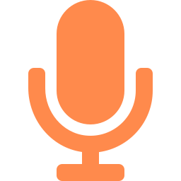
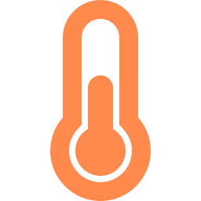


Talk to it. It does the tracking.
WHAT GLITCH DOES
Voice logging
Say “I'm having a hot flash” or “my blood pressure is 132 over 84”. It's logged hands-free.
Night-sweat detection
Flags nights that run warm against her own baseline and have broken sleep.
Staging and alerts
STRAW+10 menopause stage, plus blood-pressure, sleep and mood alerts.
Doctor summary
One printable page: weekly flashes, sweats, sleep, HRV, blood pressure and mood.
Notes:
0:30. Demo time. Open /?reset, tap 'Here for menopause support', connect the WHOOP demo, and say 'I'm having a hot flash', then 'my blood pressure is 132 over 84'. Show the night-sweat chart and the doctor summary. Say clearly: the wearable data in the demo is simulated because no public WHOOP dataset exists.

Slide 4
Real data, real methods, honest labels
DATA SCIENCE
METHOD | DATA | RESULT
Hot-flash risk · ridge logistic regression | REAL TSHS study, 375 women | F1 0.61, MCC 0.40, AUC 0.73. Honest: most of the signal is one question, earlier symptoms
Fairness audit and calibration | REAL Same TSHS data | Race used to audit, never to score. Ranking and calibration similar; error-rate gaps published
Population reference | REAL NHANES 2017–18, 1,811 US women | Percentiles by age, and who is affected: high BP 62% Black vs 38% White women
Night-sweat detector · personal 14-night baseline | SIMULATED 6,780 nights, known answers | Precision 94%, recall 44%, F1 0.59. 1% false alarms (17% on sleep alone)
Ovulation detector · “3 over 6” rule | SIMULATED 600 cycles, 15% anovulatory | Recall 87%, rejects 90% of no-ovulation cycles, F1 0.92, MCC 0.64
Trigger finder · permutation test | PER USER Her own symptom logs | False triggers cut from 24% to 9% of users (simple rule vs corrected)
Evidence-grounded plans · BM25 retrieval (RAG) | CITED 13 passages, 18 test questions | Right passage in top 3: 100%. 0 equipment errors in 3,000 plans
REAL = public dataset. SIMULATED = known answers we generated: a stress test of the method, not clinical validation.
Notes:
2:00. Three real pieces. A hot-flash risk model trained on 375 women from a real study: AUC 0.73, F1 0.61, and honestly most of its signal is one question, earlier symptoms. A fairness audit: we never score anyone by race, but we use it to measure; ranking and calibration are similar, error rates are not. And we compare each user with NHANES, a US national survey. The night-sweat and ovulation detectors were stress-tested on simulated nights with known answers, because no public dataset has confirmed night sweats. Be upfront that those are simulated.

Slide 5
Right when it flags, honest about who it misses
RESULTS
At +0.35 °C: 94% of flagged nights are real sweats, 1% false alarms. Lower it to catch more.
Axis starts at 0.5 (a coin flip). Education gap rests on 39 women: a hint, not a verdict.
Notes:
2:45. Left: the night-sweat detector. At plus 0.35 degrees it is right 94% of the time with 1% false alarms; lowering the threshold catches more sweats, and the lab in the app lets you drag it. Right: model ranking accuracy by group. Race isn't a feature and ranking is similar across racial groups, but I'll be honest on the next slides that error rates are not equal at a fixed cutoff. The pale bar is only 39 women, so a hint, not a verdict.

Slide 6
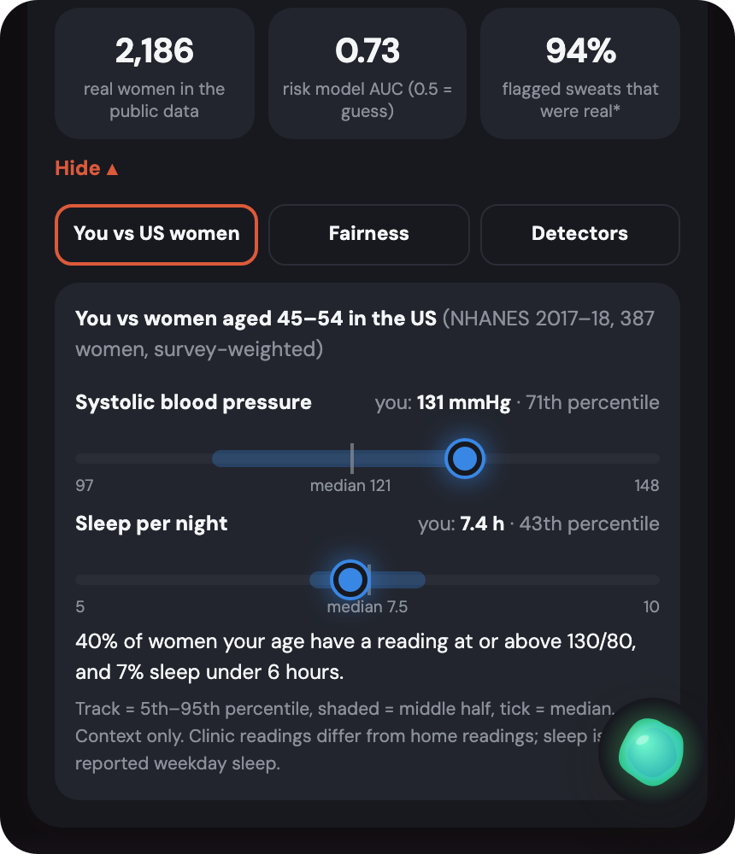
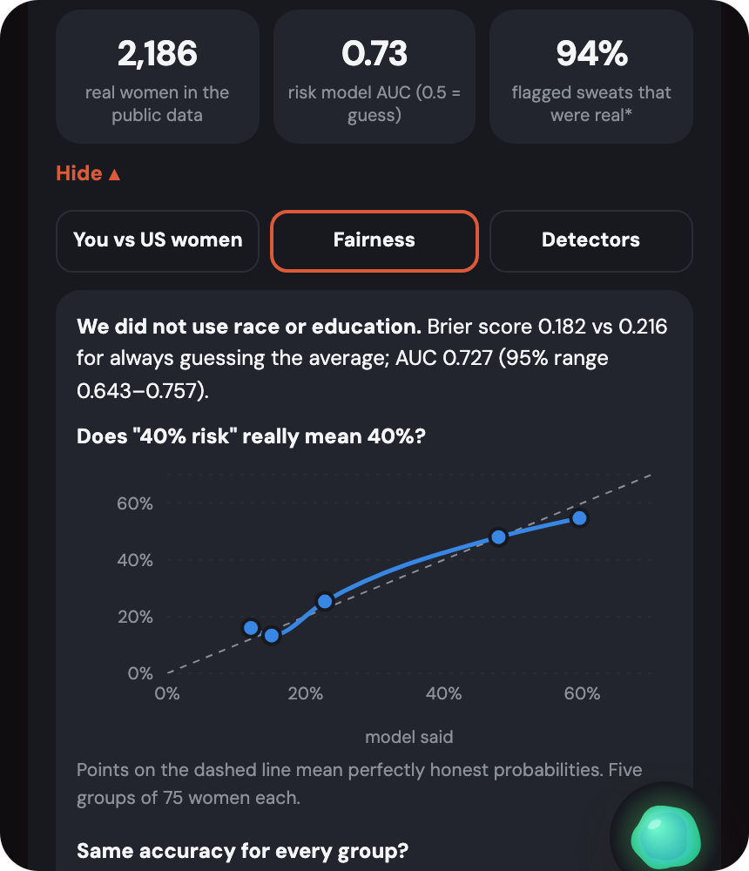
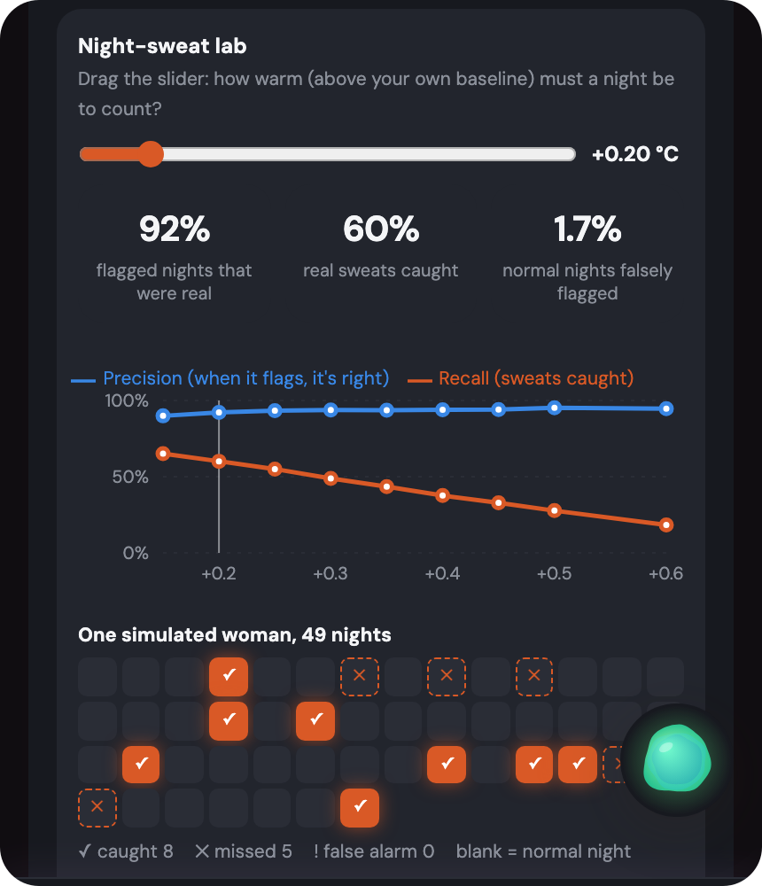
The evidence is inside the product
LIVE IN THE APP
You vs US women
Is it fair?
Night-sweat lab
Her blood pressure and sleep as percentiles of NHANES women her age
Calibration curve and accuracy by group, in plain language
Drag the threshold and watch simulated nights re-score live
Notes:
If the live demo fails, this slide is the backup. Left: where her blood pressure and sleep sit among US women her age. Middle: the calibration curve and fairness check. Right: the night-sweat lab where dragging the threshold re-scores simulated nights.

Slide 7
We audited ourselves, and fixed what we found
RESPONSIBILITY AND ETHICS
3 modes
54% vs 30%
94% → 78%
Privacy claim was wrong
Fair ranking, unequal errors
Sensors may not be equal
The coach saw name, conditions and WHOOP scores. Now: AI off, chat only (default), or opt-in health summary. A live panel shows exactly what was sent.
Flagged as above average, by group. Ranking is similar (AUC 0.69, 0.72) but base rates differ (39% vs 25%), so false alarms are 38% vs 21%. We measure by race, never score by it.
Detector precision with 3× noisier skin-temperature readings. A constant offset changes nothing: each woman is compared with herself.
Accessibility: axe-core (WCAG 2.1 A and AA) on 6 screens found 3 kinds of issue (zoom disabled, chart with no text alternative, low-contrast buttons). All fixed; re-run shows zero violations.
Notes:
3:05. We tested our own claims. One: we'd said only text and a mood label reach the AI. That was wrong: the coach prompt included name, conditions and WHOOP scores. We built three AI modes, default to chat-only, and a live panel showing exactly what was sent. Two: 'equal across groups' was only true for ranking and calibration. At one cutoff the model flags 54% of one group and 30% of the other, because base rates differ, so we publish that table and never use the flag to gate care. Three: sensors. A constant offset doesn't matter because we compare each woman to herself, but noisy sensors hurt, which is why a pilot across skin tones comes next.

Slide 8

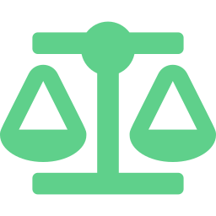


Built to do no harm
RESPONSIBILITY AND ETHICS
Privacy
Fairness
Encrypted on the device, no database. The AI sees only what she says unless she opts in to share a health summary.
We never score by race, but we measure by it: error gaps and national disparities are published in the app.
Transparency
Harm mitigation
Every number is labelled educational, estimated or simulated. A model card is in the app.
Not a diagnosis. Ten harms are tabled with mitigations. Logging and alerts still work if the AI is down.
Known risks: wearable cost bias · a small 2001 cohort · skin-tone sensor differences untested
Notes:
3:30. Everything is encrypted on the device, there is no database, and race isn't used in the model. Every number is labelled educational, estimated or simulated, and the app never diagnoses: alerts point to a clinician. We also name our known risks: wearable cost bias, a 2001 cohort, and sensor accuracy across skin tones that we haven't tested.

Slide 9
WHAT'S NEXT
Evidence, not guesswork.
Connect
Validate
Pilot
Live WHOOP sync with server-side tokens, replacing the simulated demo data.
Check ovulation and night-sweat detection on hormone-confirmed data (mcPHASES, once access comes through).
20–30 women aged 40–60, with consent, and clinician review of the doctor summary.
Demo wearable data is simulated: no public WHOOP dataset exists. Models are trained on TSHS and calibrated against NHANES.
Thank you · github.com/rohinimachavolu/Glitch
Notes:
3:45. Next: connect real WHOOP data, validate the detectors on hormone-confirmed data, and run a small clinician pilot. Glitch gives women evidence, not guesswork. Thank you.

Slide 10
Scorecards and error analysis
APPENDIX
MODEL | PREC. | RECALL | F1 | MCC | DUMB BASELINE | BIGGEST ERROR CAUSE
Hot-flash risk (real, n=375) | 54% | 71% | 0.61 | 0.40 | Always “no”: 69% accurate, F1 0 | All misses have no earlier symptoms; all false alarms have them
Night sweats (simulated) | 94% | 44% | 0.59 | 0.57 | Always “normal”: 75% accurate, F1 0 | 87% of misses: temperature barely rose. 88% of false alarms: warm non-sweat nights
Ovulation (simulated) | 98% | 87% | 0.92 | 0.64 | Always “yes”: F1 0.92, MCC 0 | 31% missed when the rise is under 0.3 °C; runs 0.4 days late
Trigger finder (simulated) | n/a | 79% at 2× | n/a | n/a | Simple rule: 24% false triggers | Misses mild (1.5×) triggers in 60 days: 33% found
Evidence retrieval | 86% | 92% | n/a | n/a | Random 3: 36% hit | Answers written by us; tuned after one miss
Accuracy alone misleads when one answer is rare, so every model is compared with a dumb baseline. Simulated rows are stress tests on cases with known answers.
Notes:
Not presented. Every number here is in the app under Model evidence, Scores, and in EVALUATION.md. Precision is how often a yes is right; recall is how many real cases it catches; F1 balances both; MCC is 0 for no better than chance.

Slide 11
Everything Glitch does
APPENDIX
Voice coach
Night sweats and cycles
Talking avatar, hands-free; reads mood on-device from face, voice tone and words.
Warm-night detection against her own baseline; ovulation confirmation.
Stage and alerts
Plans from your choices
STRAW+10 stage, early-menopause flags, blood-pressure, sleep and mood alerts, PHQ-2/GAD-2.
Goal, equipment, styles and days rebuild the plan and food targets, with cited evidence.
Bone health and Form Coach
Food, three ways
Strength and impact training for bone; camera form feedback with MediaPipe.
Voice, photo (with consent) or typed. Targets computed from your numbers, never guessed.
Supplements and check-ins
Your data, your call
Timing rules for iron, calcium and more; appraisal-based mood check-ins.
AI off, chat only or opt-in summary; see what was sent; export; delete everything.
Notes:
Not presented. A full list of what is in the app, for judges reading the deck.

Slide 12
How it is built
APPENDIX
Runs in the browser
Small server
Trained and checked
React 19, TypeScript, Vite, Tailwind, framer-motion, Recharts. Encrypted storage (AES-GCM). MediaPipe and Web Speech on-device.
Express serves the app and a Groq proxy that holds the key, fails over between models and rate-limits. No database, no health data stored.
Python trains the risk model on TSHS. 167 automated tests, an axe accessibility audit with zero violations, fairness and sensor stress tests.
AI use disclosure: built with AI assistance (Kiro and Claude Code). We set the problem, reviewed and curated the output, and checked it with tests, an accessibility audit and the fairness analysis.
Notes:
Not presented. Architecture and build summary. Disclosure: built with AI assistance (Kiro and Claude Code); the team set the problem, reviewed the output and tested it.

