Slide 1
– Data analysis – Airbnb in New York city
Shivam Sinha
ALY 6140
Prof. Richard He
12/09/24
1

Slide 2
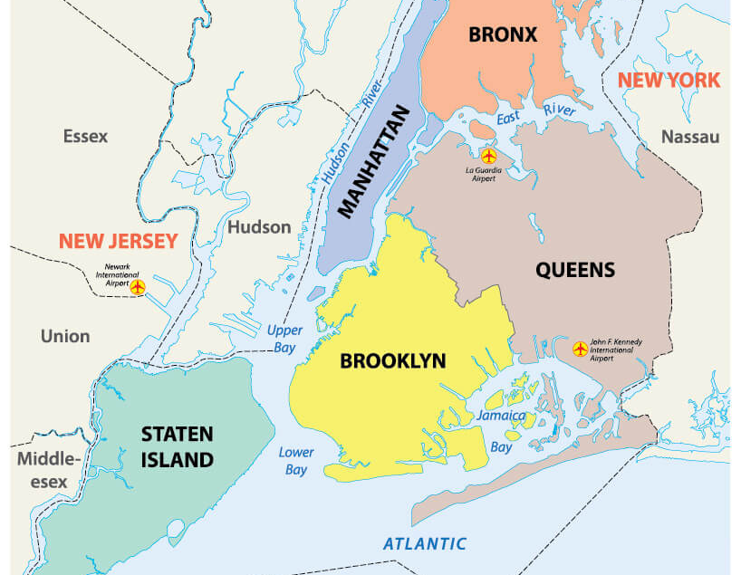
Introduction to Dataset
New York City Airbnb Open Dataset from Kaggle
Contains ~100,000 entries and 16 relevant fields
Variable | Description
host_identity_verified | Whether the host’s identity is verified
neighbourhood_group | The borough where the listing is located
neighbourhood | The neighborhood that the property is in
instant_bookable | Where the listing can be booked instantly (Yes/No)
cancellation_policy | The type of cancellation policy offered
room_type | The type of room offered (e.g., Entire Home, Private Room)
construction_year | Year when the property was constructed
price | Cost per night for the listing
service_fee | Additional fee for services per booking
minimum_nights | Minimum number of nights required for booking
number_of_reviews | Total number of reviews received by the listing
last_review | Date of the most recent review
reviews_per_month | Average number of reviews per month
review_rate_number | Average review score given by guest
availability_365 | Whether the property is listed all year round (Yes/No)
house_rule | Whether the listing includes house rules for guests
Source: https://www.loumovesyou.com/blog/boroughs-of-new-york/
Goal: Draw insights into the factors that contribute to the price and review scores of Airbnb listings in New York City
Notes:
- Hope that these findings would translate to different cities and states.

Slide 3

Exploratory Data Analysis
Guiding Questions:
How does occupancy rate vary between room types and neighborhoods?
Are rental prices associated with the property’s year of construction?
Which characteristics are associated with high review scores?
Does host verification impact price and review score?
How does the age of the listing (how long the property has been on Airbnb) affect review scores or occupancy rates?

Slide 4
data cleaning and preparation
Column Reduction: Removed unnecessary columns to streamline the dataset and reduce bloat.
Data Type Optimization: Assigned proper numeric and categorical data types in the Pandas DataFrame.
Handling Missing Data: Removed rows with missing values in relevant columns and replaced null values in the "reviews per month" column with zeros.
Data Transformation: Created new variables (e.g., occupancy rate) and converted string price values to numeric by removing dollar signs.

Slide 5
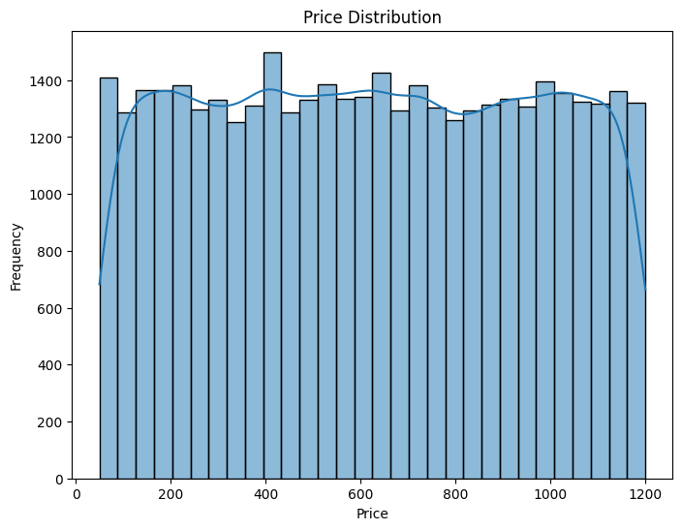
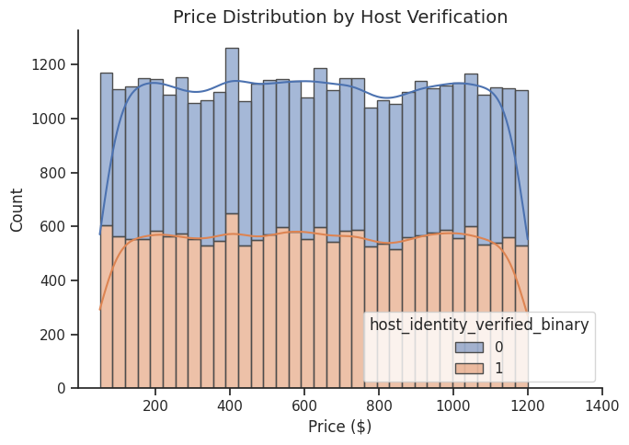
Price distribution
Price is distributed uniformly across its range. This was surprising – we expected a normal distribution
No obvious sign that verified hosts tend to charge higher prices. Again – somewhat surprising.

Slide 6
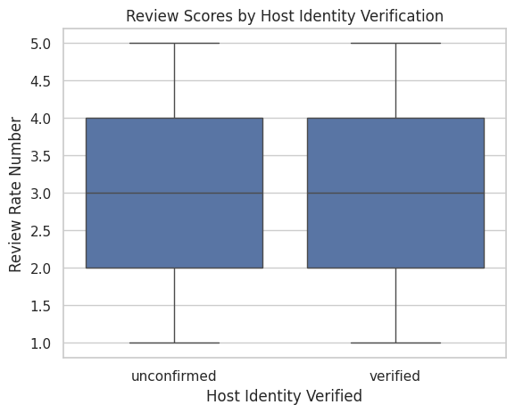
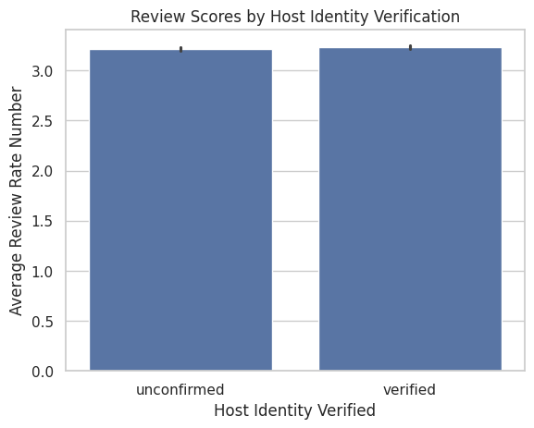
Verification and review score
Review scores are identically distributed between verified and unverified hosts
More evidence that whether a host is verified is unimportant

Slide 7
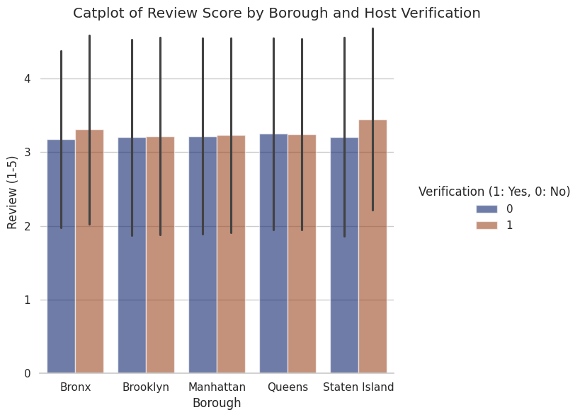
Review Score
No borough yields far higher reviews than the others
Again, verification plays little role, although there is a marked difference between scores of verified and non-verified hosts in the Bronx and Staten Island

Slide 8
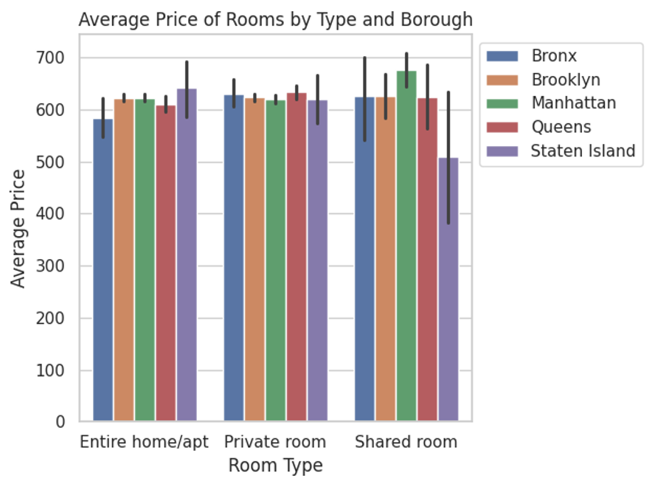
Room type
Generally modest differences in average price neighborhoods and room types
The biggest exception to this is Staten Island shared rooms
Could be why they are so frequently occupied
Most expensive are shared rooms in Manhattan
Highest real estate prices in all of USA

Slide 9
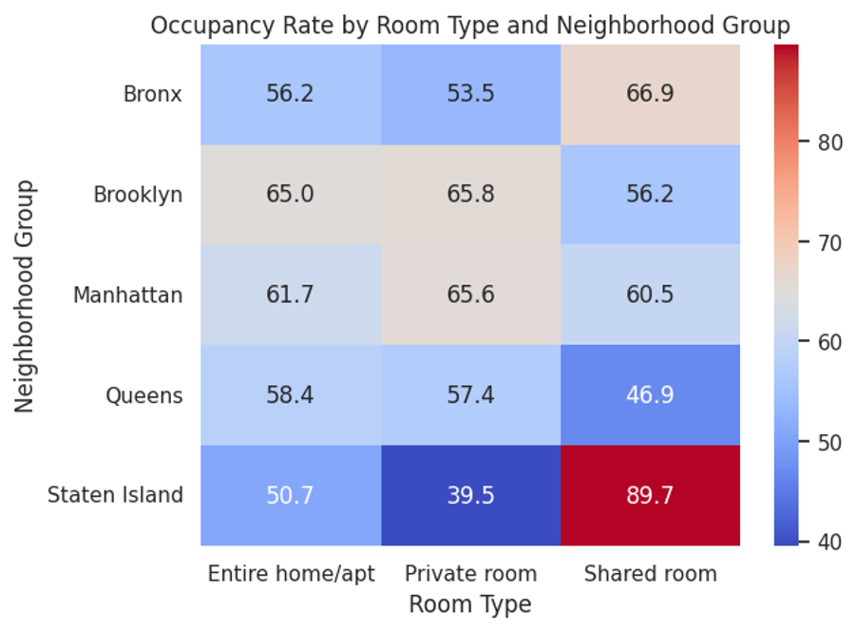
Neighborhood Group
Overall occupancy sits at around 60%, but very significant variation in occupancy rate both between neighborhoods and room types
Staten Island has both the least occupied room type (Private) and the most occupied (Shared)

Slide 10
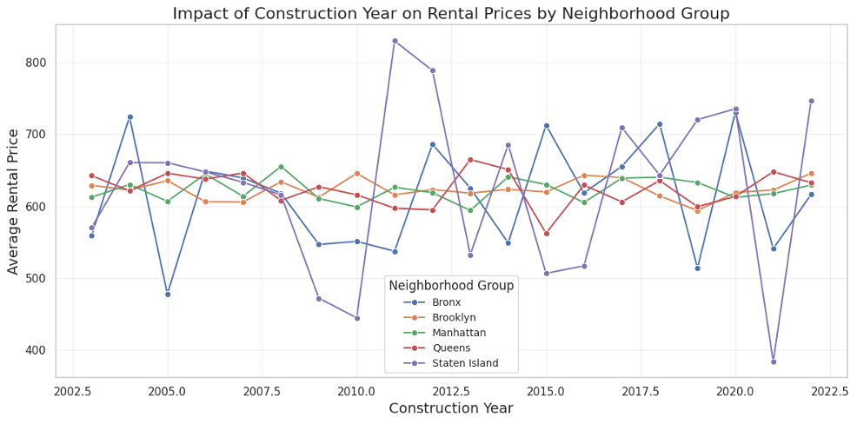
Construction Year
Staten Island and the Bronx show the largest variance in average price year to year
Possible small positive trend

Slide 11
Exploratory Data analysis: Key insights
Verification Impact: Host verification has minimal influence on prices or review scores, showing near-identical distributions for verified and unverified hosts.
Staten Island Trends: Staten Island stands out with the highest shared-room occupancy, the lowest private-room occupancy, and volatile year-to-year rental prices.
Room Type & Prices: Shared rooms in Manhattan are the most expensive across all boroughs, reflecting the city's high real estate costs.
Occupancy Variance: Occupancy rates vary significantly by borough and room type, with Staten Island’s shared rooms having the highest rates.

Slide 12
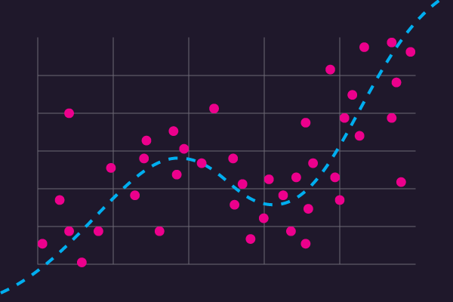
Models
Research goal: run different regression models to help learn about which factors contribute to price and review scores.
Linear Regression: Construction year's impact on price
Random Forest Regression: Characteristics of high review scores
Point Biserial and Logistic Regression: Host verification impact on review score
Linear Regression: Age of listing impact on review scores and occupancy rates
Random Forest Regression: Price Prediction Model
Source: https://www.imsl.com/blog/what-is-regression-model

Slide 13
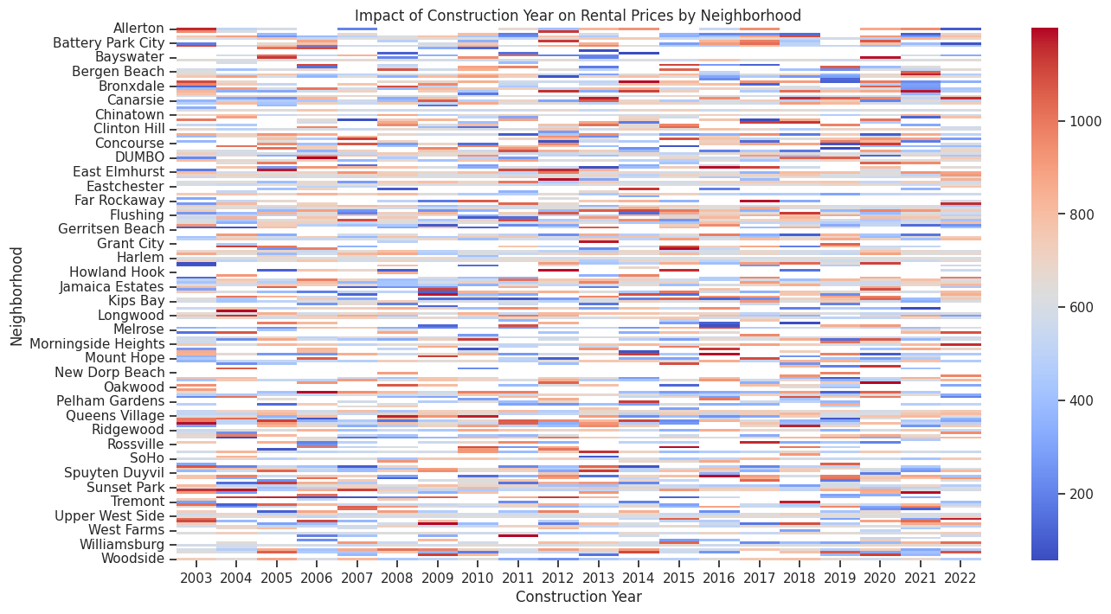
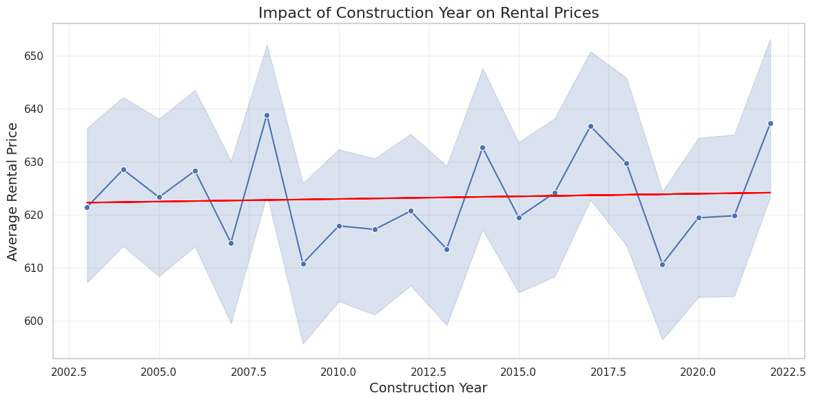
Predictive model 1: Linear regression Price vs. construction year
Regression Coefficient: 0.0987 (Impact of Construction Year - small)
Intercept: 424.63
Visuals support findings: very small positive correlation
Notes:
How does the year of construction impact rental prices across different neighborhoods?

Slide 14
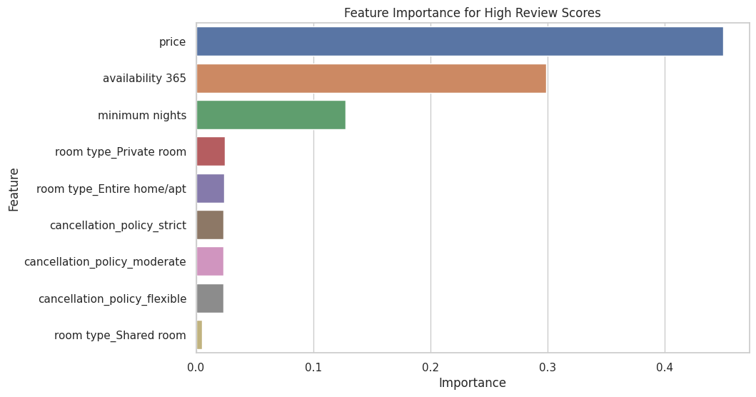
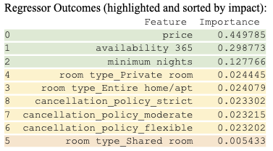
Predictive model 2: Random forest regression Review scores
Price, availability, and minimum nights have the most impact on high review scores
When searching for places to stay, look based on price and availability
Linear regression on price and review score: -4.59e-05 regression coefficient
Very small negative correlation
Notes:
Which listing characteristics within each neighborhood are associated with high review scores?

Slide 15
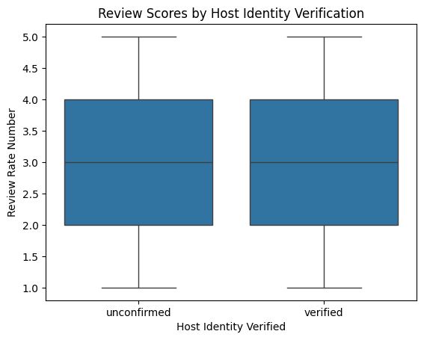
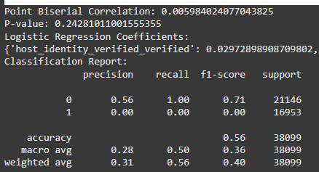
CORRELATION : host identity and review score
Point Biserial
Point Biserial Correlation: The correlation between host identity verification and review scores is weak and insignificant.
Correlation: 0.00598
P-value: 0.2428
Logistic Regression: `host_identity_verified` has a negligible positive coefficient. The model performs poorly, likely due to weak relationships between features and the target and imbalanced data

Slide 16
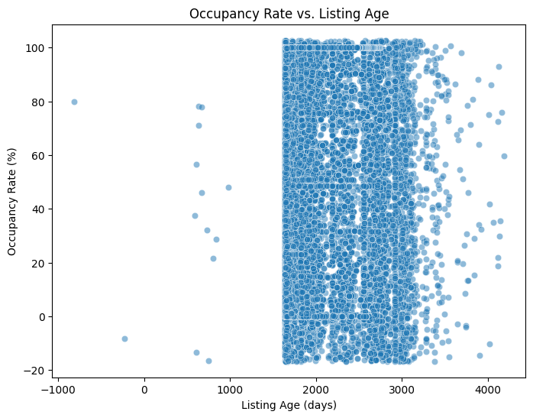
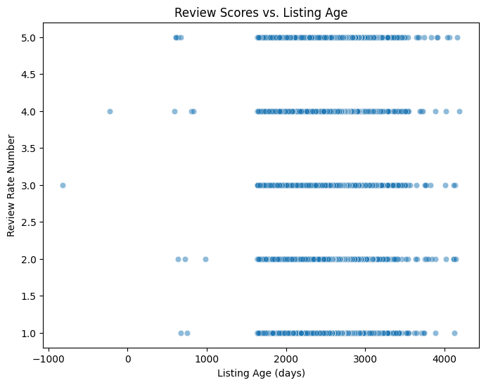
age of the listing vs review scores
Linear regression 2
The negative impact of listing age on review scores suggests that older listings tend to have slightly lower review scores.
The positive impact of listing age on occupancy rates suggests that older listings are somewhat more likely to have higher occupancy rates, but the effect is very small.
Linear regression is useful for quantifying the relationship between listing age and review scores or occupancy rate, allowing for clear insights into how these factors are influenced by the age of the listing

Slide 17
Price prediction model
Our objective is to create a model predict the price of a listing based on various features such as review counts, availability, construction year, and others. It's an application of supervised machine learning where the model learns from historical data to predict the price based on input features. The dataset includes various categorical and numerical features, which are processed and used to train the model
Our model learns from the data provided and after predicting an estimated price, classifies the listing as over-price, Good-deal or bargain. This helps in real world implementation and visualization of our output.

Slide 18
Model we Use
The Random Forest Regressor is the machine learning model used in this code
Handling Non-linear Relationships: Random Forests are powerful when it comes to handling complex, non-linear relationships between features and the target variable (price). In this dataset, price is likely influenced by several factors in non-linear ways (e.g., a large number of reviews might affect the price differently depending on the room type).
Feature Importance Evaluation: Random Forest can also help identify the importance of different features (e.g., days since last review, number of reviews) in predicting the target variable.
Robust to Overfitting: Random Forest models reduce the risk of overfitting by averaging the results of multiple decision trees, making them more stable and accurate.
Handles Mixed Data Types: Random Forest works well with both numerical and categorical data, which is present in this datase

Slide 19
Steps to create price prediction model
Import Dataset
Clean Dataset
One-Hot Encode Columns
Feature Extraction
Train Model
Predict and classify prices

Slide 20
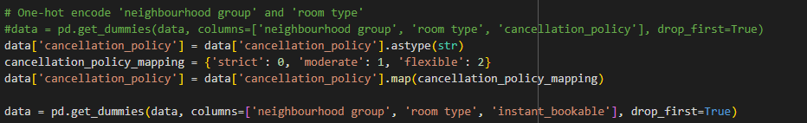
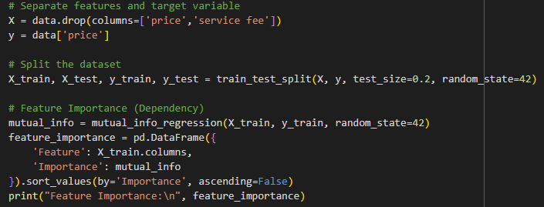
Code Snippets

Slide 21
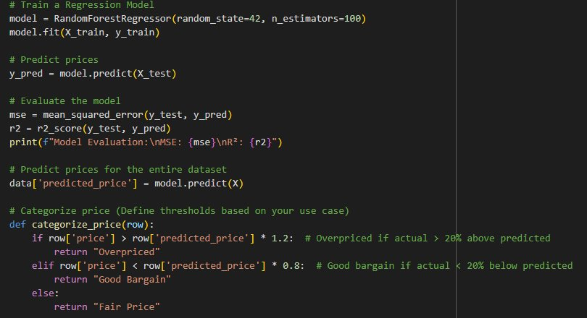

Slide 22
Feature Importance: price
days_since_last_review (0.400280) — The number of days since the last review is the most important feature.
reviews per month (0.380897) — The number of reviews per month also has significant predictive power.
availability 365 (0.265864) — The listing's availability throughout the year plays an important role.
number of reviews (0.259994) — The total number of reviews is also impactful.
Construction year (0.129753) — The year the property was built shows some influence.
Other features with relatively lower importance include review_month, minimum nights, review_rate_number, and several neighborhood and room type indicators

Slide 23
Model Evaluation (Sample Predictions):
Price: 966.0 → Predicted price: 795.13 → Category: Overpriced
Price: 142.0 → Predicted price: 319.44 → Category: Good Bargain
Price: 368.0 → Predicted price: 456.19 → Category: Fair Price
Price: 204.0 → Predicted price: 358.39 → Category: Good Bargain
Price: 577.0 → Predicted price: 599.20 → Category: Fair Price

Slide 24
Model Evaluation:
Mean Absolute Error (MAE): 222.8323 — This indicates the average difference between the predicted and actual prices. A smaller MAE would suggest more accurate predictions.
Mean Squared Error (MSE): 75850.9554 — MSE penalizes larger errors more heavily than MAE due to squaring the errors. This can be useful when large errors need to be minimized.
Root Mean Squared Error (RMSE): 275.4105 — RMSE gives you the error in the same units as the target variable (price), which is more interpretable.
R-squared (R²): 0.3129 — This means that the model explains approximately 31.3% of the variance in the price data, which could be considered low, indicating there is room for improvement in the model.

Slide 25
Future Enhancements
R² (0.3129): This value suggests that the model's performance is suboptimal, as it only explains around 31% of the variance in the target variable (price). A higher R² value (closer to 1) would indicate a better fit.
MAE, MSE, RMSE: These metrics suggest that while the model is making reasonable predictions, there is still significant room for improvement, especially considering that the MAE and RMSE are relatively high.
Improvement Areas:
More features could be engineered or selected.
Hyperparameter tuning could help improve model performance.
Trying more complex models, like Gradient Boosting Machines (GBM) or XGBoost, may yield better results.

Slide 26
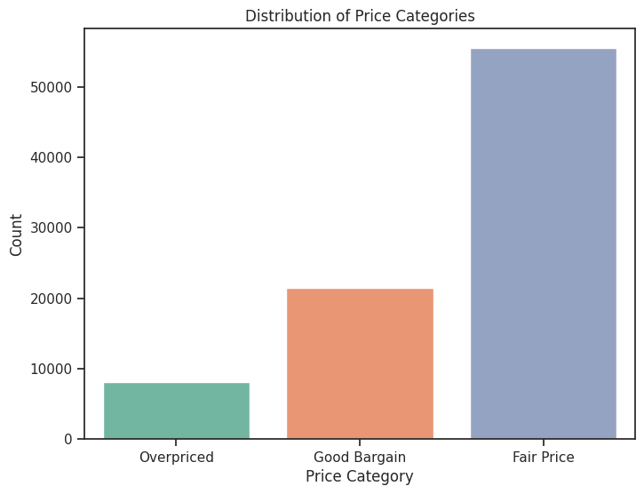
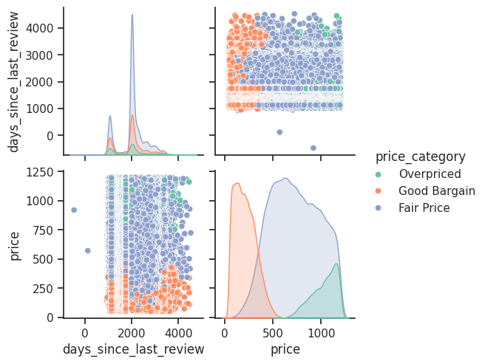
Other conclusions from the model

Slide 27
Overall conclusions – prediction models
Linear Regression
Best For: Simple, linear relationships; small datasets.
Strengths: Fast, interpretable, computationally efficient.
Limitations: Struggles with complex or non-linear data; sensitive to outliers.
Random Forest
Best For: Complex, non-linear data; large datasets.
Strengths: Robust to overfitting, handles feature interactions well, high accuracy.
Limitations: Less interpretable, computationally expensive.
Biserial Correlation
Best For: Analyzing relationships between continuous and binary variables.
Strengths: Measures strength of association.
Limitations: Not used for predictive modeling; limited to binary categorical variables.
Best Choice: Random Forest
Highest predictive accuracy for complex and non-linear datasets.

Slide 28
Overall conclusions – dataset
Price Distribution Insights:
The distribution of prices is highly skewed, with a few expensive listings driving the higher end of the spectrum. This suggests that most listings are reasonably priced, but there are some outliers that need special attention (e.g., luxury or unique properties).
Feature Importance:
From the feature importance analysis, reviews per month and days since last review are critical features influencing the model’s predictions. Listings with frequent reviews and more recent reviews tend to have higher prices.
availability 365 is also a significant factor, suggesting that properties with higher availability throughout the year generally command higher prices.
Correlation Between Features:
There is a strong correlation between reviews per month and number of reviews, indicating that properties with more reviews are typically more active and possibly better-rated, contributing to a higher price.
cancellation policy and host_identity_verified show a weaker correlation to price, indicating they might not be as significant predictors in this case.
Price vs. Location:
Based on neighborhood group data, Brooklyn and Manhattan have higher average prices compared to other boroughs, as seen in the graphs.

Slide 29
Sources
Azmoudeh, A. (2022, August 1). Airbnb Open Data. Kaggle. https://www.kaggle.com/datasets/arianazmoudeh/airbnbopendata
Example gallery. Seaborn. (n.d.). https://seaborn.pydata.org/examples/index.html
Example gallery. Matplotlib. (n.d.). https://matplotlib.org/stable/gallery/index.html

Slide 30
Image Links
https://www.loumovesyou.com/blog/boroughs-of-new-york/
https://www.imsl.com/blog/what-is-regression-model

