Slide 1

CRICKET TEAM PERFORMANCE ANALYZER
GROUP—CS-53-54
SHIVAM SINGH
RITESH SHARMA
VAIBHAV SRIVASTVA

Slide 2

CONTENT
* INTRODUCTION
* DATA SOURCES
* KEY METRICS
* DATA VISUALISATION
* TEAM PERFORMANCE TRENDS
* CONCLUSION

Slide 3
INTRODUCTION
The purpose of the presentation on the Cricket Team Performance Analyzer is to provide a comprehensive analysis of a cricket team's performance. This tool enables coaches, players, and analysts to evaluate various aspects of the team's gameplay, including batting, bowling, fielding, and overall strategy. By presenting data-driven insights, the analyzer aims to help teams make informed decisions, identify areas for improvement, and ultimately enhance their performance on the cricket field

Slide 4
DATA SOURCES
A Cricket Team Performance Analyzer relies on various data sources to provide a comprehensive analysis of a team's performance. These data sources include:
1. Match Statistics: This primary source includes data from each match played, such as runs scored, wickets taken, boundaries, dot balls, extras, and individual player performances. These statistics are collected during live matches and are crucial for assessing overall team performance.
2. Video Footage: Video recordings of matches are invaluable for in-depth analysis. Coaches and analysts can review match footage to assess player techniques, field placements, bowling actions, and batting styles. Slow-motion replays and multiple camera angles help in detailed scrutiny

Slide 5
3.GPS and Wearable Technology: Players may wear GPS trackers or other wearable devices that monitor their movements on the field. This data helps assess fielding efficiency, player fitness, and fatigue levels during a match.
match is crucial for understanding how they affect gameplay. Data on pi
4.Pitch and Weather Data: Information about the pitch conditions and weather during a tch speed, bounce, and weather conditions (e.g., humidity, wind speed) can impact batting and bowling strategies.
5.Ball-tracking Systems: Ball-tracking technology, like Hot Spot and Snickometer, provides additional insights into ball movement, bat-ball contact, and potential edges or impacts. This data is often used in decisions related to dismissals and reviews.

Slide 6

KEY MATRICS
These metrics help in evaluating the effectiveness of different aspects of the game. Here are some key performance metrics commonly analyzed:
Batting Average: The average number of runs scored by a batsman per dismissal. It indicates a batsman's consistency in scoring runs.
Batting Strike Rate: The number of runs scored by a batsman per 100 balls faced. It measures the speed and aggressiveness of a batsman's scoring.
Bowling Economy Rate: The average number of runs conceded by a bowler per over bowled. A lower economy rate is generally favorable for bowlers as it signifies control over runs.

Slide 7
DATA VISUALISATION
Certainly! Data visualization is crucial in a Cricket Team Performance Analyzer to present team performance data effectively. Here are various types of charts and graphs that can be used to represent team performance data:
Bar Charts: Bar charts can be used to compare performance metrics for different players or teams. For example, you can create a bar chart to compare batting averages of different players in a team.
Pie Charts: Pie charts can be used to show the distribution of runs scored by a team through different types of shots (boundaries, singles, dots, etc.)

Slide 8
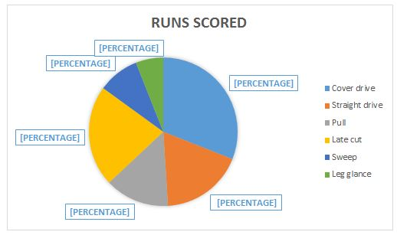
TEAM PERFORMANCE
Certainly, here's an example of how a pie chart can be used in a Cricket Team Performance Analyzer to show the distribution of runs scored by a team through different types of shots:
Pie Chart: Distribution of Runs Scored by Shot Type
In this pie chart, you can visually represent the breakdown of runs scored by a cricket team based on the types of shots played. The chart might look something like this:
Cover Drive (4s and 6s): 40%
Leg Grace: 35%
Dots (No runs scored): 15%
Pull: 5%
Sweep 3%
Extras (Byes, Leg byes, No balls, Wides): 2%

Slide 9
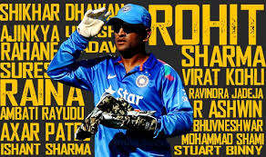
CONCLUSION
In conclusion, the Cricket Team Performance Analyzer is an indispensable tool for modern cricket teams aiming to elevate their performance and competitiveness in the sport. By harnessing the power of data analysis and visualization, teams can gain valuable insights into their strengths, weaknesses, and areas for improvement.

Slide 10



