Slide 1

Basic Details of the Team and Problem Statement
Ministry: Central Water Commission (CWC), Ministry of Jal Shakti
PS Code: RK1112
Problem Statement Title:Drought Information and Management
Team Name: Jal Doot
Team Leader Name: Shivam Thakkar
Institute Code: C212
Institute Name: L.D. College Of Engineering
Theme Name: Agriculture Foodtech & Rural Development

Slide 2
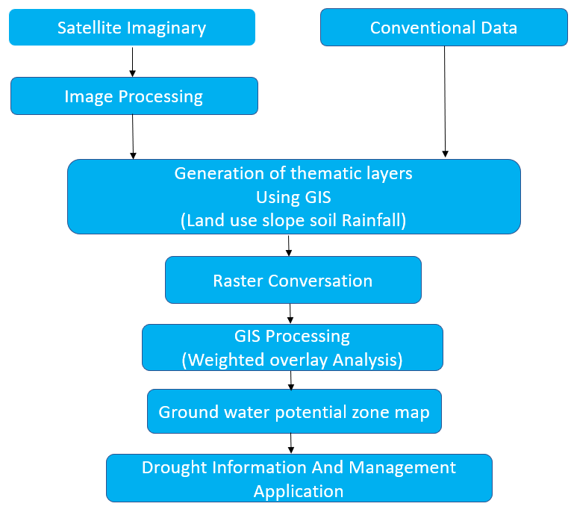
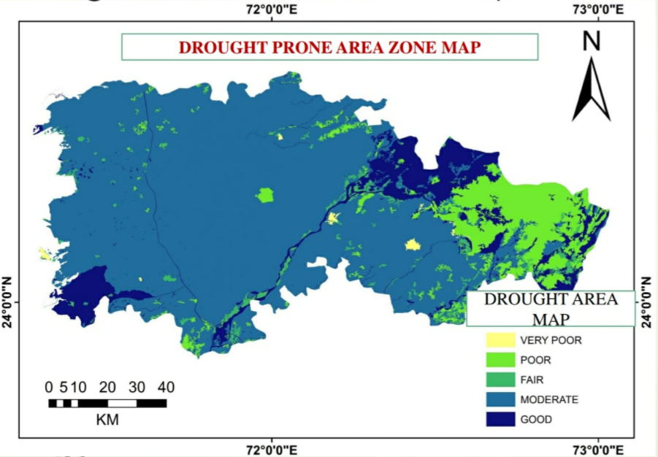
Idea/Approach Details
Describe your idea/Solution/Prototype here:
Our idea is to design easily accessible stand-alone App which can generate location specific notifications to the common user.
It will aid in better monitoring and management of portents of drought by different agency and department to related to water and drought management.
Describe your Technology stack here:
Geospatial software tools (GIS) are used for creating, viewing, managing, analyzing, and utilizing geospatial data.
Geospatial data can include socio-economic, environmental, geophysical, and technical data about the Earth and societal infrastructure and it is pivotal in environmental modeling and management (EMM).

Slide 3
Idea/Approach Details
Describe your Use Cases here
Describe your Dependencies /Show stopper here
Careful monitoring of the symptoms of drought and early warning are key to effective management of the calamity
Provide accurate and timely information on rainfall, crop sown area, data on soil moisture (wherever possible), stream flow, groundwater, lake and reservoir storage at the relevant spatial scale at the State / district / sub-district levels.
Detect drought conditions as early as possible in order to implement District Agriculture Contingency Plans and the Crisis Management Plan.
The available information and forecast by agencies on rainfall, soil moisture, surface and groundwater levels, colour coded areas may be generated using google maps for display of vulnerability magnitude for the whole country at district/sub-district level.
GIS and MIF
Indian meteorological department, ministry of earth science

Slide 4
Team Member Details
Team Leader Name: Shivam Thakkar Branch: BE | Stream: IT | Year: II YEAR
Team Member 1 Name: Mauli Timani
Branch: BE Team Member 2 Name: Jeel Patel | Stream: Civil Engineering | Year: II YEAR
Branch: BE | Stream: IT | Year: II YEAR
Team Member 3 Name: Kartik Suthar Branch: BE | Stream: Civil Engineering | Year: II YEAR
Team Member 4 Name:Jay Patel
Branch: BE Team Member 5 Name: Shubham Patel | Stream: Civil Engineering | Year: II YEAR
Branch: BE | Stream: IT | Year: II YEAR
Team Mentor 1 Name: Sudhanshu Dixit Category: Academic | Expertise : Water Resources Engg | Domain Experience (in years): 07
Team Mentor 2 Name: Vidisha Thakkar
Category: Academic | Expertise : Data Analytics, Big Data and Associate fields | Domain Experience (in years): 07

