Slide 1
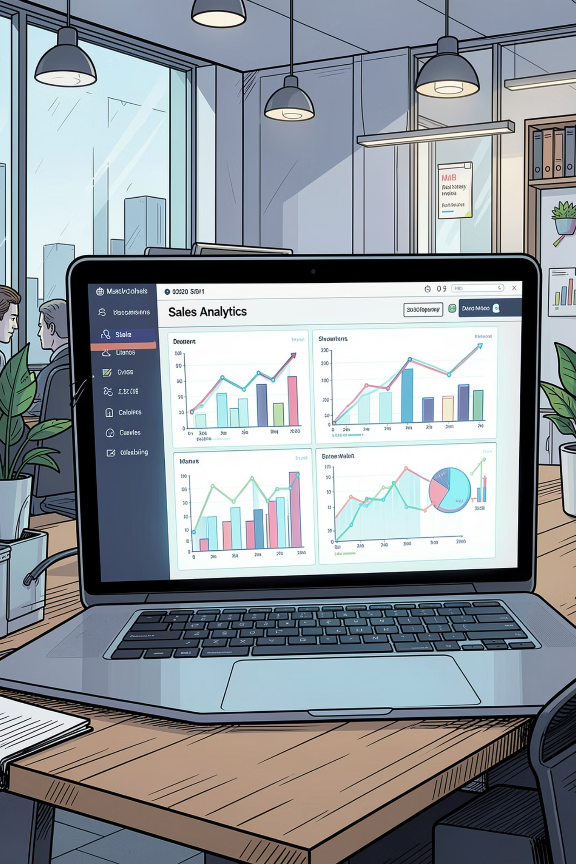
Sales Analytics Project Report
An in-depth analysis of sales transactions, customer behavior, product performance, and store operations — powered by an interactive Excel Dashboard.
EXCEL · PIVOT TABLES · DASHBOARD

Slide 2
About the Dataset
What's Inside
The dataset covers sales transactions, customers, products, discounts, and store locations — enabling analysis across four key dimensions.
Product Performance
Customer Analysis
Sales Team Performance
Store Analysis

Slide 3
Dashboard Overview — Key Metrics
₹24.7M
₹22.3M
Gross Sales
Total Sales
Total gross sale amount across all products
Net sales after discounts applied
9.96%
₹2.37M
Avg Discount
Discount Amount
Average discount percentage across transactions
Total value of discounts given
The dashboard features five panels: Overview, Product Performance, Store Analysis, Sales Team Performance, and Customer Analysis — with filters for Month, Category, Location, and more.

Slide 4
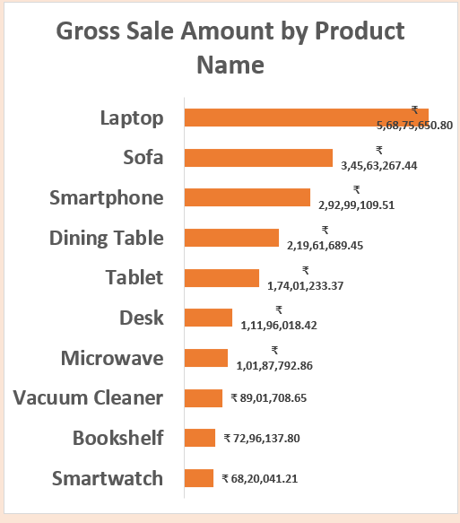
Overview

Slide 5
Product Performance

Slide 6

Sales Team Performance
🏆 Top Performer — Varun
Highest gross sales (₹3.50Cr), total sales (₹3.16Cr), and units sold (3,089). Consistently leads across all metrics.
📊 Balanced Team
Sales distribution among all 8 reps is relatively close, indicating balanced overall team performance.
💡 Discount Strategy
Riya & Sonal offer the highest avg discounts (10.3%); Amit the lowest (9.6%). Monitor to protect margins.

Slide 7
Store Analysis
Store Insights
Hyderabad leads in both total sales (₹3.69Cr) and units sold (3,431)
Chennai records the lowest total sales despite high unit volume
Kolkata, Delhi & Hyderabad offer the highest avg discounts (10.1%)
Mumbai & Pune have the lowest avg discounts (9.8%)

Slide 8
Customer Analysis
Customer Insights
Kavya Nair & Arjun Mehta generate the highest total sales among top customers
Arjun Mehta has the highest avg order value at ₹63,148
Aditya Roy receives the highest avg discount (10.7%); Ananya Das the lowest (9.7%)

Slide 9

Key Business Insights
1
Products
Laptops & Smartphones dominate revenue; Smartwatches underperform. Electronics leads all categories.
2
Sales Team
Varun & Nidhi are top performers. Team distribution is balanced — replicate top strategies across reps.
3
Stores
Hyderabad leads in sales & volume. Chennai & Mumbai need stronger marketing and operational support.
4
Customers
Top 10 customers drive significant revenue. High-value customers deserve personalized retention strategies.

Slide 10
Business Recommendations
Promote Best-Sellers
Train Sales Team
Increase marketing for Laptops & Smartphones; improve Smartwatch visibility with targeted offers.
Coach lower-performing reps using Varun & Nidhi's successful strategies to lift team output.
Scale Winning Stores
Customer Retention
Apply Hyderabad's playbook to Chennai & Mumbai; adjust discount strategies by city.
Offer personalized deals to high-value customers; launch loyalty programs to reduce heavy discounting.
Inventory Planning
Data-Driven Decisions
Maintain adequate stock of high-demand products to prevent shortages and lost sales.
Use sales data regularly to guide strategy, improve performance, and optimize profitability.

Slide 11
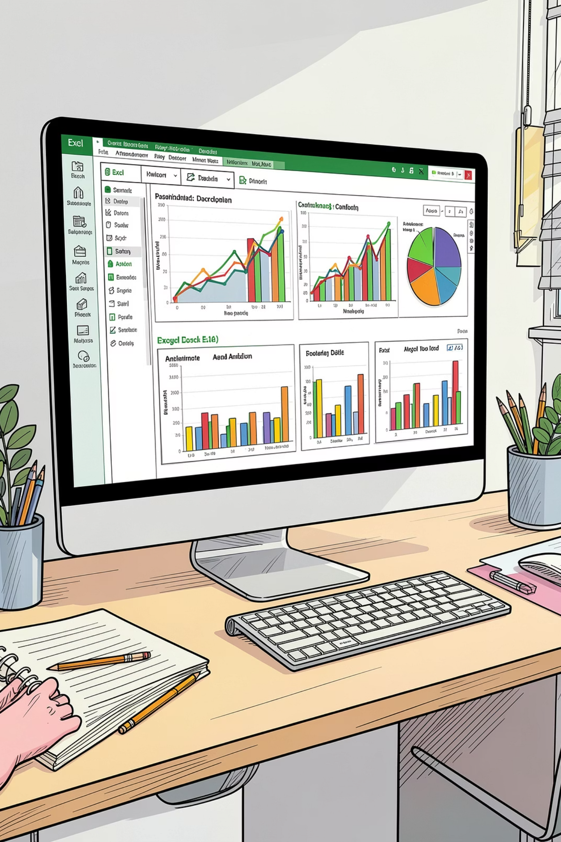
Conclusion
This project leveraged Pivot Tables and an Excel Dashboard to transform raw sales data into actionable insights across products, customers, sales teams, and store locations.
Microsoft Excel
Core analysis platform
Pivot Tables
Data aggregation & summarization
Excel Dashboard
Interactive visual reporting
Charts & Graphs
Visual storytelling & insights

