Slide 1
Console Based Banking System
Python Implementation
By Shivam Tandon

Slide 2
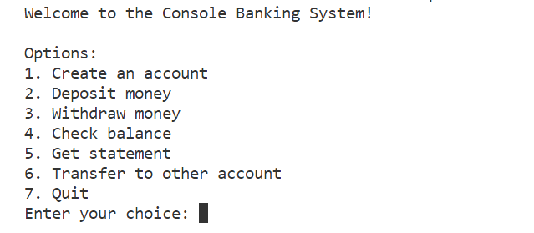
Introduction
The Console Banking System is a simple banking application implemented in Python.
It provides basic functionalities such as creating an account, depositing and withdrawing money, checking the balance, getting account statements, and transferring money between accounts.

Slide 3


System Requirements
Python installed (version 3.x)
SQLite database for data storage
`db-sqlite3` package for Python (install using pip install db-sqlite3)
This Photo by Unknown Author is licensed under CC BY
This Photo by Unknown Author is licensed under CC BY-NC-ND

Slide 4
Architecture
Database Structure:
Accounts Table: Stores account details (account number, name, mobile number, address, password, balance).
Transactions Table: Logs all transactions with details (transaction ID, account number, transaction type, amount, transaction date).
Class Structure:
Account Class:
Manages account-related functionalities.
Interacts with the SQLite database to store and retrieve account details and transactions.
Methods include creating an account, depositing, withdrawing, checking balance, getting statements, and transferring money.

Slide 5
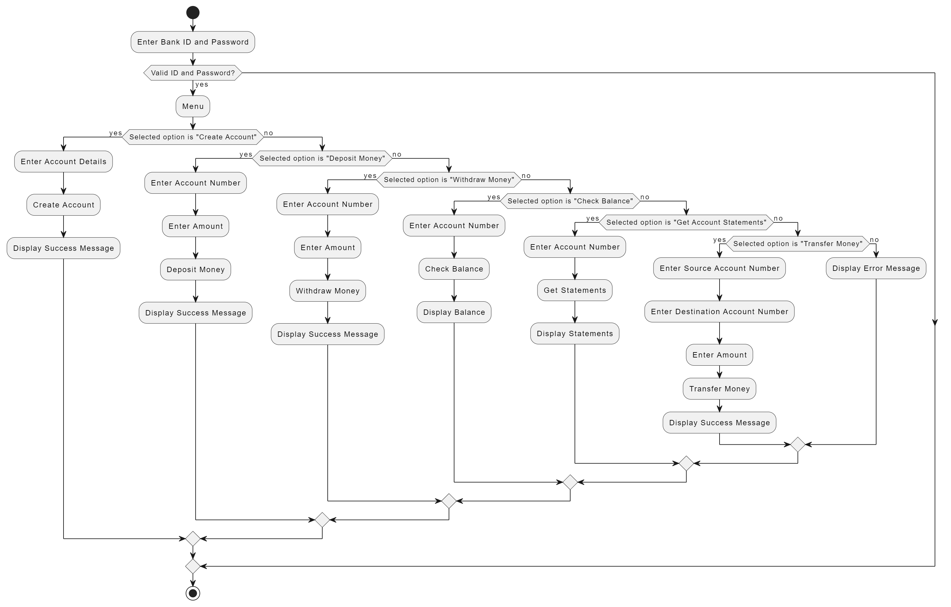

Slide 6
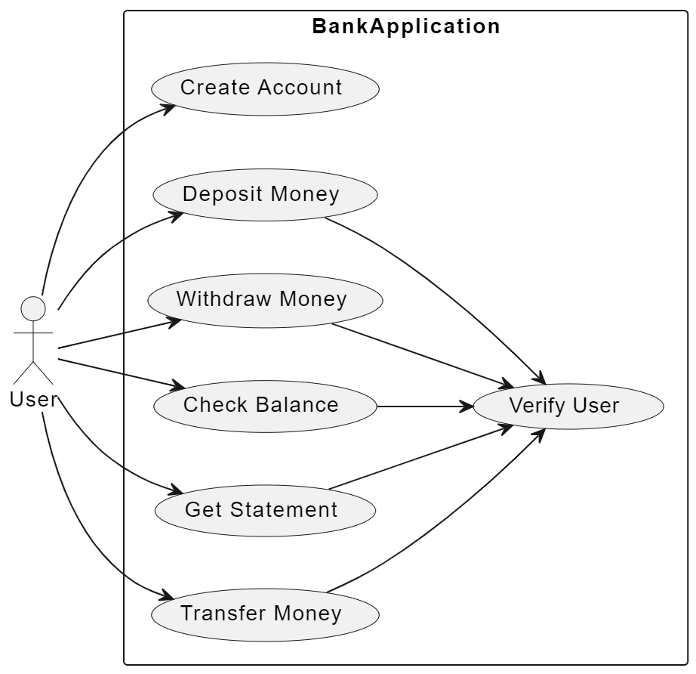
Use Case Diagram

Slide 7
User Interface
The user interacts with the Console Banking System through a command-line interface.
Main menu options include account creation, deposit, withdrawal, balance inquiry, statement retrieval, fund transfer, and system exit.
Each option guides the user through the necessary inputs for the chosen operation.

Slide 8
Workflow
1. Account Creation :
User selects the "Create an account" option from the main menu.
The system generates a unique 6-digit account number and prompts the user for personal details (name, mobile number, address, password).
The “Account” class creates an instance, inserts account details into the 'accounts' table, and commits the transaction.

Slide 9
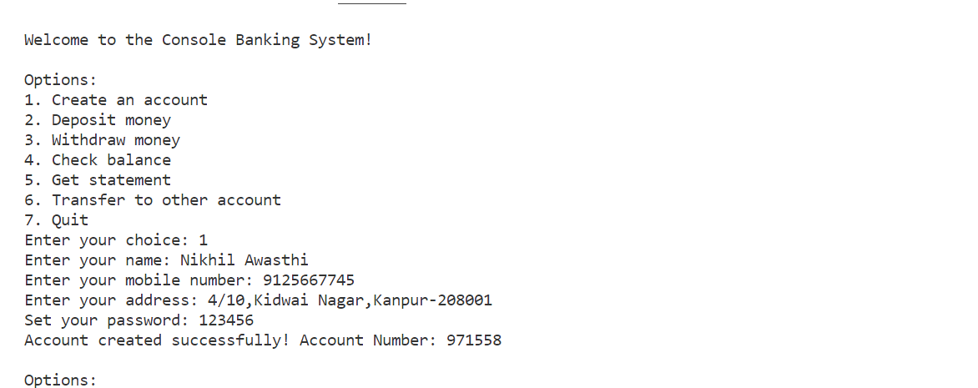
Account Creation (Continued)

Slide 10
Workflow
2. Deposit Money :
User selects the "Deposit money" option.
The system prompts the user for their account number and password.
Upon successful verification, the user inputs the amount to deposit.
The ‘Account’ class updates the balance in the 'accounts' table and logs the deposit transaction in the 'transactions' table.

Slide 11
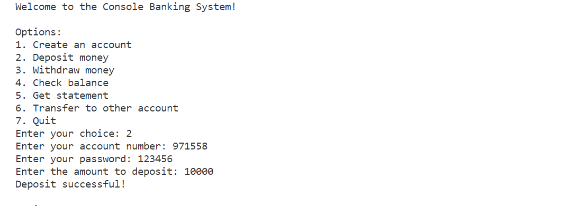
Deposit Money (Continued)

Slide 12
Workflow
3. Withdraw Money :
User selects the "Withdraw money" option.
The system prompts the user for their account number and password.
Upon successful verification, the user inputs the amount to withdraw.
The ‘Account’ class checks for sufficient funds, updates the balance, and logs the withdrawal transaction.

Slide 13

Withdraw Money (Continued)

Slide 14
Workflow
4. Check Balance :
User selects the “Check Balance" option.
The system prompts the user for their account number and password.
Upon successful verification, the ‘Account’ class retrieves and displays the account balance from the 'accounts' table.

Slide 15
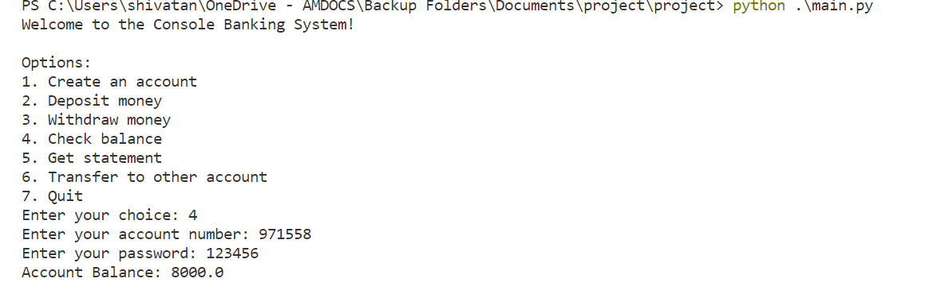
Check Balance (Continued)

Slide 16
Workflow
5. Get Statement :
User selects the “Get Statement" option.
The system prompts the user for their account number and password.
Upon successful verification, the ‘Account’ class retrieves account details and transaction history from the 'accounts' and 'transactions' tables.
The details are displayed, including account information and a transaction statement.

Slide 17
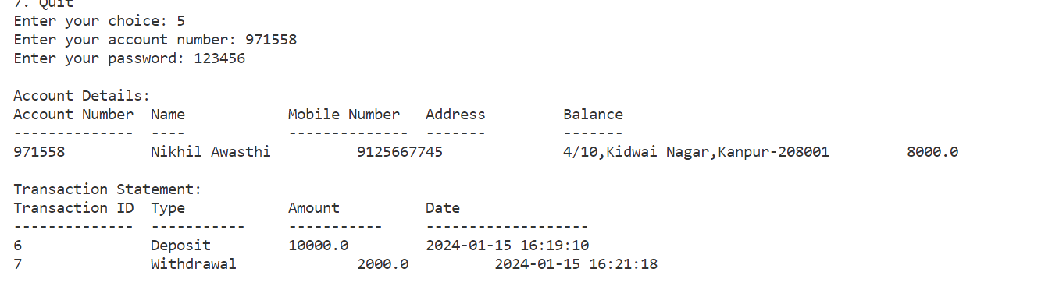
Get Statement (Continued)

Slide 18
Workflow
6. Transfer Money :
User selects the “Transfer Money" option.
The system prompts the user for their account number and password.
Upon successful verification, the user inputs the recipient's account number and the amount to transfer.
The ‘Account’ class checks for sufficient funds, updates both accounts' balances, and logs the transfer transactions in the 'transactions' table.

Slide 19
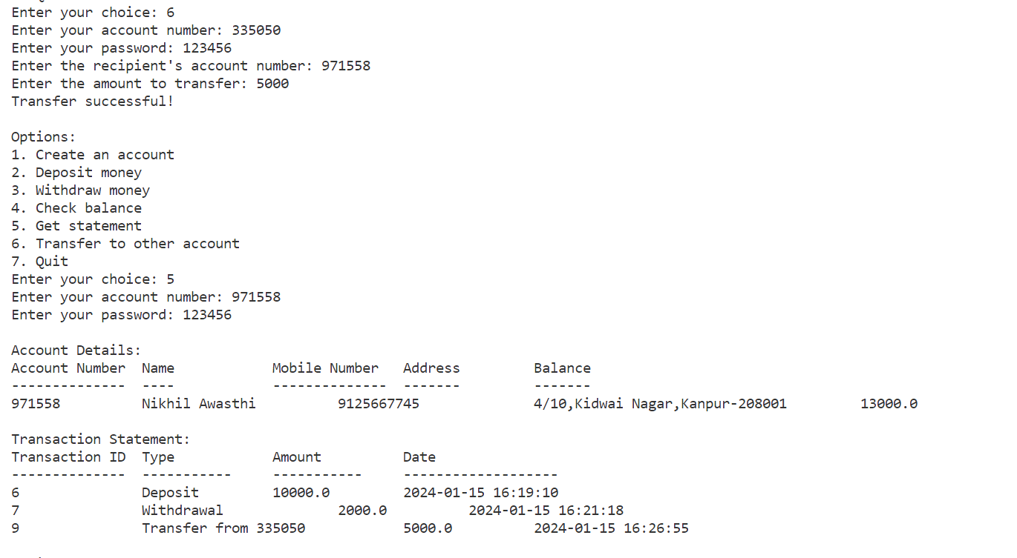
Transfer Money (Continued)

Slide 20
Workflow
7. Exit :
User selects the "Quit" option.
The system terminates the program, concluding the banking session.

Slide 21
Technologies Used
Programming Language: Python 3.x
Database: SQLite
Database Package: db-sqlite3
Version Control: Git

Slide 22
Conclusion
The Console Banking System provides a simplified banking experience with essential functionalities.
It employs Python for its logic, SQLite for data storage, and a command-line interface for user interaction.
The modular design allows for easy extension of features, making it a versatile and scalable solution.
The system is a foundation that can be enhanced and adapted for more complex banking applications in the future.

Slide 23
Thank You

