Slide 1
Node.js
A presentation given by Shivam Thareja

Slide 2
What is node.js
Node.js is a very powerful JavaScript-based platform built on Google Chrome's JavaScript V8 Engine. It is used to develop I/O intensive web applications like video streaming sites, single-page applications, and other web applications. Node.js is open source, completely free, and used by thousands of developers around the world.
It is an :
Open source
Cross platform
runtime environment for developing server-side and networking applications

Slide 3


Upcoming Slides
Features
Where to use Node.js
Limitations
REPL
NPM
Callback concept
Events
Buffer , streams

Slide 4
More
Global objects and Utility Modules
Web Modules
Express Framework
RESTful API
Scalability

Slide 5
Features
Single threaded but highly scalable
Asynchronous and event driven
No buffering
Very fast (Built on google chrome V8 javascript engine )

Slide 6
Where to use Node.js
I/O bound application
Data intensive Real time (DIRT) applications
Data streaming applications
JSON API based applications
Single page applicatiions

Slide 7
Limitations of Node.js
Since node.js applications are usually highly I/O intensive , it is recommended that they must not be used as CPU intensive applications to reduce CPU cycles.

Slide 8
REPL
REPL stands for Read , Evaluate , Print and Loop.
It is an Command Line interface , it uses node.js on command line in an interactive mode.
Simple REPL expression
$ node
> 1 + 3
4
> 1 + ( 2 * 3 ) - 4
3
>

Slide 9
NPM ( NODES PACKAGE MANAGER )
Node Package Manager (NPM) provides two main functionalities −
Online repositories for node.js packages/modules which are searchable on search.nodejs.org
Command line utility to install Node.js packages, do version management and dependency management of Node.js packages.
NPM comes bundled with Node.js installables after v0.6.3 version.
There is a simple syntax to install any Node.js module −
$ npm install <Module Name>

Slide 10
Callback concept
Callback is an asynchronous equivalent for a function. A callback function is called at the completion of a given task. Node makes heavy use of callbacks. All the APIs of Node are written in such a way that they support callbacks.
For example, a function to read a file may start reading file and return the control to the execution environment immediately so that the next instruction can be executed. Once file I/O is complete, it will call the callback function while passing the callback function, the content of the file as a parameter. So there is no blocking or wait for File I/O. This makes Node.js highly scalable, as it can process a high number of requests without waiting for any function to return results.

Slide 11
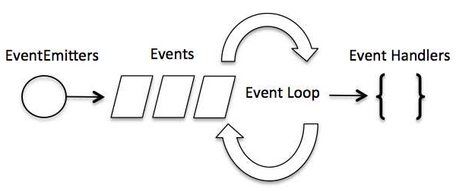
Events
Node.js is a single-threaded application, but it can support concurrency via the concept of event and callbacks. Every API of Node.js is asynchronous and being single-threaded, they use async function calls to maintain concurrency. Node uses observer pattern.
Node.js uses events heavily and it is also one of the reasons why Node.js is pretty fast compared to other similar technologies. As soon as Node starts its server, it simply initiates its variables, declares functions and then simply waits for the event to occur.
In an event-driven application, there is generally a main loop that listens for events, and then triggers a callback function when one of those events is detected.
Methods used : addListener(event, listener) , on(event, listener) , once(event, listener) , removeListener(event, listener) , removeAllListeners([event]) , setMaxListeners(n) , listeners(event)
And emit(event, [arg1], [arg2], [...])

Slide 12
BUFFERS
Pure JavaScript is Unicode friendly, but it is not so for binary data. While dealing with TCP streams or the file system, it's necessary to handle octet streams. Node provides Buffer class which provides instances to store raw data similar to an array of integers but corresponds to a raw memory allocation outside the V8 heap.
Buffer class is a global class that can be accessed in an application without importing the buffer module.

Slide 13
STREAMS
Streams are objects that let you read data from a source or write data to a destination in continuous fashion. In Node.js, there are four types of streams −
Readable − Stream which is used for read operation.
Writable − Stream which is used for write operation.
Duplex − Stream which can be used for both read and write operation.
Transform − A type of duplex stream where the output is computed based on input.
Each type of Stream is an EventEmitter instance and throws several events at different instance of times. For example, some of the commonly used events are −
data − This event is fired when there is data is available to read.
end − This event is fired when there is no more data to read.
error − This event is fired when there is any error receiving or writing data.
finish − This event is fired when all the data has been flushed to underlying system.

Slide 14
Some global objects
__filename
The __filename represents the filename of the code being executed. This is the resolved absolute path of this code file.
__dirname
It returns the directory of the code being executed.
setTimeout(cb,ms)
The setTimeout(cb, ms) global function is used to run callback cb after at least ms milliseconds
setInterval()
The setInterval(cb, ms) global function is used to run callback cb repeatedly after at least ms milliseconds. The actual delay depends on external factors like OS timer granularity and system load. A timer cannot span more than 24.8 days.
clearTimeout(t)
The clearTimeout(t) global function is used to stop a timer that was previously created with setTimeout(). Here t is the timer returned by the setTimeout() function.

Slide 15
Utility Modules
Sr.No. | Module Name & Description
1 | OS Module Provides basic operating-system related utility functions.
2 | Path Module Provides utilities for handling and transforming file paths.
3 | Net Module Provides both servers and clients as streams. Acts as a network wrapper.
4 | DNS Module Provides functions to do actual DNS lookup as well as to use underlying operating system name resolution functionalities.

Slide 16
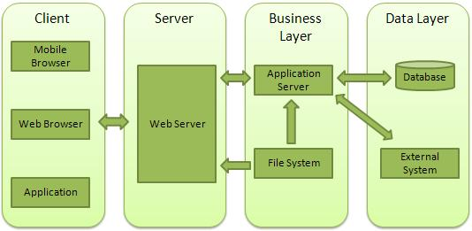
Making web server
Client − This layer consists of web browsers, mobile browsers or applications which can make HTTP requests to the web server.
Server − This layer has the Web server which can intercept the requests made by the clients and pass them the response.
Business − This layer contains the application server which is utilized by the web server to do the required processing. This layer interacts with the data layer via the database or some external programs.
Data − This layer contains the databases or any other source of data.

Slide 17
Express Framework
Express is a minimal and flexible Node.js web application framework that provides a robust set of features to develop web and mobile applications. It facilitates the rapid development of Node based Web applications. Following are some of the core features of Express framework −
Allows to set up middlewares to respond to HTTP Requests.
Defines a routing table which is used to perform different actions based on HTTP Method and URL.
Allows to dynamically render HTML Pages based on passing arguments to templates.

Slide 18
Rest Architecture
REST stands for REpresentational State Transfer. REST is web standards based architecture and uses HTTP Protocol. It revolves around resource where every component is a resource and a resource is accessed by a common interface using HTTP standard methods. REST was first introduced by Roy Fielding in 2000.
A REST Server simply provides access to resources and REST client accesses and modifies the resources using HTTP protocol. Here each resource is identified by URIs/ global IDs. REST uses various representation to represent a resource like text, JSON, XML but JSON is the most popular one.

Slide 19
Scaling Node.js
Node.js runs in a single-thread mode, but it uses an event-driven paradigm to handle concurrency. It also facilitates creation of child processes to leverage parallel processing on multi-core CPU based systems.
Child processes always have three streams child.stdin, child.stdout, and child.stderr which may be shared with the stdio streams of the parent process.
Node provides child_process module which has the following three major ways to create a child process.
exec − child_process.exec method runs a command in a shell/console and buffers the output.
spawn − child_process.spawn launches a new process with a given command.
fork − The child_process.fork method is a special case of the spawn() to create child processes.

Slide 20
JXcore
Node.js runs in a single-thread mode, but it uses an event-driven paradigm to handle concurrency. It also facilitates creation of child processes to leverage parallel processing on multi-core CPU based systems.
Child processes always have three streams child.stdin, child.stdout, and child.stderr which may be shared with the stdio streams of the parent process.
Node provides child_process module which has the following three major ways to create a child process.
exec − child_process.exec method runs a command in a shell/console and buffers the output.
spawn − child_process.spawn launches a new process with a given command.
fork − The child_process.fork method is a special case of the spawn() to create child processes.

Slide 21
Scaling Node.js
JXcore, which is an open source project, introduces a unique feature for packaging and encryption of source files and other assets into JX packages.
Consider you have a large project consisting of many files. JXcore can pack them all into a single file to simplify the distribution. This chapter provides a quick overview of the whole process starting from installing JXcore.

Slide 22
Thank You

