Slide 1
Nuxt.js
A presentation given by Shivam Thareja

Slide 2
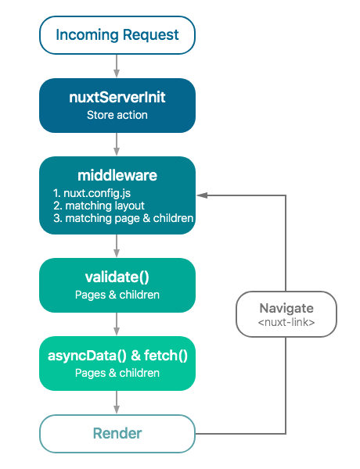
What is Nuxt.js
Its main scope is UI rendering while abstracting away the client/server distribution.
Our goal is to create a framework flexible enough that you can use it as a main project base or in addition to your current project based on Node.js.
Nuxt.js presets all the configuration needed to make your development of a server-rendered Vue.js Application more enjoyable.

Slide 3
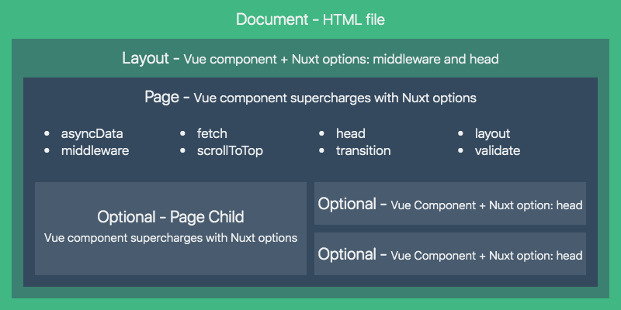

Slide 4
Middleware
In universal mode, middlewares will be called server-side once (on the first request to the Nuxt app or when page refreshes) and client-side when navigating to further routes. In SPA mode, middlewares will be called client-side on the first request and when navigating to further routes.
The middleware will be executed in series in this order:
nuxt.config.js (in the order within the file)
Matched layouts
Matched pages

Slide 5
Components
Vue Components are one of the important features of VueJS that creates custom elements, which can be reused in HTML.
<component></ component>

Slide 6
External Packages
We may want to use external packages/modules in our application (one great example is axios) for making HTTP request for both server and client.
First, we should install it via npm:
npm install --save axios

Slide 7
Plugins
Vue Plugins
If we want to use Vue plugins, like vue-notifications to display notification in our application, we need to setup the plugin before launching the app.
We create the file plugins/vue-notifications.js:
import Vue from 'vue'
import VueNotifications from 'vue-notifications'
Vue.use(VueNotifications)
Then we add the file path inside the plugins key of our nuxt.config.js:
export default {
plugins: ['~/plugins/vue-notifications']
}
To learn more about the plugins configuration key, check out the plugins api.
ES6 plugins
If the plugin is located in node_modules and exports an ES6 module, you may need to add it to the transpile build option:
module.exports = {
build: {
transpile: ['vue-notifications']
}
}

Slide 8
Vue.use(VueNotifications)
Then we add the file path inside the plugins key of our nuxt.config.js:
export default {
plugins: ['~/plugins/vue-notifications']
}
To learn more about the plugins configuration key, check out the plugins api.
ES6 plugins
If the plugin is located in node_modules and exports an ES6 module, you may need to add it to the transpile build option:
module.exports = {
build: {
transpile: ['vue-notifications']
}
}

Slide 9
Modules
While developing production-grade applications with Nuxt, you'll soon discover that the framework's core functionality is not enough. Nuxt can be extended with configuration options and plugins, but maintaining these customizations across multiple projects is tedious, repetitive and time-consuming. On the other hand, supporting every project's needs out of the box would make Nuxt very complex and hard to use.
List of Nuxt.js modules
The Nuxt.js team offers official modules:
@nuxt/http: Light and universal way to make HTTP requests, based on ky-universal
@nuxtjs/axios: Secure and Easy Axios integration with Nuxt.js to make HTTP requests
@nuxtjs/pwa: Supercharge Nuxt with a heavily tested, updated and stable PWA solution
@nuxtjs/auth: Authentication module for Nuxt.js, offering different schemes and strategies

Slide 10


Thank You

