Slide 1
Strapi
A presentation given by Shivam Thareja

Slide 2
What is Strapi
Strapi because it is open source, MIT licensed, fully customizable and based on Node.js. Strapi lets you manage your content and distribute it anywhere. Strapi allows you to securely and privately serve your database of choice from your hosting and server of choice.
It is said to be a headless CMS

Slide 3
Fundamentals of Strapi
File Structure
Controllers

Slide 4
Controllers
Controllers are JavaScript files which contain a set of methods called actions reached by the client according to the requested route. It means that every time a client requests the route, the action performs the business logic coded and sends back the response. They represent the C in the MVC pattern. In most cases, the controllers will contain the bulk of a project's business logic.
module.exports = {
// GET /hello
index: async (ctx) => {
ctx.send('Hello World!');
}
};
In this example, any time a web browser is pointed to the /hello URL on your app, the page will display the text: Hello World!.
#

Slide 5
Filters
Filters are a handy way to request data according to generic parameters. It makes filtering, sorting and paginating easy and reusable (eg. GET /users?_limit=30&name=John).
Not suffix or eq: Equals
ne: Not equals
lt: Lower than
gt: Greater than
lte: Lower than or equal to
gte: Greater than or equal to
in: Included in an array of values
nin: Isn't included in an array of values
contains: Contains
ncontains: Doesn't contain
containss: Contains case sensitive
ncontainss: Doesn't contain case sensitive
#

Slide 6
Relation b/w entities
One-way
One-to-one
One-to-many
Many-to-many

Slide 7
Authentication
This Authentication API requires the Users & Permissions plugin which comes with Strapi, installed by default.
Token usage
A jwt token may be used for making permission-restricted API requests. To make an API request as a user, place the jwt token into an Authorization header of the GET request. A request without a token, will assume the public role permissions by default. Modify the permissions of each user's role in admin dashboard. Authentication failures return a 401 (unauthorized) error.
Registration
Creates a new user in the database with a default role as 'registered'.
Login
Submit the user's identifier and password credentials for authentication. When the authentication is successful, the response data returned will have the users information along with a jwt authentication token.

Slide 8
Forgotten password
This action sends an email to a user with the link of you reset password page. This link contains an URL param code which is required to reset user password.
#Usage
email is your user email.
url is the url link that user will receive. After the user triggers a new password reset, it is used to redirect the user to the new-password form.

Slide 9

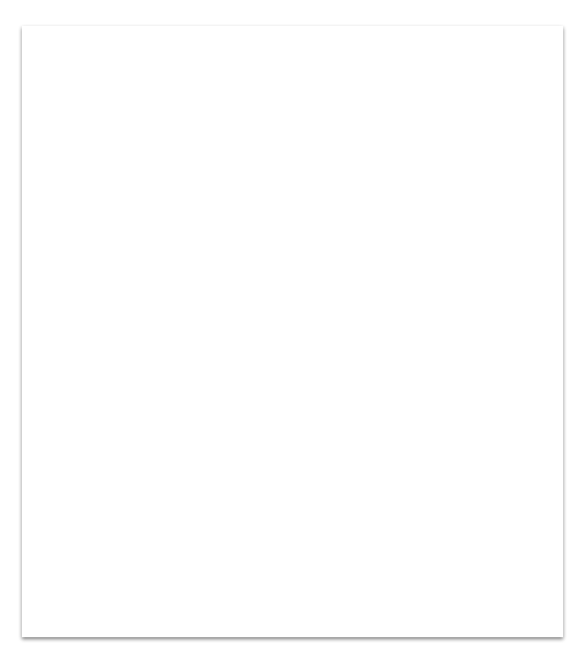
Thank You

