Slide 1

National Institute of Technology Tiruchirappalli
FACE RECOGNITION
FOR INSTITUTE
Mini Project
Review-2
EDUCATION
Guide:
Dr. P. J. A. Alphonse
Proposed By:
Swapnil Gupta(205118077)

Slide 2
Problem Statement
To build solution for recognizing the people around department and categories them into :
Faculty
Student
Outsider

Slide 3
Proposed Solution
Save the data, i.e, Image of person with his/her detail
Face Recognition Library:
It’s a python library helpful in face recognition applications.
Face of people withing frame of reference will be compared to already saved data with the Face Recognition Library of python.
If image gets a match from saved data, then gives output as individual’s detail.
If not, it will simply tag OUTSIDER.

Slide 4
Libraries Used
Face Recognition
CV2
OS
Numpy

Slide 5
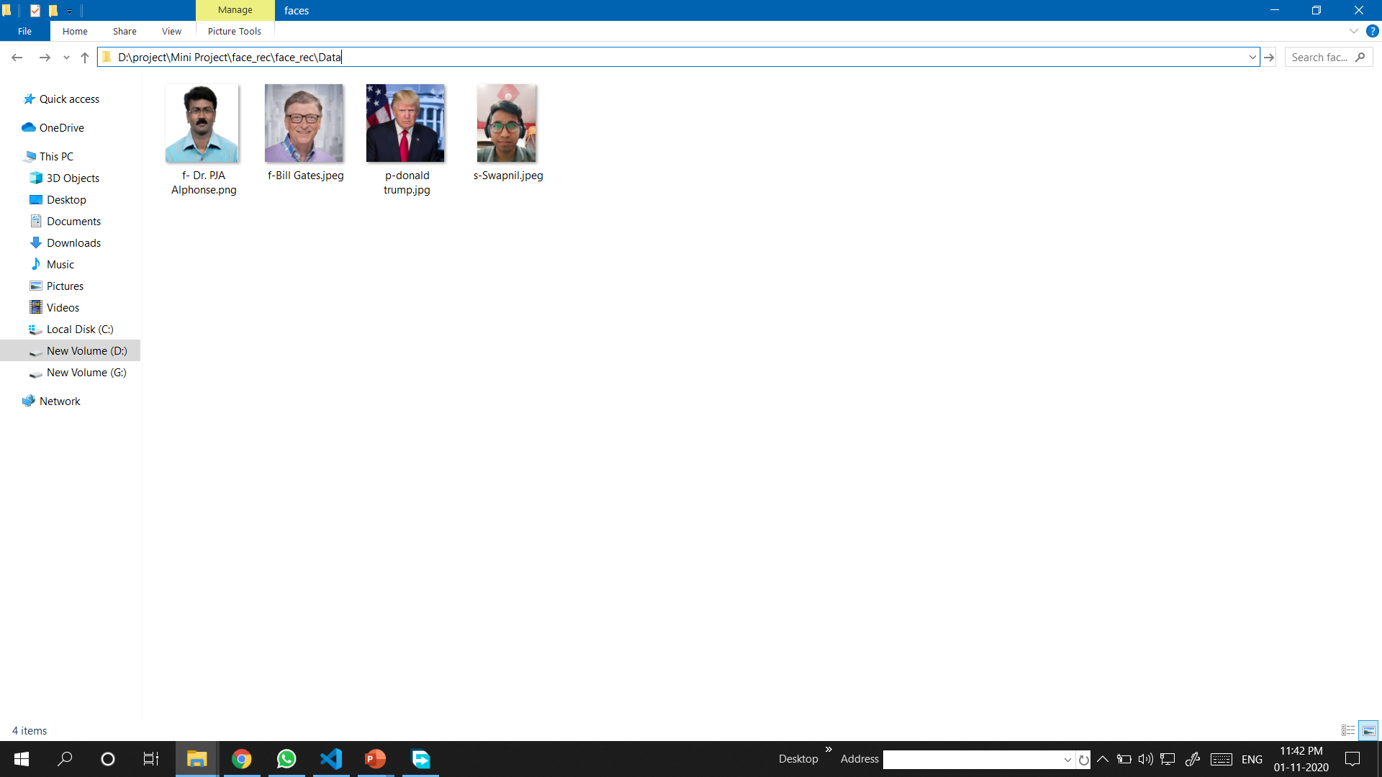
Saved Images

Slide 6
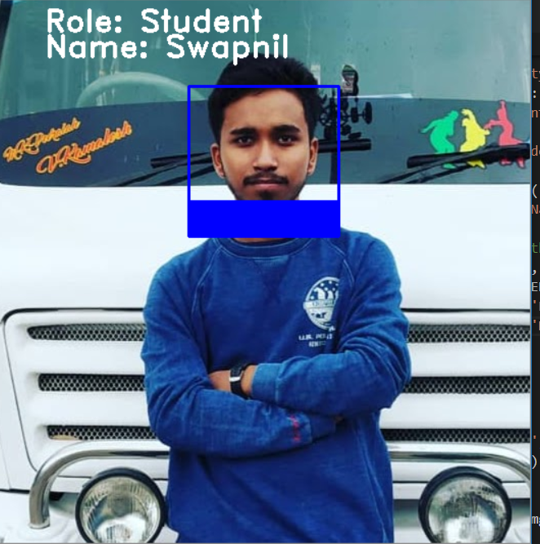
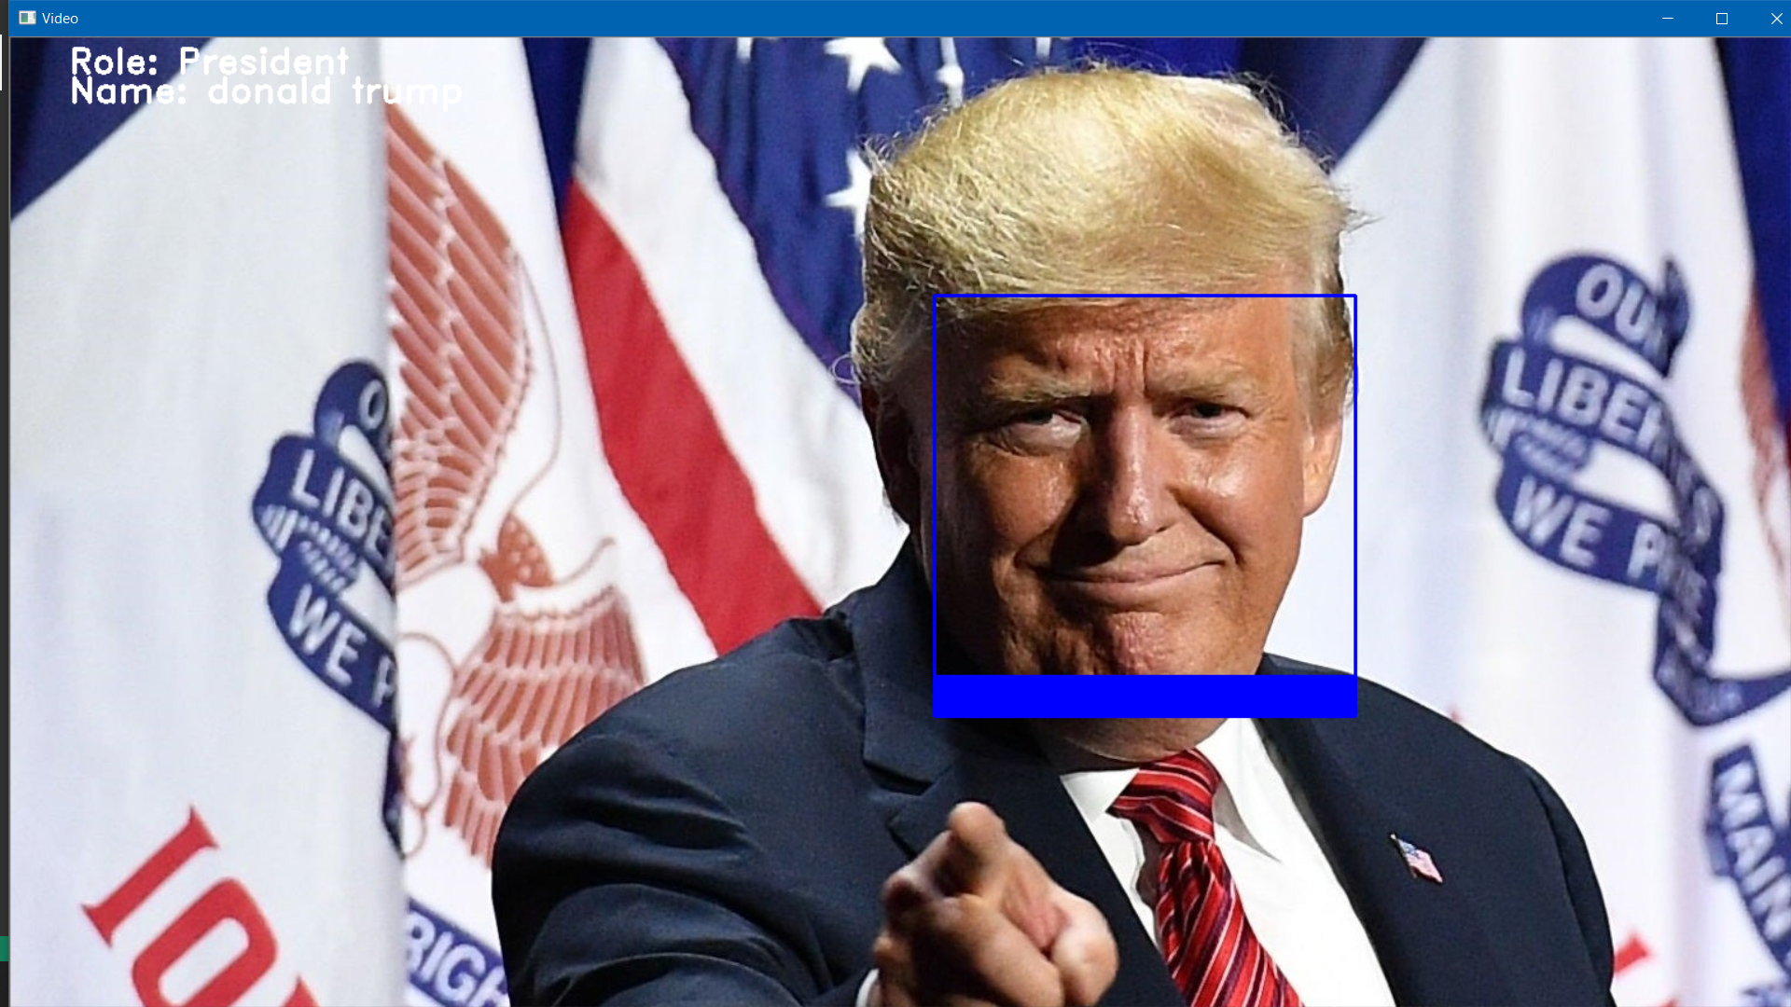
Test Images

