Slide 1
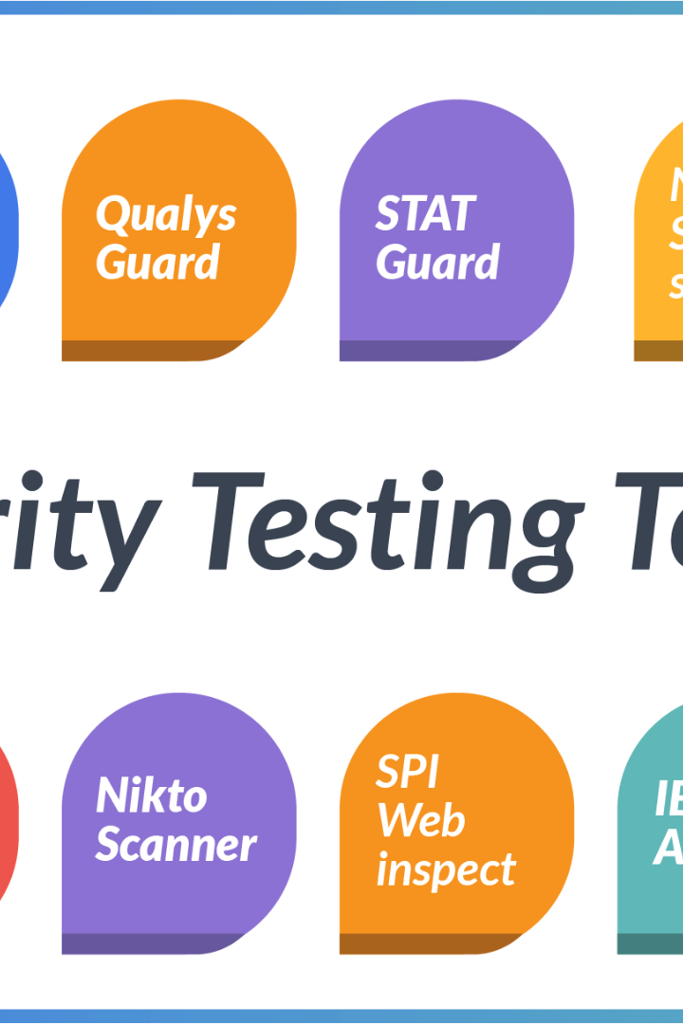

DevOps Testing Tools
DevOps is incomplete without the right testing tools. In this presentation, we will dive into everything related to DevOps testing tools.
by charan jeet

Slide 2

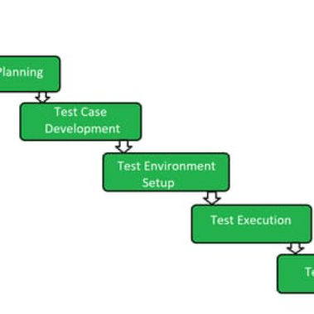
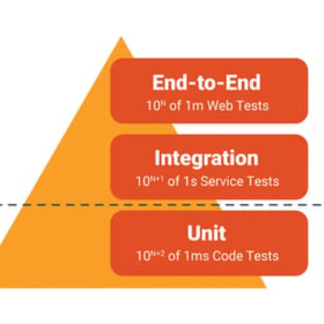
Introduction to DevOps Testing Tools
DevOps Testing Tools focus on incorporating testing early and often throughout the software development cycle. It automates testing to ensure quick feedback on the quality of the software being developed.
The Agile Manifesto
Testing Cycle Automation
Testing Pyramid
DevOps Testing Tools are rooted in the Agile Manifesto. They enable faster feedback loops, increase collaboration and handle failures effectively.
It's critical to include testing throughout the development cycle instead of just at the end. DevOps Testing tools automate the entire testing cycle.
DevOps Testing tools help organizations follow the testing pyramid and ensure more testing at the lower levels of the pyramid.

Slide 3
Popular DevOps Testing Tools
There are numerous tools that can help organizations improve their software delivery pipeline. Here are some of the most popular DevOps testing tools:
Selenium
JMeter
Appium
A popular automation testing framework, used to test web applications. Supports various languages, including Java, Python, and Ruby.
A performance testing tool, used to test the load on servers and client machines. Can be used for stress, functional, and database testing.
An open-source tool for mobile application testing for iOS and Android. Supports testing native, web, and hybrid mobile apps.
Jenkins
An open-source automation server used to automate software delivery processes. It supports building, testing, and deploying software.

Slide 4

Benefits of using DevOps Testing Tools
Here are some of the benefits of using DevOps Testing Tools:
1
Collaboration
2
Automated Testing
DevOps Testing Tools encourage collaboration between teams, thereby reducing delays and ensuring faster delivery.
DevOps Testing Tools automate repetitive testing tasks, reducing human errors and freeing up QA teams' time to focus on more productive tasks.
3
Real-Time Feedback
DevOps Testing Tools provide real-time feedback, enabling teams to fix issues and keep software development on track.

Slide 5
Challenges faced while implementing DevOps Testing Tools
Although DevOps Testing Tools offer numerous benefits, there are several challenges associated with their implementation:
Tool Integration
Various testing tools may not integrate well with existing tools, leading to conflicts and delays. It's important to test compatibility before making tool selections.
1
2
3
Resistance to Change
Legacy Architecture
It can be challenging to convince team members to adopt new processes and tools. Change management and training programs can help overcome resistance to change.
Legacy architectures may not support DevOps Testing Tools integration, making it challenging to adopt such technologies. Refactoring and restructuring the codebase can help in this case.

Slide 6
Best practices for DevOps Testing Tools implementation
Here are some best practices that can help organizations implement DevOps Testing Tools effectively:
Collaboration
Start Small
Continuous Review
Encourage open communication between teams
Implement new tools in smaller teams or projects initially
Regularly review and improve processes and tools
Build an inclusive culture that values collaboration
Gradually scale these tools across the organization
Keep up with emerging technologies and incorporate them where necessary

Slide 7



Real-world examples of companies using DevOps Testing Tools
Several organizations across various industries have effectively utilized DevOps Testing Tools:
Etsy
4Life Research
Red Hat
Etsy uses Jenkins to automate building, testing, and deploying code. Since adopting DevOps Testing Tools, they have reduced their deployment process from weeks to minutes.
4Life Research used Selenium for automated tests. They improved test reliability, reducing the need for manual testing and increasing test coverage.
Red Hat implemented Cucumber to enhance collaboration and reduce conflicts in their DevOps testing cycle. This resulted in a quicker release time and better software quality.

Slide 8

Conclusion: Future of DevOps Testing Tools
The use of DevOps Testing Tools is on the rise, and it is clear that companies adopting these tools are seeing faster delivery of higher quality software. However, it is important to remember that these tools are only a part of the DevOps culture. A focus on automation, standardization, and collaboration will continue to be critical for successful implementation of DevOps Testing Tools.

