Slide 1


The Basics of Testing in DevOps
Welcome to the world of testing in DevOps! Testing is a critical component of any software development project. Let's explore the basics.
by charan jeet

Slide 2
Introduction to Testing in DevOps
Why Test?
Testing Goals
Types of Tests
Testing ensures that your software is free from bugs and is functioning as intended. It helps deliver a quality product to customers.
Reduce the number of bugs and the time it takes to detect and fix them. Increase the quality of the code and the efficiency of the testing process.
Functional, performance, security, and usability are some of the testing types that form part of the software testing mix in DevOps.

Slide 3
Types of Testing in DevOps
Integration Testing
Testing how different units of the software interact with each other to ensure that the integrated system is functioning as intended.
1
2
3
Unit Testing
System Testing
Testing individual units of code in isolation to ensure that they are working as intended.
Validating how the complete system behaves under different conditions to ensure that it meets the quality standards and stakeholder requirements.

Slide 4
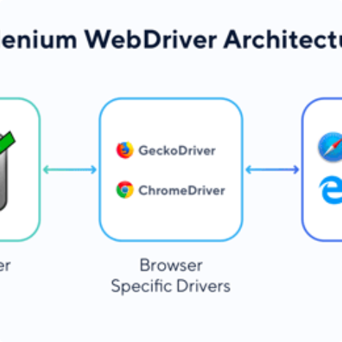
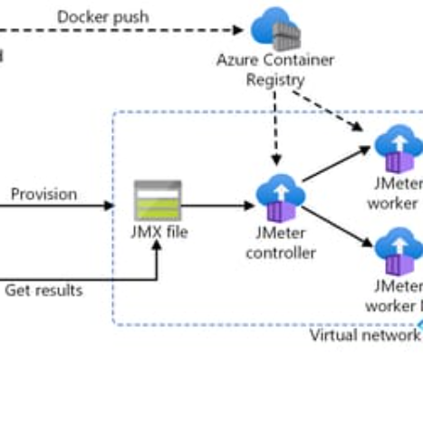
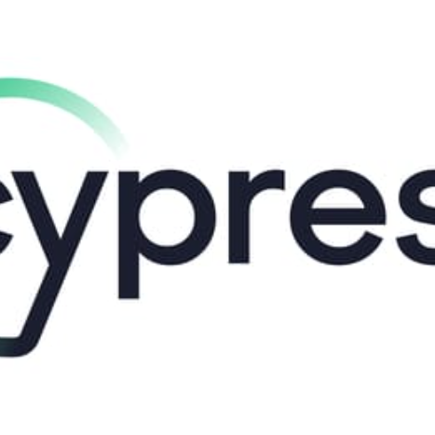
Test Automation Tools and Frameworks
Selenium WebDriver
JMeter
TestingBot
Cypress
A popular tool used for automating and testing web applications. It supports a variety of programming languages, making it a flexible choice for teams.
A powerful tool used for performance and load testing, helping to identify bottlenecks and areas for optimization in your application.
A cloud-based tool for cross-browser testing, making sure that your application looks and performs the same across different browsers and devices.
A modern front-end testing tool that can run hundreds of tests automatically in seconds, giving you instant feedback on your code changes.

Slide 5
Continuous Integration and Testing
1
Continuous Integration
The process of merging code changes into a central repository and running automated builds and tests to make sure that everything works together.
Continuous Delivery
2
The process of deploying code changes to the production environment automatically after they pass various quality checks. It helps to reduce the time it takes to release new features.
3
Continuous Testing
The practice of testing the software frequently and continuously throughout the development lifecycle, minimizing the chance of finding bugs too late in the process.

Slide 6
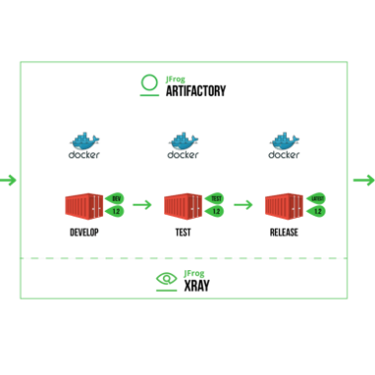
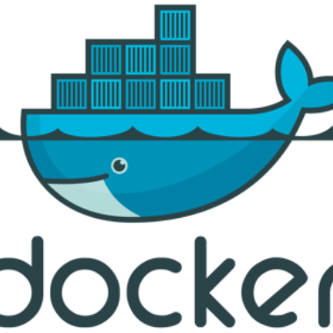
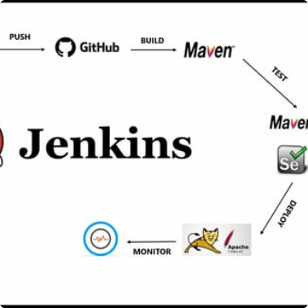
Test Environment Management
Artifactory
Docker
Jenkins
A binary repository manager for different software artifacts such as packages, docker images, and more. It supports a range of technologies, making it easy to deploy and run your environment.
A lightweight, container-based approach to running applications and their dependencies in a consistent environment. It's a great tool for easy and quick setup of testing environments.
An open-source automation server that can run various testing and build tasks in an efficient, streamlined manner, making it a great choice for test environment management.

Slide 7

Challenges in Testing in DevOps
1
Technical complexity
2
Managing Environments
With DevOps, there is an increased emphasis on automation, integration, and testing, which requires a greater technical skillset and understanding.
As testing environments become more complex, managing multiple environments to develop, test, and deploy software can become challenging.
3
Tool Selection Complexity
With so many testing tools and frameworks in the market, selecting the right tool for your organization can be overwhelming.

Slide 8
Best Practices for Successful Testing in DevOps
Collaboration
Automation
Continuous Testing
Ensure timely and clear communication between teams to avoid issues and surprises.
Use automation to reduce the chance of human errors.
Run tests as early as possible and as often as needed.
Automate every part of the testing process that can be automated.
Include testing into the Continuous Integration (CI) and Continuous Delivery (CD) process.
Plan and execute code reviews.
Create a blame-free, exploratory mindset for testing.
Choose tools that fit your team's skillset and expertise.
Test for user experience and usability as early as possible and as often as needed.

