Slide 1

The Power of Continuous Testing in DevOps
Continuous testing is not just a buzzword in DevOps; it's essential to ensure that software is reliable, secure, and high-quality. This presentation will delve into why continuous testing is vital for DevOps success and how it can transform your DevOps process.
by charan jeet

Slide 2
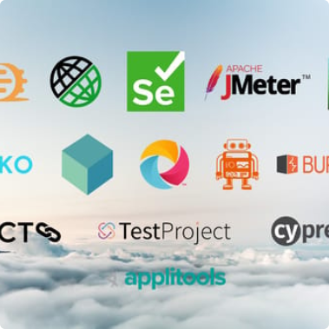


The Benefits of Continuous Testing
Accelerated Software Delivery
Increase Efficiency
Global Deployment
By including testing earlier in the software development life cycle, developers can identify and correct issues before they become more time-consuming and expensive to fix.
Continuous testing can identify bottlenecks and streamline various processes, making testing cost-effective and efficient.
Continuous testing ensures that the software can work across devices, time zones, and regulatory compliances.

Slide 3
Challenges in Continuous Testing
Test Data Management
Test data changes frequently, which makes it difficult for continuous testing to be aligned with the expected end-user experience, leading to problems with deployment.
1
2
3
Test Environment Set-Up
Integration Testing
One of the significant challenges in continuous testing is setting up test environments. This can be expensive and time-consuming, especially when managing complex systems.
As continuous testing is part of the DevOps pipeline, it's difficult to determine who is responsible for integration testing and how to coordinate its success.

Slide 4
Tools and Technologies for Test Automation
Code Review Tools
Testing Frameworks
Continuous Integration Tools
Code review tools like GitHub Peer Review can help in automating code review tasks and ensuring that code adheres to standards.
Testing frameworks like Selenium and Appium can help automate functional and regression testing.
Integration tools like Jenkins can automate the build process, making sure that all code commits are tested and released to production.
Performance Monitoring Tools
Performance monitoring tools like New Relic can provide continuous insights on application behavior and suggest areas to optimize.

Slide 5
Best Practices in Continuous Testing
1
Keep it Simple
Use a standardized testing procedure that is clear and concise to developers and testers alike.
Make it Repeatable
2
Automation is key to repeatable testing results. It ensures consistency and eliminates human error.
3
Start Testing Early
Testing should begin early in the development process. It helps identify potential security, performance, and process problems.
Collaborate Efficiently
4
Collaboration between developers, testers, and operations teams can help speed up continuous testing and make it more efficient.

Slide 6
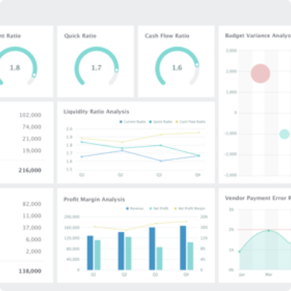
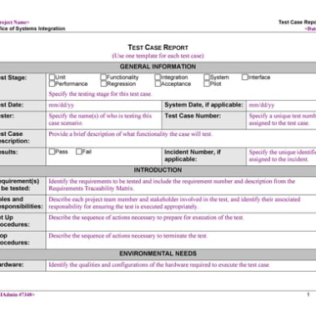
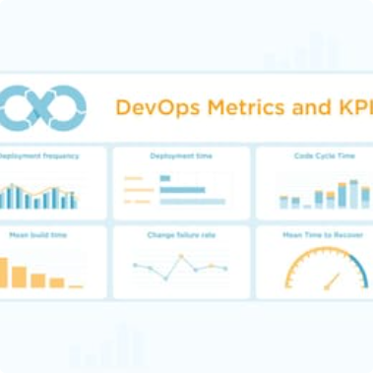
Metrics to Measure the Success of Continuous Testing
Code Coverage
Number of Test Cases
Deployment Frequency
Code coverage measures the percentage of code that has been tested by automated tests.
The number of test cases executed across the software development life cycle can be a valuable metric.
Deployment frequency measures how often code changes are pushed to production.

Slide 7
Future of Continuous Testing in DevOps
AI-Based Testing
Integration with DevOps Pipeline
Continued Importance
A fully automated continuous testing process using AI-based testing tools is the future of continuous testing.
Continuous testing will continue to be essential in ensuring high-quality, reliable, and secure software for end-users.
Continuous testing will become integrated with the DevOps pipeline, making it a more streamlined and efficient process.

Slide 8

Conclusion
Continuous testing is a vital part of the DevOps pipeline to ensure reliable, secure, and high-quality software. By automating testing procedures, developers and testers can speed up functionalities, optimize processes and ensure optimal levels of quality. Adopting continuous testing strategies and technologies can help organizations achieve their goals and deliver value to end-users in today's digital-first world.

