Slide 1

CAMPUS COMMERCE • REAL-TIME WEB APP
StallScout
https://shivamtyagi-jii.github.io/StallScout/
Find the fastest stall. Order smarter. Queue less.
Team: Belivers
Team members:
1]Vedant Rajaram Bokare
2]Shivam Kumar
3]Tiwari Swapnil Manoj
4]Soham Kalsotra
A student + shopkeeper portal for live inventory, digital queues, and smarter campus decisions.

Slide 2
01 • PROBLEM
The campus stall problem
Wasted trips
Uncertain queues
Counter chaos
Students may walk to a Bhawan only to discover an item is unavailable or the stall is closed.
Crowds and wait times are hard to judge before leaving a room or study space.
Shopkeepers handle shouted orders, changing stock, and rush-hour demand at once.
The opportunity
Give both sides one shared, browser-based view of availability and order status—so students can make better choices and stalls can organize demand.
02

Slide 3
02 • SOLUTION
StallScout: one system, two focused portals
STUDENT PORTAL
SHOPKEEPER PORTAL
• Browse stalls and items
• Check reported stock and stall status
• Compare estimated travel + queue time
• Place a pre-order
• Receive a ready-for-pickup alert
• View incoming orders in a queue
• Update item availability
• Set crowd status
• Mark orders ready, then picked up
• Review completed orders in a separate area
03

Slide 4
03 • USER JOURNEY
How the experience works
1
→
2
→
3
→
4
→
5
Search
Compare
Order
Prepare
Collect
Student searches for an item or stall.
Website ranks eligible stalls using estimated travel and queue time.
Student submits a pre-order from the portal.
Shopkeeper sees the incoming order and updates its status.
Student receives a ready alert and picks up the order.
Important boundary
Alerts and order states depend on connected clients and broker availability; production use needs robust persistence and access controls.
04

Slide 5
04 • STUDENT VALUE
For students: decide before you walk
Live inventory
Smart routing
Pre-order alerts
See the latest stock status reported by the stall.
Compare estimated travel time plus queue wait—not distance alone.
Order remotely and listen for a ready-for-pickup notification.
Digital Queue & Crowd Control
Zero-Friction & Zero App Downloads
Shopkeepers manage incoming orders on an organized dashboard and toggle crowd levels to balance campus foot traffic.
Runs entirely in any web browser with instant real-time cloud syncing.
05

Slide 6
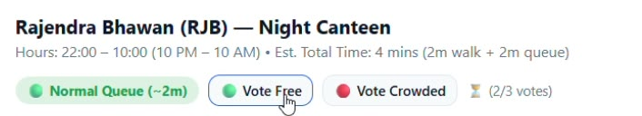
05 • SHOPKEEPER VALUE
For shopkeepers: a calmer, clearer queue
Digital queue
One-click updates
Order lifecycle
Incoming orders appear in a focused dashboard.
Change stock or crowd status to inform students.
Move orders from active queue to ready, then picked up.
Queue design
Active orders remain visible while they need action. Picked-up orders can move into a collapsible completed-orders area, keeping the main screen readable during rushes.
06

Slide 7
06 • TECHNICAL ARCHITECTURE
Architecture: lightweight browser clients + MQTT
Student browser
MQTT broker
Shopkeeper browser
Publish ↔
↔ Subscribe
HTML • CSS • Vanilla JS
EMQX public broker
WebSocket transport
HTML • CSS • Vanilla JS
Browser-local state
Cross-device messages
localStorage can persist state on that browser/device and support same-browser reloads.
MQTT topics carry published updates to subscribed clients; this is messaging, not a durable shared database by itself.
07

Slide 8
07 • TOOLS AND APIS
Technology stack
Frontend
Real-time messaging
Browser APIs
HTML5 semantic structure
CSS3: Grid, Flexbox, variables, animations
Vanilla JavaScript (ES6+)
mqtt.js client library
MQTT over WebSockets
EMQX public broker endpoint in prototype
Web Audio API for synthesized alerts
Geolocation API for GPS coordinates
localStorage for local persistence
Catalog data
Deployment
A static JavaScript/JSON-style catalog is described in the implementation notes; spreadsheet source names were supplied as fruitshop.xlsx, statioanary.xlsx, and price list.xlsx.
Hosting platform was not specified in the supplied details. Add the actual platform and build/deploy process before presenting this as complete.
08

Slide 9
08 • ROUTING LOGIC
Smart Route Finder: estimate total time
Total estimated time = travel time + queue wait time
1 • Distance
2 • Walking estimate
3 • Rank stalls
Haversine formula estimates straight-line distance between GPS coordinates and a stall coordinate.
Prototype assumptions: multiply straight-line distance by 1.25, then divide by 80 m/min.
Add the stall's current estimated queue wait and rank open, eligible stalls by total time.
Accuracy caveat: the 1.25 pathway factor and 80 m/min walking speed are heuristics, not route measurements. Buildings, paths, crossings, GPS error, accessibility, and actual queues can change the result.
09

Slide 10
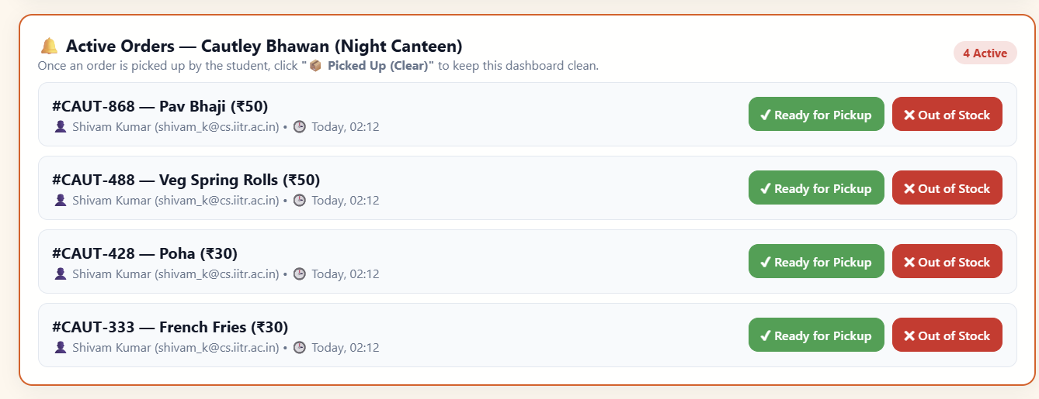
09 • INTERACTION DETAILS
Real-time updates and audio alerts
MQTT message flow
Audio unlock
A client publishes an update to a topic; other subscribed clients can receive it while connected. The broker and network determine delivery timing.
Browsers often restrict autoplay. A user gesture such as clicking Login or an action button can initialize/resume AudioContext, subject to browser behavior.
10

Slide 11
10 • HACKATHON LEARNINGS
Challenges we addressed
Real-time sync without a custom server
“Walking through walls” estimates
Used MQTT over WebSockets to exchange updates between browser clients.
Added a pathway multiplier to improve on straight-line distance; still an approximation.
Browser audio restrictions
Endless active order list
Synthesized alerts with Web Audio API and initialized audio after user interaction.
Separated picked-up orders from the active queue in a completed-orders drawer.
11

Slide 12
11 • RELIABILITY & SAFETY
What we would harden before real campus use
Access control
Shared data
Privacy & location
Use authenticated accounts and server/broker-enforced permissions. Frontend-only passcodes are not strong security.
Use a durable database and trusted service layer for orders, stock, and history; localStorage is device-local.
Request location only when needed, explain its use, and provide manual location/stall selection as a fallback.
Message integrity
Operational resilience
Validate payloads, scope topics by stall, avoid exposing sensitive order data, and handle duplicate/stale messages.
Show connection status, retry safely, reconcile state after reconnect, and test concurrent edits and order transitions.
12

Slide 13
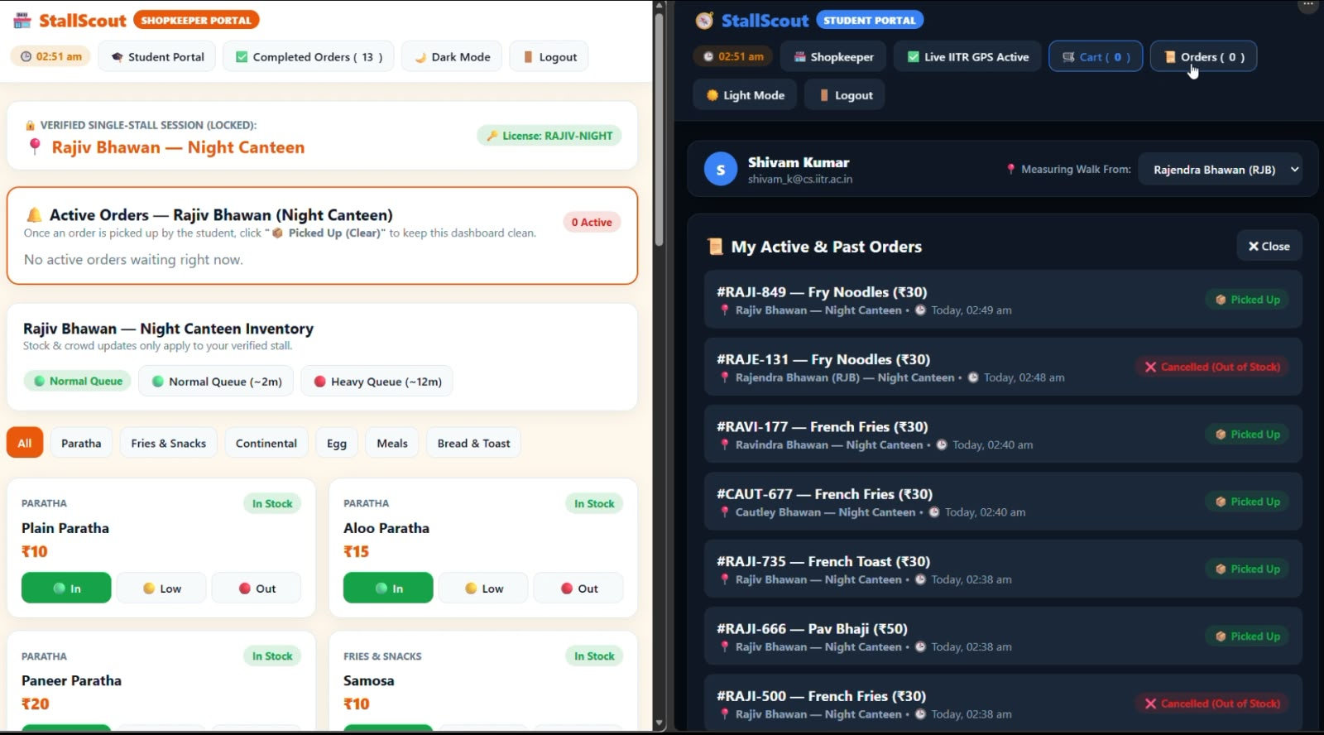
12 • EVALUATION PLAN
System outcomes
How we would measure success
• Update delivery latency
• Reconnect recovery rate
• Order state consistency
Student outcomes
• Fewer wasted trips
• Lower time from search to pickup
• Better accuracy of stock information
Shopkeeper outcomes
• Shorter counter queues
• Fewer missed orders
• Easier handling of peak demand
13

Slide 14
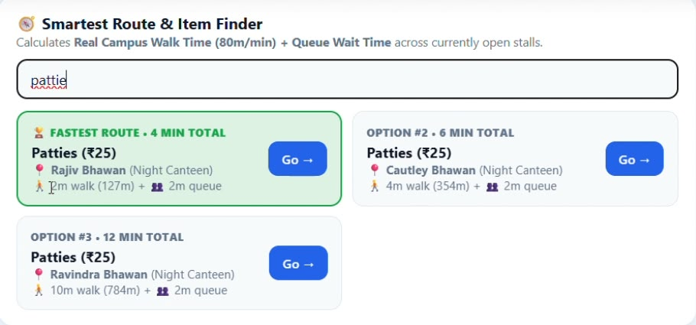
13 • NEXT STEPS
Phase 2 • Production readiness
Phase 3 • Smarter routing
Roadmap
• Real campus paths
• Better wait-time estimates
• Accessibility-aware route options
• Authentication and permissions
• Durable database
• Broker isolation and monitoring
Phase 1 • Stabilize
• Test two-device sync
• Validate order lifecycle
• Add reconnect and error states
14

Slide 15
STALLSCOUT • THE TAKEAWAY
Less uncertainty.
More organized campus commerce.
FIND
ORDER
PICK UP
StallScout connects student decisions with shopkeeper operations through a lightweight web experience—combining reported availability, digital order flow, and estimated travel-plus-queue time.
One browser.
Two portals.
A clearer queue.
Thank you

