Slide 1

Loan Prediction
RNS INSTITUTE OF TECHNOLOGY
BENGALURU - 98
DEPARTMENT OF INFORMATION SCIENCE & ENGINEERING
Presentation on Internship
NAME:- SHIVAM KUMAR
USN: 1RN18IS098
New Age Solutions Technology
Internal Guide
Mrs. Hema N
Asst. Prof, Dept of ISE, RNSIT
External Guide
Mr. Aman Upadhaya
Instructor, NASTECH

Slide 2
AGENDA
Abstract
Introduction
Literature Survey
Requirements
System Design
Implementation
Conclusion and Future Enhancements
References

Slide 3
ABSTRACT
Loans are the core business of banks. The main profit comes directly from the loan’s interest.
The two most pressing issues in the banking sector are:
1) How risky is the borrower?
2) Should we lend to the borrower given the risk?
The response to the first question dictates the borrower's interest rate. Interest rate, among other things (such as time value of money), tests the riskiness of the borrower, i.e. the higher the interest rate, the riskier the borrower. However, whether he or she does not repay the loan, the lender loses money.
At that time, making a decision would take a long time. As a result, the loan prediction machine learning model can be used to assess a customer's loan status and build strategies.

Slide 4
INTRODUCTION
Banking is a sector that is regulated in most of the countries as it is an important factor in determining the financial stability of the country.
It also includes lending money to people and businesses which has to be paid back within the given amount of time without failing.
Today many banks and financial companies approve loan after a stressful, long and weary process of verification but still there is no surety whether the chosen applicant is credible or not or in other words if he is able to return the amount with interest in the given time.
It is very difficult to predict the possibility of payment of loan by the customer. Using Machine learning we predict the loan approval.

Slide 5
LITERATURE SURVEY
1. “Loan Prediction using Decision Tree and Random Forest “Author- Kshitiz Gautam, Arun Pratap Singh, Keshav Tyagi, Mr. Suresh Kumar Year-2020.
In India the number of people or organization applying for loan gets increased every year. The bank have to put in a lot of work to analyze or predict whether the customer can pay back the loan amount or not (defaulter or non-defaulter) in the given time. The aim of this paper is to find the nature or background or credibility of client that is applying for the loan. We use exploratory data analysis technique to deal with problem of approving or rejecting the loan request or in short loan prediction. The main focus of this paper is to determine whether the loan given to a particular person or an organization shall be approved or not.
2. “Loan Prediction System Using Decision Tree and Random Forest Algorithms”
Authors- Shubham Chaudhary, Vishal Baliyan, Yatharth Katheria
the idea of this undertaking is to gather loan data from the Lending Club website and use machine learning techniques on this data to extract important information and predict if a customer would be able to get a loan from a bank or not. Most banks are renewing their business models and switching to Machine Learning methodology. In this paper, we have discussed classifiers based on Machine and deep learning models on real data in predicting loan defaultprobability. The most important features from various models are selected and then used in the modelling process to test the stability of Random Forest classifiers and Decision Tree Classifier by comparing their performance on data.
3. A. Goyal and R. Kaur, “Accuracy Prediction for Loan Risk Using Machine Learning Models”.
Estimating the probability that an individual would default on their loan, is useful for banks to make a decision whether to approve a loan to the individual or not. In this paper, we find the accuracy of several models in R language and evaluate it to establish the finest model to forecast the finance status for an organization. We did the experiment five times on the same data set and find the experimental results that show the Tree Model for Genetic Algorithm is the best model for forecasting the finance for costumers.
4. A. Goyal and R. Kaur, “A survey on Ensemble Model for Loan Prediction”, International Journal of Engineering Trends and Applications (IJETA), vol. 3(1), pp. 32-37, 2016.
In this paper we discuss the ensemble model that is combination of two or more algorithms and give better results as compared to stand alone models. The performance is also enhanced through the ensemble model.

Slide 6
Requirements
Software Requirements
Hardware Requirements
Name of Components | Specification
OperatingSystem | Windows 10
python | conda
Browser | Chrome, IE
Integrated Development Environment | Jupytr notebooks
Name of Components | Specification
Processor | 10TH Gen CORE i3 Processor
RAM | 8GB
Hard Disk | GB SSD

Slide 7
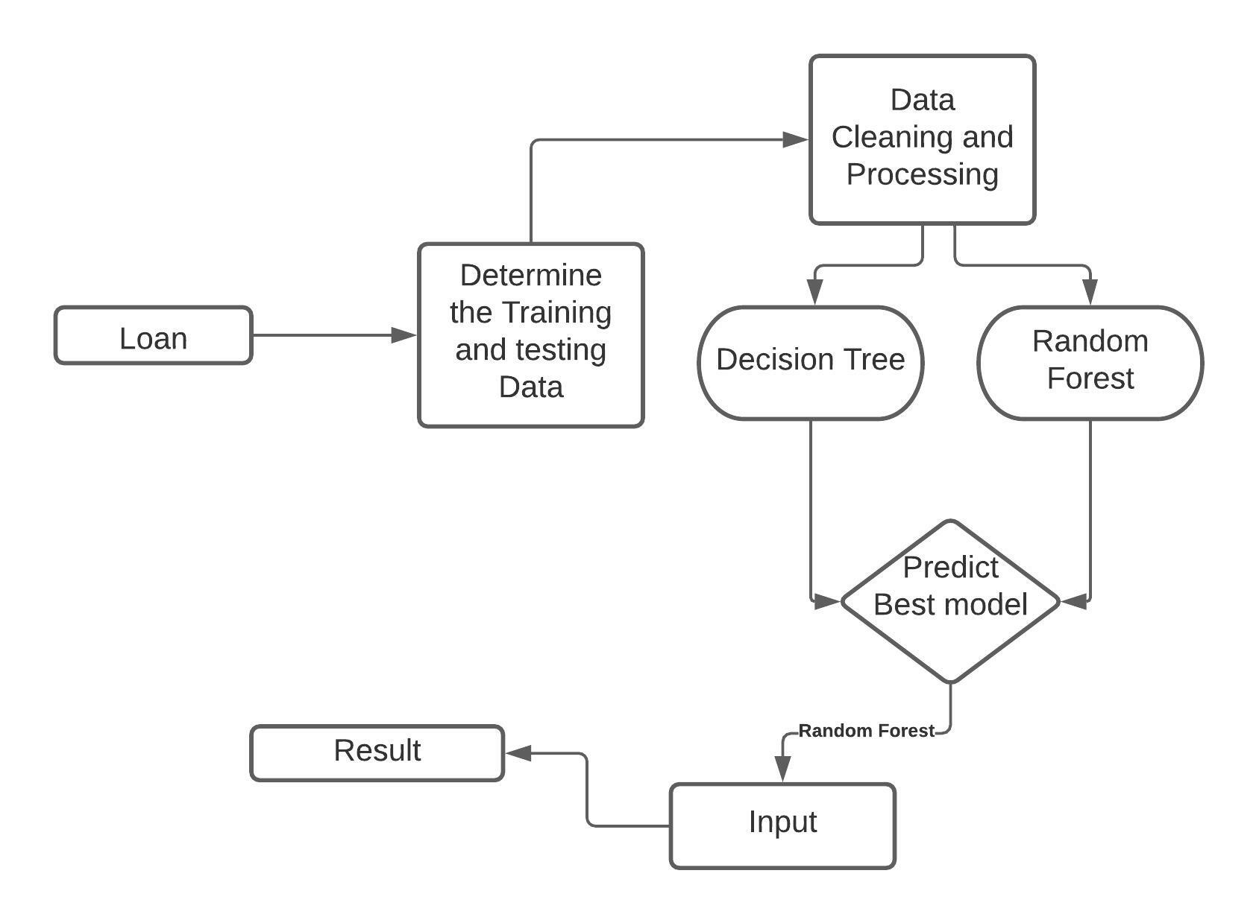
System Design
Phase 1 – Collection of data:
Through a Kaggle competition.
Phase 2 – Data preprocessing:
Gathered meaningful information
Visualized dataset
Phase 3 – Comparing different models and training :
Trained on Decision Tree and Random Forest
Compared both Models
Phase 4 – Result/Deploying the model

Slide 8
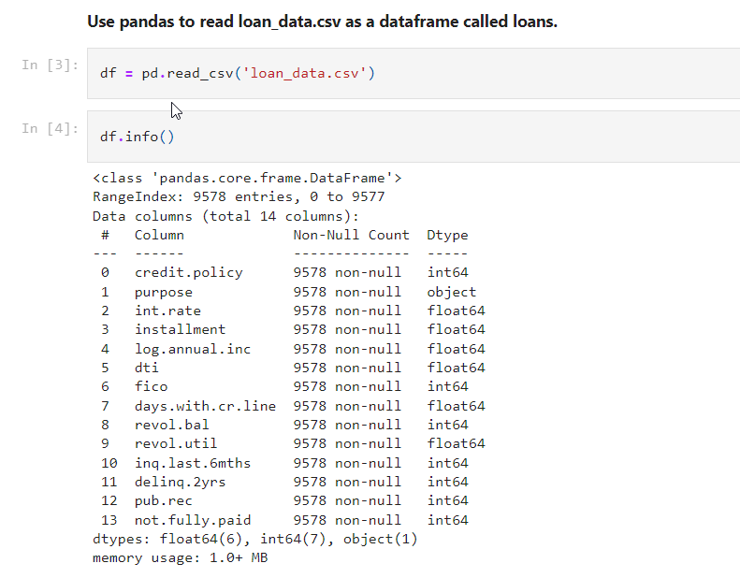
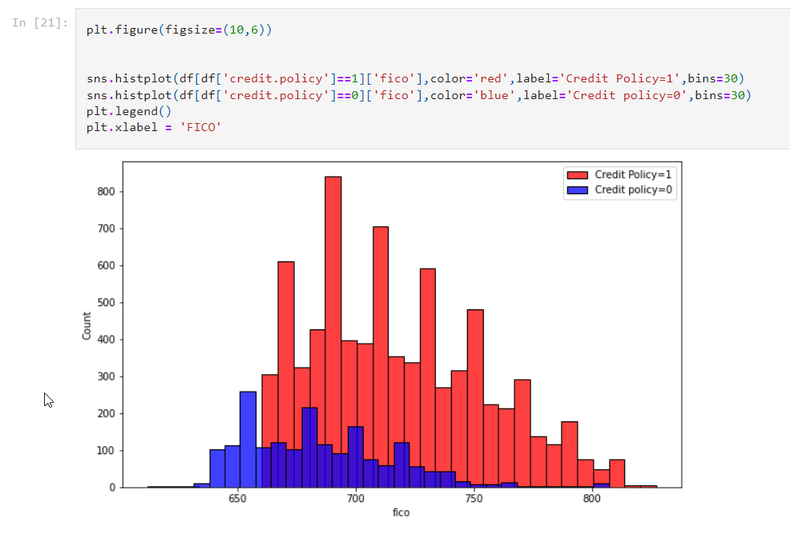
Implementation / Coding
Get the data
Exploratory data analysis.
plotting histogram for credit policy

Slide 9
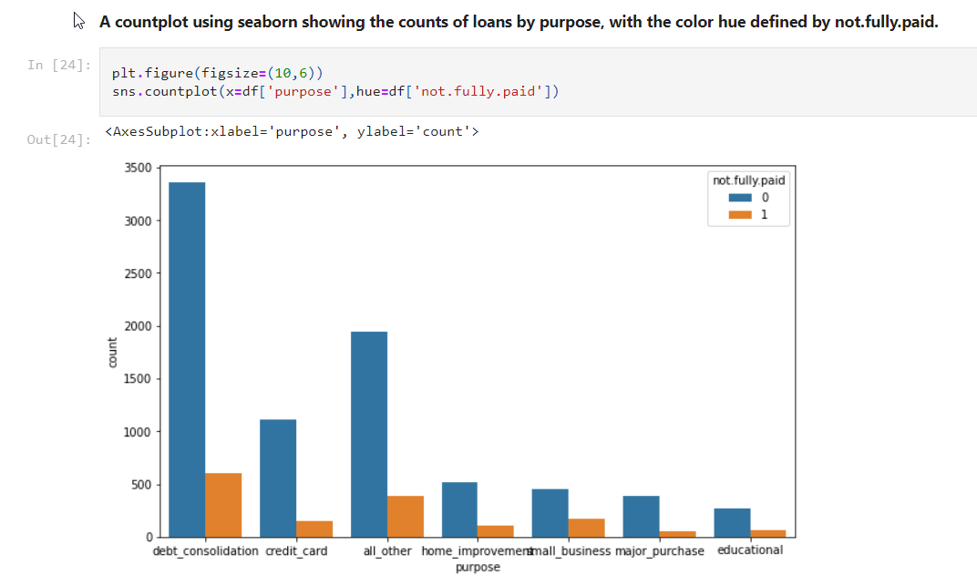
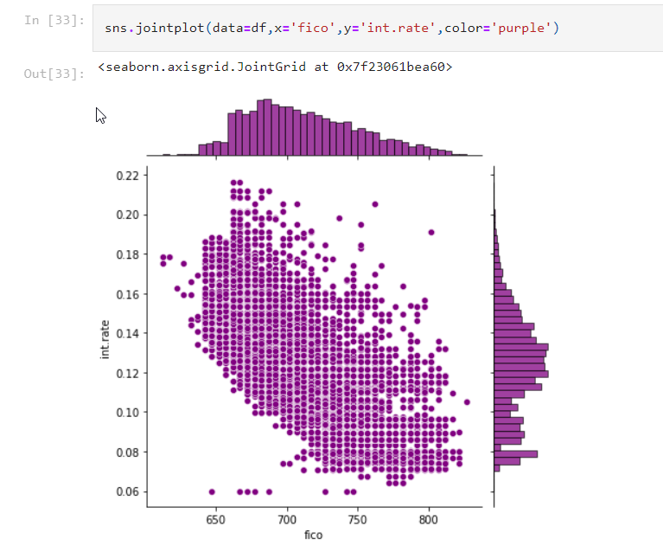
plotting histogram for purpose of loan
graph for fico Vs interest rate

Slide 10
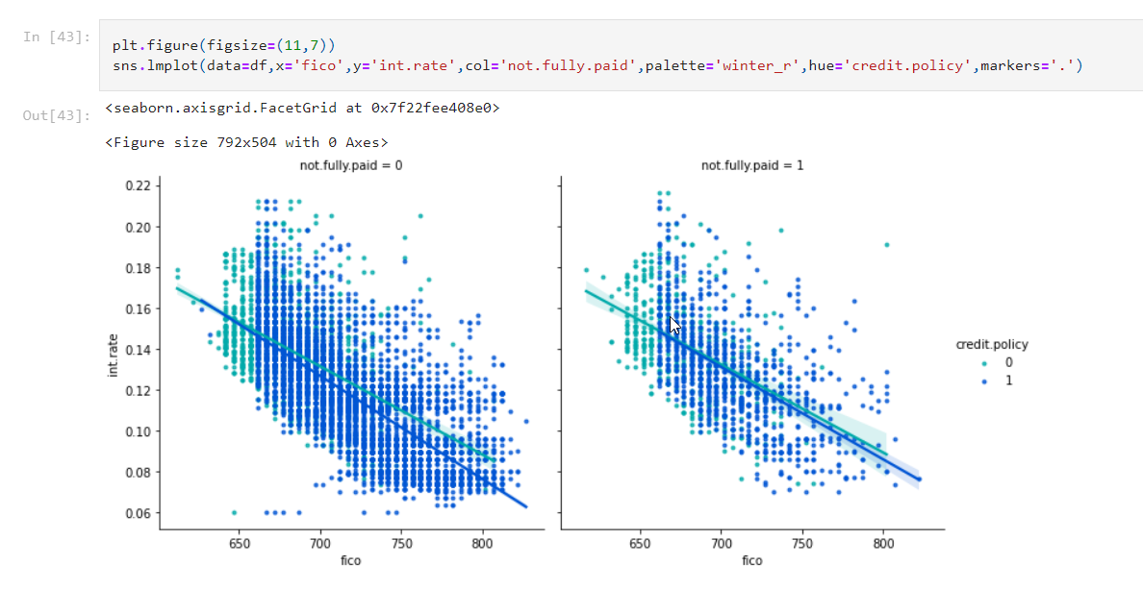
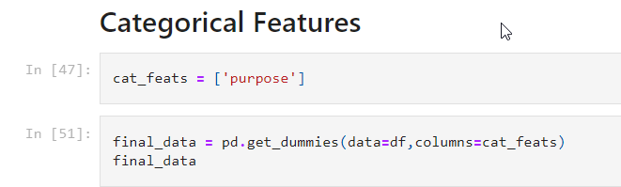
graph on fico Vs Int_rate w.r.t fully paid

Slide 11
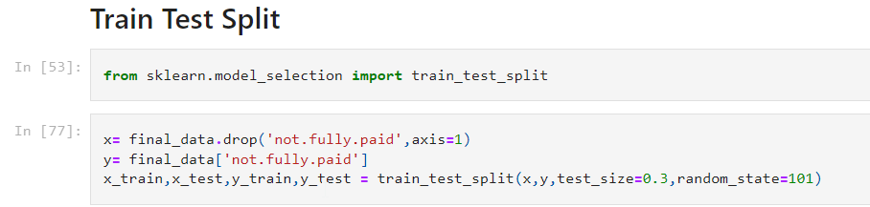
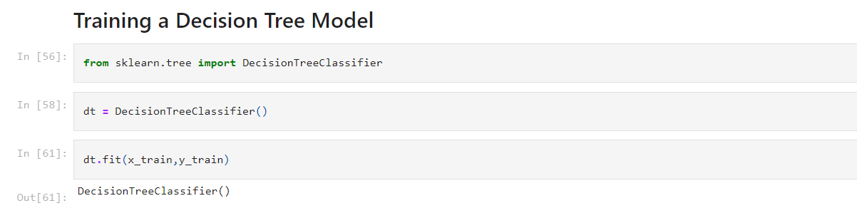
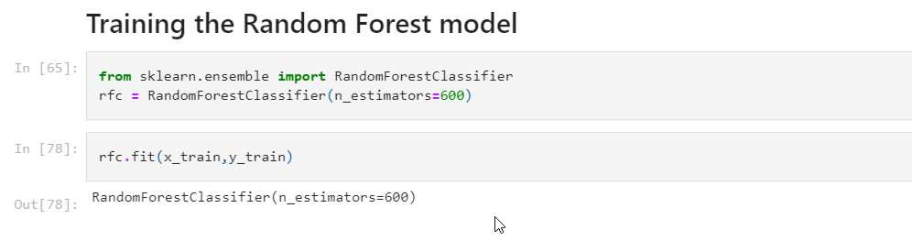

Slide 12
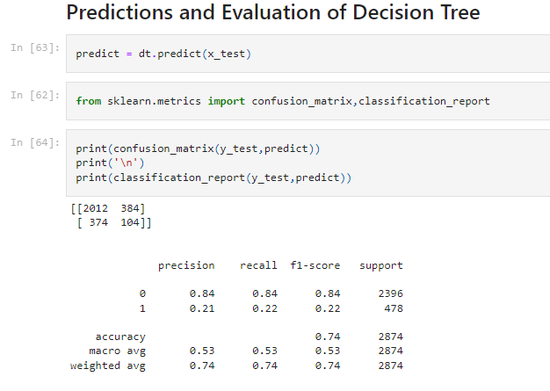
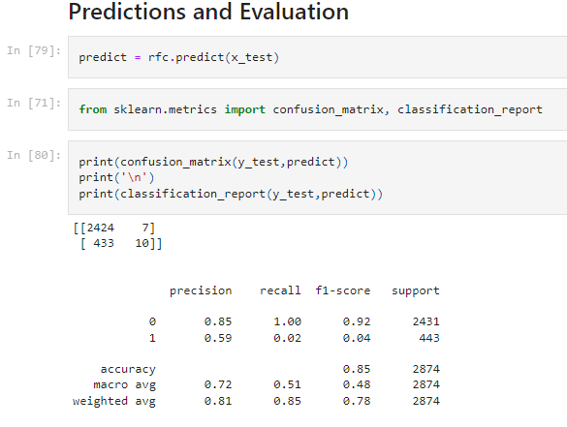
Results

Slide 13
CONCLUSIONS
The main purpose of this work is to classify and analyze the nature of the loan applicants. Form a proper analysis of available data and constraints of the banking sector, it can be concluded that by keeping safety in mind that this modelling is much effective or highly efficient. This application is operating efficiently and fulfilling all the major requirements of Banker. Although the application is flexible with various systems and can be plugged effectively.
The module can be enhanced to cover below business scenarios
This paper work can be extended to higher level in future so the software could have some better changes to make it more reliable, secure, and accurate.
Thus, the system is trained with a present data sets which may be older in future so, it can also take part in new testing to be made such as to pass new test cases.

Slide 14
REFERENCES
Loan Prediction using Decision Tree and Random Forest Kshitiz Gautam, Arun Pratap Singh, Keshav Tyagi, Mr. Suresh Kumar, IRJET
Loan Prediction System Using Decision Tree and Random Forest Algorithms ,Shubham Chaudhary, Vishal Baliyan, Yatharth Katheria, IJETIE
A. Goyal and R. Kaur, “Accuracy Prediction for Loan Risk Using Machine Learning Models”.
A. Goyal and R. Kaur, “A survey on Ensemble Model for Loan Prediction”, International Journal of Engineering Trends and Applications (IJETA), vol. 3(1), pp. 32-37, 2016.
https://en.wikipedia.org/wiki/Exploratory_data_analysis
https://www.experian.com/blogs/ask-experian/credit-education/score- basics/what-is-a-good-credit-score/

Slide 15
THANK YOU

