Slide 1
Retail Support Resolution Agent
An agentic RAG system that answers policy questions and resolves returns, using cited evidence and Model Context Protocol tools
LangGraph
Hybrid RAG
MCP
29 cases
stateful agent
dense + BM25 + rerank
4 business tools
end-to-end evaluation
Notes:
Problem: a retail support team answers policy, shipping, order and return questions. The system finds evidence, picks tools, runs multi-step resolutions and explains itself with citations.

Slide 2
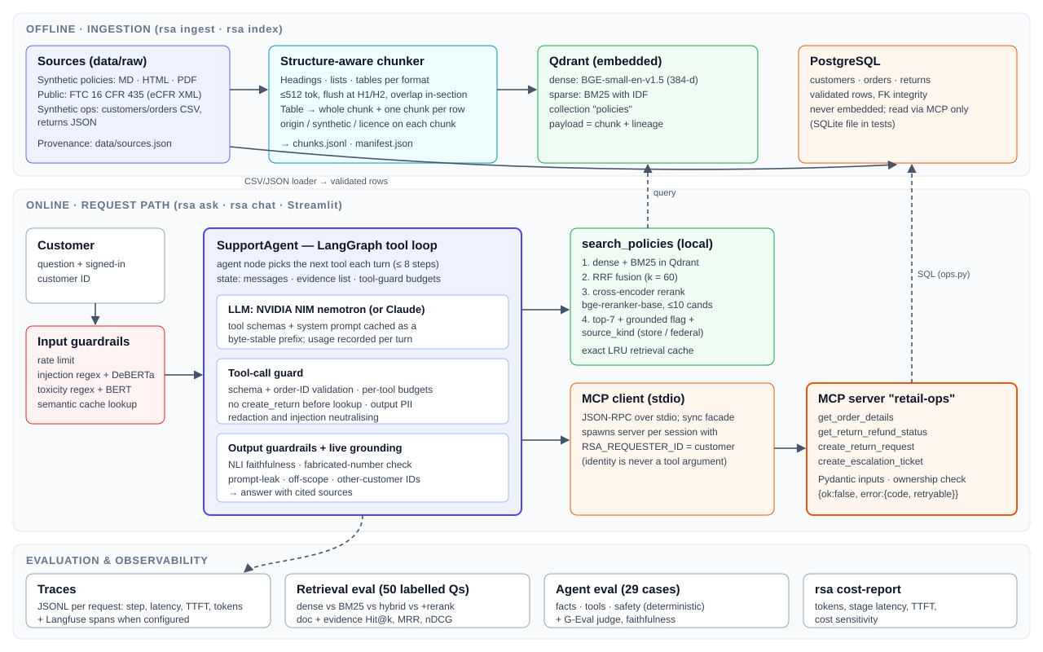
Hard rules live in code, the model only chooses actions
Customer identity is fixed on the MCP server
The model cannot read another account, whatever it is told
Return eligibility is enforced in ops code
Returns are refused with typed errors (e.g. RETURN_WINDOW_EXPIRED)
No answer without evidence
If the model answers unsupported, the graph forces a policy search
Notes:
LangGraph StateGraph: input_guard → cache_lookup → prepare → agent ⇄ tools / forced_search → output_guard → grounding → finalize. Tools are LangChain StructuredTools; the LLM client is our own, to keep streaming TTFT and provider prompt caching. Trade-off: more code than create_agent, every rule is a visible node.

Slide 3
Six formats, every file traceable to its source
22
6
427
1 / 21
source files
formats (PDF, HTML, MD, XML, CSV, JSON)
indexed chunks
public / labelled synthetic
Public source: the FTC Mail, Internet or Telephone Order Merchandise Rule (16 CFR 435), public domain
Synthetic policies and records are labelled in every file (header, meta tag or column) and in sources.json
Generated manifest records publisher, licence, lineage and SHA-256 for every file
Layout-aware chunking: prose by section, tables one row per chunk with headers kept
Repeatable: rsa ingest → rsa index; rsa index --incremental re-embeds only changed files

Slide 4
Hybrid retrieval gives the big gain; reranking adds little
Fusion matters
Evidence Hit@1 66% (dense) → 76% (hybrid), for ~43 ms
Rerank is not significant
Full mode wins 4 questions and loses 2 (sign test p ≈ 0.69), at 4.2 s mean
How we judge
Evidence-level labels (the passage that answers), not just the right document

Slide 5
A state machine the model steers, tools it cannot misuse
Input guard
Semantic cache
Agent (LLM)
Output guard
Grounding (NLI)
tools · forced policy search · step cap 8
get_order_details
get_return_refund_status
Order, category, tier and computed return eligibility
Return and refund state for one order
create_return_request
create_escalation_ticket
Write: needs a prior lookup and the customer's request
Write: hands the case to a human agent
Notes:
MCP contracts: Pydantic inputs, typed error envelopes {ok, error: {code, message, retryable}}. Read-only tools are retried in code on transient errors; writes never are. Per-message tool budgets. Scenario 2 trace: get_order_details → search_policies → answer with the next step.

Slide 6
End-to-end: 29 cases across the three scenarios
100%
100%
98.6%
100%
fact accuracy (deterministic)
tool selection
faithfulness to evidence
safety checks passed
Scenario | Cases | Fact accuracy | Judge correct | Mean latency
Knowledge query | 10 | 100% | 100% | 7.9 s
Multi-step return | 11 | 100% | 95.5% | 5.9 s
Exceptions | 8 | 100% | 100% | 2.7 s
Cost and latency
5,434 input / 148 output tokens per case
96.7% of input served from prompt cache
Latency p50 5.7 s, p95 11.9 s
≈ $2.41 per 1k queries at $0.4/$1.6 per M tokens
Judge: nvidia/nemotron-3-ultra-550b-a55b (G-Eval) · agent: nvidia/nemotron-3.5-bolt-e4b
Single run; the previous run scored 93.1% fact accuracy and caught a regression fixed before this one. Traces: traces/representative/

Slide 7
Limitations and next steps
What limits it today
What we would do next
Cross-encoder rerank dominates retrieval latency for no significant gain
Judge shares a model family with the agent; deterministic checks are the primary metrics
21 of 22 sources are synthetic; a real corpus would test the chunker harder
Evidence rule adds a search and an LLM call on small talk
Drop or distil the reranker; keep hybrid RRF as the default
Cross-family judge and a larger human-labelled calibration set
Run the MCP server as a service with real auth instead of a pinned identity
Track eval metrics per commit in CI

