Slide 1

MINI PROJECT Topic :- Online Auction System
Department :- TE-Artificial Intelligence and Machine Learning
Guided By:-
Mr. Umesh Mohite
GROUP DETAILS:-
Mr. Gaurav Raut - 227
Mr. Roshan Yadav – 271
Mr. Shivam Yadav – 272

Slide 2
CONTENTS
Abstract
Problem statement and objectives
Literature survey
Proposed system
System Architecture
Project Modules
Partial implementation
Conclusion
Future work

Slide 3
Abstract
The advance and secure online auctioning system is a versatile approach for facilitating lot-based online auction system. In this effort, we have tried building a safe and advance online auction website. The system has been built to be extremely scalable and capable of serving huge groups in a promotional events. You may browse deals and put bids on a secure server using the online auction system. The service provider is responsible for all the shipping cost. The goal is to create a user-friendly auctioning platform where any good may be auctioned and where bidder and seller can receive value added services. The item will be verified, and the site will provide a safe and secure experience for online users. Auction system is further divided into two different easy platform in which one is special designed for only the developers to maintain and update the system according the current requriements and demands while other is specific for user-end platform. It is very secure, efficient and reliable for all type of buyers, seller, bidder.

Slide 4
Problem statement and Objectives
This system will try over coming the problem of scalability and unlikeability which is faced.
This system will be more focused on developing the functionality and improving environment so that it can conduct different types of auction and be secure at he same time.
The system will be designed to the common problems that are being faced by other auction system websites.

Slide 5
Objective
The goal is to create a user-friendly auctioning platform where any goods maybe auctioned and where the bidders and sellers can receive value-added services.
The items will be verified and the site will provide a secure and safe experience for online users.

Slide 6
Literature survey
An online auction that holds online auction of various products on a website and servers sellers and bidders accordingly
The system is designed to allow users to set up their products for auction and bidders to register and bid for various products available for bidding.

Slide 7
Sr no | Paper Title (Reference) | Year | Conclusion | Author name | Research Gap
1 | Secure E-Auction System Using Block-chain: UAE Case study ( Advances in Science and Engineering Technology International Conferences (ASET). IEEE, 2020.) | 2020 | Traditionally, e-auction systems have been developed using traditional computing methods such as web development. Though efficient, the electronic auction systems that are build using traditional web development methodology do pose certain risks and other limitations. This research paper has proposed a blockchain based electronic auction system that aims to minimize the risks faced by web-based electronic auction systems. They have also introduced the concept of smart contract which ensures the anonymity of identity during the bidding function. Which reduces the chances of coalition among the participants | Hani Qusa, J Tarazi, V Akre
2 | uAuction: Analysis, Design And implementation of a Secure Online Auction System (Data Intelligence and Computing and Cyber Science and Technology Congress (DASC/PiCom/DataCom/CyberSciTech). IEEE | 2017 | This paper was all about their experience on e-auction. They provided a simple and elegant design for auction system using UML. The uAuction was mainly facilitate in order to catch the shill bidders in real-time. | N Majadi, J Trevathan
3 | Implementation of Online E-Auction to Overcome of the problem of Corruption with Effective and Efficient Procurement with transparency ( Turkish journal of Computer and mathematics Education {TURCOMAT} | 2021 | The result of this research paper is that now we can have the system that is way strong and advanced than before and also will focuses on the main concern of the people worldwide. Also, the main issue i.e. trust and security has been taken under noticed in more effective ways followed by the facilitation options like navigation and suggestions bar. This will give 'all in one ' options in single platform i.e. in our online auction system. | Prof. (Dr.) Darpan Anand

Slide 8
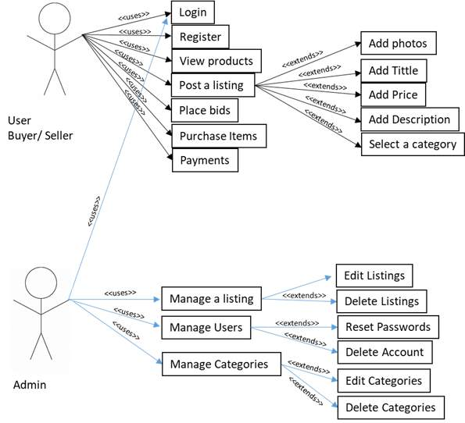
Proposed System

Slide 9
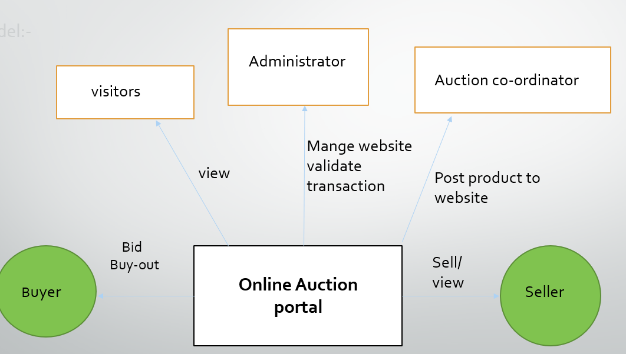
System Architecture

Slide 10
Project Modules
Front End :
HTML ( Hyper text markup language)
CSS ( Cascading Style Sheets)
Javascript
Back End : PHP
MySqL

Slide 11
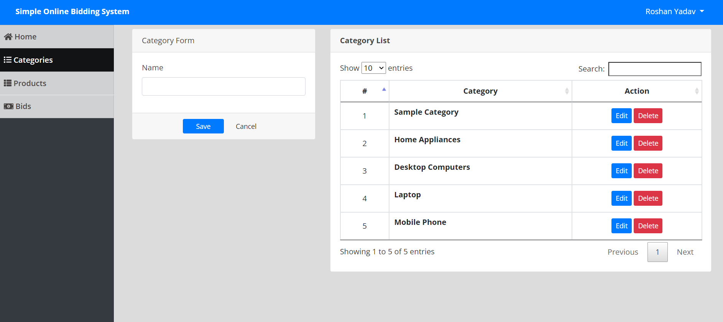
Partial Implementation

Slide 12
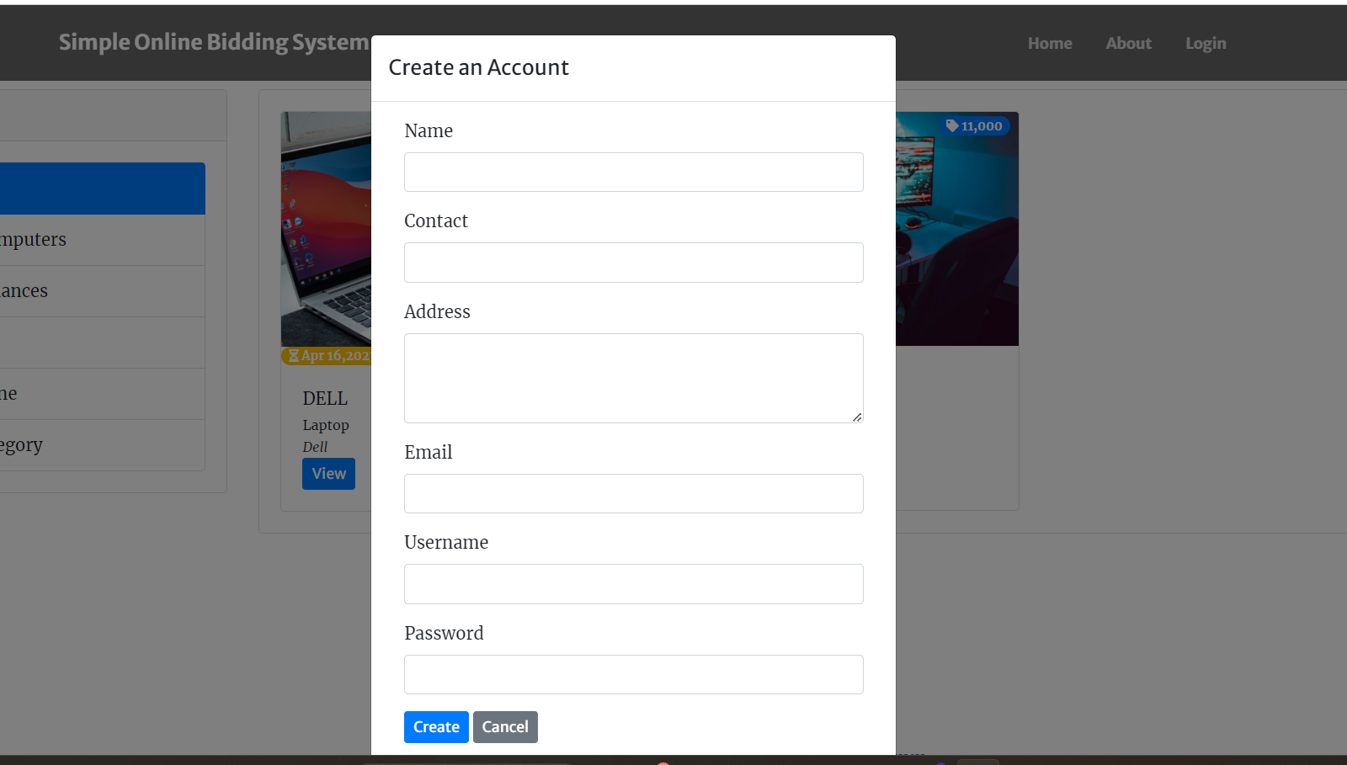
Login

Slide 13
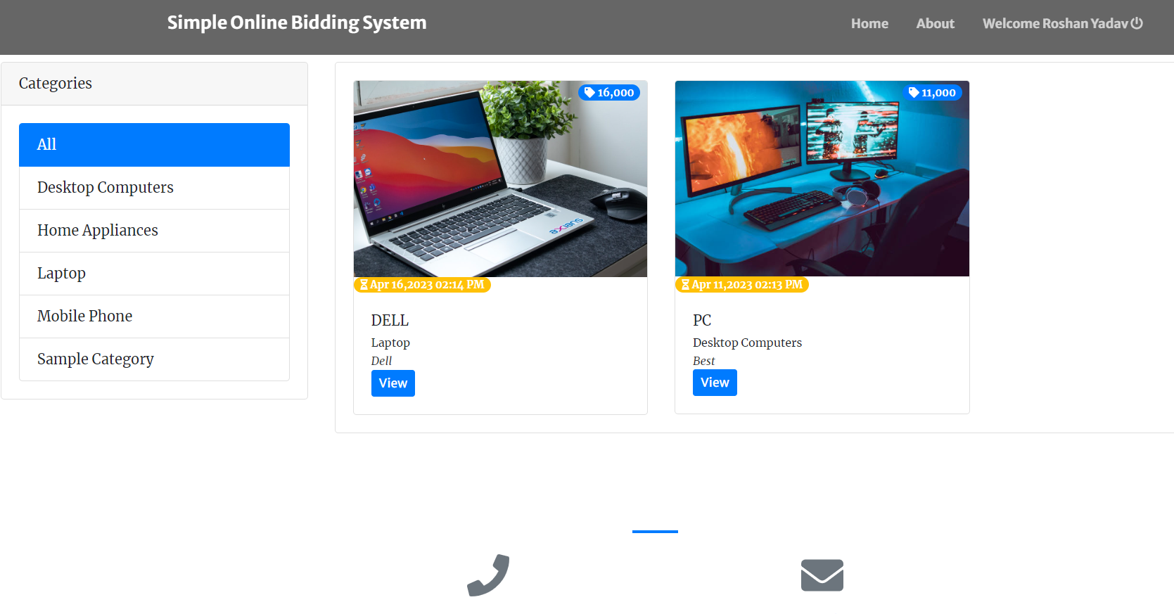
Auction page

Slide 14
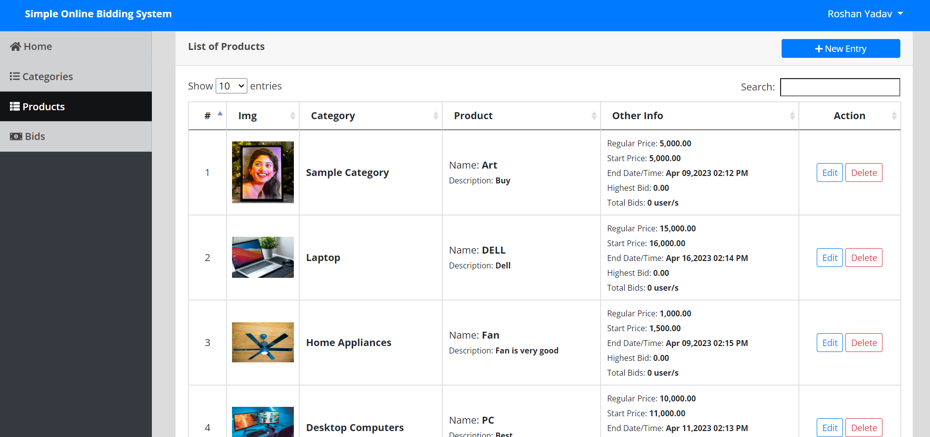
Upcoming auction

Slide 15
Conclusion
The project entitled ‘Online Auction System’ developed using HTML,SCSS,JAVASCRIT for frontend and PHP, Mysql, Node.js/express.js in backend to computerized the prcoess of auction i.e buying and selling product. This project covers only the basic requried. Online Auction system will give new approach and demension to auction system. It will encourage both buyers and seller to participate in auction process. Remove geographical boundaries , Location constraints and time constraints

Slide 16
Future Work
We have tried adding all the basic feature that an online auction system requries. We will try to constantly add new features to the website based on the requests made by the users and which will benefit them.

Slide 17
Reference
uAuction: Analysis, Design, and Implementation of a Secure Online Auction System | IEEE Conference Publication | IEEE Xplore
https://www.w3schools.com/html/default.asp
https://www.javatpoint.com/java-tutorial

