Slide 1
Graph Query Optimization: Performance Analysis and heuristics for a Time Tree in Neo4j - Sparks Shiva Nalla, Puneet Kaur, Ahmed Shaik, Reshma K

Slide 2
Related Works
[1] Martinez-Bazan Norbert and David Dominguez-Sal: "Using semi-join programs to solve traversal queries in graph databases" Proceedings of Workshop on Graph Data Management Experiences and Systems. ACM, 2014.
[2] Holzschuher, Florian, and René Peinl: "Performance of Graph query languages: Comparison of Cypher, Gremlin and Native Access in Neo4j" Proceedings of the Joint EDBT/ ICDT 2013 Workshops. ACM, 2013.
[3] GraphAware Neo4j TimeTree – Library for representing time in Neo4j as a tree of time instants, 2014.
[4] Barceló Baeza, Pablo: "Querying Graph databases" Proceedings of the 32nd symposium on Principles of database systems. ACM, 2013.

Slide 3
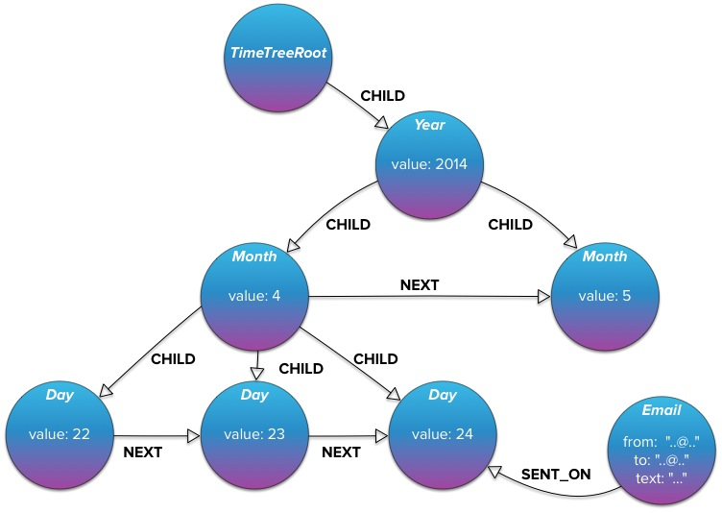
Related Work (contd..)
GraphAware Time Tree
Library for representing time in Neo4j as a tree of time instants
Builds the Time Tree On-Demand through REST API

Slide 4
Contributions
We address the following issues:
What is the additional cost, if any, involved in building this time tree?
What is the impact of time tree on execution time over a frequent set of queries?
What are the factors that the execution time in this time tree depend on?
Deciding when to use a time tree vs indexed graph?

Slide 5
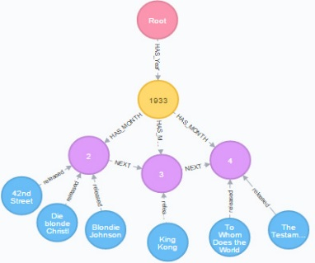
Proposed Work
Re-model the graph structure as a Time Tree that allows us to represent events as nodes and link them to nodes representing instants of time
Then do a comparison of this time tree versus original graph model with indexes created on the time attributes.
Create time based queries and execute them in both indexed and time tree models.

Slide 6
Contd..
Used a graph database (Movies) with more than 12000 Movie nodes, each with a timestamp attribute ‘Release Date’ in milliseconds
Performed database pre-processing
Created time tree that supports a resolution of one year down to one month
Nodes have ‘Next’ relationship with adjacent nodes to help traverse when queried
Performance evaluation of TimeTree and Indexed graph models
Database Pre-processing
Build the TimeTree
Query the time tree and indexed graph
Performance Analysis of time tree vs indexed graph

Slide 7
Performance Evaluation
Dataset is initially manually pre-processed to check for outliers and invalid time values
Attributes releaseYear, releaseMonth are added through a Java program by establishing a Jdbc connection to Neo4j database
Comparative study on the performance of 5 selected query types in the original graph model with index on time attribute versus time tree model
Each query type is executed with different selectivity factors over a varied range of time values
Plotted a graph of selectivity factor against the execution time

Slide 8
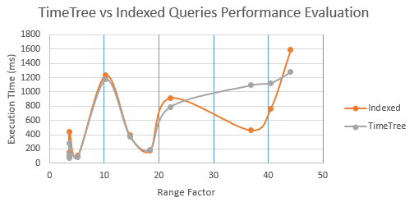
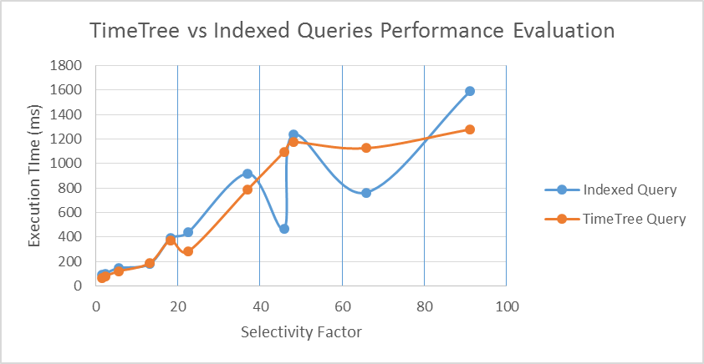
Query: All movies in a given time range

Slide 9
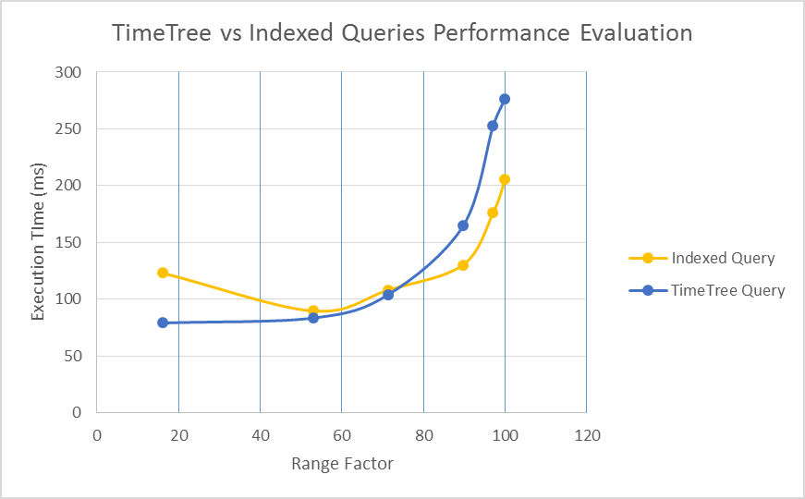
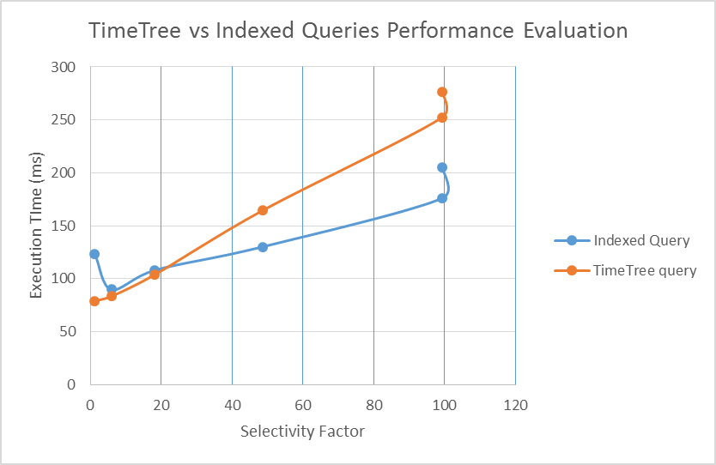
Query: Names of the directors for movies released before 1950

Slide 10
Important Findings
Performance of the query in Neo4j is largely affected by the SELECTIVITY FACTOR for both time-tree and indexing techniques.
Another prominent factor is NUMBER OF NODES over a particular range for a query.
Time Tree model is not necessarily optimal in each and every case when compared to indexed method.
When using queries involving multiple attributes, time tree doesn’t perform well when used as is; better way would be to split into several trees

Slide 11
Conclusion and Future Work
Heuristic Measure:
Computation of heuristic measure for different queries and making decision whether to execute a specific query with time tree model or not depending upon the value of heuristic variable.
Multi-Mapped Tree:
Linking of identified class of nodes to the time-tree and association of multiple time trees with each other through joins
Advance Tree Model:
Building a tree model taking into account of other attributes like location or combination of time and location.

Slide 12
Thank you

