Slide 1
Graph Query Optimization - Performance Analysis and heuristics for a Time Tree in Neo4j - Sparks Shiva Nalla, Puneet Kaur, Ahmed Shaik, Reshma K

Slide 2
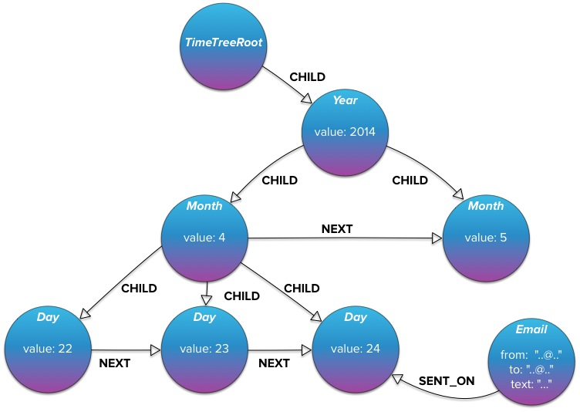
Related Work
GraphAware Neo4j Time Tree
Library for representing time in Neo4j as a tree of time instants
Builds the Time Tree On-Demand through REST API

Slide 3
GOALs
We address the following issues:
What is the additional cost, if any, involved in building this time tree?
What is the impact of time tree on the size of the graph and execution time of a frequent query set?
What are the factors that influence the execution time in this time tree?
Inputs for deciding when to use a time tree vs indexed graph

Slide 4
Proposed Work
Re-model the graph structure as a Time Tree that allows us to represent events as nodes and link them to nodes representing instants of time
Comparison of the time tree versus original graph model with indexes created on the time attributes.
Creation of time based queries and their execution in both indexed and time tree models.

Slide 5
Block diagram
Database Pre-Processing
Build the TimeTree
Query the time tree and indexed graph
Performance Analysis of time tree vs indexed graph

Slide 6
Database Pre-Processing
Used a graph database (Movies) with more than 12000 Movie nodes, each with a timestamp attribute ‘Release Date’ in milliseconds
Performed database pre-processing: checked for outliers and invalid time values
Attributes releaseYear, releaseMonth are added through a Java program by establishing a Jdbc connection to Neo4j database

Slide 7
time tree Construction
Database Pre-processing
Build the TimeTree
Query the time tree and indexed graph
Performance Analysis of time tree vs indexed graph

Slide 8
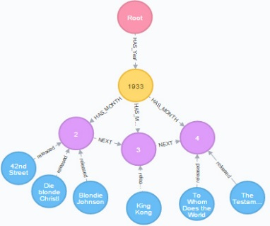
time tree Construction
Created time tree that supports a resolution of one year down to one month
Nodes have ‘Next’ relationship with adjacent nodes to help traverse when queried
Movie Node as child to Release Month node

Slide 9
Query Execution
Database Pre-processing
Build the TimeTree
Query the time tree and indexed graph
Performance Analysis of time tree vs indexed graph

Slide 10
Query Execution
Query 1: All movies in a given month of a year (say May 1984)
Query 2: All movies in a given time range (say between 1950 and 1975 both inclusive)
Query 3: Names of the actors and the number of movies they acted in a given time range (say between 1950 and 1975 both inclusive)
Query 4: List all directors for movies released before 1950
Query 5: List all 5 star rated movies after 2000

Slide 11
Performance Evaluation
Database Pre-processing
Build the TimeTree
Query the time tree and indexed graph
Performance Analysis of time tree vs indexed graph

Slide 12
Performance Evaluation
Comparative study on the performance of 5 selected query types in the original graph model with index on time attribute versus time tree model
Each query type is executed with different selectivity factors over a varied range of time values
Plotted a graph of selectivity factor against the execution time

Slide 13
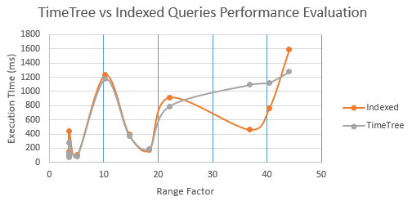
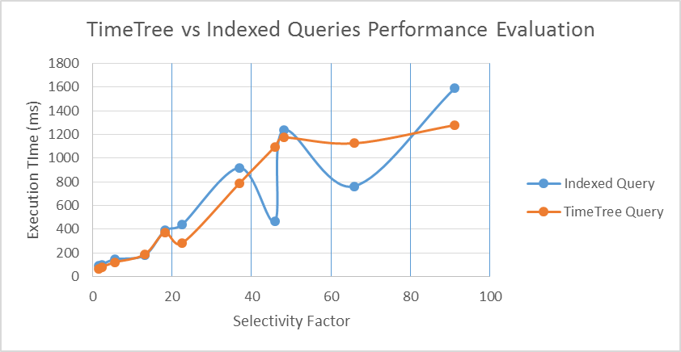
Query: All movies in a given time range

Slide 14
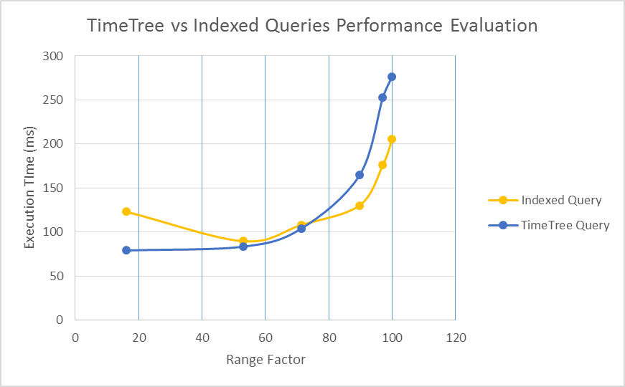
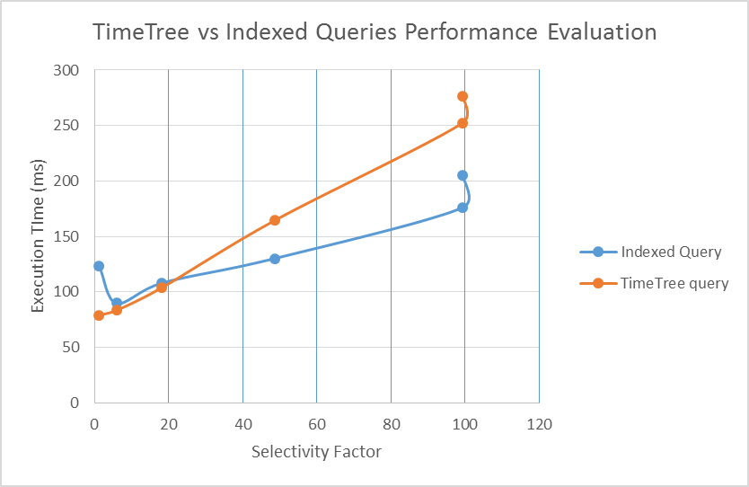
Query: Names of the directors for movies released before a SPECIFIC Year (SAY 1950)

Slide 15
Important findings
Performance of the query in Neo4j is largely affected by the SELECTIVITY FACTOR for both time-tree and indexing techniques.
Another prominent factor is NUMBER OF NODES over a particular range for a query.
Time Tree model is not necessarily optimal in each and every case when compared to indexed method.
When using queries involving multiple attributes, time tree doesn’t perform well when used as is; better way would be to split into several trees

Slide 16
Conclusion and Future work
Heuristic Measure
Computation of heuristic measure for different queries and making decision whether to execute a specific query with time tree model or not depending upon the value of heuristic variable.
Multi-Mapped Tree
Linking of identified class of nodes to the time-tree and association of multiple time trees with each other through joins
Advance Tree Model
Building a tree model taking into account of other attributes like location or combination of time and location.

Slide 17


